Slide 1
🎯 Digital Interview Performance Scoring System
An AI-Driven Proctoring & Evaluation Platform Submitted by: Vir K. Gusai (12202110501063) BrainyBeam Info-Tech Pvt. Ltd. GCET | CVM University

Slide 2
The Problem
🔴 Human Bias — Interviewers are prone to unconscious favoritism
🔴 Inconsistency — Evaluation standards vary between interviewers
🔴 Scalability — High-volume recruitment is slow and manual
🔴 Proctoring Integrity — Difficult to verify cheating in remote interviews
🔴 No Data — Traditional interviews produce no quantifiable metrics

Slide 3
Project Objective
✅ Build a Supervised ML model to predict interview performance scores
✅ Integrate Computer Vision for facial presence & emotion detection
✅ Apply NLP for sentiment analysis on candidate speech transcripts
✅ Implement live WebRTC proctoring with cheat detection
✅ Create an AI Video Scorer for asynchronous evaluation
✅ Generate Power BI-style dashboards with actionable suggestions

Slide 4
Technology Stack
🐍 Python 3.10+ — Core Runtime
📊 Scikit-Learn — ML Models (Random Forest, Gradient Boosting, Ensemble)
👁️ OpenCV — Haar Cascade face and smile detection
💬 TextBlob — NLP Sentiment Analysis
🎙️ SpeechRecognition + PyAudio — Speech-to-text transcription
🎬 MoviePy — Video-to-audio extraction for AI Video Scorer
🌐 Streamlit + WebRTC — Web UI + Real-time proctoring
📈 Plotly — Interactive gauge charts and radar charts

Slide 5
Dataset Details
📁 Source: Kaggle — Virtual Interview Performance Dataset
📊 14 Features: Age, Education Score, Coding Test Score, Confidence,
Eye Contact, Speech Speed, Filler Words, Interviewer Rating, etc.
🎯 Target: Final Interview Performance Score (Continuous)
🔢 Task Type: Supervised Regression
📐 Preprocessing: StandardScaler normalization, 80/20 train-test split

Slide 6
Machine Learning Pipeline
Step 1: Load & preprocess virtual_interview_with_target.csv
Step 2: Train 4 base models — Linear, Random Forest, AdaBoost, GradBoost
Step 3: Build VotingRegressor (Ensemble) combining all 4
Step 4: Evaluate R², MAE, RMSE on 20% test set
Step 5: Select best model (Ensemble if R² ≥ best individual)
Step 6: Save model.pkl, scaler.pkl, feature_columns.pkl via Joblib

Slide 7
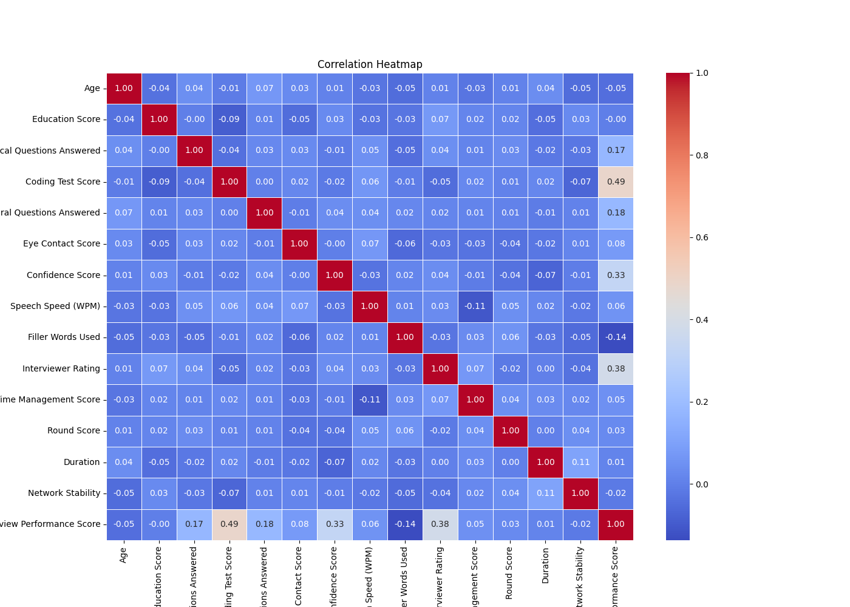
EDA: Correlation Heatmap
Feature-to-feature and feature-to-target correlation matrix

Slide 8
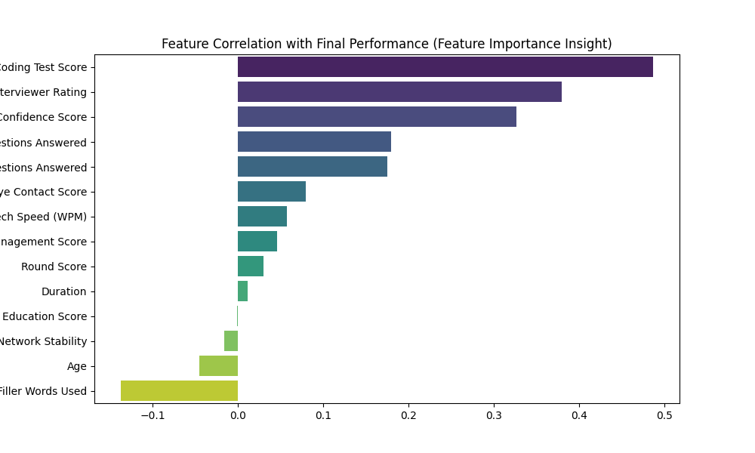
EDA: Feature Importance
Random Forest feature importance ranking

Slide 9
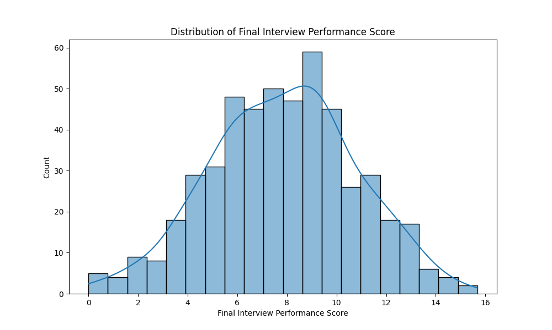
EDA: Final Score Distribution
Histogram of target variable distribution

Slide 10
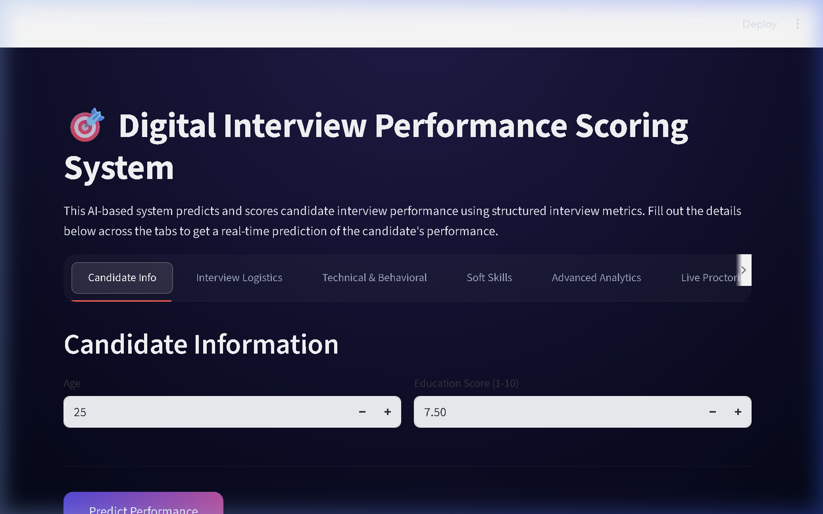
Application UI — Premium Dark Theme
Glassmorphic inputs, gradient buttons, Outfit font, radial gradient background

Slide 11
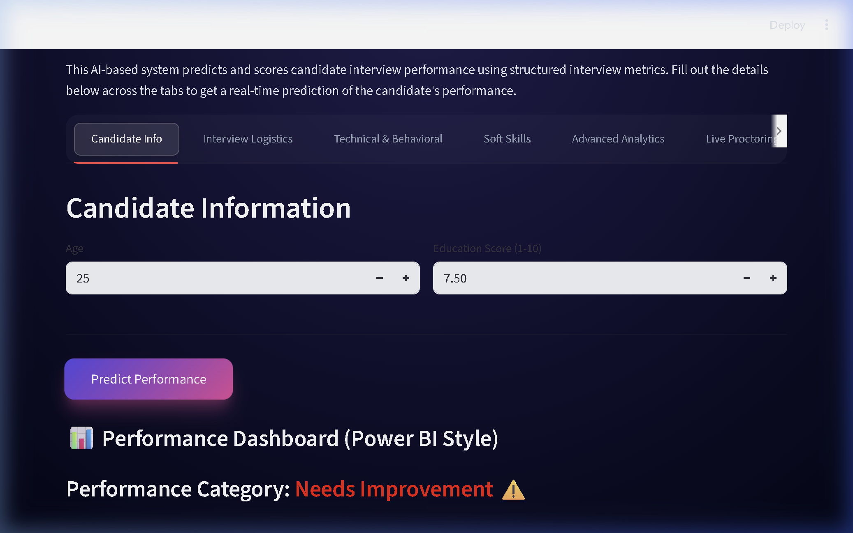
Output: Power BI-Style Dashboard
Gauge chart, radar chart, and actionable suggestions

Slide 12
System Modules Overview
📋 Tabs 1-4: Manual metric input (14 fields in 2/3-column layouts)
🧠 Tab 5: Advanced Analytics — NLP sentiment, OpenCV face, voice tone
🎥 Tab 6: Live Proctoring — WebRTC video + audio + screen share
→ Real-time face tracking with bounding boxes
→ Live speech transcription via Google STT
→ Tab-switch cheat detection via JavaScript injection
🎬 Tab 7: AI Video Scorer — Upload video → auto-score everything

Slide 13
Live Proctoring System
👤 Face Tracking: OpenCV detects 0, 1, or multiple faces per frame
→ Green box = candidate detected
→ Red warning = no face OR multiple faces
🎙️ Audio Processing: Buffers mic frames → transcribes on demand
🖥️ Screen Share: JavaScript getDisplayMedia() observes candidate screen
⚠️ Cheat Detection: visibilitychange event fires alert on tab switch

Slide 14
AI Video Scorer — Automated Pipeline
Step 1: MoviePy extracts audio → SpeechRecognition transcribes speech
Step 2: OpenCV analyzes every 15th frame for face + smile detection
Step 3: TextBlob computes NLP sentiment on the full transcript
Step 4: Compute Eye Contact, Confidence, Voice Tone, NLP scores
Step 5: Generate Plotly Gauge + Radar dashboard
Step 6: AI produces verdict — Excellent / Good / Needs Improvement

Slide 15
Scoring & Categorization Logic
Manual Mode (ML Prediction):
→ Score ≥ 20: 🌟 Excellent — Fast-track recommended
→ Score ≥ 12: 👍 Good — Consider with improvements
→ Score < 12: ⚠️ Needs Improvement — Not recommended
AI Video Scorer (CV + NLP):
→ Overall ≥ 7/10: 🌟 Excellent Candidate
→ Overall ≥ 5/10: 👍 Good Candidate
→ Overall < 5/10: ⚠️ Needs Significant Improvement

Slide 16
Future Enhancements
🧠 Deep Learning: Replace Haar Cascades with CNN (DeepFace/FER+)
🎙️ Streaming ASR: Use OpenAI Whisper for real-time transcription
💾 Database: PostgreSQL for persistent interview history
📄 PDF Reports: Auto-generate downloadable candidate scorecards
🌍 Multi-language: Extend NLP and STT beyond English
🤸 Body Language: MediaPipe Pose for gesture analysis

Slide 17
Thank You!
Digital Interview Performance Scoring System Vir K. Gusai | BrainyBeam Info-Tech Pvt. Ltd. GCET | CVM University Questions?

