Slide 1

How to get full points on your text
4B SA Writing Task
2 Example Texts

Slide 2
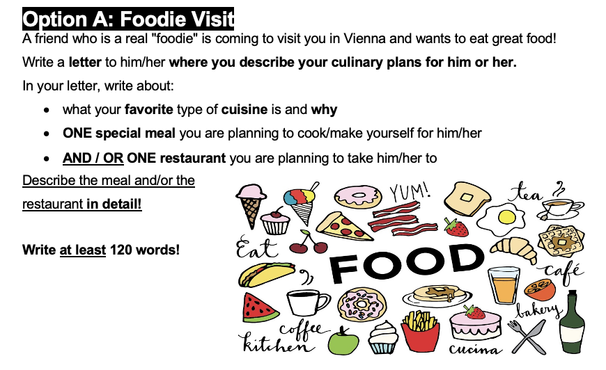

Slide 3
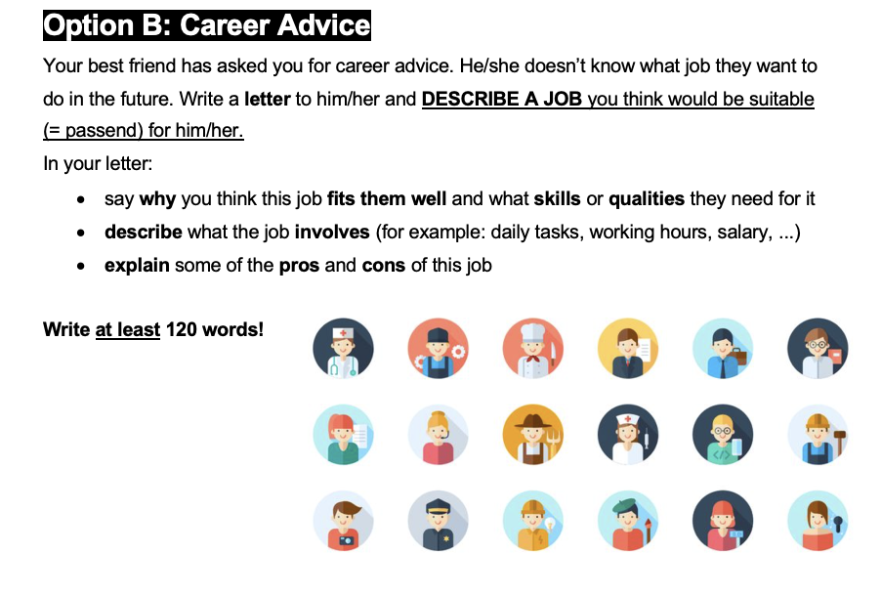

Slide 4
The categories we analyze for each text
LANGUAGE FACTORS
TASK ACHIEVEMENT
Advanced vocabulary
Favourite cuisine / Why job fits
Great descriptions and details
Meal you cook or eat / What the job involves
Restaurant details / Pros and cons of the job

Slide 5

MODEL TEXT
Student A
01
Option A:
Foodie Visit

Slide 6
Student A: Opening
Setting the scene with personal connection
RESTAURANT
STUDENT TEXT
Introduction: recommend a restaurant to you
Dear Marianna,
MEAL
Introduction: cook for you
You texted me and told me you're arriving in Vienna tomorrow, so I wanted to recommend a restaurant to you since I know how you love food. I will also cook for you, so you don't have to eat take out.
PERSONAL TOUCH
References a real conversation ("You texted me") as an introduction

Slide 7
Student A: Cuisine + Homemade Meal
Two bullet points covered in one natural paragraph
FAVOURITE CUISINE ✓
Japanese - stated directly and simply
STUDENT TEXT
MEAL DETAILS ✓
My favourite cuisine is Japanese cuisine, so I've learnt how to make sushi and I'm sure you'll like it. I usually make it with some salmon and some cucumbers, but since you hate cucumbers, I'll replace them with some cream cheese.
Sushi with salmon, describes ingredients
PERSONAL DETAIL
"since you hate cucumbers"

Slide 8
Student A: Restaurant Introduction
Setting up the detailed description
RESTAURANT ✓
Name (808) + location (city center) - basic info covered
STUDENT TEXT
ATMOSPHERE
You told me you wanted to visit a nice restaurant, so I found one. It's called 808 and it's located near the city center. It's a beautiful and cozy restaurant. My favourite dish there is their truffle pasta.
"beautiful and cozy"
VOCABULARY
"truffle pasta" – specific food vocabulary
Transition: References friend's wish again ("You told me") - maintains conversational flow

Slide 9
Student A
Vivid, sensory details
SENSORY DETAILS
"blue fire" / "huge parmesan wheel" / "melting cheese" - visual imagery that makes the reader hungry
STUDENT TEXT
ADVANCED VOCABULARY
It's full of flavour, hot and the preparation is definitely worth watching. The waiter brings the boiled pasta right to your table and throws it into a huge parmesan wheel. He adds a tiny bit of alcohol and a blue fire starts. He mixes it with the melting cheese right in front of you and grates some black truffles on top of it.
"preparation" / "grates" / "black truffles" / "boiled" - precise cooking verbs and terms
RESTAURANT DETAIL ✓✓
Describes the EXPERIENCE, not just the food - tableside service, the process, the show
Why this works well: The reader can picture this scene. It goes far beyond "the food is good" - shows what makes this restaurant SPECIAL.

Slide 10
Student A: Strong Finish
VIVID EXPRESSION
"make your taste buds go crazy" – idiomatic (this means using phrases like Native speakers)
STUDENT TEXT
The flavour is incredible. The tenderness of the pasta and the flavour of the truffles will make your taste buds go crazy. It's also really filling and not fattening at all. I'm definitely taking you to that place!
VOCABULARY
"tenderness" / "flavour" / "incredible" - great descriptors
PRACTICAL INFO
Best regards,
Student A
"filling and not fattening" - addresses what a foodie friend would care about
Good closing: "I'm definitely taking you" -

Slide 11
Student A: Summary
What makes this text excellent
WHAT ELEVATES IT
TASK ACHIEVEMENT
Sensory details: blue fire, melting cheese, parmesan wheel
Favourite cuisine: Japanese
Vocabulary: tenderness, grates, truffles, preparation
Meal to cook: Sushi with salmon + cream cheese
Personal touches: "you hate cucumbers", "you texted me"
Restaurant: 808 with truffle pasta description
Natural idioms: "taste buds go crazy"
All bullet points covered with detail that exceeds the minimum
~245 words - double the requirement, but doesn’t feel like too much

Slide 12

MODEL TEXT
Student B
02
Option B: Career Advice

Slide 13
Student B: Why This Job Fits
Direct and clear opening
JOB IDENTIFIED
STUDENT TEXT
Dear Stella,
WHY IT FITS ✓
"kind, patient and responsible" - three qualities, directly linked to why the job suits Stella
I think it's great that you want to become a children's doctor. This job is perfect for you because you are kind, patient and responsible.
Efficient: First bullet point fully covered in just two sentences. No wasted words.

Slide 14
Student B: What the Job Involves
Detailed discussion daily tasks and requirements of the job
DAILY TASKS ✓
Check-ups, diagnose problems, advise parents - covers what you actually DO
STUDENT TEXT
As a children's doctor, you will help babies and kids, do check-ups, find out what's wrong, and tell parents what to do. You can work in a doctor's office or hospital, and you will see regular visits, shots and sometimes emergencies. You need to know a lot about medicine, talk well with others, work in a team, and stay calm when things are hard.
WORK SETTINGS ✓
"doctor's office or hospital" - two options, both realistic
VARIETY OF WORK ✓
"regular visits, shots and sometimes emergencies" - range of situations
SKILLS NEEDED ✓
Medical knowledge + communication + teamwork + staying calm - all relevant skills listed

Slide 15
Student B: Pros and Cons
Balanced, honest assessment
PROS ✓
Helping children (meaningful)
Variety of tasks
Job security ("steady job")
STUDENT TEXT
The good things about this job are helping children, doing many different tasks, and having a steady job. The hard parts are long work hours, feeling sad sometimes, and learning all the time.
CONS ✓
Long hours
Emotional factors ("feeling sad")
Constant learning required
Parallel structure: Three pros, three cons - balanced and easy to follow.

Slide 16
Student B: Supportive Closing
Personal encouragement and offer of help
ENCOURAGEMENT
STUDENT TEXT
"you will be very good at it" - confident, positive, supportive tone
I think you will be very good at it! I'm here to help you with your studies anytime.
OFFER OF SUPPORT
"help you with your studies anytime" - concrete offer
Best wishes,
Student B

Slide 17
Student B: Summary
What makes this text excellent
WHAT MAKES IT WORK
TASK ACHIEVEMENT
Clear structure: One idea per sentence, logical flow
Why job fits: kind, patient, responsible
B1 vocabulary: "check-ups", "steady job", "emergencies"
What job involves: tasks, settings, skills
Parallel structures: Lists are balanced and easy to read
Pros and cons: 3 each, balanced
Warm tone: Supportive friend throughout
Every bullet point addressed clearly and systematically
~165 words - meets requirement efficiently, no filler – every word appropriate

