Slide 1
Simulation Framework Workshop
James Jones
27/07/2018

Slide 2
Contents
Layout of the framework
Workflow
Example
Element
Hierarchy
Support files:
Read Beam File
Read Twiss File
ASTRA Plotter

Slide 3
Basic Layout
Master Lattice
Framework
Elements
Quad
K1
L
position_start
position_end
Dipole
…
Lattices
type
Elements
Groups
Groups
type
elements
Generator
Npart
Q_total
Lattice Codes

Slide 4
Initialise Framework
Load a lattice settings file
Modify Master Lattice
Get element objects
Modify object parameters
For each line
HDF to Code Input Format
Run Lattice Code
Initialise directory
For each screen
Code Output Format to HDF5
For End Element
Code Output Format to HDF5
Generate code specific output

Slide 5
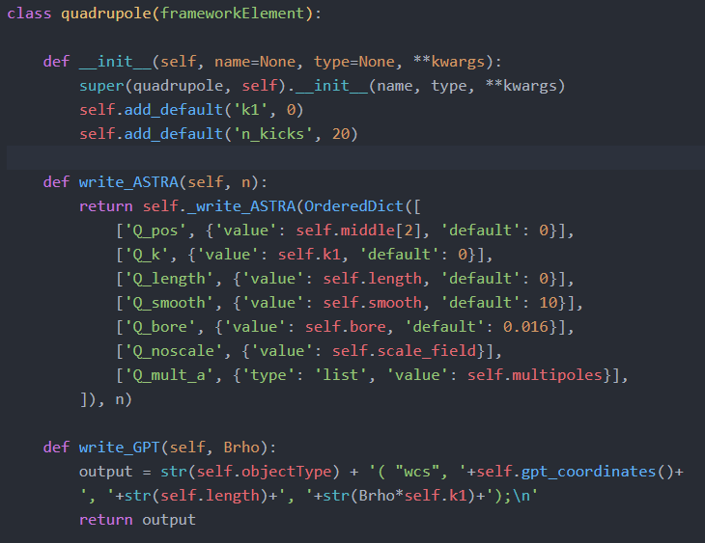
Example Element

Slide 6
Framework Hierarchy
frameworkLattice
elegantLattice
astraLattice
frameworkObject
frameworkElement
dipole
quadrupole
astra_header
astra_newrun
astra_charge
…
csrtrack_element
csrtrack_forces
…
gpt_element
gpt_setfile
frameworkCommand
gptLattice
csrtrackLattice

Slide 7
Read Beam File
Reads in ASTRA / CSRTrack / SDDS / GDF files
Internal representation is always:
x , y, z, px, py, pz
Automatic conversion to:
Gamma, cp[xy,z], β[x,y,z], v[x,y,z], [x,y]p etc.
Twiss analysis:
Beta_[x,y], alpha_[x,y], gamma_[x,y], (n)emittance
Also corrected quantities
Slice analysis:
Emittance, momentum, current
Chirp
Twiss matching (ala sddsmatchtwiss)
Export to HDF5

Slide 8
Read Twiss File
Reads ASTRA emit files and SDDS “.twi” and “.sig”
Internal representation is:
TBD
Export to HDF5
Not finished…

Slide 9
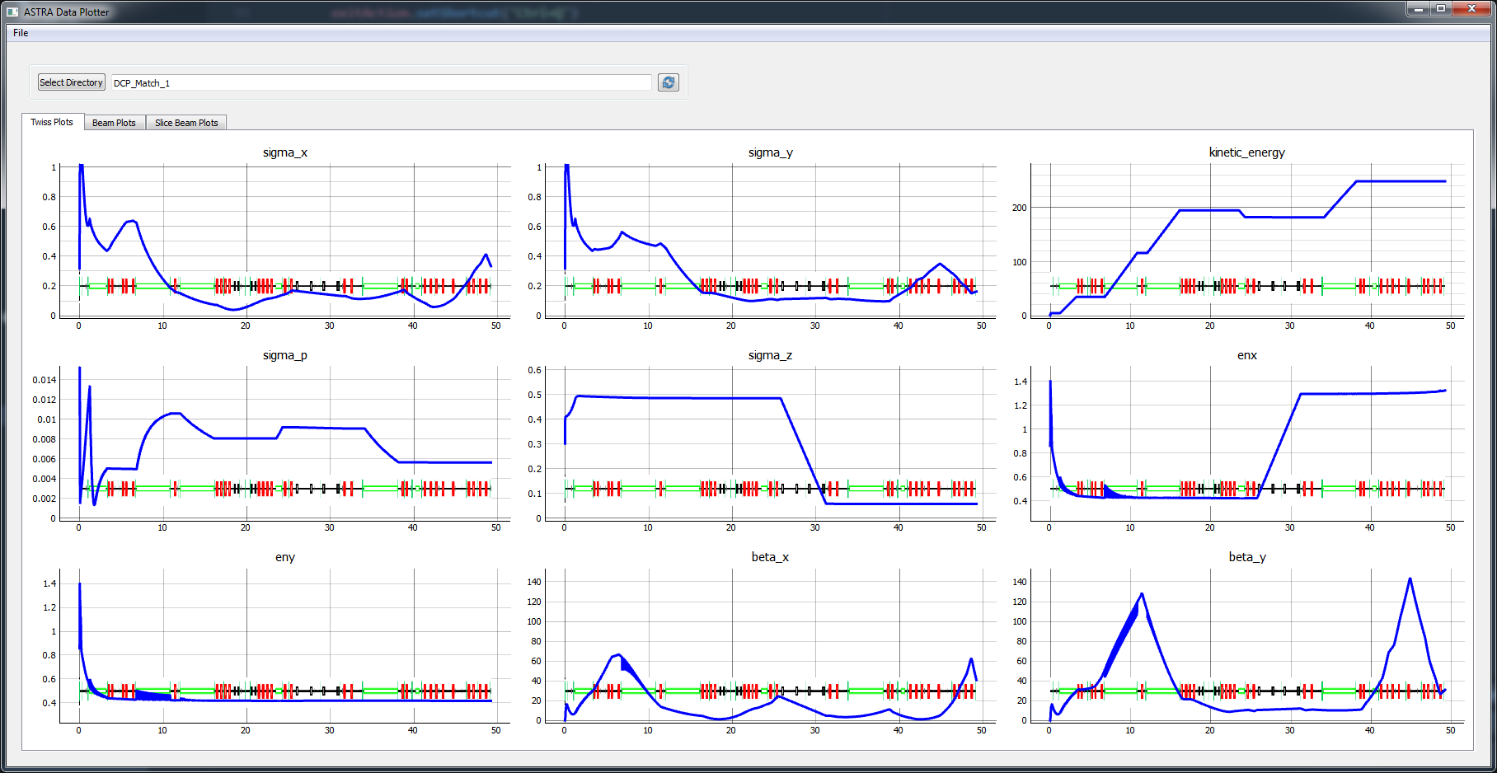
Astra plotter (test)
Reads ASTRA emit and beam files
Plots twiss, beam density plot, slice analysis

Slide 10
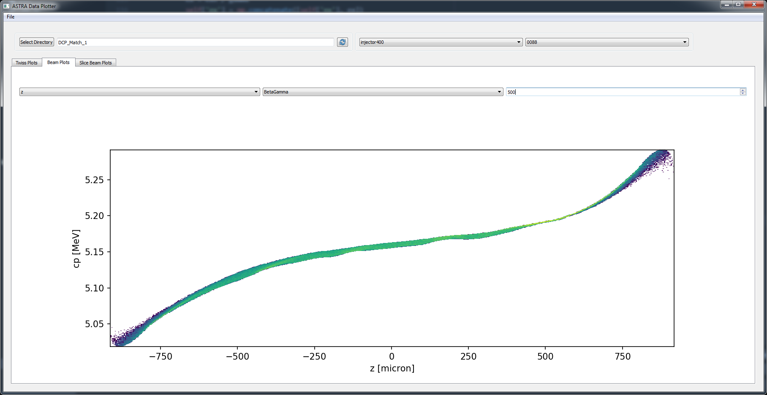
Astra plotter (test)
Reads ASTRA emit and beam files
Plots twiss, beam density plot, slice analysis

Slide 11
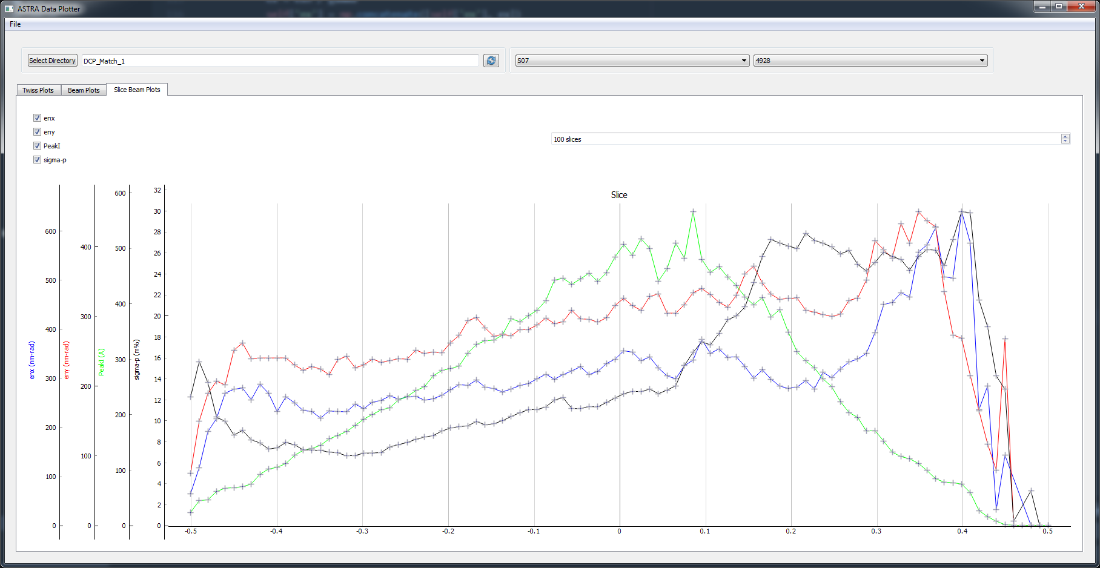
Astra plotter (test)
Reads ASTRA emit and beam files
Plots twiss, beam density plot, slice analysis

Slide 12
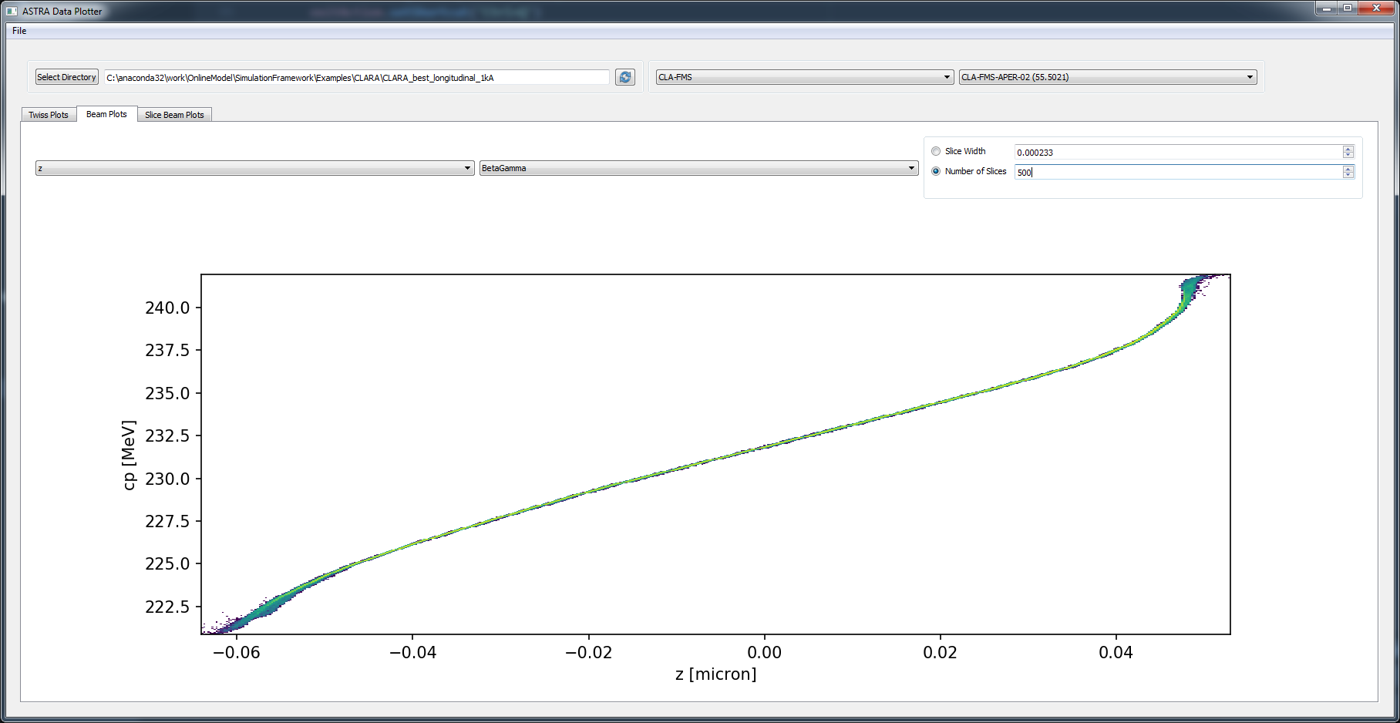
Data Plotter (h5)
Reads HDF5 twiss and beam output files
Otherwise…practically identical!
Only code to be updated going forward

