Slide 1
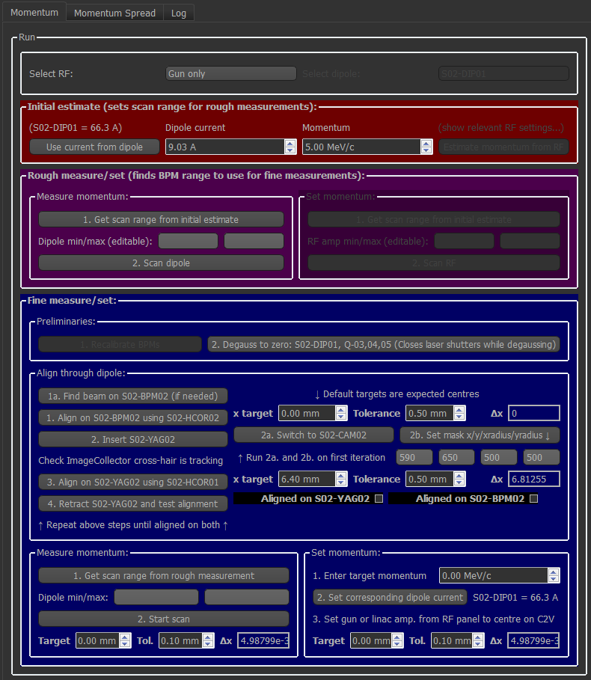
Select to measure momentum
Select gun or linac
Sets fine step for dipole scan
Sets initial estimate for momentum
Make initial estimate for momentum
Informs range for dipole scan
Scan C2V dipole
Returns rough measurement
Informs range for dipole scan
Degauss magnets
Align beam on BPM
Insert screen
Align beam on screen
View screen
Set mask
Test aligned on BPM?
Scan C2V dipole

Slide 2
Scenarios
Convert between momentum and dipole current
Get a rough momentum measurement
Get a fine momentum measurement – has to do this
Collapsible boxes?

