Slide 1
Driver Anti-Sleep Device
TeamNo : 02
PRESENTED By:
ARAVINDHAN A (22AI002)
HARISH.S.S (22AI017)
VELUSAMY.G (22AI056)
Guided By :
Dr.K.LALITHA

Slide 2
Abstract :
Driver drowsiness is a major cause of road accidents, highlighting the need for effective safety solutions. This project introduces a Drowsiness Detection System using an ESP32 CAM and machine learning to monitor driver alertness and prevent accidents.
The system detects the driver's eye status through the ESP32 CAM. If drowsiness is detected, it activates a buzzer to alert the driver, disables the vehicle ignition using a relay, and sends an SMS alert to emergency contacts via a GSM module. An MQ3 sensor adds extra safety by detecting alcohol consumption.
This affordable and easy-to-implement system combines IoT and machine learning to enhance road safety and reduce accidents caused by fatigue or intoxication.

Slide 3
Objectives:
The objective of this project is to design and implement a Drowsiness Detection System using the ESP32 CAM and machine learning to enhance road safety. The system aims to:
Monitor the driver’s eye status in real-time to detect signs of drowsiness or fatigue.
Alert the driver immediately through a buzzer when drowsiness is detected.
Prevent potential accidents by deactivating the vehicle's ignition system when necessary.
Notify emergency contacts via SMS using a GSM module in critical situations.
Integrate an alcohol detection feature using the MQ3 sensor to prevent driving under the influence.
The system focuses on providing a cost-effective, reliable, and scalable solution to reduce road accidents and save lives.

Slide 4
Hardware and Software Components:
Hardware Components :
ESP32 Controller
ESP32 CAM
16x4 LCD Display
MQ3 Alcohol Sensor
SIM800C GSM Module
12V DC Electromagnetic Relay
5V DC Buzzer
12V 1 Amp DC Adaptor
Software Components :
1. MATLAB Application
2. Arduino IDE
3. Embedded C/C++
4. GSM Communication Protocols

Slide 5
Implementation: (Hardware or software)
Hardware Components :
ESP32 Controller: The main microcontroller for processing and system management.
ESP32 CAM: Captures real-time video for drowsiness detection.
16x4 LCD Display: Displays system information and alerts.
MQ3 Alcohol Sensor: Detects alcohol levels to enhance safety.
SIM800C GSM Module: Sends SMS notifications to emergency contacts.
12V DC Electromagnetic Relay: Controls the vehicle's ignition system.
5V DC Buzzer: Issues sound alerts for driver warnings.
12V 1 Amp DC Adaptor: Powers the system components.

Slide 6
Implementation: (Hardware or software)
Software Components :
MATLAB Application:
For processing video streams and implementing machine learning algorithms to detect drowsiness.
Used for analyzing eye status and making real-time decisions.
Arduino IDE: For programming the ESP32 controller and interfacing with peripherals.
Embedded C/C++: Programming language for ESP32 functionality.
GSM Communication Protocols: To enable SMS-based alert notifications.

Slide 7
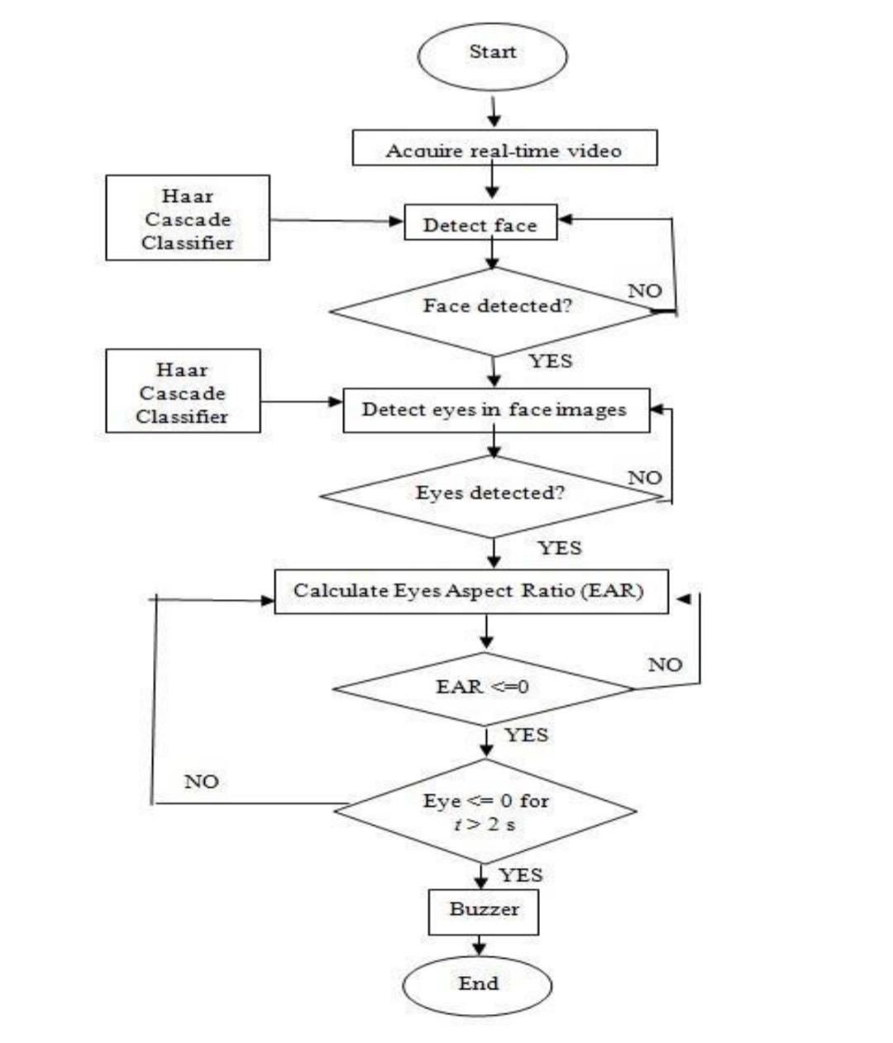
Flow Diagram:
VIBRATOR ON

Slide 8
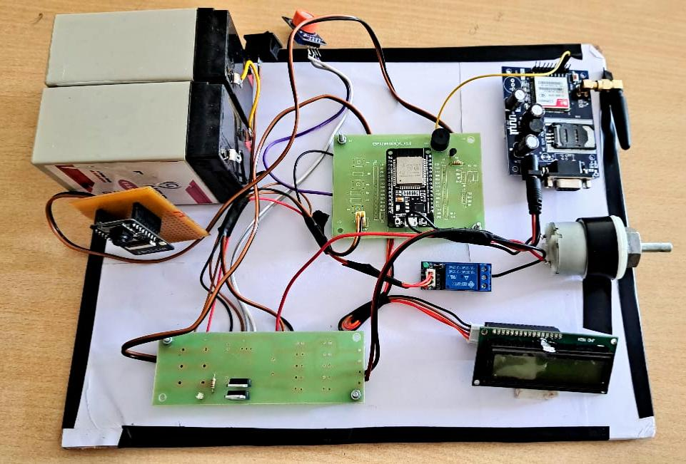
Circuit Diagram:

Slide 9
THANK YOU

