Slide 1

Automatic Text Summarization
Group members
V VENISHA -2300032694
T TEJASRI - 2300033513
Kamran Akmal- 2300030835

Slide 2
Introduction
Large amounts of textual data are generated daily.
Manual summarization is time-consuming and inefficient.
Text summarization automatically converts long text into short, meaningful content.
This project uses a Conditional GAN with Transformer (BART) to generate high-quality summaries.
The system produces paragraph and bullet summaries with a confidence score.

Slide 3
Problem Statement
The rapid growth of digital content has made it difficult for users to read and understand long text documents efficiently. Manual summarization is time-consuming and may result in loss of important information. Therefore, there is a need for an automated text summarization system that can generate concise, meaningful summaries from lengthy text while allowing users to control the summary length through an interactive web interface.

Slide 4
Objectives
To develop an automated text summarization system using Transformer models.
To implement a Conditional GAN architecture for improving summary quality.
To generate both paragraph and bullet format summaries.
To evaluate summary quality using a discriminator-based confidence score.
To build a user-friendly web interface for real-time summarization.

Slide 5
Literature Review / Existing System
Traditional summarization methods use extractive techniques, selecting important sentences from the text.
Machine learning models improved summarization using statistical and feature-based approaches.
Transformer-based models like BART, GPT, and T5 introduced abstractive summarization with better contextual understanding.
Most existing systems do not include a quality evaluation mechanism for generated summaries.
Existing models generate summaries but lack adversarial learning for improving accuracy and reliability.

Slide 6
Proposed System
The system uses a Conditional GAN architecture for text summarization.
Generator (DistilBART Transformer) generates abstractive summaries from input text.
Conditional Discriminator evaluates the quality of the generated summary.
Supports both: Paragraph summaries Bullet summaries
Provides a confidence score to indicate summary reliability.
Implemented with PyTorch, HuggingFace Transformers, and Flask Web Interface for real-time usage.

Slide 7
Types of Text Summarization
1. Extractive Summarization
Selects important sentences directly from the original text.Does not generate new sentences.Maintains original wording.Simple and faster method.
2. Abstractive Summarization
Generates new sentences that capture the meaning of the text.Uses deep learning and Transformer models.More natural and human-like summaries.Requires advanced NLP techniques.

Slide 8
Technology Stack
Programming Language: Python
Deep Learning Framework: PyTorch
NLP Library: HuggingFace Transformers
Model Used: DistilBART (Pre-trained Transformer)
GAN Architecture: Conditional Generator & Discriminator
Dataset: CNN/DailyMail
Backend: Flask
Frontend: HTML, CSS, JavaScript
Additional Tools: NLTK (Sentence Tokenization)

Slide 9
Transformer Model Overview
Transformer is a deep learning architecture used for Natural Language Processing tasks.
It uses an attention mechanism to understand relationships between words.
Works with sequence-to-sequence models for text generation tasks.
Handles long text efficiently compared to traditional RNNs and LSTMs.
Widely used for translation, summarization, and chatbots

Slide 10
DistilBART Model
DistilBART is a lightweight version of the BART Transformer model.
It is optimized for faster inference with reduced model size.
Maintains high summarization quality while improving efficiency.
Pre-trained on large news datasets for text summarization tasks.
Used in this project to generate abstractive summaries.

Slide 11
GAN Concept
GAN stands for Generative Adversarial Network.
It consists of two neural networks:
Generator – Generates new data (summary).
Discriminator – Evaluates whether the generated data is real or fake.
Both networks compete with each other in an adversarial process.
The Generator tries to produce better summaries.
The Discriminator tries to detect whether the summary is real (original) or generated.
Through this competition, the Generator improves its performance.

Slide 12
System Architecture
Frontend (HTML, CSS, JavaScript) – Collects user input
Flask Backend – Handles API requests and model execution
Generator (Transformer Model) – Produces abstractive summary
Discriminator (GAN Component) – Evaluates summary quality
Output Module – Displays summary and confidence score
Input
↓
Flask API
↓
Generator (BART)
↓
Conditional Discriminator
↓
Output Display
(Summary + Confidence Score)

Slide 13
Working Flow
User enters long text in the web interface.
User selects summary length and mode (paragraph or bullet).
Frontend sends input data to Flask backend via POST request.
Generator (DistilBART) creates an abstractive summary.
Discriminator evaluates the summary and calculates confidence score.
Backend sends summary and score back to frontend.
Final summary and confidence percentage are displayed to the user

Slide 14
Code Explanation – Backend
Developed using Flask (Python Framework).
Loads DistilBART (Generator) and Conditional Discriminator models.
/summarize API receives text, length, and mode from frontend.
Generates abstractive summary using Transformer model.Creates bullet summary using sentence tokenization.
Discriminator evaluates summary and produces confidence score.
Returns summary and score in JSON format to frontend.

Slide 15
Code Explanation – Frontend
The frontend is developed using HTML, CSS, and JavaScript.
HTML is used to create the structure of the web page (textarea, buttons, sliders, dropdown).
CSS is used for styling the interface (layout, colors, progress bar, buttons).
A textarea allows the user to enter long text.A range slider is used to select summary length.
A dropdown menu allows selection between paragraph and bullet mode.
When the “Generate Summary” button is clicked, JavaScript sends a POST request to the Flask backend using the fetch() API.
The backend response (summary, bullets, score) is received in JSON format.The summary is dynamically displayed on the webpage.
A progress bar visually shows the confidence score.

Slide 16
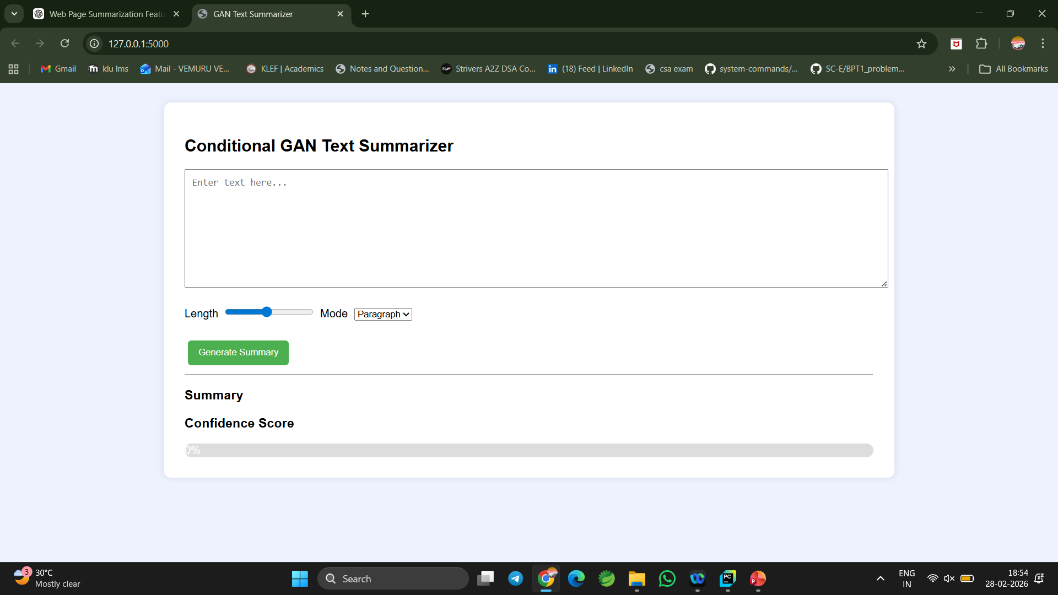
Results / Output Screens
The system successfully generates meaningful and concise summaries from long text.
Produces both abstractive (paragraph) and extractive (bullet) summaries.
The Conditional Discriminator provides a confidence score for quality estimation.
GAN training improves the quality and coherence of generated summaries.
The web interface enables real-time summarization with smooth performance.

Slide 17
Advantages
Automatically generates concise and meaningful summaries.
Combines Transformer (BART) and GAN architecture for improved quality.
Supports both paragraph (abstractive) and bullet (extractive) summaries.
Provides a confidence score for summary evaluation.
Faster and more efficient than manual summarization.
User-friendly web interface for real-time usage.

Slide 18
Limitations
The model is trained on a limited dataset, which may affect generalization.
GAN training is complex and may be unstable.
Generated summaries may sometimes miss important information.
Confidence score is based on discriminator prediction, not human evaluation.
Performance depends on input text length and quality.
Requires good computational resources for training and inference.

Slide 19
Future Enhancements
Train the GAN model on larger and more diverse datasets for better performance.
Improve the Discriminator to provide more accurate quality evaluation.
Implement ROUGE and BLEU metrics for advanced summary evaluation.
Add multilingual text summarization support.
Optimize the model for faster inference and deployment.
Integrate the system with mobile or cloud-based applications.

Slide 20
Conclusion
The project successfully implements a Conditional GAN-based Text Summarizer using Transformer architecture.
The Generator (DistilBART) produces meaningful abstractive summaries.
The Conditional Discriminator evaluates summary quality and provides a confidence score.
The system supports both paragraph and bullet summaries.
The web-based interface enables real-time text summarization.
Overall, the project demonstrates how combining Transformers and GANs can improve the quality and reliability of automated text summarization systems.

