Slide 1
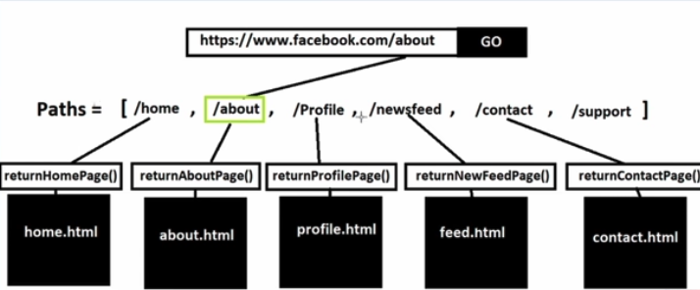

Chapter 3: Client Server and SOA
Adapted from © 2012-2021 Armando Fox & David Patterson
Licensed under Creative Commons Attribution-NonCommercial-ShareAlike 3.0 Unported License
‹#›

Slide 2
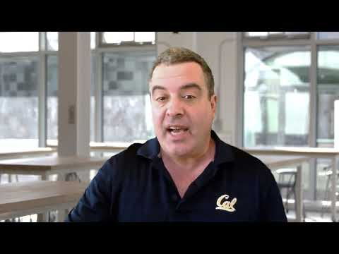
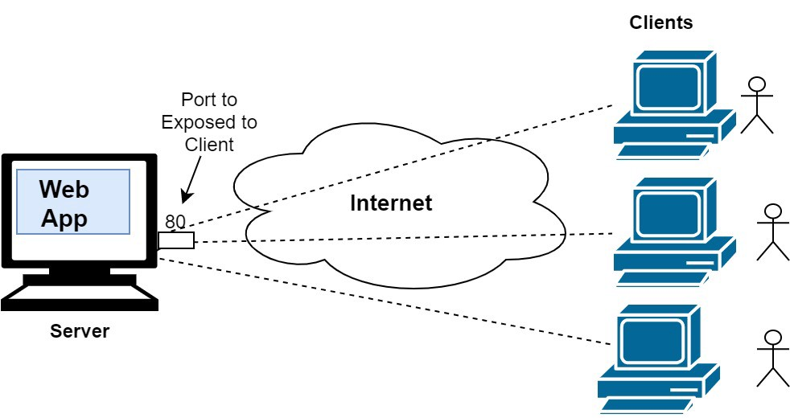
Chapter 3 Overview
SaaS apps follow the client-server pattern, in which a client makes requests and a server responds to the requests of many clients.
Fundamental to the Web's architecture are the Hypertext Transfer Protocol (HTTP), a request-reply protocol over which Web content is delivered

Slide 3
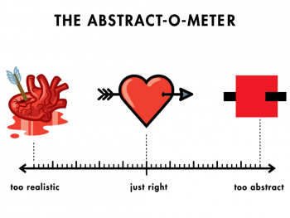
What is Abstraction?
In software engineering and computer science, abstraction is a technique for arranging complexity of computer systems. It works by establishing a level of complexity on which a person interacts with the system, suppressing the more complex details below the current level.
A car is a very complex machine but the interface is simple (a steering wheel, a gas pedal and a gear shift)
A video game controller only has a few buttons, but underneath the controller is complex control mechanism
A programming language can be fairly simple, but it translates the instructions you write into machine code, which is impossibly complex

Slide 4
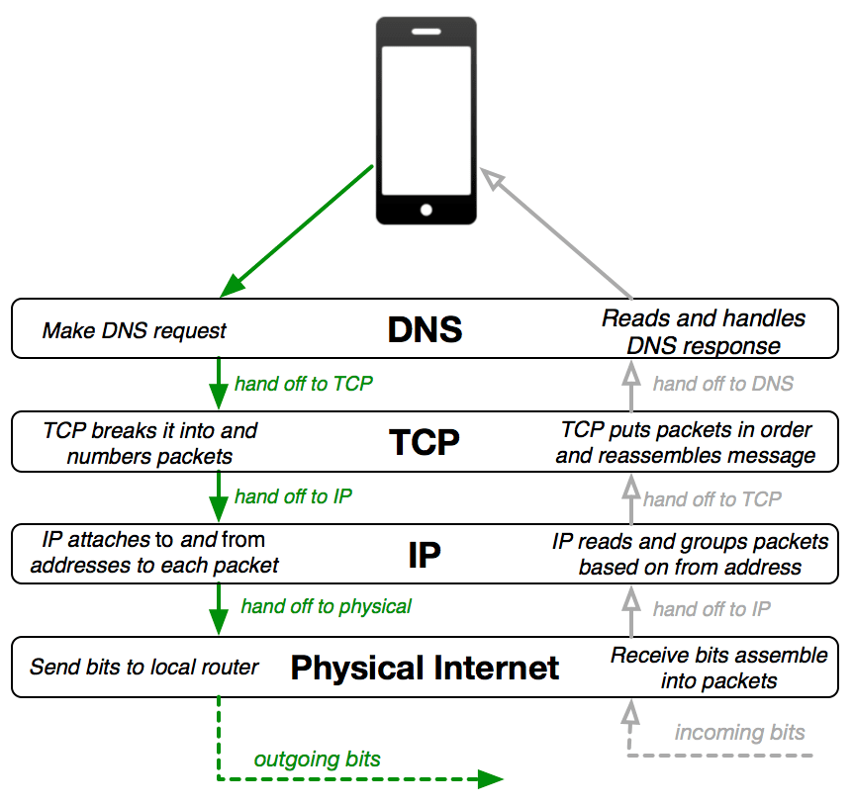
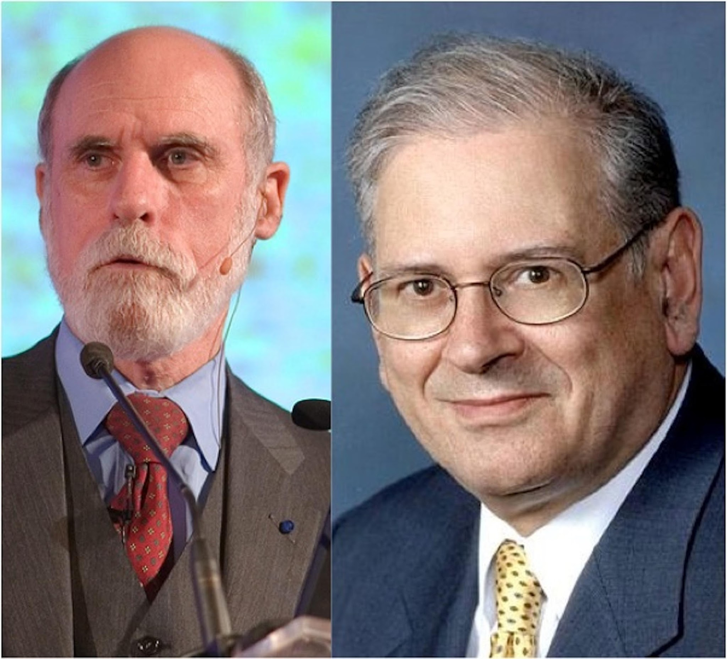
Internet Layers of Abstraction
Many protocols and systems of the Internet work together in layers to make the Internet function.
Here is a simplified version of what's known as the "Internet Protocol Stack."
The system was constructed with layers of abstraction where each layer only needs to concern itself with its specific job, and then hands it off to another layer.
At the top layer, for example, the DNS protocol does not even need to know how the other layers work. It just relies on them doing their jobs.
HTTP and Abstraction on the Internet
Outgoing information going DOWN the stack and incoming information going UP the stack.
Vint Cerf & Bob Kahn: 2004 Turing Award for Internet architecture & protocols, incl. TCP/IP

Slide 5
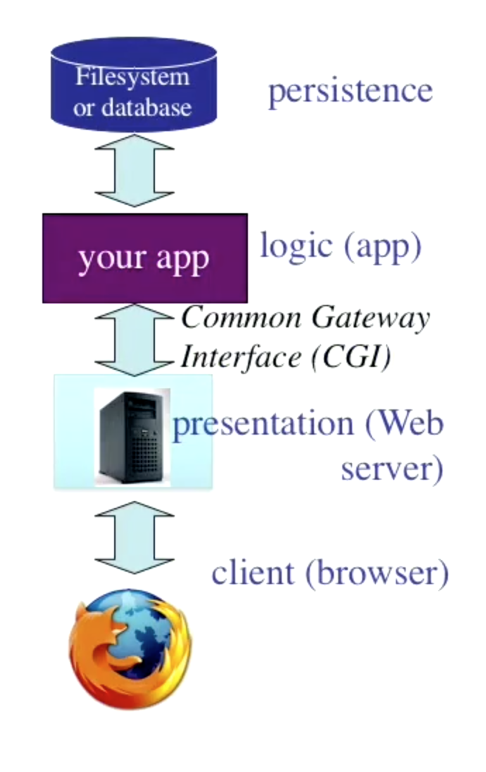
Tiers
Layers form an abstraction around the work that needs to be done. Each layer has a specific role and responsibility within the application:
Persistence: database, filesystem, memory space of application (file cabinets, excel sheets, vaults)
Logic: the code that converts input to output and make changes on the info saved in persistence layer (the processes like transfer money, update your balance) execute rules for the request
Presentation: the representation of data that the app outputs/displays (online banking UI) handling all user interface and browser communication logic
*** No service can directly reach other’s data! ***

Slide 6
Patterns in Software Development
Design Patterns capture common structural solutions to recurring problems (architectural, computational, structural)
Software Architecture Pattern: how subsystems are connected together to meet the application’s functional and non-functional requirements.
Software Design Pattern: a general architectural solution to a family of similar problems
Software architecture shows the system's structure and hides the implementation details, focusing on how the system components interact with one another.
Software design, on the other hand, concentrates on the system's implementation, often delving into considerable detail
Notes:
Always looking for patterns to solve problems
architectural patterns - general reusable solution that describes the main components and their role in the system
Other patterns - computational patterns - formulas
structural patterns - relationship of classes in application to make code more maintainable

Slide 7


Client-Server vs. Peer-to-Peer
Client & server each specialized for their tasks like web apps meaning request-reply oriented
Server: A computer that awaits and responds to requests for data
  Example: a DNS server awaits and responds to requests for URLs to be translated to IP addresses.
Client: A computer that requests data stored on a server
  Example: When you type an address into your browser, your computer is the client and it sends the request to the DNS server.
Captures the reusable behavior of specialized servers and clients without specifying how servers and clients should be implemented.
Peer to Peer
  Everyone is client and server
C
C
S
C
C
P
P
P
P
P
P
‹#›

Slide 8

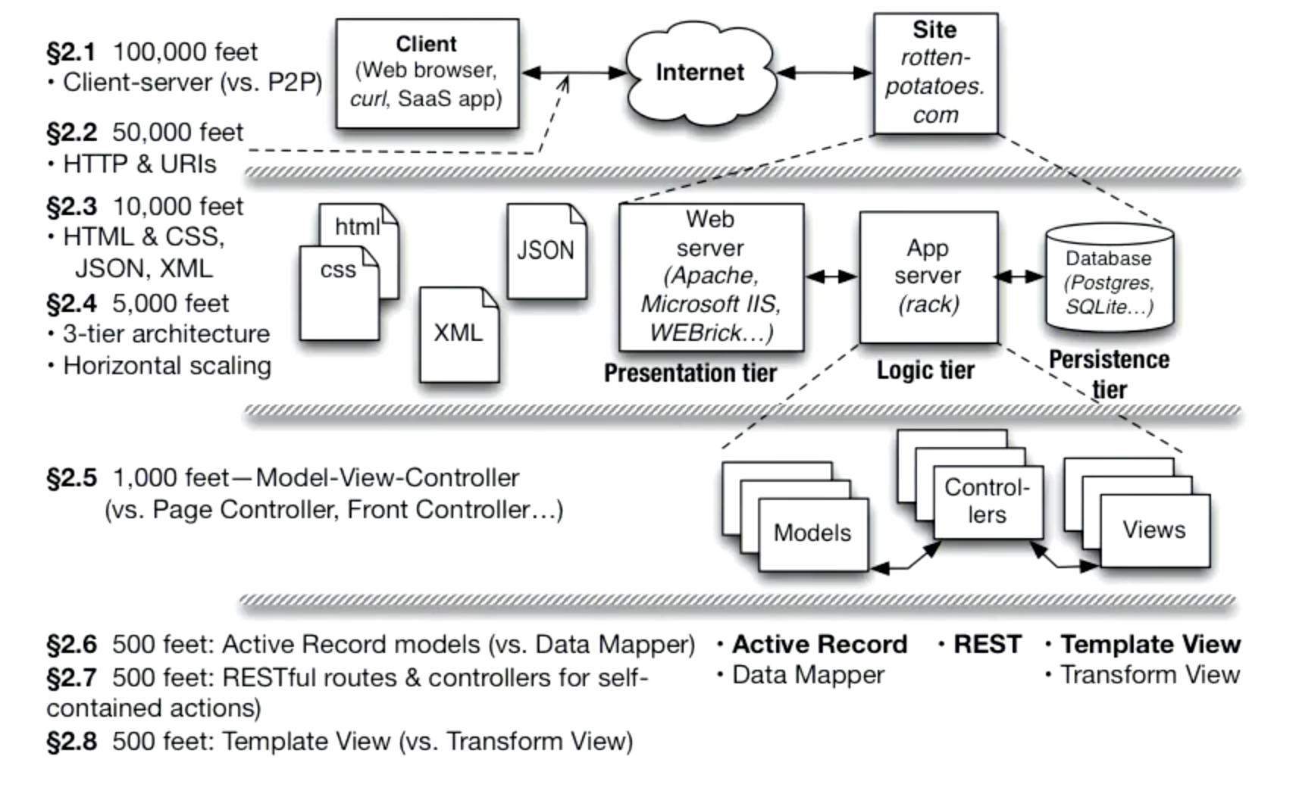
Client-Server
Client & Server specialized for their tasks
Client: ask questions on behalf of users; let users interact w/data
Server: wait for & respond to questions, serve many clients
Popular Movies — The Movie Database (TMDB)

Slide 9
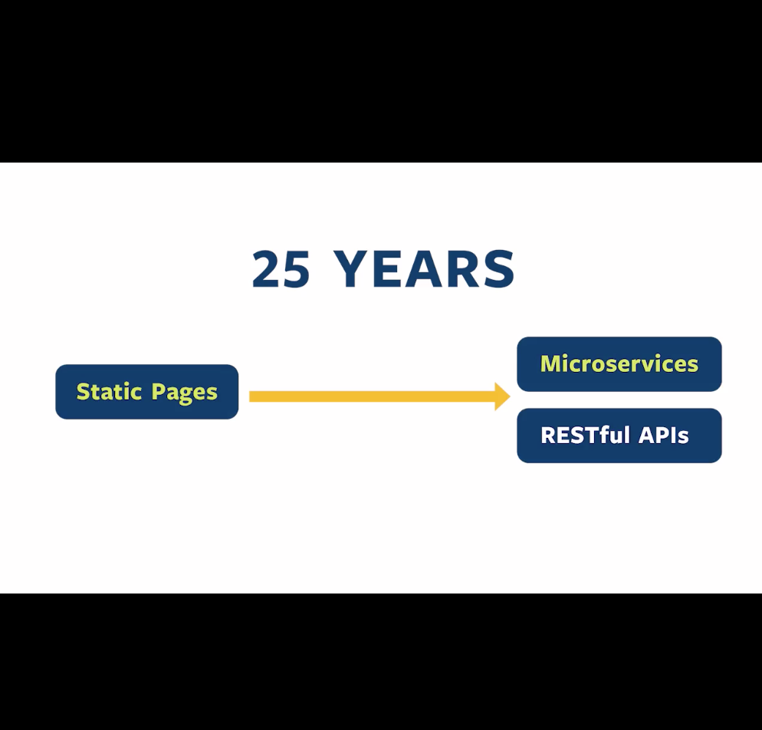
Evolution of the Web
Web Before
Originally served static content - URL names static page
Then e-commerce sites run a program to generate each “page” - URL invokes a remote program to generate each page on the fly
Web Now
collection of programs that can be invoked remotely to return any kind of data (not just a static web page to be viewed)
Remote procedure calls where a web client can call a function that gets executed on another computer and returns an answer to the client
Web = collection of services

Slide 10
What is Service Oriented Architecture?
Service-oriented architecture (SOA) is a software development model that uses services to communicate across different platforms and languages to form applications
reusable software components exchange information via services.
Services are accessed through defined application program interfaces (APIs)
Each service contains the code and data required to execute a business function
  checking a customer’s credit, calculating a monthly loan payment, or processing a mortgage application
This provides abstraction so can be called without knowing the details of how the service is implemented
The services are available using standard network protocols

Slide 11
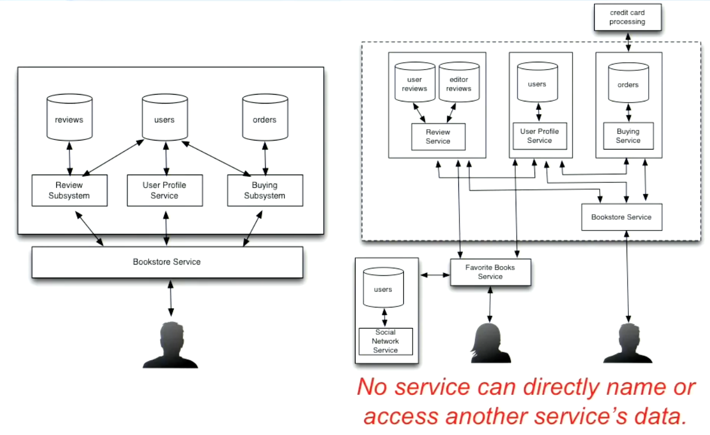
Amazon: Early Adopter of SOA
Service Oriented Architecture (SOA) is a set of independent composable services that can be combined as black boxes
each service manages their own data
Use service to get data and not allow direct access
Outside users can now build a new service and make programmatic request
Silo version behind a single API
All three subsystems are independent and available via APIs

Slide 12

Discussion
Explore https://www.themoviedb.org/
How do web apps work? What protocols are used to communicate?
Explore https://developers.themoviedb.org/3/search/search-movies
What is an API? What is an HTTP Request?
Discuss this URI https://www.themoviedb.org/search?query=coco

Slide 13
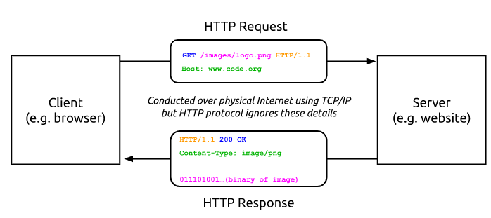
HTTP (HyperText Transfer Protocol
HTTP is an ASCII-based request/reply protocol for transferring information on the Web.
Clients request and receive data like web pages, images, video, audio, and files from the servers containing them.
A client will send a request to the server with an identifier for a desired piece of data, and the server will attempt to respond to the request

Slide 14
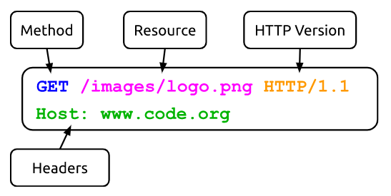
HTTP Request
HTTP request includes:
  request method (GET, POST, etc.)
  Uniform Resource Identifier (URI)
  HTTP protocol version understood by the client
  headers—extra info regarding transfer request
HTTP is stateless
  every HTTP request is completely independent of each other
  hence cookies are used to pass information in header that this is same client
form route
Code.org
Notes:
‹#›

Slide 15
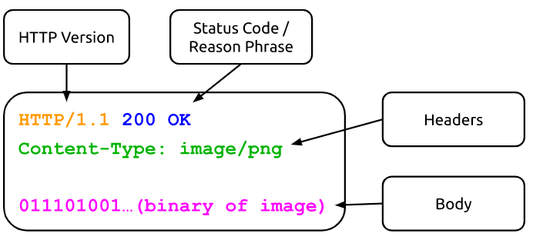
HTTP Response
HTTP response from server
  Protocol version & Status code =>
  Response headers
  Response body
HTTP status codes:
2xx — all is well
3xx — resource moved
4xx — access problem
5xx — server error
Code.org
Notes:
‹#›

Slide 16
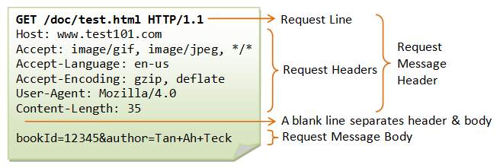
HTTP Communication
HTTP Server is listening to localhost:3000
Web Client requests Rotten Potatoes home page from a Web Server
  Web Client’s browser creates HTTP request using GET method and URI: localhost:3000 to contact web server listening to same computer, same port.
  Web Server receives the HTTP request
HTTP Headers for Dummies

Slide 17
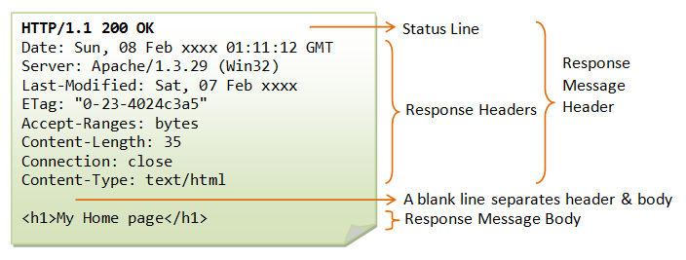
HTTP Communication
HTTP Server obtains Rotten Potatoes app and sends this content back to Client
  Server returns content encoded in HTML using HTTP
  Client receives the content as a HTTP reply
Web Client displays content according to directives
Web Client closes its HTTP connection
Web Server is still listening for clients.

Slide 18
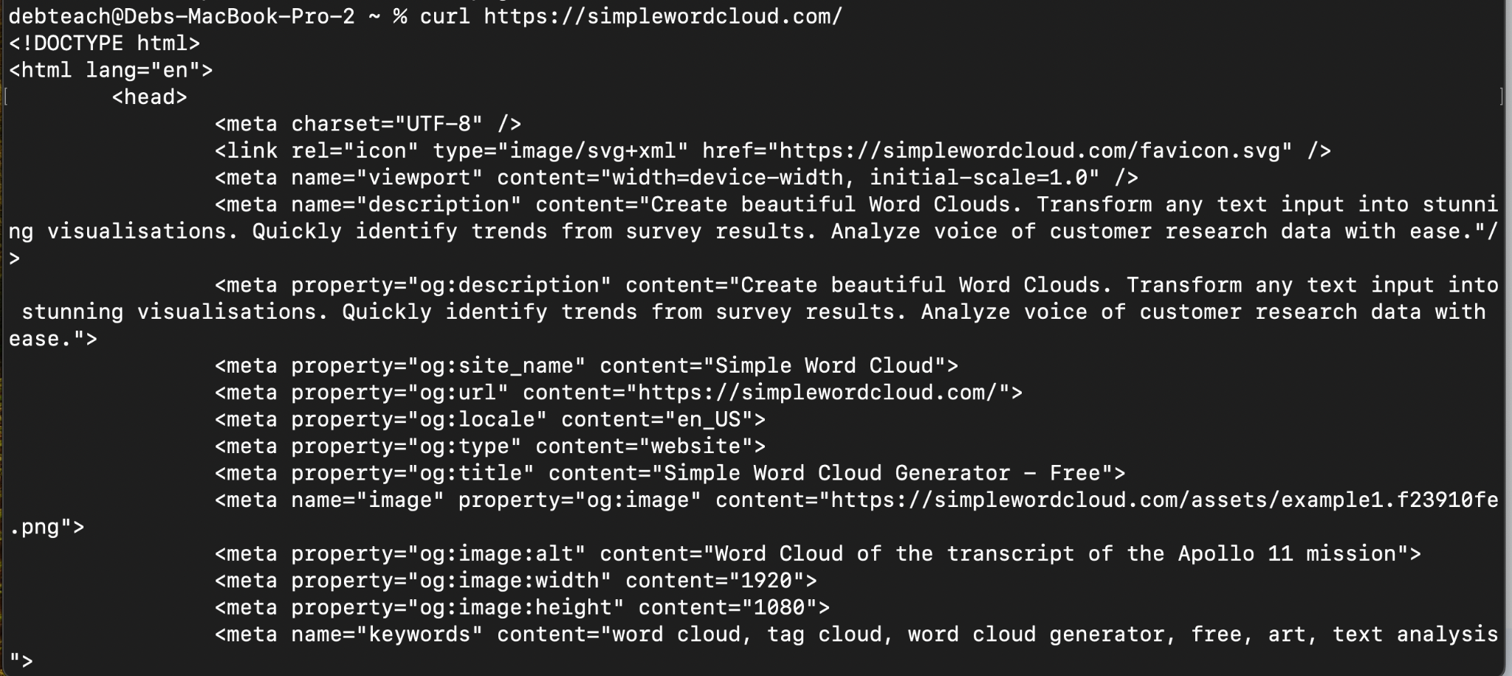
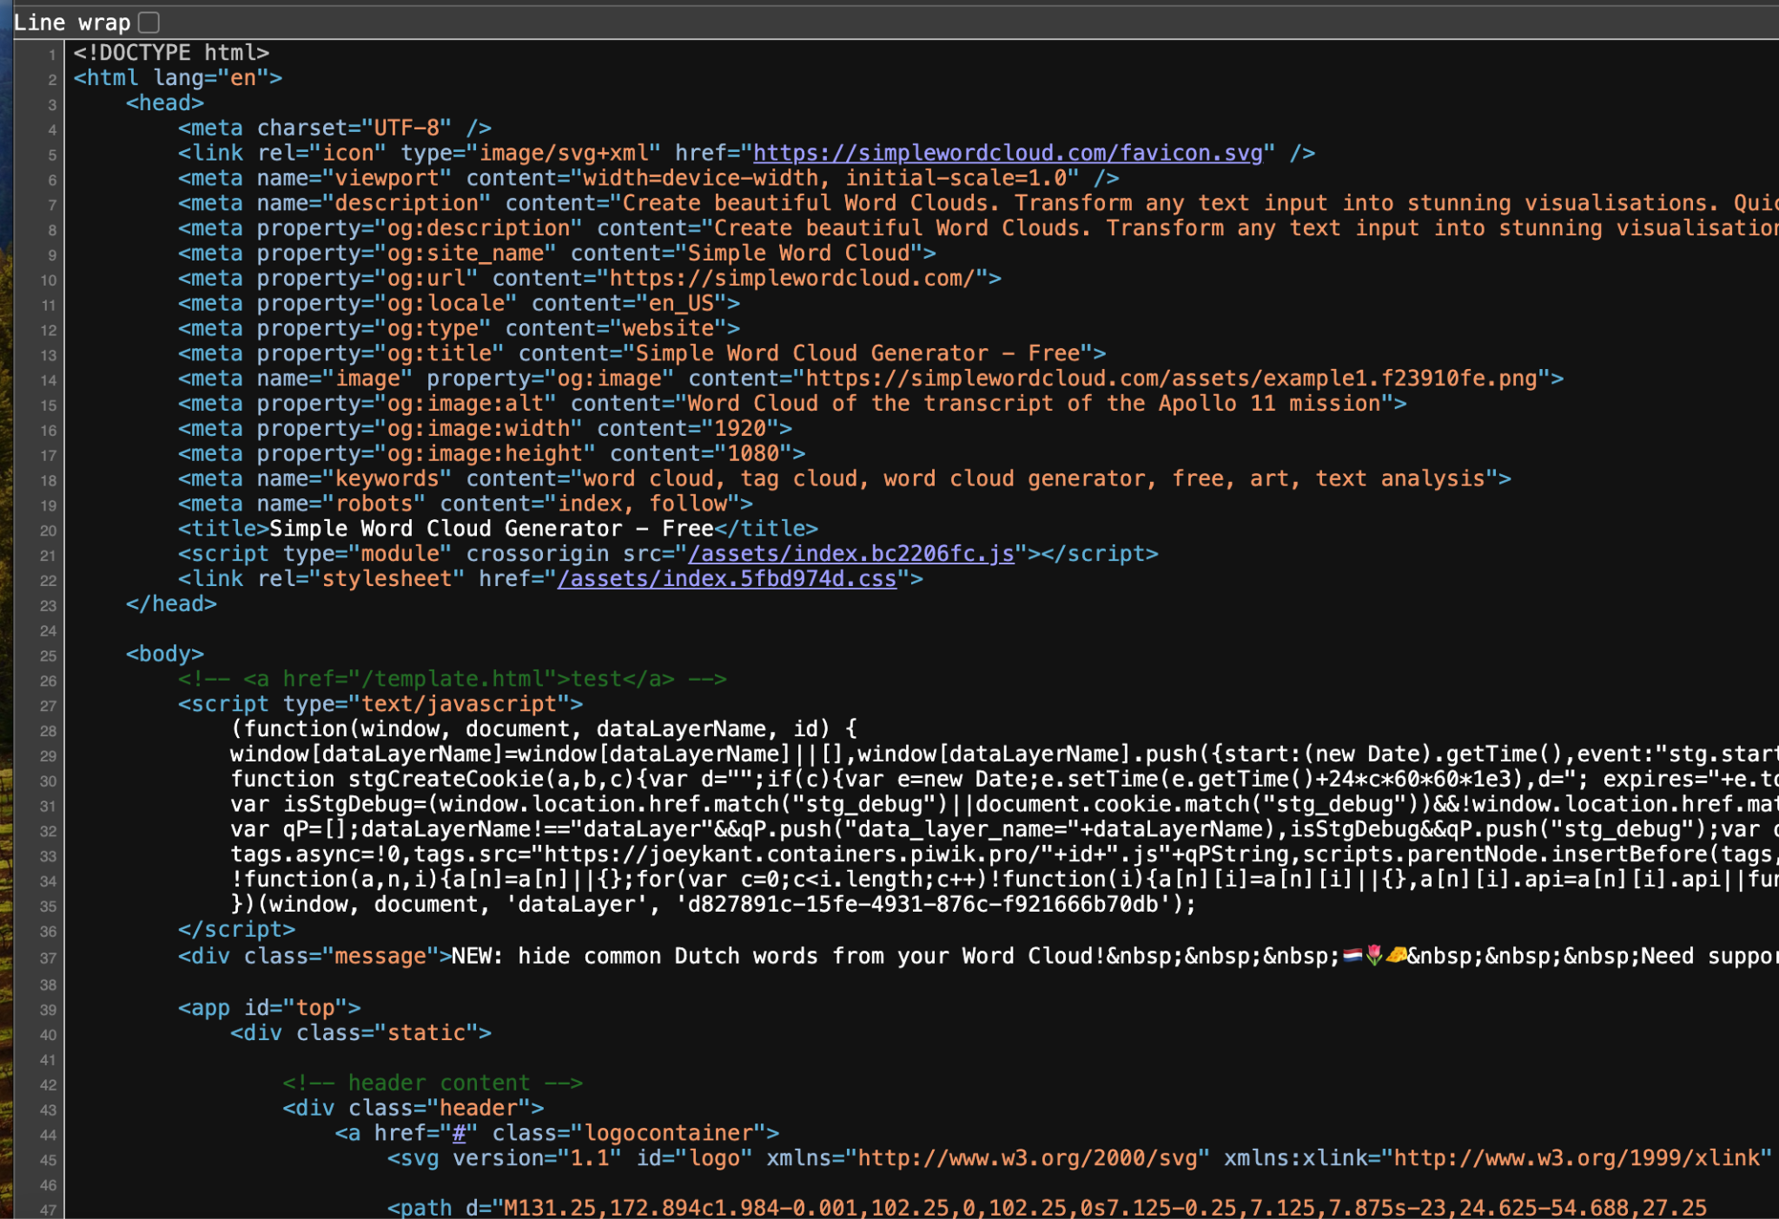
Demo HTTP Request Using Curl
curl (Client URI) is a command line tool that enables transferring of data to and from servers. Acts as HTTP client to send requests to a server and stores whatever comes back from the server.
Run command: curl https://simplewordcloud.com/
Returns the html file
Notes:
Run command in linux environment

Slide 19
Demo HTTP Request Using Curl -i
curl -I option will return the headers sent back from the server
deb@LAPTOP-5974SGTP:~$ curl -i http://watchout4snakes.com/Random/RandomWord
HTTP/1.1 200 OK
Cache-Control: private, max-age=20
Content-Type: text/html; charset=utf-8
Expires: Fri, 06 Jan 2023 22:55:55 GMT
Last-Modified: Fri, 06 Jan 2023 22:55:35 GMT
Server: Microsoft-IIS/10.0
X-AspNetMvc-Version: 3.0
X-AspNet-Version: 4.0.30319
X-Powered-By: ASP.NET
X-Powered-By-Plesk: PleskWin
Date: Fri, 06 Jan 2023 22:55:35 GMT
Content-Length: 4080
<!DOCTYPE html>
<html>
<head>
<title>Random Word Generator - Word</title>
Notes:
Run command in linux environment

Slide 20
Demo HTTP Request Using Curl -v
curl using -v option will return both the client headers and server headers
deb@LAPTOP-5974SGTP:~$ curl -v http://watchout4snakes.com/Random/RandomWord
* Trying 50.62.160.127:80...
* Connected to watchout4snakes.com (50.62.160.127) port 80 (#0)
> GET /Random/RandomWord HTTP/1.1
> Host: watchout4snakes.com
> User-Agent: curl/7.81.0
> Accept: */*
>
* Mark bundle as not supporting multiuse
< HTTP/1.1 200 OK
< Cache-Control: private, max-age=20
< Content-Type: text/html; charset=utf-8
< Expires: Fri, 06 Jan 2023 23:10:16 GMT
< Last-Modified: Fri, 06 Jan 2023 23:09:56 GMT
< Server: Microsoft-IIS/10.0
< X-AspNetMvc-Version: 3.0
< X-AspNet-Version: 4.0.30319
< X-Powered-By: ASP.NET
< X-Powered-By-Plesk: PleskWin
< Date: Fri, 06 Jan 2023 23:09:55 GMT
< Content-Length: 4080
client request headers
route - GET URI
user agent - identifies type of client so can be used to determine browser
accept any type of data
Server Reply
200 status code means everything ok
More descriptors followed by the resource that was requested

Slide 21
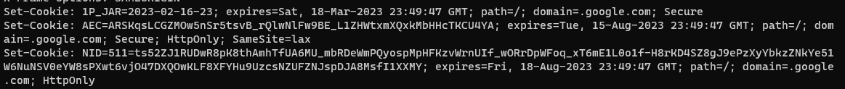
Cookies
HTTP is a stateless protocol in that every request is independent of every other request, even from the same user.
HTTP cookies allow server to track client
  Browser automatically passes cookie to server on each request
  Server may change cookie on each response
  Typical usage: cookie includes a handle to server-side information
  That’s why some sites don’t work if cookies are completely disabled
HTTP Cookies 101: What is it & How Does HTTP Cookies Work?
curl -D - http://www.google.com -o /dev/null
see the cookie arriving from google.com
Notes:
Demo: see cookie arriving from Google.com
curl -D - http://www.google.com -o /dev/null
‹#›

Slide 22
Application Programming Interface (API)
API - A set of well-defined methods for interacting with the data of a software system. Defines what kind of requests are acceptable to access their servers and what kind of requests should be expected
API documents show info about:
identify function to be called
pass arguments (variable names, formatting)
how to receive return value (return types)
errors, exceptions
Library documentation is basically API documentation describing a method/function
strtof, strtod, strtold - cppreference.com
https://curl.se/libcurl/c/
How do these translate into service-oriented architecture paradigm when using HTTP routes with URIs to make calls to a remote server.

Slide 23
SOA API
An Application Programming Interface (API) for a microservice is a formal description of the operations the microservice can do. The API first design stance suggests that even when creating a large SaaS app, we get a more modular design by thinking about the app in terms of its smaller components and the APIs by which they communicate.
SOA Service Oriented Architecture- Clients need a way to name the server function to be called, pass arguments to it, consume return values, detect and handle server exceptions when an application calls a library function, using HTTP for communication.
Identify the Callee on web server
Endpoint meaning a URI can receive HTTP request asking it to call a function
Route consists of base URI (API Version), method, path, optional & required arguments
Operation usually first path component of URI
Pass Arguments
For GET, embed in URI query string
For POST, can post as part of from body

Slide 24
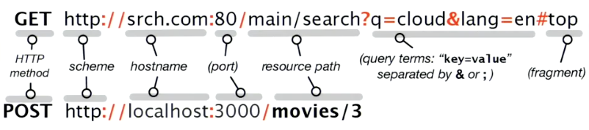
Routes
URI (Uniform Resource Identifier, name a particular resource on the Web and may specify parameters (options) for accessing it. A basic building block of SaaS is an HTTP route, which combines a method such as GET or POST with a URI.
or https which uses public-key cryptography
Route = HTTPS method + URI
Methods GET, POST, PUT, PATCH, DELETE, HEAD
URI parts
  protocol + server:port (most cases HTTP or HTTPS protocol and most cases the standard web port)
  Path to resource for operation to be done
  After ? is a set of key value pairs as arguments to the function
    q value is cloud and lang value is en

Slide 25
API Framework: REST
Roy Fielding proposed REST in his Ph.D. dissertation as a way of mapping requests to actions that is particularly well suited to a service-oriented architecture.
REST (REpresentational State Transfer) - not a standard, but a design stance regarding how a service should be constructed, and what its API should look like
Instead of thinking about a route as a page or action, think about it as a resource and operation. If an API is RESTful it should state
What is primary resource affected?
What operation is to be done, and what are possible results and side effects?
What other data needed for operation and how specified?

Slide 26
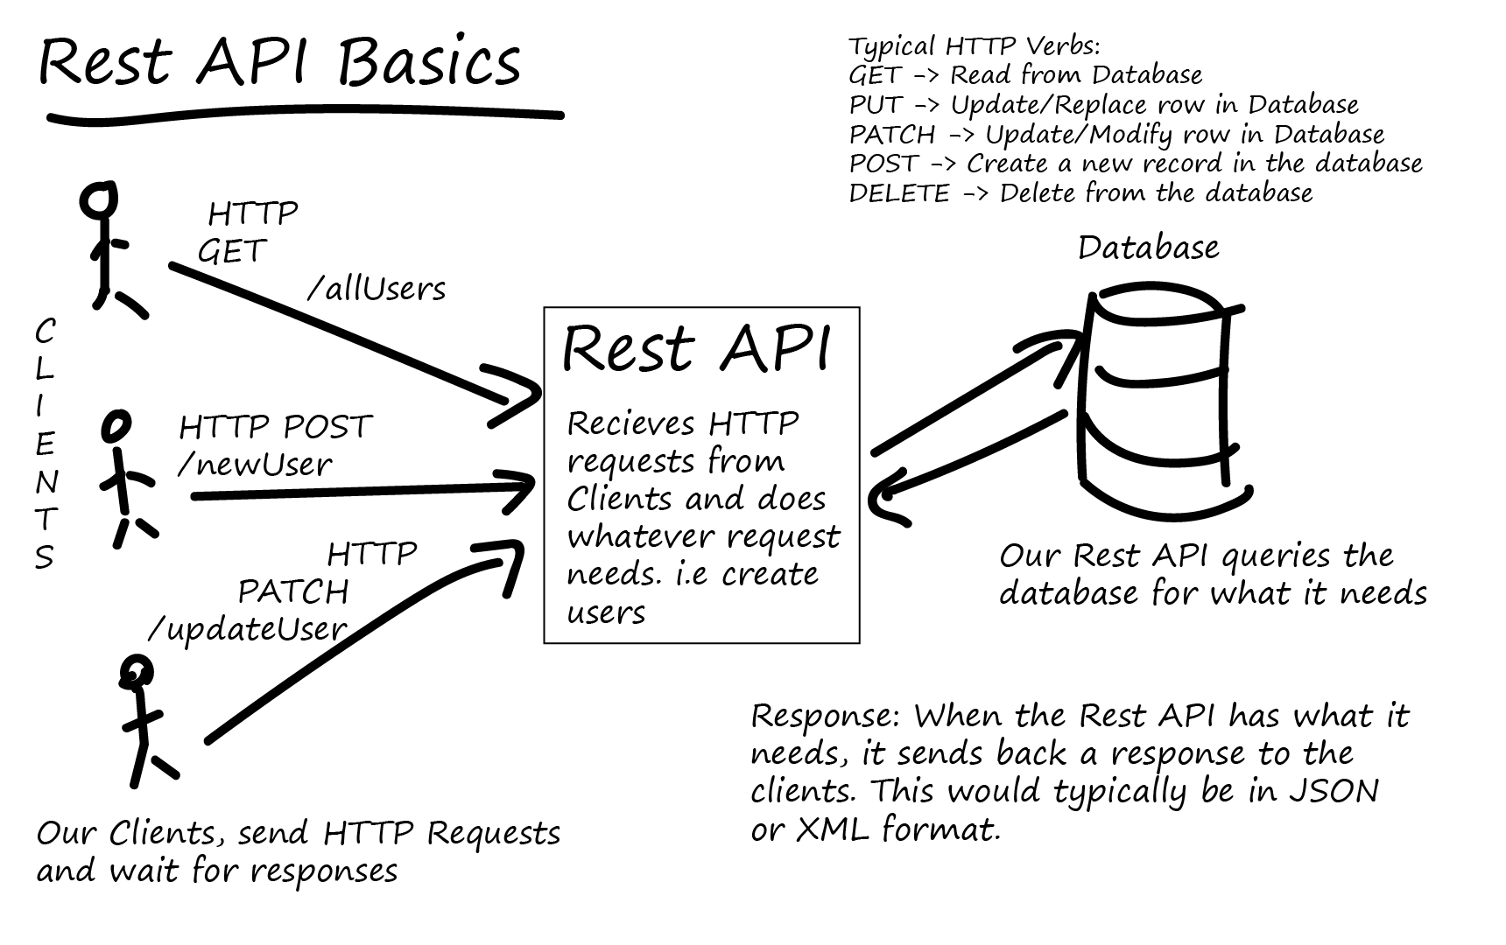
or HTML

Slide 27
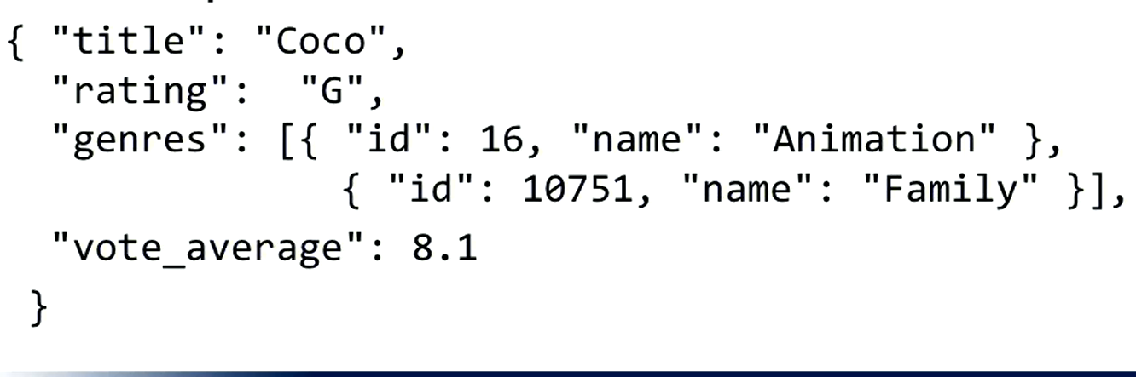
Get returned results
A resource may have multiple possible representations
Underlying resources are the same but could be represented differently such as
JSON (JavaScript Object Notation) objects if accessed through API calls
  JSON object = unordered hash in {}
  Keys are strings’ values can be string, number, [Array], or {nested hash}
  Key/value pairs separated by comma’ whitespace irrelevant
Displayable HTML page

Slide 28
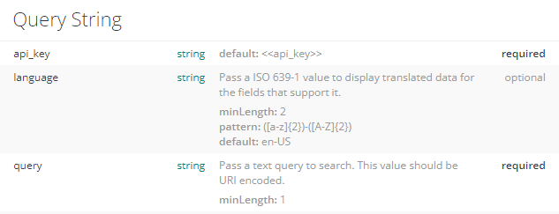
Search Movie Database: Request
API 3/search/movie
Route:
GET https://api.themoviedb.org/3/search/movie?api_key={apikey}&language=en-US&query=coco&page=1&include_adult=false
Remember the parts of a URI
https://www.themoviedb.org/search?query=coco
Notes:
Prepare routes ahead of time

Slide 29
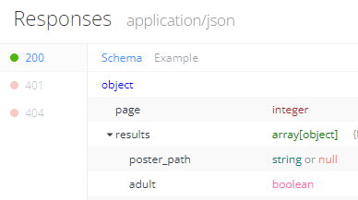
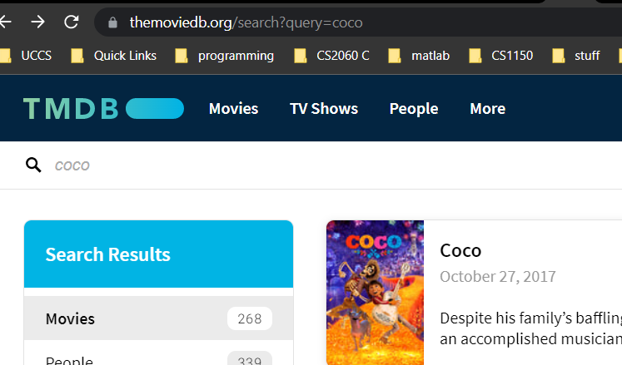
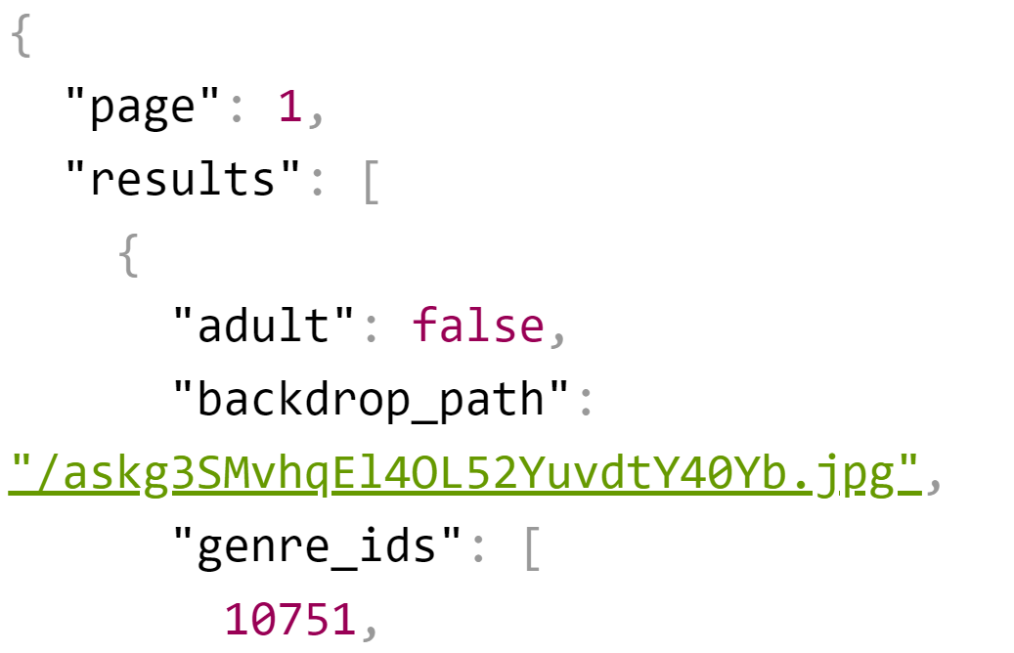
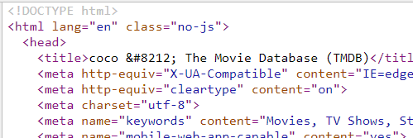
Search Movie Database: Response
API 3/search/movie
What Is JSON and How Do You Use It?
Notes:
Look at json and html

Slide 30
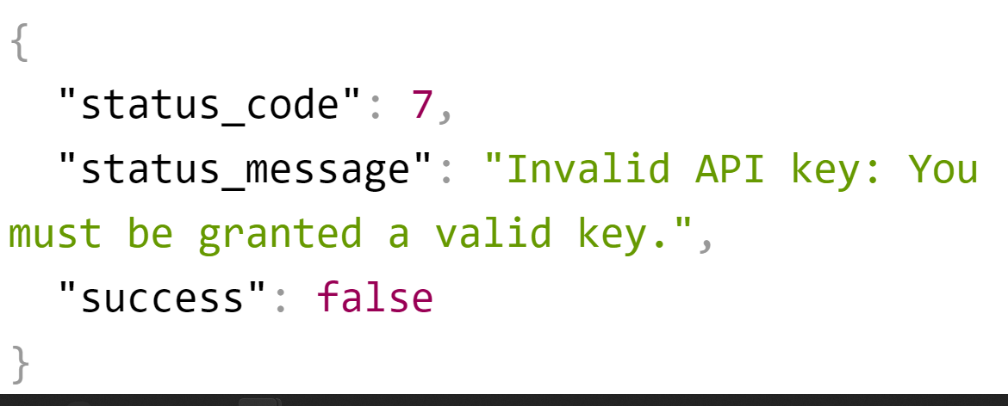
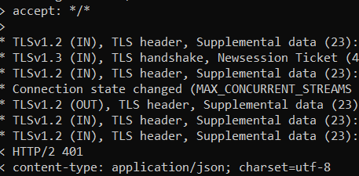
Search Movie Database Error: HTTP Status Codes
API Status Codes — The Movie Database (TMDB)
https://api.themoviedb.org/3/search/movie?api_key=1&language=en-US&query=coco&page=1&include_adult=false
curl -v 'https://api.themoviedb.org/3/search/movie?api_key=1&language=en-US&query=coco&page=1&include_adult=false'

Slide 31
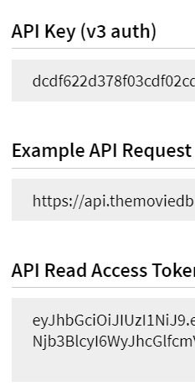
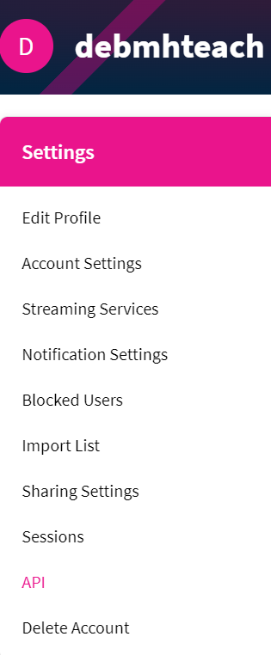
The Movie Database APIs
Explore APIs for https://www.themoviedb.org/
API Overview — The Movie Database (TMDB)
account
Introduction to APIs
curl.1 the man page (standard in Linux, MacOs; https://curl.se/windows/ for windows)
JSON Viewer - Chrome Web Store
Notes:
When running use your access token and api_key

Slide 32
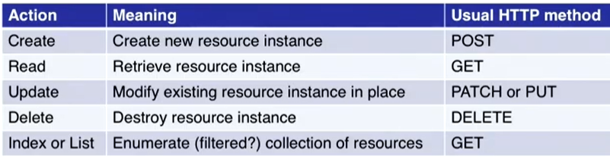
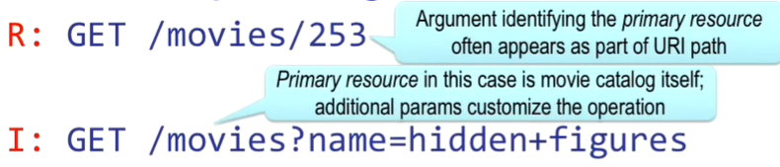
CRUDI: Basic Operations
RESTful API defines up to five operations on a resource, captured by the acronym CRUDI:
RESTful : What is resource, what is operation, and any other necessary data?

Slide 33
CRUD on a RESTful resource: resources :movies
I
C
R
U
D
get '/movies' => 'movies#index', :as => 'movies'
get '/movies/:id/new'=>'movies#new', :as=>'new_movie'
post '/movies' => 'movies#create', :as => 'movie'
get '/movies/:id' => 'movies#show', :as => 'movie'
get '/movies/:id/edit' => 'movies#edit', :as => 'edit_movie'
put '/movies/:id'=>'movies#update', :as=>'movie'
delete '/movies/:id' => 'movies#destroy', :as=>'movie'
Route | Action
GET /movies/3 | Show info about movie whose ID=3
POST /movies | Create new movie from attached form data
PUT /movies/5 | Update movie ID 5 from attached form data
DELETE /movies/5 | Delete movie whose ID=5
‹#›
Notes:
‹#›

Slide 34
Summary: Web Apps as RESTful Services
REpresentational State Transfer
Everything is a resource
  Basic ops: create, read., update, delete, list
  If can’t express desired operation may need new resource
RESTful operations identifies resource, operation to be done, and any other data needed to complete operations
Resource can have different representations
  HTML page
  JSON or XML (rarely) data structure
Many frameworks exist to implement a web app more efficiently. We will look at the Django framework next.

Slide 35

Chapter 1
Django Design Patterns and Best Practices
Arun Ravindran

Slide 36
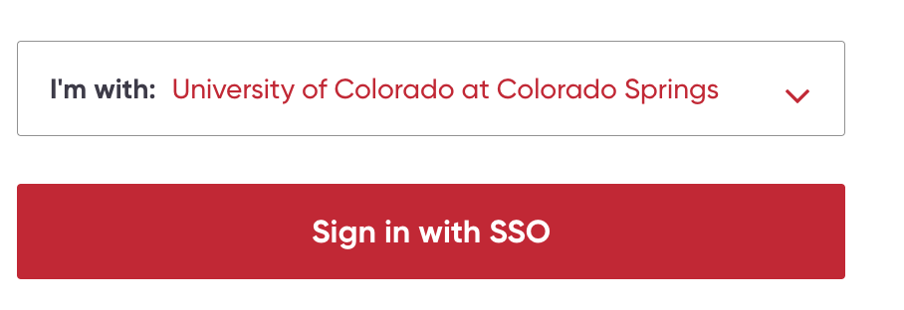


Django Overview
Chapter 1: What is a Pattern? - Django Design Patterns and Best Practices by Arun Ravindran
Sign in with UCCS email and
Goals:
Architectural Framework
Model View Template Overview
Design Patterns in Django
Remember this class is about learning how to learn architectures and framework as technologies are always changing. The skill is not to be an expert in Django and Python but to learn how to approach new technologies.

Slide 37
Framework
Identify architectural pattern, an arrangement of subsystems in a larger app, and construct frameworks that facilitate building framework around that pattern
Framework take care of connections among elements and can hide or abstract the mechanics of tasks that aren’t central to the app itself like dealing with HTTP directly.
Think about your app as a collection of resources and operations on them. Think of each resource having its own model, view and template. You can see how a resource based app maps

Slide 38
Learning an Architecture Framework
Learning a language and learning a framework often go together: learning Python and Django. This means you must understand three things:
The language
the structure or architectural model for the framework
How the language features are used to expose that structure.
Understand the app architecture implied by the framework:
What is the application structure or set of patterns in the framework?
What are the major “moving parts” of an application built using that framework, and how does their arrangement influence the way we formulate an application’s functionality in terms of that framework?

Slide 39
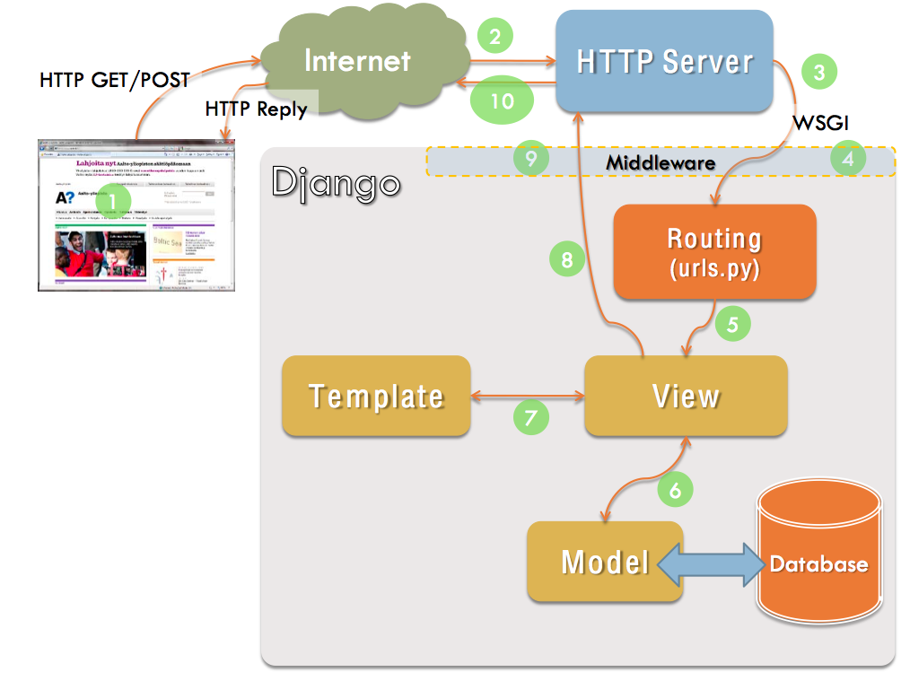

Django Model View Template
How does Django work?
Model - Data access layer.
Template - Presentation layer. This deals with how data is displayed to the client.
View - Business logic layer. This is a bridge between models and templates.
Browser
From https://devopedia.org/django

Slide 40
Patterns
What is a Pattern? Christopher Alexander states that "Each pattern describes a problem, which occurs over and over again in our environment, and then describes the core of the solution to that problem in such a way that you can use this solution a million times over, without ever doing it the same way twice."
Explore different Design Patterns
Creational patterns
Structural patterns
Behavioral patterns

Slide 41
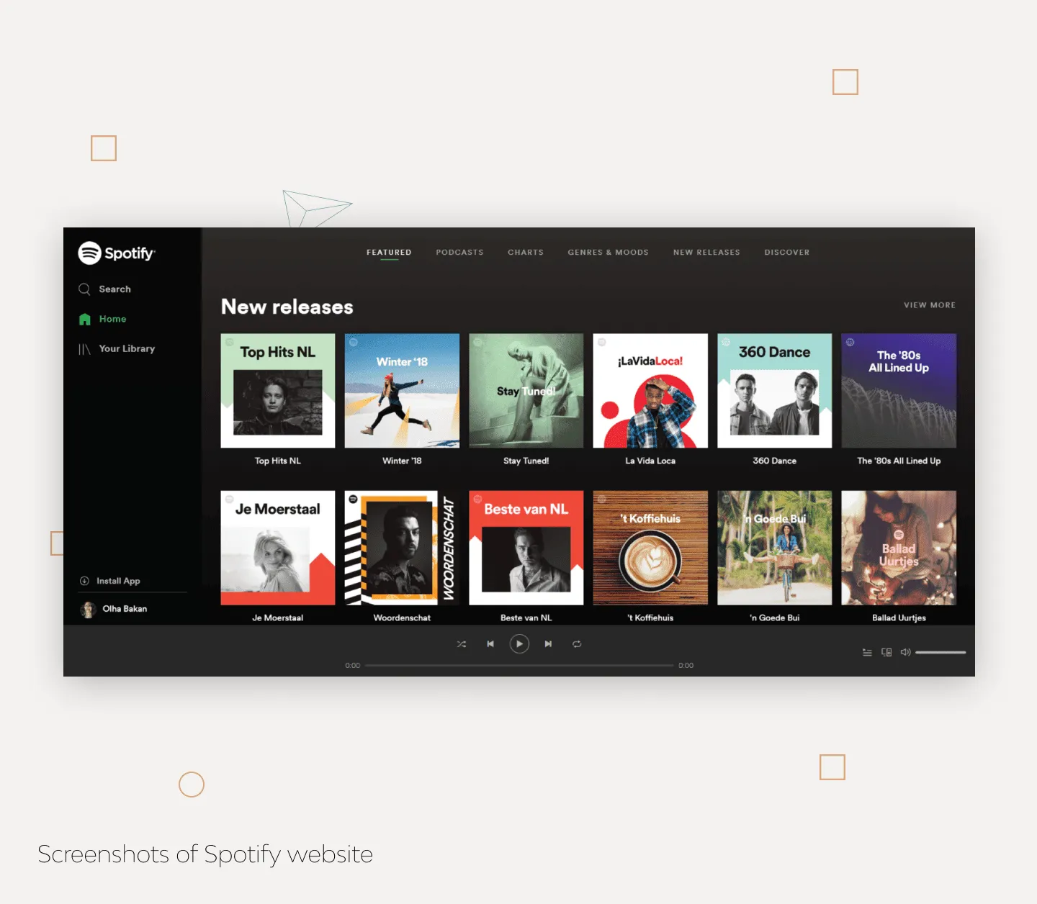
Django Design Philosophies
Django design philosophies
Remember from Ch01 and L01 : The goal is to allow software developers to write complex software more productively.
4 techniques
  Code that writes code (Synthesis, generators)
  Clarity via conciseness
  Reuse
  Automation and Tools
10 Popular Django Websites That You Probably Know

Slide 42
Django MVT Design Pattern
Some Django Patterns we will be using. Design Patterns Cheat Sheet
GoF Pattern | Django Component | Explanation
Command Pattern | Http Request | This encapsulates a request in an object
Observer pattern | Signals | When one object changes state, all its listeners are notified and updated automatically
Template Method | Class-based generic views | Steps of an algorithm can be redefined by subclassing without changing the algorithm's structure
Active Record | Django Models | Django models and ORM use Active Record concept
Class Table Inheritance | Model Inheritance | Each entity in the hierarchy is mapped to a separate table
Identity Field | Model Id Field | Id Field
Template View | Django Templates | Renders into HTML by embedding markers in HTML

Slide 43
Technology Versions
Version Compatibility FAQ: Installation | Django documentation It is important to keep versions given in the GE documentation and let me know if somethings is not working due to versions.

