Slide 1
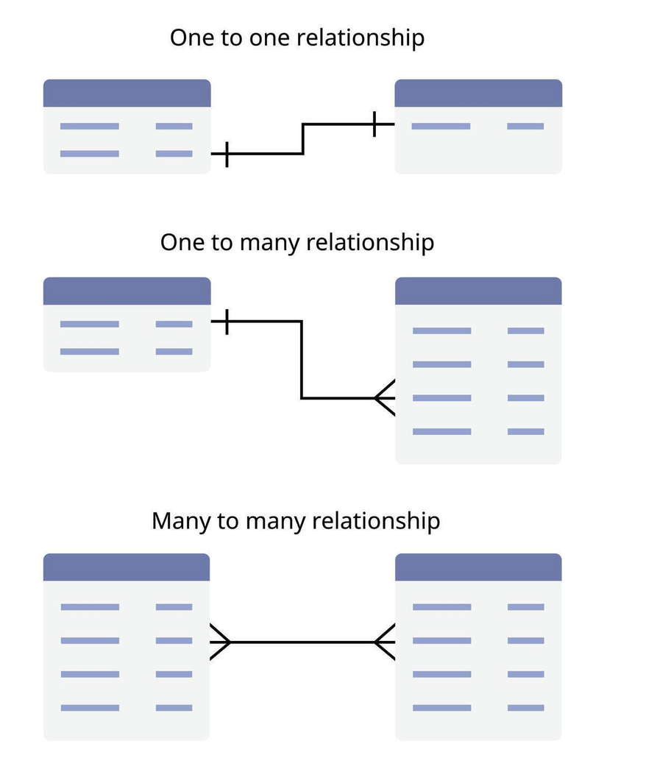
Models and Database Relationships

Slide 2
Goals
Branching with Git
Identify one-to-one and one-to-many relationships in a data model.
Explain how primary and foreign keys connect related database records.
Design relationships between Student, Portfolio, and Project based on portfolio requirements.
Implement model relationships using Django OneToOneField and ForeignKey.
Apply migrations after changing Django models and inspect the resulting database tables.
Create and test related records using Django Admin.
Use Django ORM queries to retrieve data and navigate relationships between model objects.
Verify that the models, database tables, and stored relationships match the intended design.
If you open a link that is not using 6.1 just change the old version number https://docs.djangoproject.com/en/6.1/topics/db/models/

Slide 3
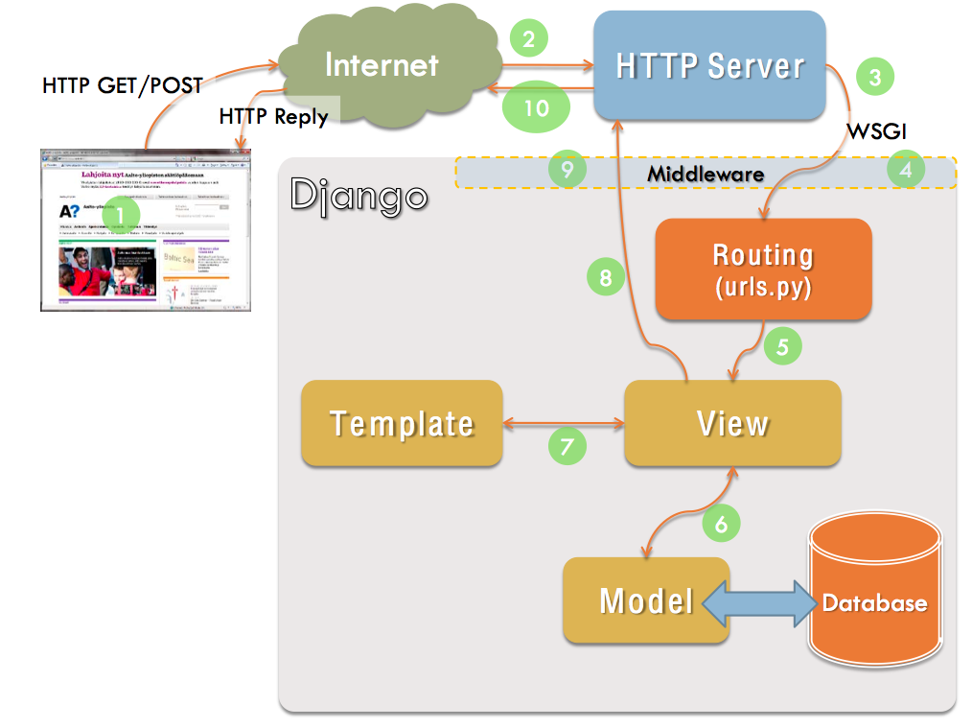
Django Model View Template
Model - Data access layer is the focus of this module.
We will focus on the model and database.
Browser
Data to ORM | Django Component | Explanation
Active Record | Django Models | Django models and ORM use Active Record concept
Identity Field | Model Id Field | Django’s automatic primary key

Slide 4
Branch Workflow
Discuss the following git commands: status, branch, log, add . , commit -m
A branch gives us a place to build and test an iteration before integrating it into the working application.
Why use a branch? A branch gives us a separate place to develop and test a new feature without immediately changing the working version on main.
Branch Workflow
1. Start with a working main. Make sure previous work is committed and pushed.
2. Create a new branch from main called model_setup. Switch to the new branch before changing your models.
3. Develop and test on this development branch. Add Portfolio and Project, create migrations, test relationships, and run ORM queries. Commit meaningful working increments.
4. When project sprint is done and tested you will merge to main.
Don't wait until the entire project is finished to commit. After something is implemented and tested commit and push or if you need to stop working on the project.

Slide 5
Development Database
Your Git branch contains your model code and migration files—not your local db.sqlite3.
If you were working on a team you would each have your own data in your local development database.
So each developer migrates after a change in the schema.

Slide 6
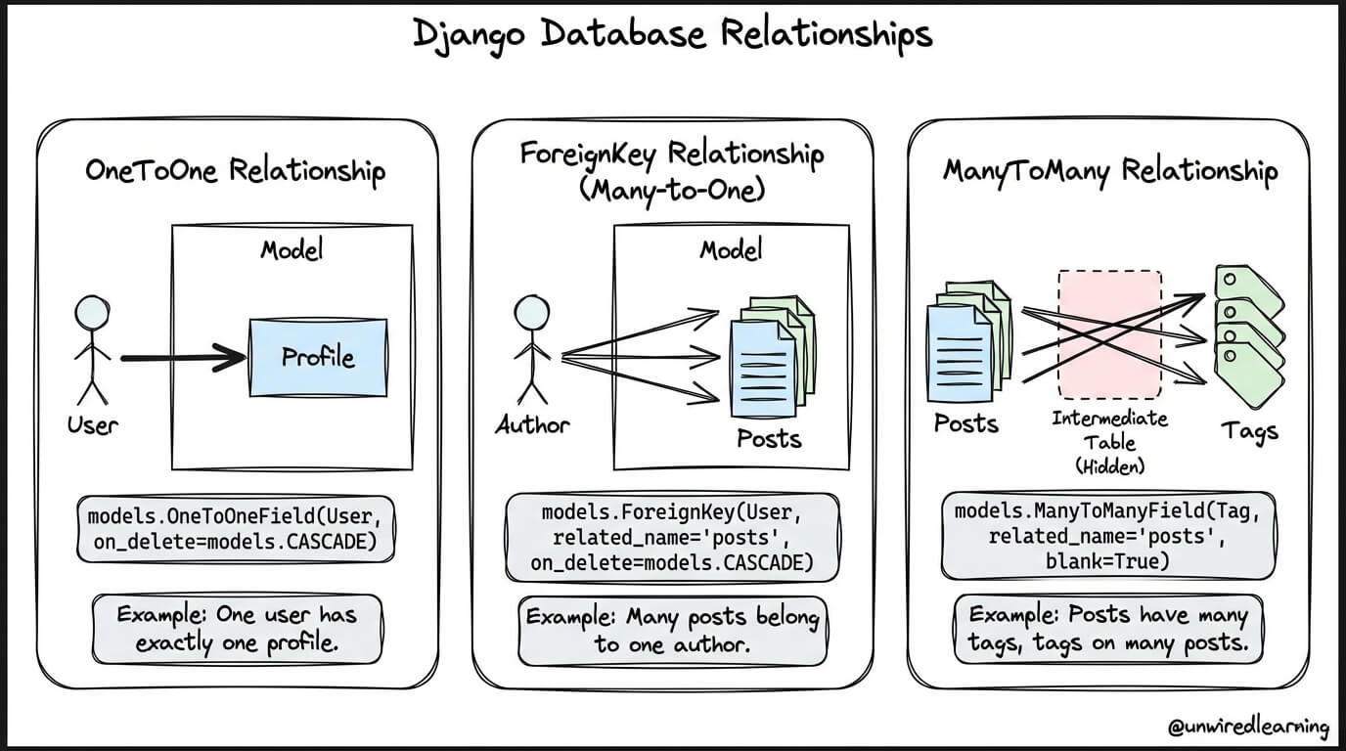
Portfolio App Relationships
Read about the Tables Relations in SQL Server: One-to-One, One-to-Many, Many-to-Many
Then explore https://unwiredlearning.com/blog/django-model-relationships

Slide 7
Design Questions
Designing the models (classes) and database relationships.
Relationship | Database | Question to Ask About the Portfolio
One-to-One | OneToOneField | Should each student have only one of these, and should each of these belong to only one student? Example: Can each Student have only one Portfolio?
One-to-Many | ForeignKey | Can one Portfolio have several Projects, while each Project belongs to only one Portfolio?
Many-to-Many | ManyToManyField | Could several students/projects share several of these? Example: Could one Project use several Skills, and could the same Skill be used in several Projects? For now, identify this relationship only—you will not implement it.

Slide 8
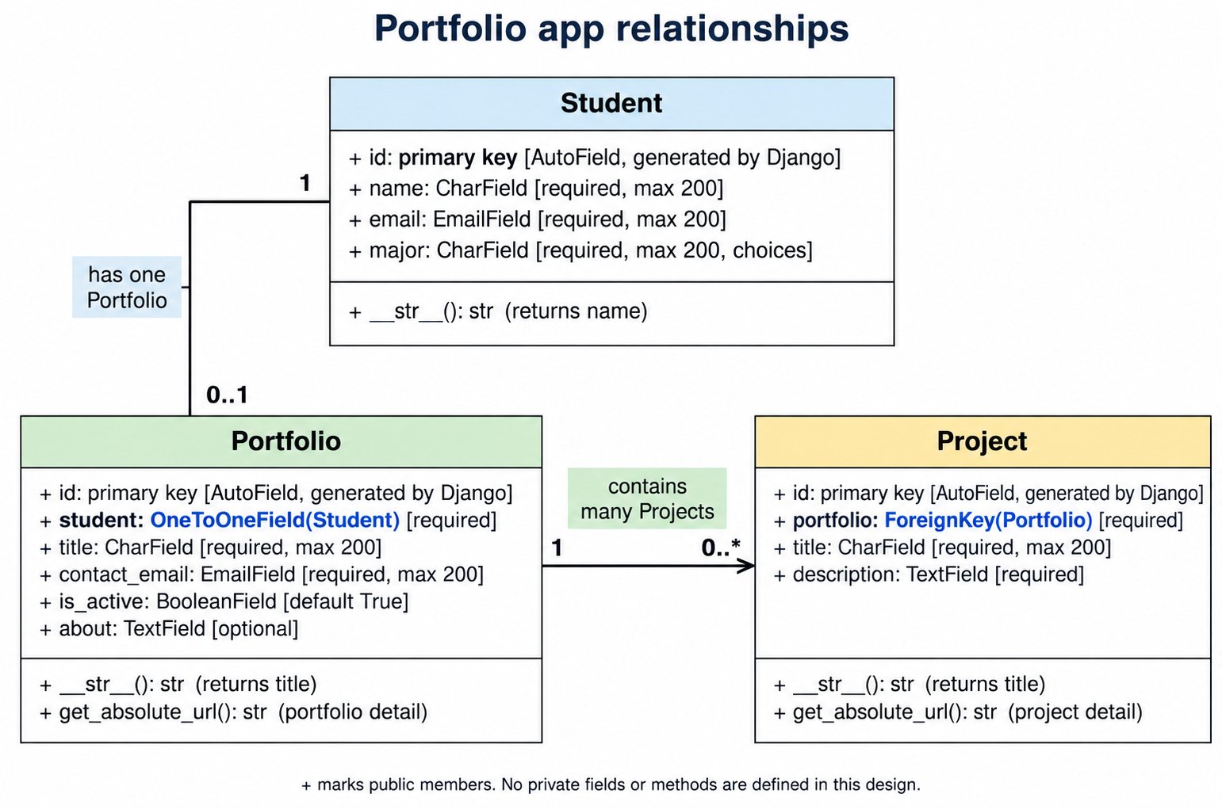
Portfolio Design
One Student can have one Portfolio.
One Portfolio can have many project.
How do we implement these relationships in Django?

Slide 9
Django Portfolio Model
Our design says each Student can have only ONE Portfolio. How can the database enforce that?
Read about setting up the one to one relationship..
Examples of model relationship API usage | Django documentation

Slide 10
Primary Key
Primary Key
A primary key (PK) is a field in a database table that uniquely identifies each record.
Think of it as the record's unique identity.
In Django:
class Student(models.Model):
Django automatically adds the id primary key.
Why can't we just use the student's name to identify the
Id (PK) | name | email | major
1 | Student A | ... | CSCI-BS
2 | Student B | ... | BICS-BI

Slide 11
Primary and Foreign Key
How do two tables know which records belong together?
Now there are two different kinds of keys:
id — Primary Key (PK): Identifies the Portfolio record itself.
student_id — Foreign Key (FK): References the primary key of a record in the Student table.
What does Portfolio.id = 1 identify?
What does Portfolio.student_id = 1 identify?
Where can we find the Student with id = 1?
id (PK) | name | email | major
1 | Maya | maya@msudenver.edu | CSCI-BS
2 | Alex | alex@msudenver.edu | BICS-BI
id (PK) | title | contact_email | is_active | about | student_id (FK)
1 | Maya's Portfolio | maya@msudenver.edu | True | CS student interested in software development | 1
2 | Alex's Portfolio | alex@msudenver.edu | True | Cybersecurity student | 2

Slide 12
Portfolio Class Model
student — name of the relationship field in the Portfolio model.
Student — the model that Portfolio is related to.
OneToOneField — each Portfolio is related to one Student, and each Student can be related to only one Portfolio.
on_delete=models.CASCADE — if the related Student is deleted, Django also deletes that student's Portfolio.
class Portfolio(models.Model):
student = models.OneToOneField( Student, on_delete=models.CASCADE)
title = models.CharField(max_length=200)
contact_email = models.EmailField()
is_active = models.BooleanField(default=True)
about = models.TextField(blank=True)
def __str__(self):
return self.title

Slide 13
Add Portfolio Model and Test
Add the new model for Portfolio and migrate
makemigrations → creates instructions describing the model/schema change.
migrate → applies those changes to the database.
Predict
What new table should Django create?
What columns do you expect in the table?
Which column will be the primary key?
Which column will connect Portfolio to Student?
Inspect the database
Where did id come from?
Where did student_id come from?
Why does the database contain student_id when our Python field is named student?
What should you test next?

Slide 14
Test the One-to-One Relationship
Register the Portfolio to use in the admin tool
Open Admin
Test adding a portfolio
Create or use an existing Student.
Create a Portfolio and select that Student.
Save it.
Inspect the Portfolio record in SQLite.
Try to create another Portfolio for the same Student.
What happened?
What evidence shows that this is a one-to-one relationship?
from .models import Student, Portfolio
admin.site.register(Student)
admin.site.register(Portfolio)

Slide 15
Test Deletion
Delete the student
Because this relationship uses CASCADE:
Deleting a Student also deletes the related Portfolio.
That gives you a good relationship test:
Create Student → Create Portfolio → Delete Student →
What happened to the Portfolio when you deleted the Student? Why?
What does this demonstrate about on_delete=models.CASCADE?

Slide 16
Deleting Data from Database During Development
As you change models and add relationships, existing test data may no longer work with your new design.
Usually, delete the records—not the database table.
Django Admin
Open Django Admin.
Select the model, such as Students or Portfolios.
Select the test record you want to remove.
Choose Delete and confirm.
Open/refresh SQLite Viewer and verify that the record is gone.
To Clear All Test Data
python manage.py flush
Bad data? Delete records using Admin or the ORM.
Want to clear all test data? python manage.py flush
Database/schema problem? Stop and investigate before deleting tables or migration files.

Slide 17
Queries with Portfolio Relationship
Make sure you have at least two students in the database.
Start the shell: python manage.py shell
Import the models: from portfolio_app.models import Student, Portfolio
Explore the following:
Student.objects.all()
Portfolio.objects.all()
portfolio = Portfolio.objects.first()
print(portfolio)
print(portfolio.title)
print(portfolio.student)
print(portfolio.student.name)
print(portfolio.student.major)
student = Student.objects.first()
print(student)
print(student.portfolio)
print(student.portfolio.title)
Portfolio.objects.filter(student__major="CSCI-BS")
portfolios = Portfolio.objects.filter(student__major="CSCI-BS")
print(portfolios.query)
We wrote a Python ORM query. What language does SQLite actually receive?

Slide 18
Preparation
Work on Project

