Slide 1
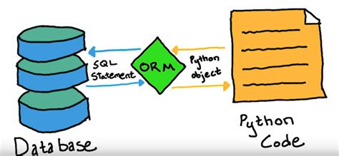
Chapter 3
Models and Database

Slide 2
Objectives
Explain where models and the database fit in Django’s Model–View–Template (MVT) structure.
Create a Django app and a basic model, then use migrations to create its database table.
Predict and inspect how model fields, primary keys, and relationships appear in database tables.
Use Django admin and ORM queries to create, view, and retrieve related records.
Explain how Django models connect Python objects to database records, including the Active Record concepts discussed in class.

Slide 3
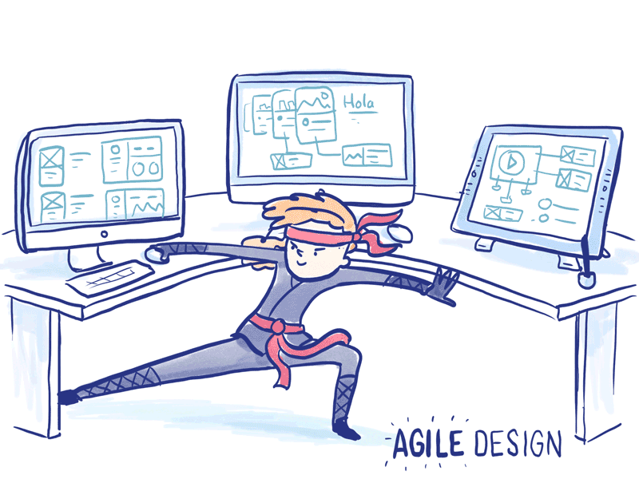
Agile
We will approach developing software with an agile mindset.
This is to guide you on how to create and respond to change and how to deal with uncertainty.
This will introduce you to how industry approaches building software.
What is Agile Software Development?
Agile is like Planning a Road Trip with Friends
Goal/Destination: Agree on where you’re heading.
Flexible Plans: Decide details as you go.
Team Collaboration: Everyone contributes ideas.
Regular Check-ins: Stop often, adjust route if needed.
Deliver in Pieces: Enjoy one stop before moving to the next.
Agile is about flexibility, feedback, and small steps — just like a trip with friends.

Slide 4
What Is Agile Software Development?
Agile is an approach to building software in small, useful steps. Developers plan what to build next, create a working piece, check it, gather feedback, and adjust their plans as they learn.
Agile is not a prescription or one required set of steps.
Teams choose practices that fit their project. What matters is that they:
Focus on what users need
Build and check small pieces of working software
Use evidence and feedback to guide changes
Reflect on how to improve their work
In our portfolio project: We will begin with the Student model, inspect what Django creates, and use what we learn when we add Portfolio and Project. Our plan gives us direction, and our observations help us refine it.

Slide 5
Developer View
User Stories focuses on customer experience (“I want to see… I’m told when…”)
Developer now focuses on implementation details (arrays, methods, return values).
Both are needed: one drives requirements, the other guides coding.
Customer View (plain language)
Story 1: Represent a Book
As a librarian, I want each book to have its details recorded so that I can identify it on the shelf.
Acceptance Criteria:
Each book shows its title, author, and year. When I look up a book, I see its information clearly formatted.
Developer View (technical detail)
Book class with private fields title, author, year.
Constructor sets fields; getters retrieve values.
toString() formats "Title" by Author (Year).

Slide 6
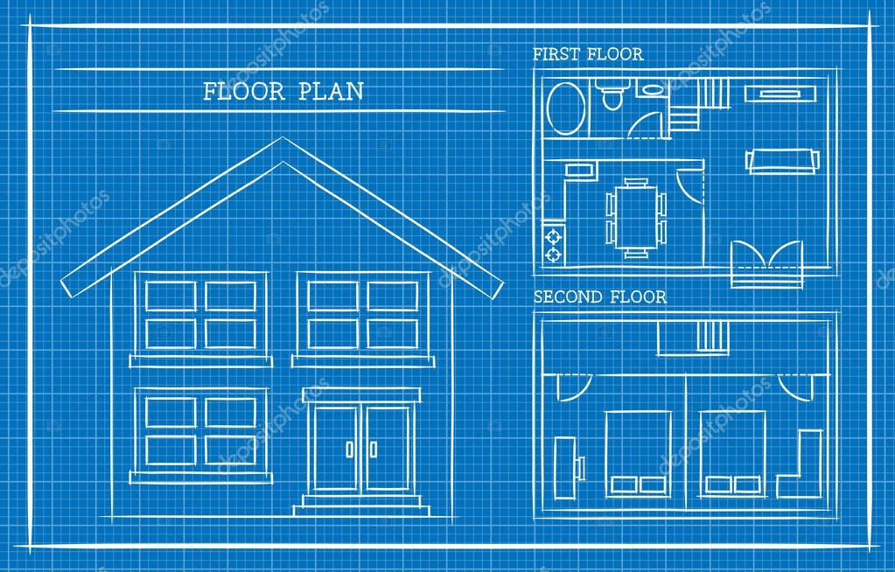

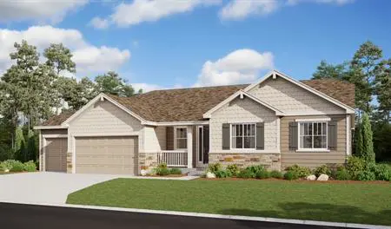

Classes and Objects
A class is a blueprint describing how to build something from the blueprint.
The blueprint is used to build similar houses
An actual house is built with the blue print
  Each house can have different attributes
    Color
    Number of rooms
    Garage Size
    Counter tops
Many houses with same blueprint but different attributes

Slide 7
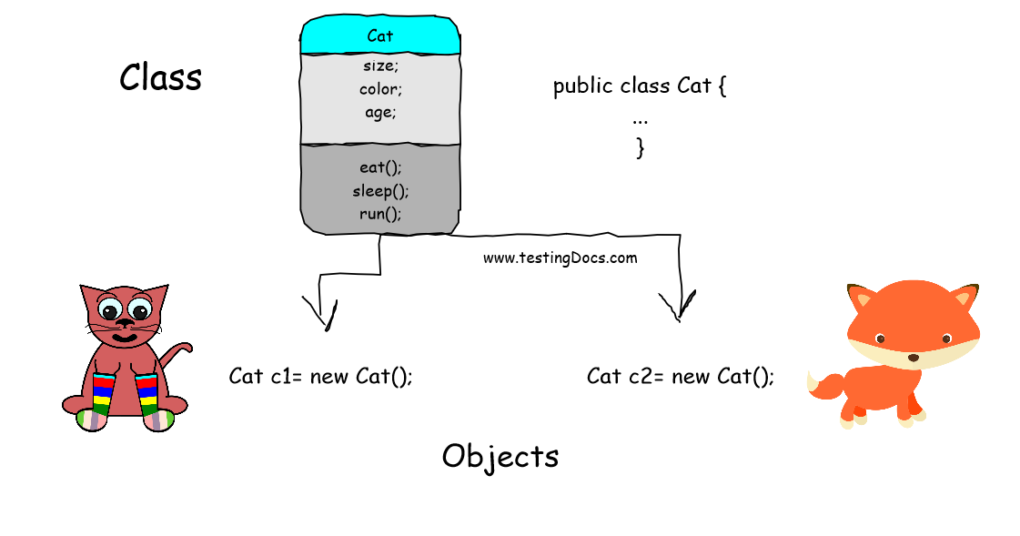
Class
Class: defines an object’s attributes and behaviors – it’s the blueprint
A class is a blueprint for creating objects. It describes the information an object can hold and the actions it can perform. An object is one instance of that class.
In the portfolio lab, Student is a class. Its fields describe the information for a student:

Slide 8
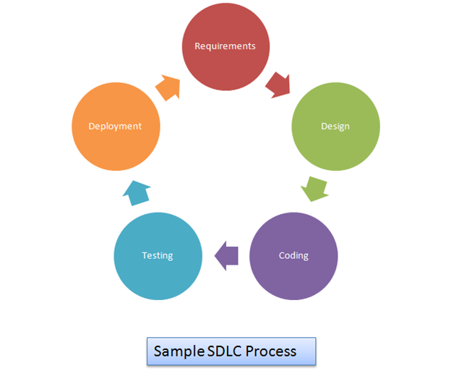
Design Phase
Requirements - What the system must do
Design - How the system will do it
Now it is time to specify the design, that is the structure of how the system will function. How?
Class-Responsibility
  What are the things it knows?
  What are the things it is responsible for doing where it might have to collaborate with other classes
UML (Unified Modeling Language) is a visual language to model the design in OOP systems.

Slide 9
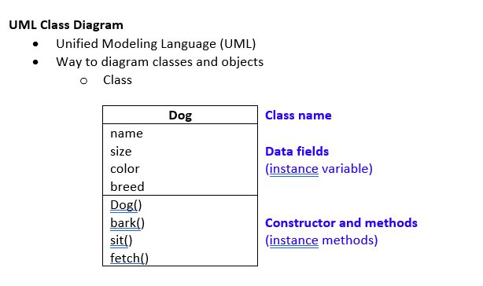
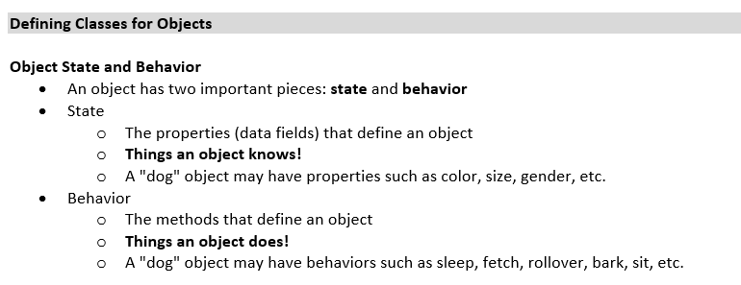
Class Design With UML
UML Class Diagram Tutorial UML is a visual notation for modeling the structure and behavior of OOP.
The class diagram is the most common and what we will use to show the class relationships and important methods.
UML Class Diagram represents
Classes
Fields(class attributes) and methods
Connections between classes

Slide 10
Design Classes
Design classes around real-world things. One job per class keeps design clean.
1. Think in Nouns
A class usually represents a thing in your program (Book, Student, Library).
The class holds the data (fields) and the actions (methods) related to that thing
2. SRP – Single Responsibility Principle
“One class, one job.”
Each class should only do one main thing.
  Book → stores book details.
  Library → manages a collection of books.
If a class tries to do too much, it becomes confusing and hard to test.
3. DRY – Don’t Repeat Yourself
“Write it once, use it everywhere.”
If you see the same code copied in two places, move it into a method or class.
  Example: Calculating late fee for an overdue library book
This makes programs shorter, easier to update, and less error-prone.

Slide 11
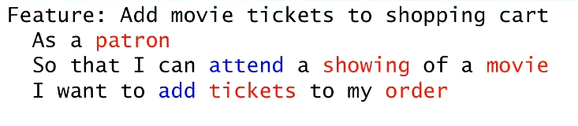
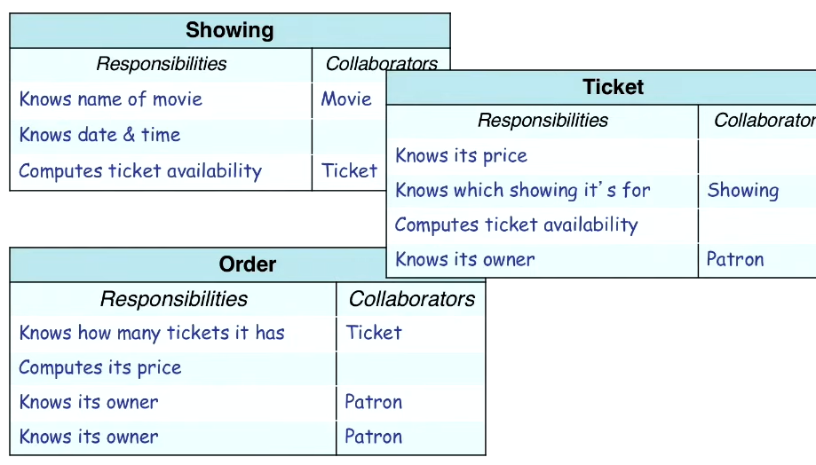
Designing Solution Example
Tickets and showings seem to be classes. How are they related
Showing has many tickets
Ticket has one showing
What class is responsible for the verb attend?
Who is responsible for adding tickets to an order?
This is not 100% perfect but this helps you identify what the main classes are likely to be and verbs as method calls.
This model will evolve as new features are added. Just do the best you can with the information you have.

Slide 12
Portfolio Project Overview
You will build a Django application that stores and eventually displays a student portfolio. A portfolio introduces the student and presents projects that show their skills, interests, and growth. We will build it in stages so you can understand how each part works before adding the next one.
Art of User Stories We will focus on implementing these user stories.
As a student, I want to store my name, email, and major so my portfolio identifies me.
As a student, I want one portfolio connected to my information so my content belongs to me.
As a student, I want to add multiple projects so I can show more than one example of my work.
As a student, I want to review the information I saved so I can check that my portfolio and projects are connected correctly.

Slide 13
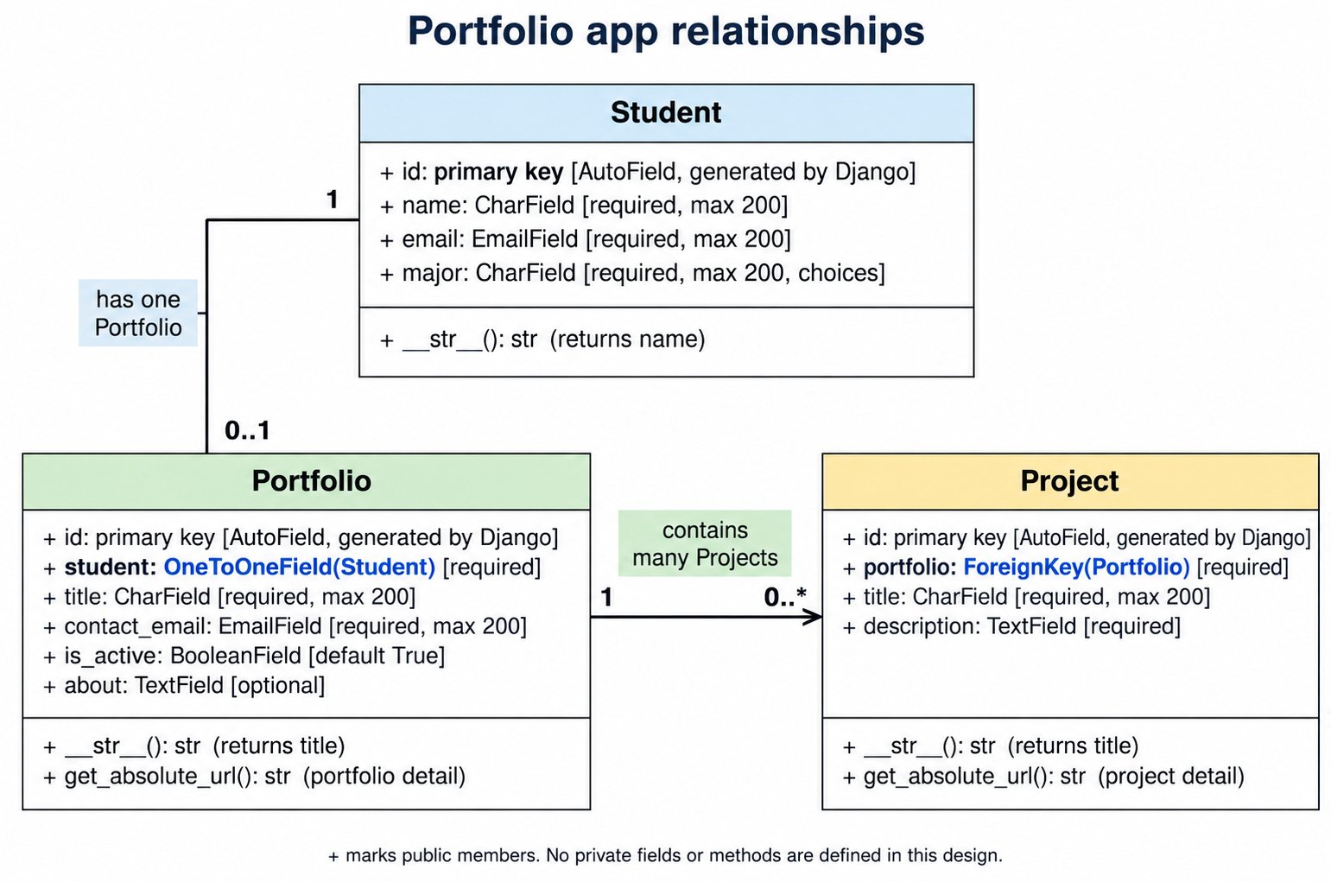
Project Design
This represents the UML design you will implement.
First you will implement the Student model

Slide 14
From User Story to Evidence
A user story states what someone needs and why:
As a student, I want to store my name, email, and major so my portfolio identifies me.
Acceptance criteria describe how we will know that part works. For this week:
The Student model (class) defines name, email, and major.
Django creates a migration for the model.
Applying the migration creates the portfolio_app_student table.
We can identify the model fields and Django’s generated id in the table.
Our process: Predict what should happen, build one piece, inspect the result, and explain what the evidence shows.

Slide 15
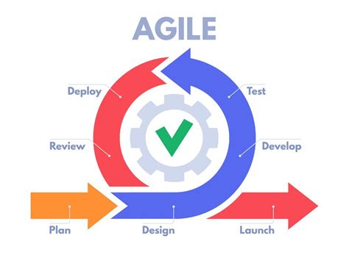
How will we use Agile
Agile software development builds a useful application in small iterations. After each iteration, we check the result, gather feedback, and decide what to improve next.
For our portfolio project:
Create the app and Student model. Check the migration and database table.
Connect Student, Portfolio, and Project. Check the relationships and queries.
Later: Build pages that display the portfolio to visitors.
Each step should leave us with something we can run and inspect. We will use Git commits to record progress and a short reflection to decide what to change next.

Slide 16
Design of Data
The data we will model
Student stores information about the portfolio owner.
Portfolio stores the introduction and other portfolio information. Each student has one portfolio.
Project stores a piece of work the student wants to present. One portfolio can contain multiple projects.
As you build, keep asking:
What did I define in Python?
What did Django create?
Where is the information stored?
How can I verify that the result matches my design?
Those questions will guide your work from the first model through the completed portfolio.

Slide 17
Student Class Model
A class is a blueprint for creating objects. It describes the information an object can hold and the actions it can perform. An object is one instance of that class.
In the portfolio, Student is a class. Its fields describe the information for a student:
Term | Portfolio example
Class | Student, the definition of what student information to store
Object (instance) | One particular student added in admin
Attribute/field | That student’s name or email
Method | __str__(), which returns a readable name for the object

Slide 18
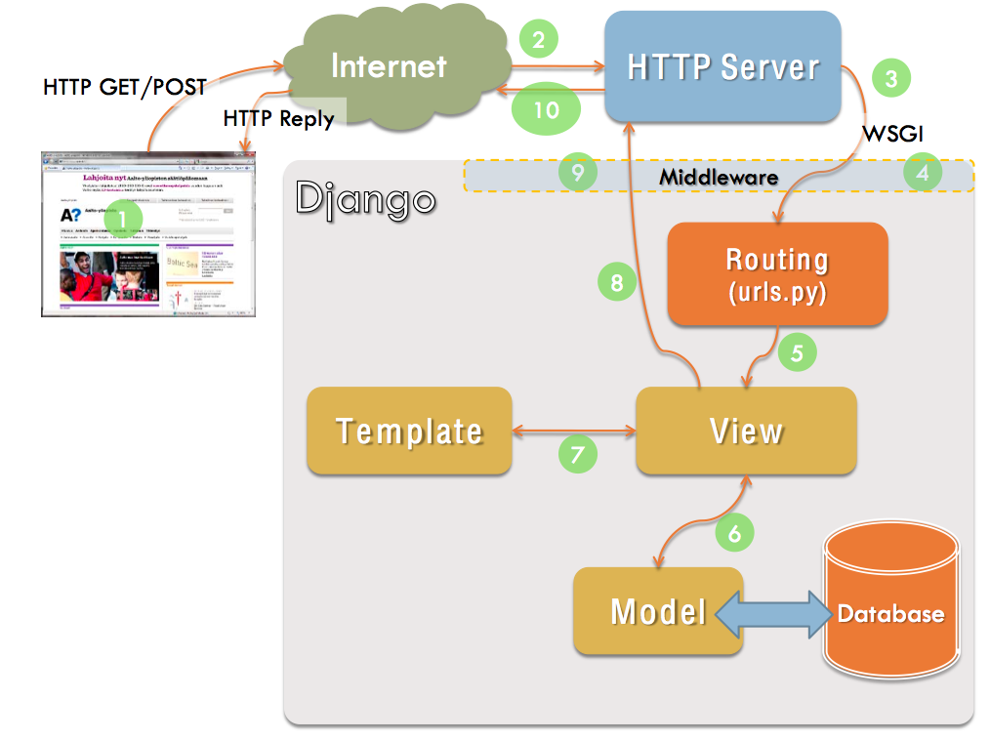
Django Model View Template
Model - Data access layer is the focus of this module.
We will focus on the model and database.
Browser
Data to ORM | Django Component | Explanation
Active Record | Django Models | Django models and ORM use Active Record concept
Identity Field | Model Id Field | Django’s automatic primary key

Slide 19
Lab: Create the Portfolio App
Start Lab: Create the Portfolio App, Student Model, and Admin Login
Complete
Before Starting Sections
Lab steps 1–3:
Check your Django project.
Create portfolio_app and explore the files Django generated.
Connect the app to the project
You will go slowly to understand the commands and what is created. After completing these steps go to the next slides.

Slide 20
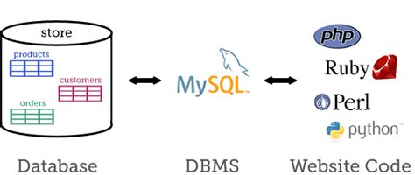
Database
SQLite Sample Database And Its Diagram
A database contains tables and relationship to logically connect and organize information.
https://mywebscribbles.blogspot.com/

Slide 21
How Django Models Connect to the Database
A model is a Python class that describes the information we want to store. In this module, we will create Student, Portfolio, and Project models.
Each model maps to a database table. Each saved object becomes a record.
Django adds an id primary key if we do not define one.
Relationship fields connect records: one Student has one Portfolio, and one Portfolio can have many Projects.
A migration records a change to the model structure. makemigrations creates the migration; migrate applies it to the database.
Django’s ORM lets us work with these records through Python objects, managers, and QuerySets instead of writing SQL for each query.
Connection to design patterns: Django models and its ORM use Active Record concepts. The automatically created id illustrates an identity field. These are the two pattern connections we will examine

Slide 22
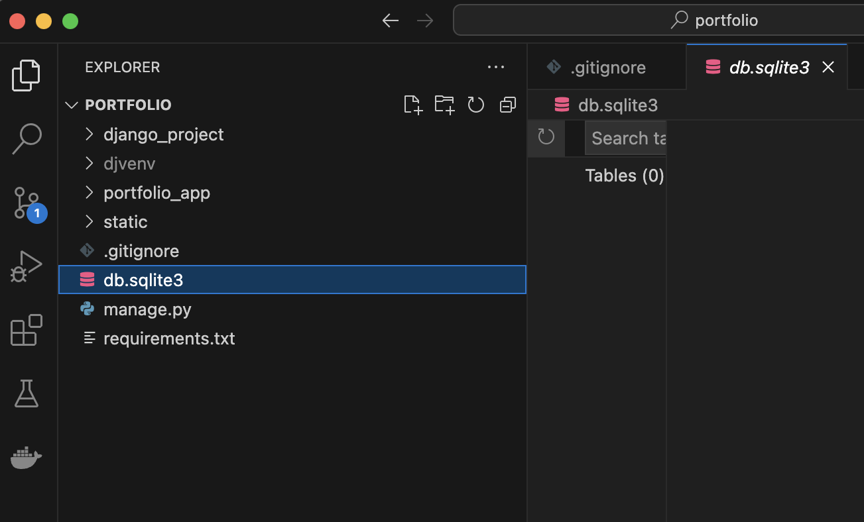
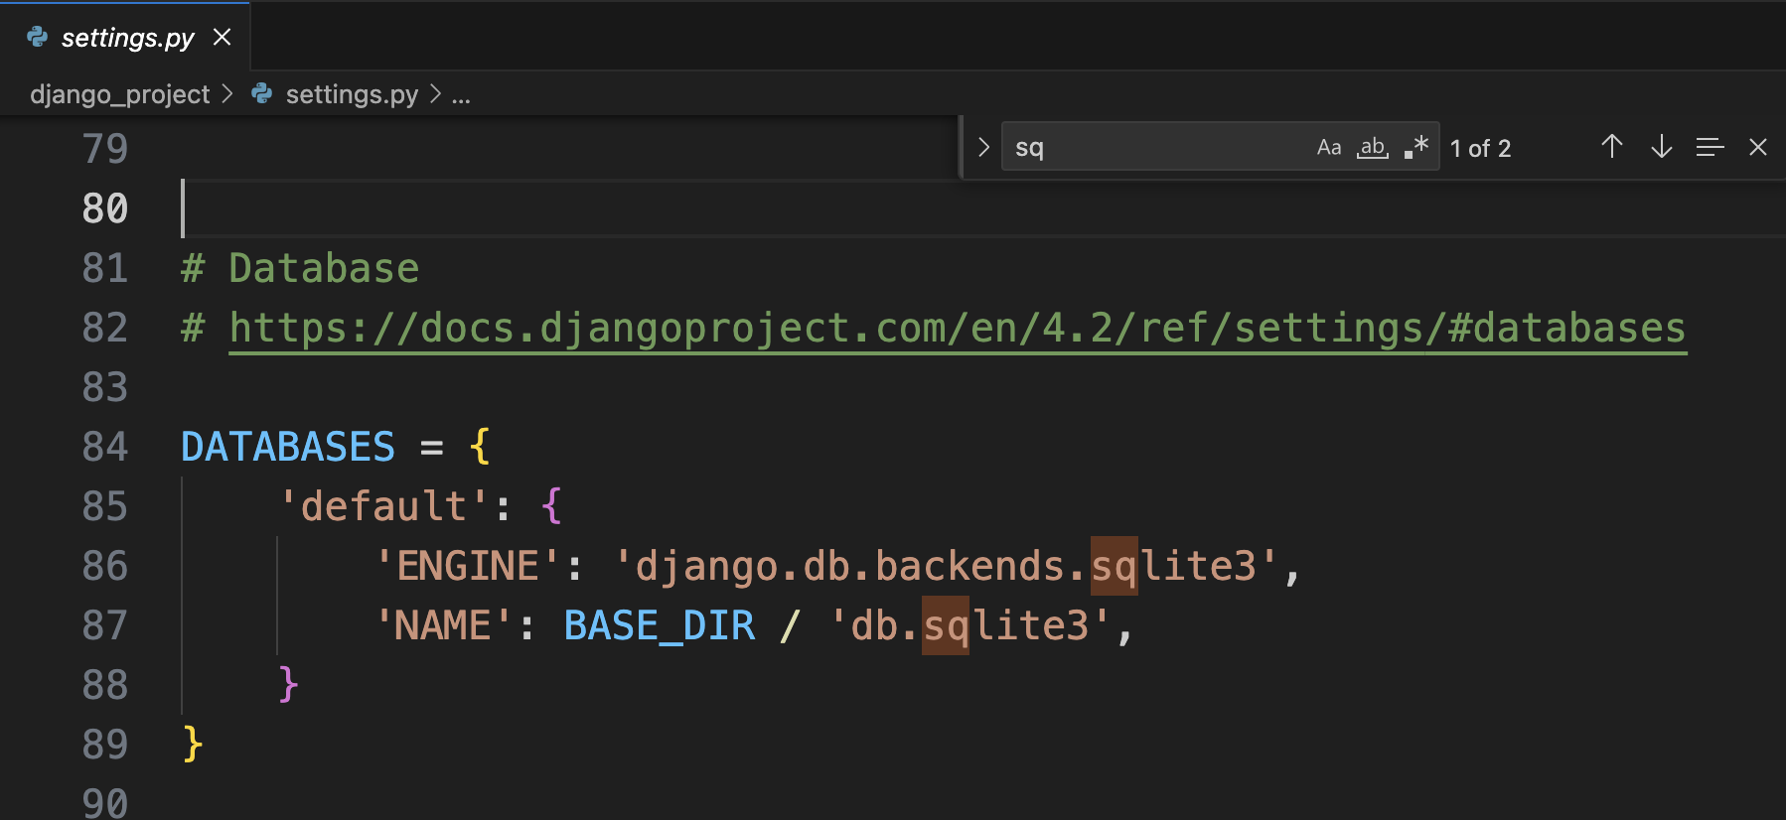
Django Database
You have a default database db.sqlites to use with your django project. This configuration is in the settings.py file.
Currently the database has not been set up.

Slide 23
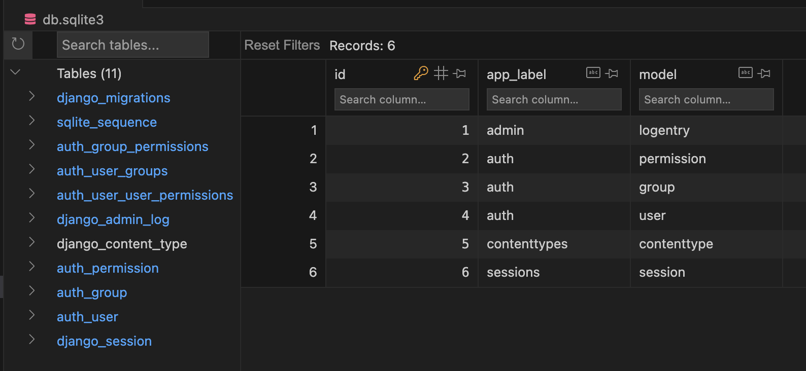
Django Database Migration
Making Django migrations in Python Migrations are Django’s way of propagating changes you make to your models (adding a field, deleting a model, etc.) into your database schema. The command python manage.py migrate will set up the database with the default tables

Slide 24
ORM and Active Record Pattern
Object Relational Mapping is an Architectural Design Pattern
The Active Record and Data Mappers of ORM Pattern
Overview of the Active Record Pattern
“The active record design pattern (considered an architectural pattern) is an approach that connects the application's business logic to a database table, allowing developers to work with the database using an object-oriented paradigm.”
A table in the database represents model
Each row maps to an instance of the object
Each column maps fields of the model for that object

Slide 25
Lab: Create the Portfolio App, Student Model, and Admin Login
Complete Steps 4–5: define Student, predict the table, run migrations, inspect SQLite
Go slowly to to make sense out of the concepts. After completing these steps go to the next slides.

Slide 26
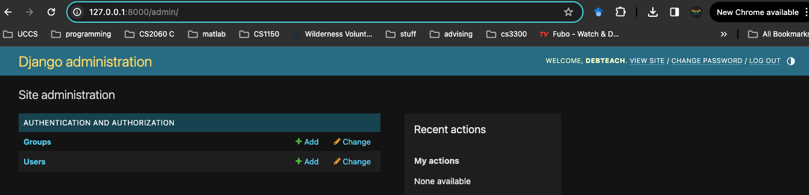
Superuser and Admin Tool
Django Tutorial Part 4: Django admin site
You will create a superuser to access the admin tool.
http://127.0.0.1:8000/admin

Slide 27
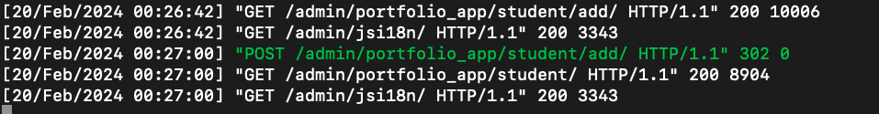
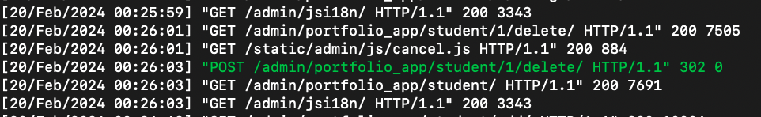
Django Admin App
API that lets you create, retrieve, update and delete objects.
CRUDI
http://127.0.0.1:8000/admin/portfolio_app/student/2/change/
http://127.0.0.1:8000/admin/portfolio_app/student/2/delete/
http://127.0.0.1:8000/admin/portfolio_app/student/
Notice URI for admin web app
Notice log for server

Slide 28
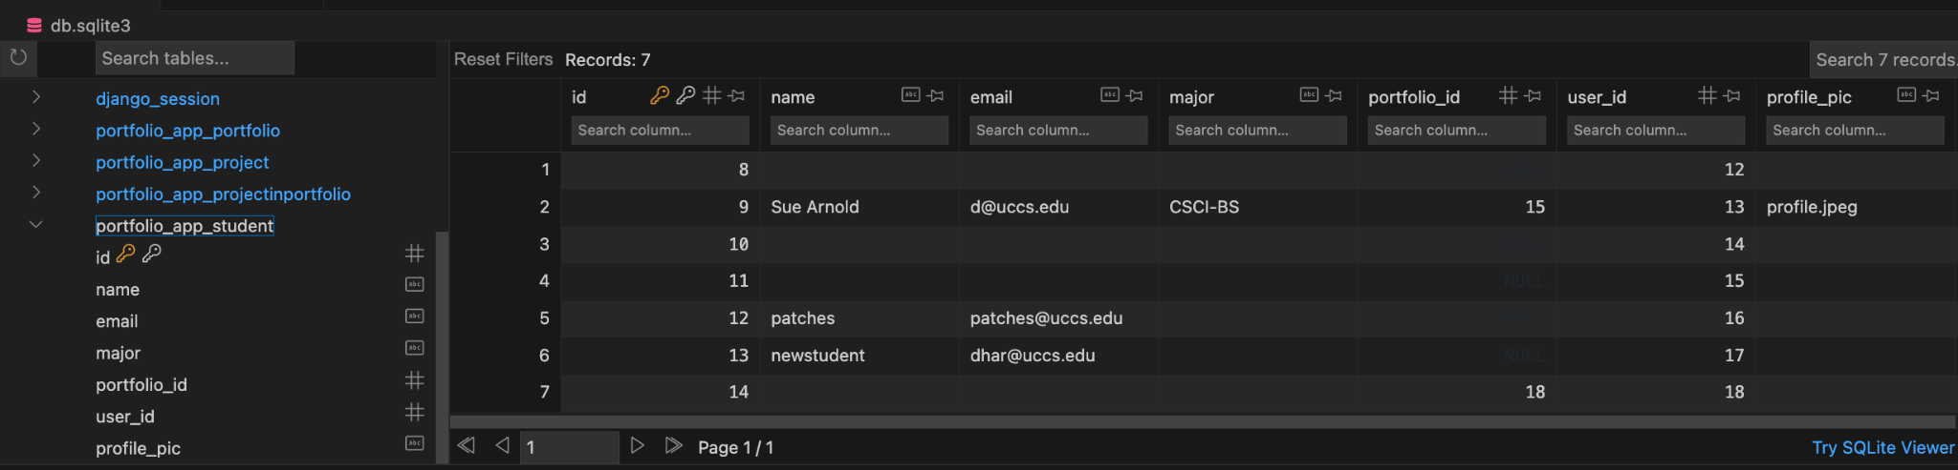
Active Record Applied in Django
Django ORM implements concepts from Active Record Pattern
A database table is wrapped in a class
The model maps to a database table
Notice the id field that was created but is not listed in the class. Why is an id needed?

Slide 29
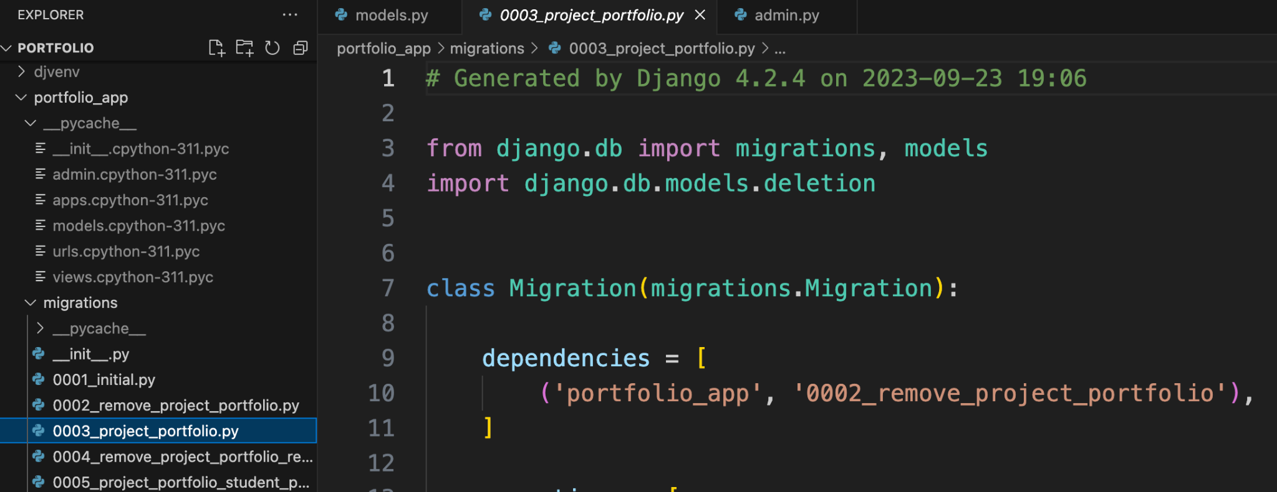
Migrations
Every Migration is tracked in Django.

Slide 30
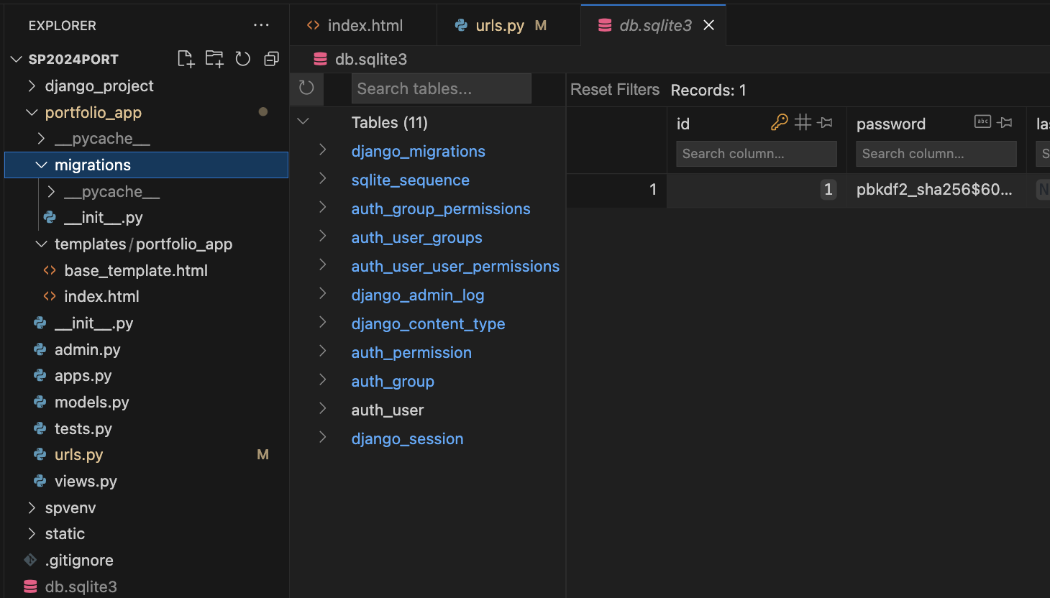
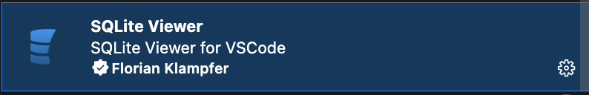
Migrations
What is a Database Schema?
Database Migrations: What are the Types of DB Migrations?
https://developer.mozilla.org/en-US/docs/Learn/Server-side/Django/skeleton_website#running_database_migrations
  python3 manage.py migrate, which is responsible for applying and unapplying migrations.
  python3 manage.py makemigrations which is responsible for creating new migrations based on the changes you have made to your models.
Every migration is tracked
user
Extension for view database
List of django tables for handling different users and permissions

Slide 31
Database Issue
You can use the admin tool to delete information from database. Don’t worry if the database gets messed up as this happens when developing an app and working with a database. That is why you have a local database associated with your own development environment.
If your database is not working: Save the error message and ask for help before running flush, deleting db.sqlite3, or changing migration files. We will choose the recovery steps based on the error.
Goal | Command | Result
Clear all records but keep the tables | python manage.py flush | Deletes Student records and the superuser. Migrations remain applied; migrate usually has nothing to do.
Rebuild a broken local SQLite database | Delete db.sqlite3, then run python manage.py migrate | Recreates the tables from migration files. Records and the superuser must be created again.

Slide 32
Lab: admin and identity field
Complete Steps 6–7: create the superuser, register Student, add two records, inspect their IDs

Slide 33
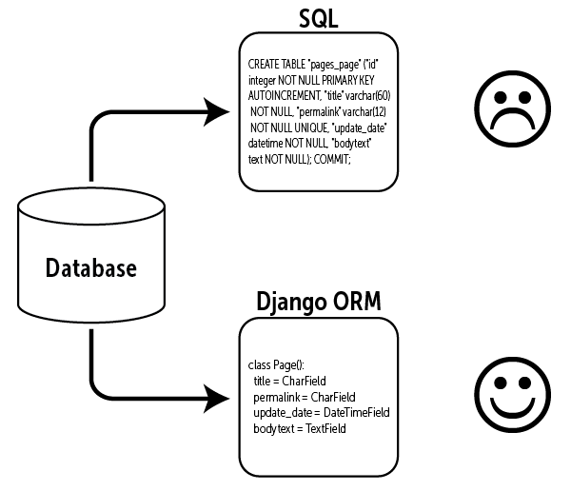
Django ORM
Models, Database and Queries

Slide 34
What does the ORM do?
A database stores information in tables. In this project, the Student model corresponds to the portfolio_app_student table. Each Student object represents a record (row), and fields such as name and major correspond to columns.
The Django ORM (Object-Relational Mapper) lets us work with those records using Python. Django translates ORM queries into SQL, the language the database understands.
SQLBolt - Learn SQL - SQL Lesson 1: SELECT queries 101
SQLBolt - Learn SQL - SQL Lesson 2: Queries with constraints (Pt. 1)
Django ORM query | What it asks for | SQL idea
Student.objects.all() | All Student records | SELECT ... FROM portfolio_app_student
Student.objects.filter(major="CSCI-BS") | Students with this major | SELECT ... WHERE major = 'CSCI-BS'
Student.objects.count() | Number of Student records | SELECT COUNT(*) ...
Student.objects.first() | The first Student record | SELECT ... LIMIT 1

Slide 35
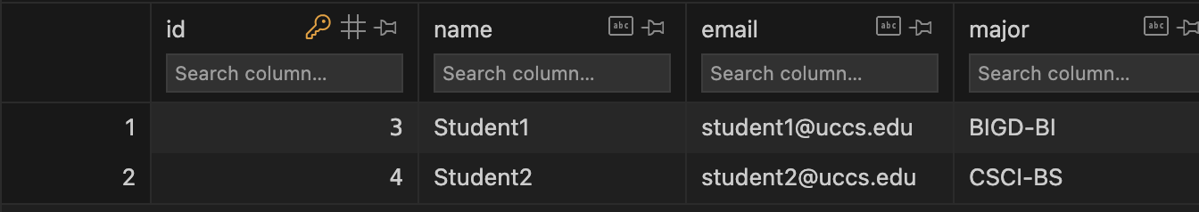
Django Model Manager and QuerySet API
Once you create the data models Django provides the model manager to query the database using QuerySet API.
Django operation to perform query
using model class
Student.objects.all()
model
Default manager for every model
QuerySet API method
SQL query
select * from student

Slide 36
Python Shell
You can use the python shell to perform commands to see how they work. Here we will define a collection of objects from the database.
Start python shell: python manage.py shell
>>> from portfolio_app.models import Student
>>> queryset = Student.objects.all()
>>> print(queryset)
<QuerySet [<Student: Student1>, <Student: student 2>]>
>>> from django.db import connection
>>> print(connection.queries)
[{'sql': 'SELECT "portfolio_app_student"."id", "portfolio_app_student"."name", "portfolio_app_student"."email", "portfolio_app_student"."major", "portfolio_app_student"."portfolio_id" FROM "portfolio_app_student" LIMIT 21', 'time': '0.001'}, {'sql': 'SELECT "portfolio_app_student"."id", "portfolio_app_student"."name", "portfolio_app_student"."email", "portfolio_app_student"."major", "portfolio_app_student"."portfolio_id" FROM "portfolio_app_student" LIMIT 21', 'time': '0.000'}]
Import model and then retrieve all objects and store them in queryset.
Print to see the objects returned.
Import connection allows you to view the query that was generated from the model action

Slide 37
Filter to Query
>>> queryset = Student.objects.filter(name = "Student1")
<QuerySet [<Student: Student1>]>
>>> print(queryset[0])
Student1
>>> print(queryset[0].major)
BIGD-BI

Slide 38
Lab: ORM and SQL
Complete Steps 10: query the records and inspect print(students.query)
Steps 8–9 and 11: complete the observations, commit and push, then write the summary

Slide 39
From Model to Database Query
We defined Student as a Python class with fields.
makemigrations created a migration file describing the change.
migrate applied that change to SQLite, creating the portfolio_app_student table.
We used the admin to create Student records.
We used the Django ORM to query those records. Django translated the query into SQL.

