Slide 1

Sreenivasa Institute Of Technology And Management Studies , chittoor
Whatsapp Individual Chat Analysis Using Machine Learning
Guide:
Mrs.R.karunia Krishnapriya
M.Tech
Department of CSD
By:
V Mohan-21751A3249

Slide 2
Abstract
Analyzing WhatsApp chats with machine learning helps us understand how people talk, feel, and interact over time.
We first clean up and organize the chat data.
Then, we figure out important stuff like what words are used most and how people express their feelings.

Slide 3
Abstract
Machine learning helps us sort messages, find common topics.
We use graphs and charts to see trends, and fancy tools help us understand feelings better.
It's important to be respectful and get permission to look at the chats.

Slide 4
Table content
SL NO TITLE
1 Introduction
2 Literature Survey
3 Project Description
4 Modules
5 Result & Discussion
6 Conclusion & Future work
7 References

Slide 5
Introduction
Overview:
In the modern era, instant messaging platforms like WhatsApp have become integral to daily communication, playing a crucial role in personal, social, and professional interactions.
This project explores the use of machine learning techniques to analyze individual WhatsApp chats.
This system can process chat data to identify trends such as message frequency, common words, and overall sentiment.
The primary goal of this analysis is to offer a deeper understanding of communication habits and the emotional tone within conversations.

Slide 6
Introduction
Machine Learning:
Machine learning aids WhatsApp chat analysis by categorizing sentiments, identifying topics.
Through algorithms like sentiment analysis and topic modeling, machine learning uncovers patterns, sentiments.
Sentiment Analysis:
Machine learning algorithms are employed to determine the emotional tone of messages, categorizing them as positive, negative, or neutral.
This helps in understanding the overall sentiment of conversations.

Slide 7
Introduction
Existing System:
  Raw data
  Time consuming
  Difficult to Analyze
  Analysis is not Accurate
      Proposed System :
        Shows different visualization
        Total messages in the chat
        Monthly timeline
        Use simple modules
        Emoji’s count

Slide 8
Objective
The objective of this project is to utilize machine learning techniques to analyze individual WhatsApp chat data, aiming to extract meaningful insights into communication patterns, sentiments, and key topics.
This analysis seeks to enhance understanding of user interactions, inform strategic decision-making, and identify potential applications in fields such as psychology, marketing, and social network analysis.
Another objective is to develop and implement efficient data processing algorithms that can accurately parse and interpret WhatsApp chat files, ensuring the seamless extraction and organization of relevant information for subsequent machine learning analysis.

Slide 9
Literature Survey
Content Analysis:
Studies often analyze the linguistic content of WhatsApp messages to understand communication styles.
  Reference : Nuruzzaman, M., & Hussain, O. K. (2021). "Analyzing speech acts in WhatsApp conversations using natural language processing." *Journal of Computational Social Science*, 4(2), 115-131.
Text Mining:
Techniques such as Natural Language Processing (NLP) and machine learning are applied to extract meaningful patterns from chat data. This includes sentiment analysis, topic modeling, and clustering.
Reference: Gupta, S., & Arora, S. (2021). "Sentiment analysis of WhatsApp messages using deep learning techniques." *Journal of Information and Optimization Sciences*, 42(6), 1251-1264

Slide 10
Project Description
System Specification:
Software Requirements:
      • IDE: Jupyter Notebook , Spyder, vs code
      • Programming Language : Python
      Hardware Requirements:
      SSD:512
      RAM:8GB

Slide 11
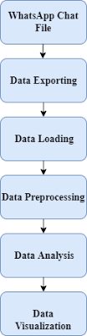
Project Description
System architecture of entire System

Slide 12
Project Description
Gather WhatsApp chat data from individual users, ensuring compliance with privacy regulations and obtaining consent.
Clean and preprocess the chat data, including tasks like tokenization, removing stop words, and stemming to prepare it for analysis.
Utilize machine learning algorithms to analyze the emotional tone of messages, categorizing them as positive, negative, or neutral.
Visualize the results of the analysis through graphs and charts, providing insights into communication patterns and sentiment dynamics for further interpretation and action.

Slide 13
Modules
The whatsapp individual chat analysis consist of six modules. They are:
Whatsapp Chat File
Data Exporting
Data Loading
Data Preprocessing
Data Analysis
Data Visualization

Slide 14
Modules
Whatsapp Chat File:
In WhatsApp individual chat analysis, the WhatsApp chat file serves as the primary source of data.
Understanding its format is crucial, typically structured in plain text or CSV format, containing details such as message content, timestamps, and participant identities.
Data Exporting:
Exporting data from WhatsApp involves accessing the chat you want to export, tapping on the three dots in the top-right corner.
selecting "More," then "Export chat."
You can choose to include media or export without media, and select the desired platform or method for sharing or saving the exported chat file.

Slide 15
Modules
This process allows users to archive or analyze their conversations outside of the WhatsApp platform.
Data Loading:
In WhatsApp individual chat analysis, data loading is the initial step where we gather the chat logs or messages from the application.
In Python, you can use the `open` function to read the text file and process the chat data for further analysis or manipulation.
Data Preprocessing:
Data preprocessing in WhatsApp individual chat analysis involves cleaning and preparing the collected chat data for further analysis.
. Data preprocessing ensures that the chat data is uniform, structured, and ready for meaningful analysis, enabling insights into communication patterns and behaviors.

Slide 16
Modules
Data Analysis:
In WhatsApp individual chat analysis, data analysis is crucial for uncovering meaningful insights from the messages exchanged between users.
Apply various methods of analysis to understand the content, sentiments, and patterns within the messages.
This analysis may involve identifying common words or phrases, detecting emotional tones, categorizing messages based on their purpose (like questions, statements, or requests), and exploring how users interact over time
Data visualization:
Through data visualization, we transform raw chat data into meaningful and easy-to-understand visual representations, such as graphs, charts.
These visualizations help uncover trends, patterns, and insights within the chat data, allowing us to identify communication dynamics, sentiment trends, and user behaviors at a glance

Slide 17
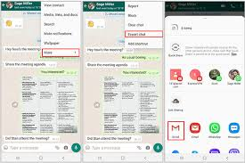
Results And Discussion
Export data from whatsapp:
To get a WhatsApp chat from a contact, open WhatsApp, navigate to the contact's chat, and use the "Export Chat" feature from the chat settings.
You can choose to include or exclude media files in the export.

Slide 18
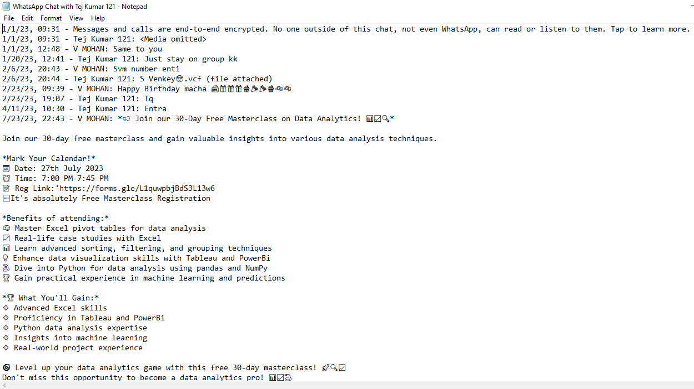
Results And Discussion
Whatsapp text file:
A WhatsApp chat file typically contains the history of conversations between users, saved in a text format (.txt) or a backup format (.crypt12). It includes messages, timestamps, and sometimes media links, allowing users to review past chats.

Slide 19
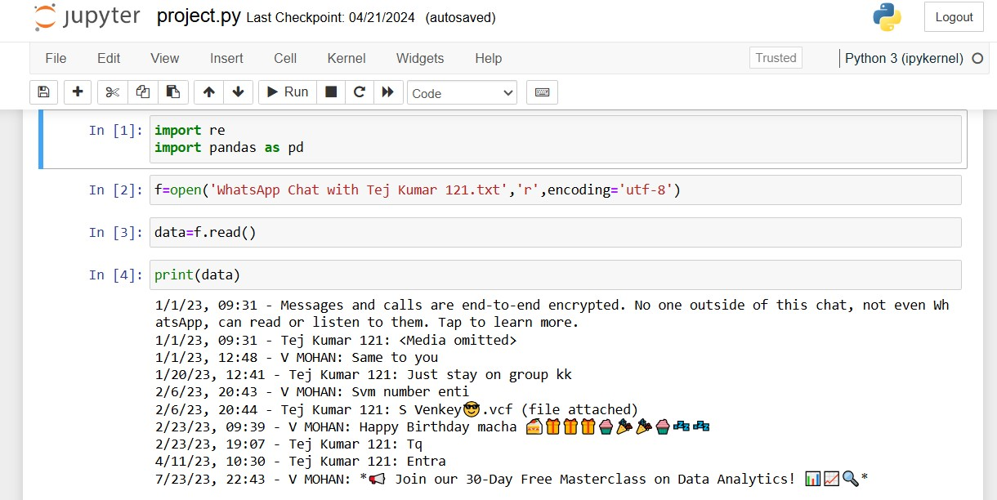
Results And Discussion
Data loading:
To load WhatsApp chat data into a program, first export the chat from WhatsApp by opening the chat, going to the chat settings, and selecting "Export Chat" (with or without media).
This will generate a text file, usually in .txt format.
In Python, you can use the `open` function to read the text file and process the chat data for further analysis or manipulation.

Slide 20
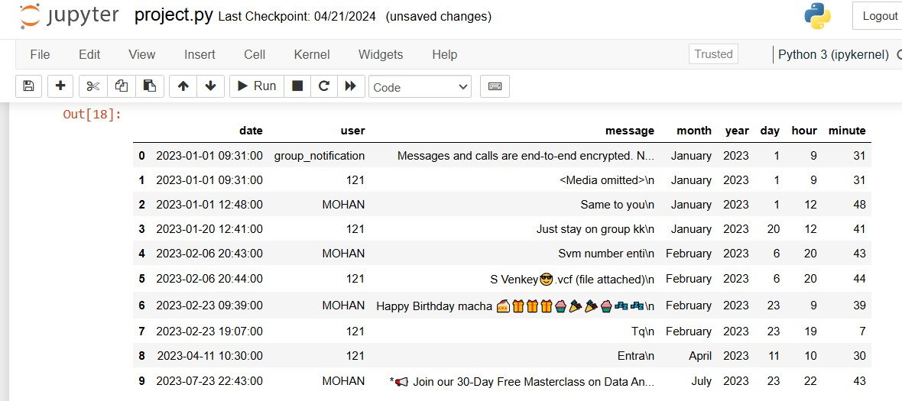
Results And Discussion
Data preprocessing :
Data preprocessing in WhatsApp individual chat analysis involves cleaning and preparing the collected chat data for further analysis.
This includes steps such as removing noise and irrelevant information.
Data preprocessing ensures that the chat data is uniform, structured, and ready for meaningful analysis, enabling insights into communication patterns and behaviors.

Slide 21
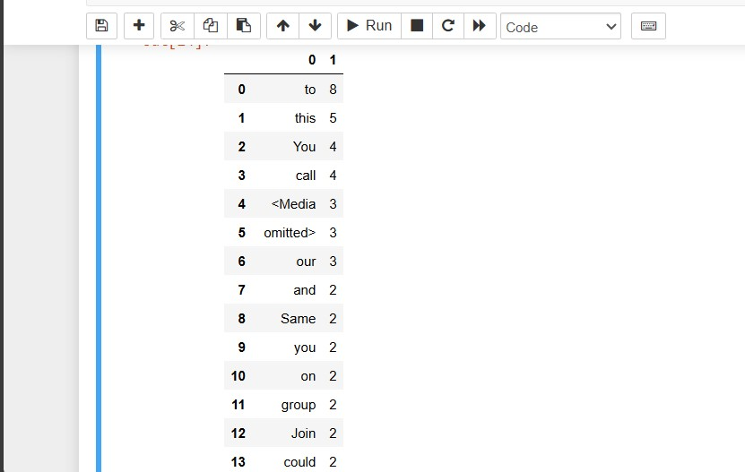
Results And Discussion
Count number of words:
Counting the number of words in WhatsApp individual chat analysis refers to quantifying the total number of words present in the messages under consideration.
This process is a fundamental step in analyzing textual data and provides valuable insights into communication patterns, language usage, and message complexity.
By determining the word count, researchers can assess various aspects of communication, such as the length of conversations, the verbosity of participants, and the richness of vocabulary.

Slide 22
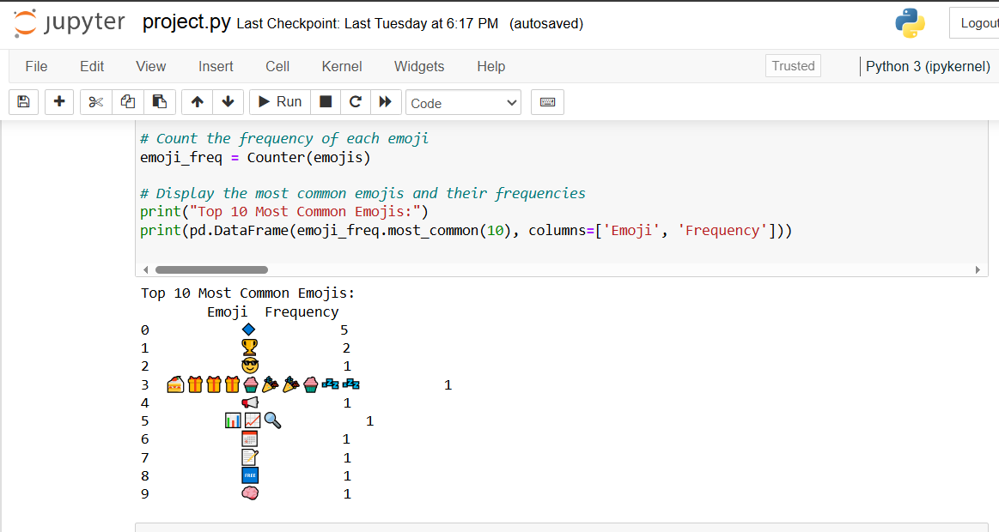
Results And Discussion
Count no of emojis:
To count the number of emojis in a WhatsApp chat file, you can parse the text and use regular expressions or specific libraries to identify and tally emoji characters.
This involves scanning each message for emoji characters and incrementing a counter for each occurrence.
Some programming languages offer built-in functions or libraries to simplify this process, making it efficient to extract and count emojis from the chat data.

Slide 23
Results And Discussion
Data visualization:
Data visualization in WhatsApp individual chat analysis involves transforming textual data into visual representations to identify patterns and insights effectively.
Techniques such as word clouds highlight frequently used words, while time series plots track message frequency over time.
Heatmaps visualize interaction intensity between users, and pie charts display the distribution of message types.
Through these visualizations, researchers can derive actionable insights from WhatsApp chat data, enabling informed decision-making and communication strategy refinement.

Slide 24
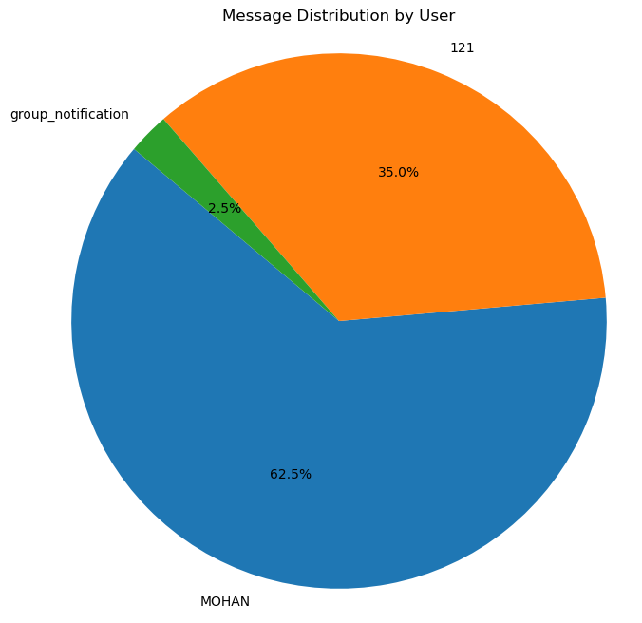
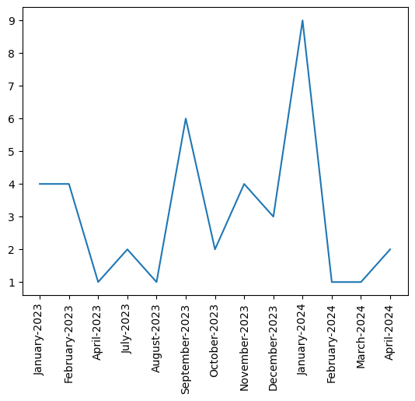
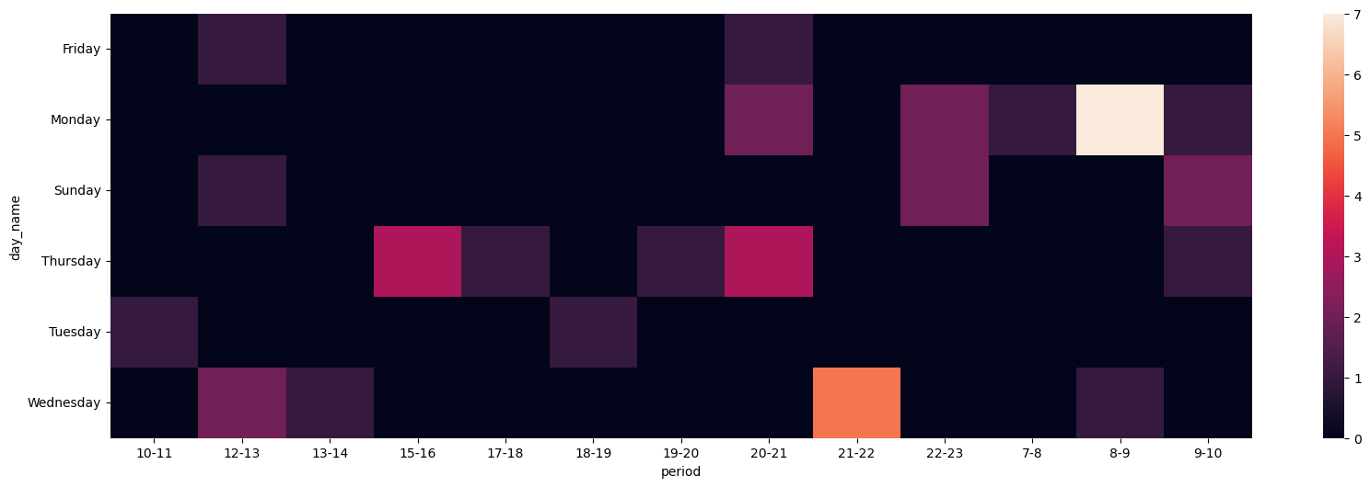
Results And Discussion

Slide 25
Conclusion And Future Work
Conclusion:
In conclusion, analyzing individual WhatsApp chats using machine learning provides valuable insights into communication patterns and user sentiment, offering practical applications across various domains.
By harnessing advanced algorithms, this approach enhances our understanding of human interactions and facilitates data-driven decision-making in diverse contexts.
In summary, leveraging machine learning for WhatsApp chat analysis offers a nuanced understanding of human communication dynamics, guiding personalized experiences and strategic decision-making.
This approach transforms raw chat data into actionable intelligence, enriching our comprehension of digital interactions.

Slide 26
Conclusion And Future Work
Future Work:
Future work could focus on refining sentiment analysis algorithms to better capture nuanced emotions and exploring the integration of chat analysis with broader contextual data for more comprehensive insights.
Additionally, advancements in natural language processing could enable deeper understanding of slang, sarcasm, and cultural nuances in WhatsApp conversations.

Slide 27
Conclusion And Future Work
Further research may involve developing algorithms to identify emerging trends and predict future communication patterns in WhatsApp chats, aiding in proactive decision-making and trend analysis.
Additionally, exploring the use of machine learning techniques to enhance chat privacy and security measures could be an important avenue for future investigation.

Slide 28
References
Nuruzzaman, M., & Hussain, O. K. (2021). "Analyzing speech acts in WhatsApp conversations using natural language processing." *Journal of Computational Social Science*, 4(2), 115-131.
Gupta, S., & Arora, S. (2021). "Sentiment analysis of WhatsApp messages using deep learning techniques." *Journal of Information and Optimization Sciences*, 42(6), 1251-1264
Marada Pallavi ,Meesala Nirmala, modugapurapu Sravani, Mohammad Shameem, Dr.K.Soumya “What’s app Chat Analysis” International Research Journal of Modernisation in Engineering Technology and Science Volume: 04/Issue:05/may/2022
Mothe Vikas Reddy, Arvapelly Ashith, Vunnam Harish, Prithviraj goud “What’s app chat analysis and spam message detection” journal of Emerging technologies and innovative research Volume 10/Issue: march/2023
Dr.T.Siva ratna sai ,T.naga nandini, M.Harshavardhan, B.Balaji, R.Sai kalyan “chat analysis on What’s app using Machine Learning” Journal of Engineering sciences Volume:14/Issue:04/2023

Slide 29
References
Ravishankara K, Dhanush, Vaisakh, Srajan I S ” What’s app Chat Analyzer” International Journal of Engineering Research & Technology (IJERT) Vol. 9 Issue 05, May-2020
Aditya Jadhav , Suraj Patil , Mujtaba Shaikh , Prajwal Pal , Prof. Aparna Sawant , Prof. Pankaj Kunekar “What’s app Chat Sentiment Analyzer” Value: 45.98; SJ Impact Factor: 7.538 Volume 10 Issue XII Dec 2022- Available at www.ijraset.com.
Nuruzzaman, M., & Hussain, O. K. (2021). "Analyzing speech acts in WhatsApp conversations using natural language processing." *Journal of Computational Social Science*, 4(2), 115-131.
Alshehri, F., Al-Khalifa, H. S., & Al-Salman, A. S. (2020). "Towards automated analysis and classification of emotions in WhatsApp status." *Procedia Computer Science*, 170, 1012-1019.
Gupta, S., & Arora, S. (2021). "Sentiment analysis of WhatsApp messages using deep learning techniques." *Journal of Information and Optimization Sciences*, 42(6), 1251-1264.

Slide 30
THANK YOU

