Slide 1
BankSight: Transaction Intelligence Dashboard

Slide 2
I created an Environment called TRA

Slide 3
Inside TRA I created the Folder and files
data
Database
App.py file

Slide 4
TRA Environment
In My environment what are the requirements need below one’s I installed
Streamlit
Pandas
Numpy
Plotly
Pillow

Slide 5
Data Folder : Is nothing but the Data Set
1) Customers Dataset
2) Account Balances Dataset
3) Transactions Dataset
4) Loans Dataset
5) Credit Cards Dataset
6) Branches Dataset
7) Support Tickets Dataset
Next I will up to the image for reference pupouse

Slide 6
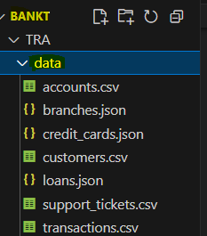

Slide 7
Scripts Folder
1) 1_data_preparation.py
2) 2_database_setup.py
3) sql_queries.py
4) __init__.py

Slide 8
App.py (Main Streamlit Application)code

Slide 9
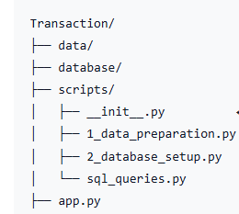
Structure

Slide 10
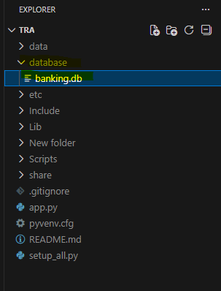
Database: banking.db

Slide 11
In the Scripts Folder I created files called
Data_Preparation.py
Database_setup.py
Sql_quires.py
Below I attached the image

Slide 12
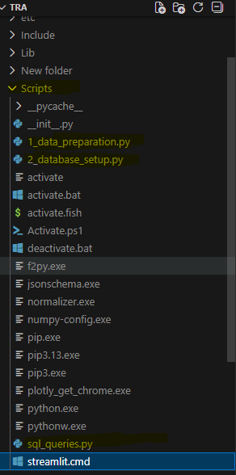

Slide 13
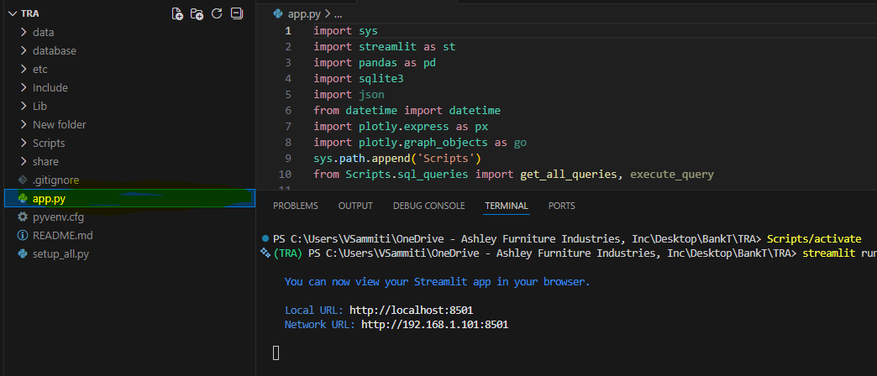
I created app.py file

Slide 14
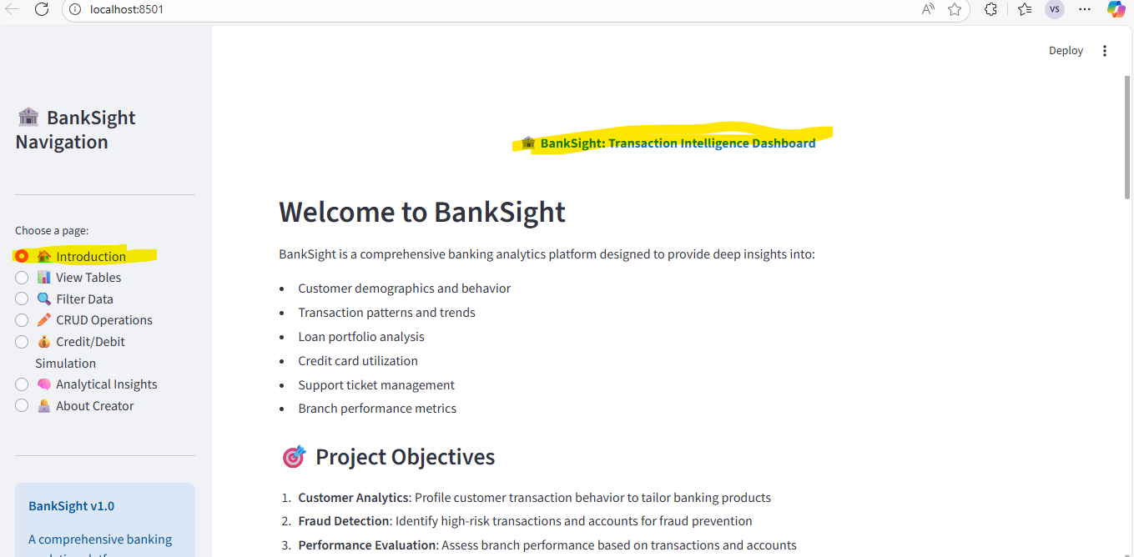
Out Put

Slide 15
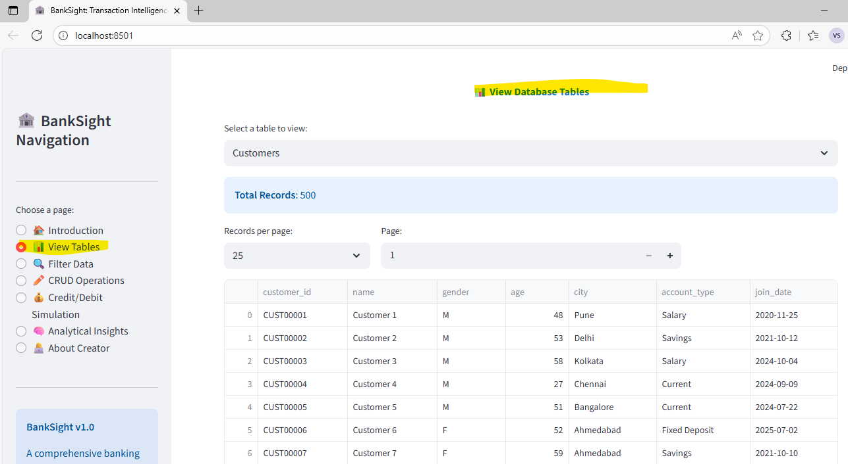

Slide 16
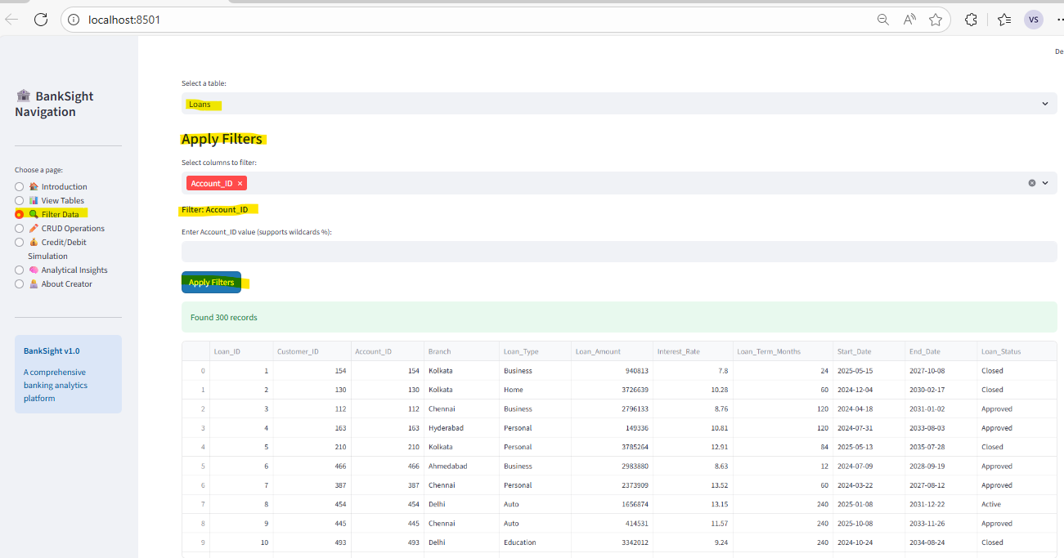

Slide 17
