Slide 1
Easy Web Service on iOS with Pico
-by William http://bulldog2011.github.com/

Slide 2
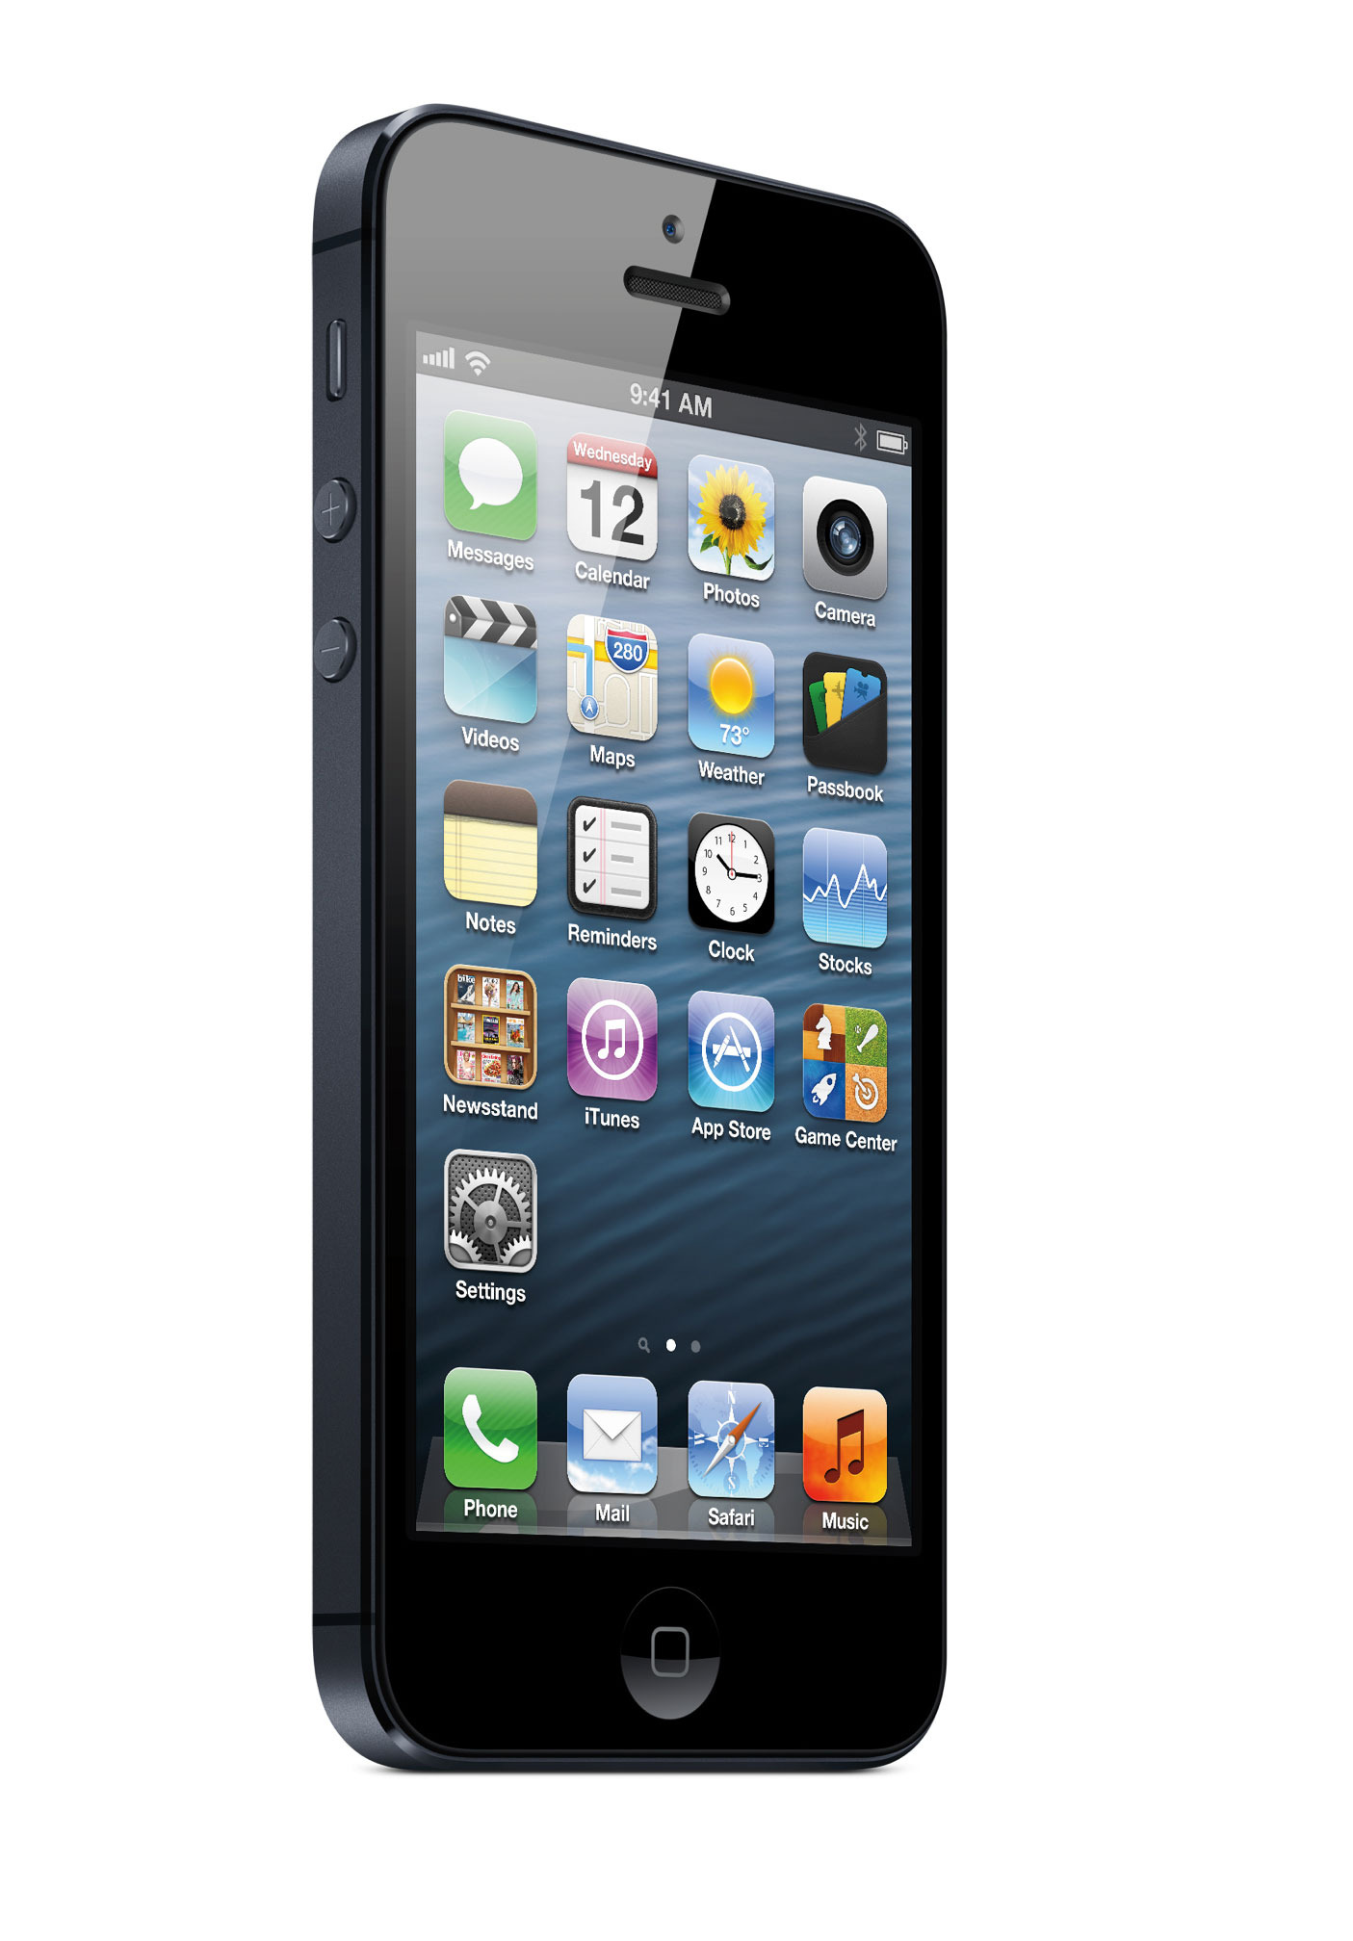
Problem Domain
There is a gap between iOS device and traditional SOAP/XML based web service
SOAP/XML Web Service

Slide 3
Pico to Fill the Gap
Pico is a light client-side web service framework tailored for iOS platform.
Feature Highlight:
Support WSDL driven development, auto-generate proxy from WSDL,
Support SOAP 1.1/1.2 and XML based Web service,
Automatic XML to Objective-C binding,
Built on popular and mature AFNetworking library,
Verified with Industrial grade Web Services like Amazon and eBay Web Services,
Asynchronous service invocation, flexible HTTP/SOAP header, timeout, encoding setting, logging, etc.

Slide 4
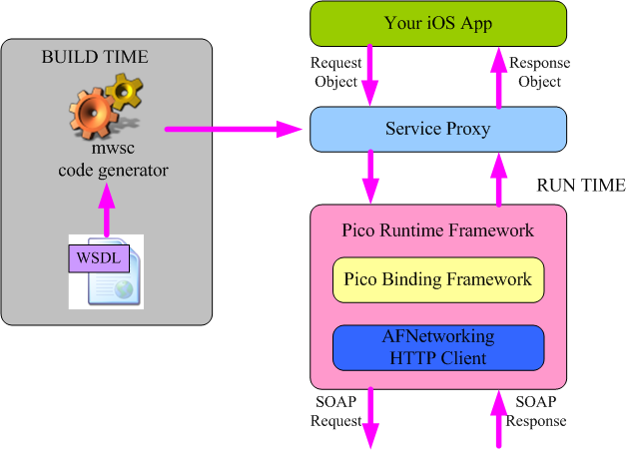
The Big Picture

Slide 5
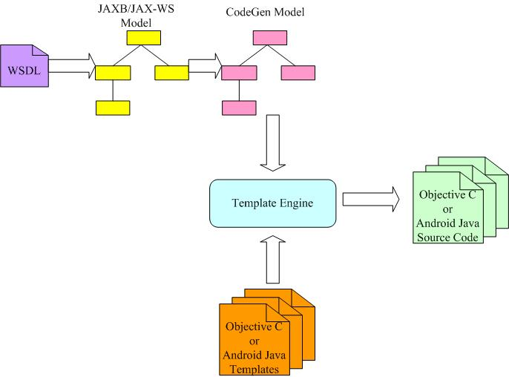
Code Generation from WSDL

Slide 6
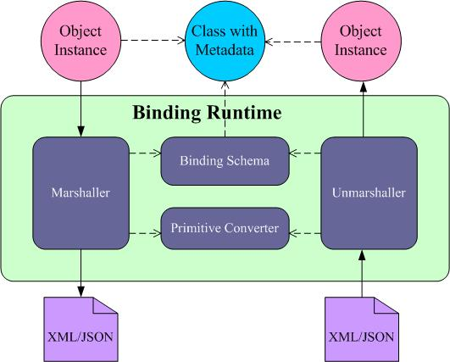
Automatic XML<>Object Binding

Slide 7
WSDL Driven Dev Flow on iOS
Generate Objective-C proxy from WSDL,
Create new iOS project, add Pico runtime and generated proxy into the project,
Implement application logic and UI, call proxy to invoke web servie as needed.

Slide 8

Simple Service Invocation Paradigm
Invoke service with:
Request object
Success callback for success handling logic
Failure callback for failure handling logic

Slide 9
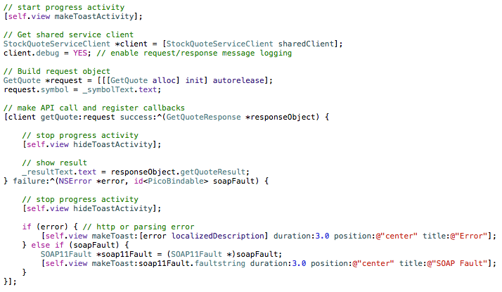
A Service Call Sample

Slide 10

Demo 1 – Currency Converter

Slide 11

Demo 2 – Amazon Book Finder
Amazon Product Advertising
API used:
itemSearch for book search
cartCreate to add chosen book into shopping cart

Slide 12
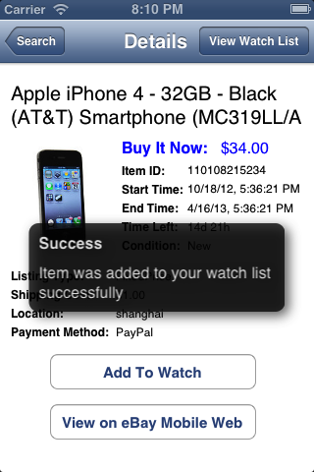
Demo 3 – eBay Demo App
eBay Finding API used:
findItemsByKeywords for item search
eBay Shopping API used:
getSingleItem for item details
eBay Trading API used:
addToWatchList for adding item to watch list
getMyeBayBuying for watch list view

Slide 13
Source, Samples and Tutorials
https://github.com/bulldog2011/pico

