Slide 1

Project Title: Study the Microstructure of Aluminium alloys(Al6061).
Name of the Student | SRN
Kushal B | R22ER842
Vinay M | R22ER881
Vinay Kumar | R22ER880
Venkata Pavan Kumar | R22ER885
Under the Guidance of
Prof. Shreyas P S
Assistant Professor
School of Mechanical Engineering, REVA University

Slide 2
OUTLINE
Introduction
Literature Survey
Summary Of Literature Survey
Research Gap
Problem Definition
Objective
Conclusion
References
2

Slide 3

INTRODUCTION
Aluminium is a chemical element with symbol Al and atomic number 13.
Aluminium is the third most abundant element and the most abundant metal in the Earth’s crust.
It is a soft, nonmagnetic, ductile metal.
Insoluble in water and alcohol.
High electrical and thermal conductivity.

Slide 4
INTRODUCTION
Aluminum alloy(Al6061) are metallic materials composed primarily of aluminum along with other alloying elements.
Aluminum alloys typically contain aluminum as the primary component, with alloying elements added to enhance specific properties.
Aluminum alloy are classified into different series based on their alloying elements.
The most common series include 1xxx,2xxx,3xxx,5xxx,6xxx, and 7xxx,each with distinct properties and applications.
The aluminum alloys excellent mechanical properties, and recyclability the importance of recycling aluminum scrap due to energy savings environmental benefits.

Slide 5

Title | Creep Aging Behavior Characterization of 2219 Aluminum Alloy
Author | Lingfeng Liu, Lihua Zhan , and Wenke Li
Objectives | The primary aim of this research paper in order to characterize the creep behaviors of 2219 alloy at different temperature and stress level. This experiment involves using the RWS-50 creep testing machine to subject the object in different temperature level vearing stress & creep level of the object.
Outcomes | It was observed that the alloy exhibited a creep curve and stress levels of corresponding to the given temperature of the object. When the (time/hr vs creep strain) figure1&2 show in below.
5

Slide 6
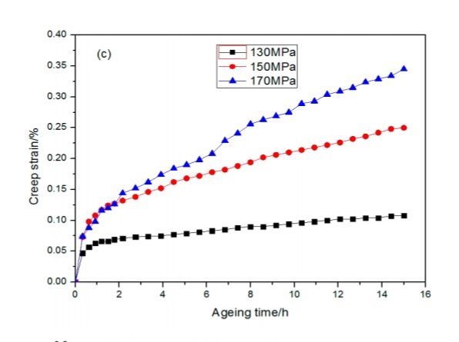
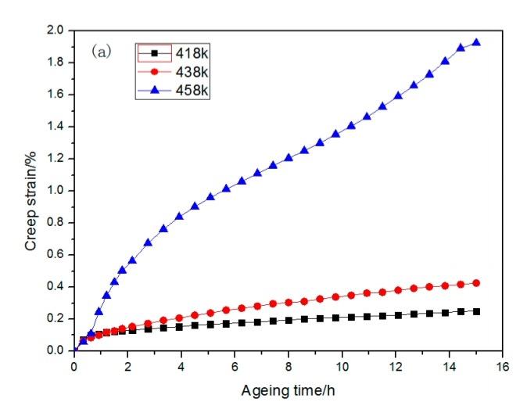
Figure1:-. Creep curves of 2219 aluminum alloy at different temperatures under the same stress. (a) 150 MPa; (b) 130 MPa.
FIG:A
FIG:B

Slide 7
LITERATURE SURVEY
Title | The Effect of Creep Aging on the Fatigue Fracture Behavior of 2524 Aluminum Alloy
Author | Wenke Li , Lihua Zhan, Lingfeng Liu and Yongqian Xu
Objectives | The normal temperature of tensile and fatigue testing was utilized to assess the mechanical and fatigue life of 2524 aluminum alloys. Under the three states of artificial aging, creep aging, and scanning electron microscope observation, the fatigue life of the sampel was examined.
Outcomes | When the results show that the alloy treated by creep aging can obtain a higher fatigue life,it suggests that creep aging enhances the fatigue properties of the alloy. The antifeudal aging fatigue life more then the creep aging.
7

Slide 8
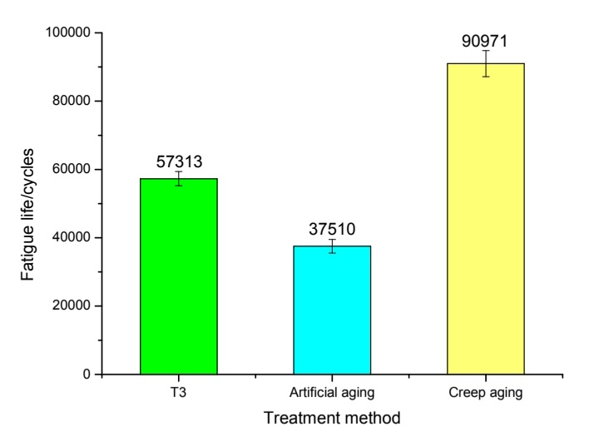
Figure2:-Fatigue lives of samples Table1:-Static tensile properties of examined alloy
Sample | Tensile Strength/MPa | Yield Strength/MPa | Elongation/%
T3 | 477.62 | 339.72 | 18.53
AA | 490.22 | 439.39 | 8.25
CA | 503.17 | 462.17 | 8.56

Slide 9
LITERATURE SURVEY
Title | Microstructure and Properties of As-Cast and Heat-Treated 2017A Aluminium Alloy Obtained from Scrap Recycling.
Author | Mrowka-Nowotnik Grazyna, Kamil Gancarczy k, Andrzej Nowotnik, Kamil Dychton, and Grzegorz Boczkal.
Objectives | The commercial and post-production scrap from continuously casting is acquired through the casting process and recycling procedures, ensuring efficient utilization of resources and minimizing waste. The ingots from the recycling process underwent chemical composition analysis through light microscopy, scanning electron microscopy, electron dispersive spectroscopy.
Outcomes | During the solution heat treatment process, primarily precipitates of intermetallic phases were identified based on the following As-Cast samples. The outcomes of plastic properties of the 2017A alloy were determined following heat treatment at 510◦C and aging at 175◦C the hardness achieved was 150.3 HB, tensile strength of 450.5 MPA, and yield strength of 268.7 MPA, the table1 show in below.
9

Slide 10
Table2:-Effect of solution heat treatment temperature and natural aging time on the strength and plastic properties of the 2017Aaluminium alloy.
Aging Time | Solution Temperature, ◦C | Yield Strength R0.2, MPa | Tensile Strength Rm, MPa | Elongation A5, % | Reduction Z, %
4 | 490 510 | 211.1 223.9 | 352.3 416.4 | 8.0 16.3 | 4.85 15.7
24 | 490 510 | 237.8 254.6 | 362.6 438.4 | 6.35 15.3 | 4.45 14.25
48 | 490 510 | 243.8 261.6 | 374.6 444.4 | 7.5 14.9 | 5.65 13.4
70 | 490 510 | 251.65 268.7 | 398.35 450.5 | 8.85 14.65 | 7.3 12.5

Slide 11

Title | Processing methods and property evaluation of Al2O3 and SiC reinforced metal matrix composites based on aluminium 2xxx alloys
Author | P. Ashwatha and M. Anthony Xavior
Objective | Extensive research has been conducted on metal matrix composites, with a particular emphasis on aluminum alloy 2xxx composites processed via powder metallurgy routes. The effect of reinforcing materials SiC and Al2O3 on the mechanical properties of composites manufactured through the conventional powder metallurgy route.
Outcomes | In metal matrix composites produced through the powder metallurgy process, samples are combined with, SiC Al2O3 and 2xxx alloys to attain desired mechanical properties such as high strength, fatigue strength, friction coefficient properties, thermal coefficient, wear resistance, and toughness. However, these composites are not corrosion resistant under atmospheric conditions, and fundamentally.
11

Slide 12
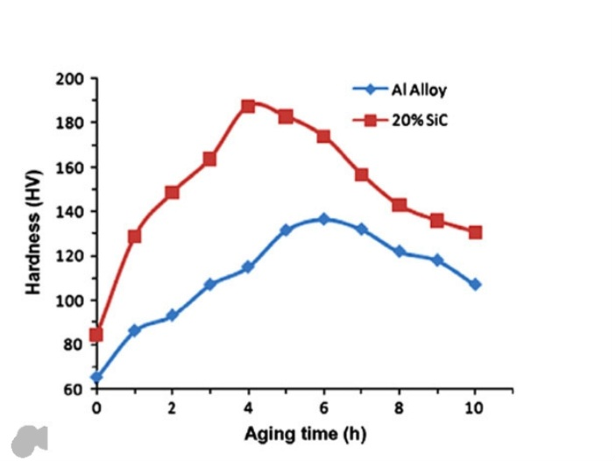
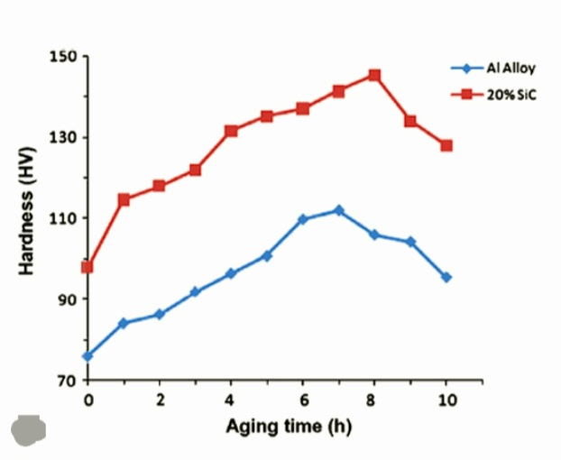
Figure3:-Variation of hardness versus aging time for 2024Al-20 vol% SiC composite and 2024 Al alloy

Slide 13
RESEARCH GAP
While the research effectively characterizes the creep behaviors of 2219 aluminum alloy under different temperatures and stress levels, there is still a gap in understanding the specific mechanisms driving creep behavior at various temperatures.
Scarcity of research highlighting the advantages of the powder metallurgy method for near-net shape manufacturing in the context of aluminum alloy-based MMCs.
Lack of comprehensive review focusing specifically on development of aluminum alloy-based metal matrix composites (MMC) processed via powder metallurgy route compared to conventional methods.

Slide 14

Summary of fundamental aspects related to the manufacturing of MMCs via powder metallurgy route, including the effects on mechanical, tribological, and microstructural properties.
The alloy manufacturing from recycled scrap exhibits relatively high mechanical properties, indicating its potential for practices applications.
Analysis of the recycled ingots identified several intermetallic phases, which were dissolved during solution heat treatment and precipitated as strengthening phases during aging.
The alloy demonstrated high hardness and mechanical properties after undergoing suitable heat treatment, suggesting its practical applicability.
14

Slide 15
OBJECTIVES
Aluminium alloys are chosen to reduce the weight is components or structures while maintaining the mechanical properties.
Aluminium alloys can be engineered to resist corrosion, ensure durability and longevity in various environments.
Aluminium alloys possess good thermal conductivity making them suitable for heat transfer applications.
The focus of 1xxx,2xxx,3xxx series aluminium alloys, specially Al6061 alloys, used in aerospace, automotive, and construction industries
Aluminium alloys are highly recyclable promoting sustainability and reducing environmental impact.

Slide 16
CONCLUSION
Optimal results including the highest hardness and fastest rate of hardness increase to maximum value, of the microscopic test.
Based on fractographic studies, it was established that in the tested alloy, regardless of the parameters of heat treatment, decohesion under tensile stress.
The value of solution heat treatment temperature affects the mechanical properties and kinetics of precipitation during the natural aging of the alloy.
The solution heat treatment temperature significantly impacts the mechanical properties and precipitation kinetics during natural aging of the 2017 alloy.

Slide 17
REFERENCES
Polmear, I.J. Light Alloys: Metallurgy of Light Metals; Arnold: London, UK; New York, NY, USA; Sydney, NSW, Australia; Auckland, New Zealand, 1995
MacKenzie, S.D.; Totten, G.E. Analytical Characterization of Aluminium, Steel and Superalloys; Taylor & Francis Group: Boca Raton, FL, USA, 2006.
King, F. Aluminium and Its Alloys; John Willey and Sons: New York, NY, USA; Chichester, UK; Brisbane, Qld, Australia; Toronto, BC, Canada, 1987
Kammer, C. Aluminium Handbook Vol. 1: Fundamentals and Materials; Aluminium Verlag Marketing & Kommunikation GmbH: Düsseldorf, Germany, 1999.
Davis, J.R. ASM Specialty Handbook: Aluminium and Aluminium Alloys; International Materials Information Society: Materials Park, OH, USA, 1998
Mondolfo, L.F. Aluminium Alloys: Structure and Properties; Butterworths: London, UK; Boston, MA, USA, 1976
Grazina, M.-N. Influence of chemical composition variation and heat treatment on microstructure and mechanical properties of ˙ 6xxx alloys. Arch. Mater. Sci. Eng. 2010, 46, 98–107.
17

Slide 18
REFERENCES
Zeren M 2005 J. Mater. Proc. Tech. 169 p 292
Fuller Ch. B, Seidman D N, Dunand D C 2003 Acta Mater. 51 p 4803
Sha G, Marcelu RKW, Gao X, Muddle B C, Ringer S P 2011 Acta Mater. 59 p 1659
Meyveci A, Karacan I, Ugur C, Durmus H 2011 J. Alloy Compd 491 p 278
Lochte L, Gitt A, Gottstein G, Hurtado I 2000 Acta Mater. 48 2969
Scholes F H, Furman S A, Hughes A E, Markley T A 2006 Corros. Sci. 48 p 1812
Gaziziv M, Kaibyshev R 2012 J. Alloy Compd 527 p 163
Guillaumi V, Mankowski G 1999 Corros. Sci. 30 p 310
Sharifitabar M, Nami H 2011 Composites Part B 42 p 2004 [10]
Kumaran S M 2012 J. Alloy Compd 539 p 179
Wang S C, Starink M J 2005 Int. Mater. 50 p 193

Slide 19
THANK YOU

