Slide 1
Employee Data Analysis using Excel
STUDENT NAME: ALFRED.H
REGISTER NO: 312211839, 04CEFFEA0CDE7B4ABB34CA03F99A3576
DEPARTMENT: COMMERCE (GENERAL)
COLLEGE: THIRUTHANGAL NADAR COLLEGE

Slide 2
PROJECT TITLE
Employee attrition Analysis using Excel

Slide 3


AGENDA
Problem Statement
Project Overview
End Users
Our Solution and Proposition
Dataset Description
Modelling Approach
Results and Discussion
Conclusion
3/21/2024 Annual Review

Slide 4

PROBLEM STATEMENT
Employee attrition can be for voluntary or involuntary reasons. The reasons are through natural means like retirement, or it can be through resignation, termination of contract. It costs precious time and money and can result in a loss of staff morale. This could also tarnish a company's reputation.

Slide 5

PROJECT OVERVIEW
.•Employee attrition
unpredictable Employee attrition
happens when an employee
leaves an organization for any
reason and is not replaced for a
long time, or not ever. It often
results in a decrease in the size of
an organization’s or department’s
workforce

Slide 6





WHO ARE THE END USERS?

Slide 7

OUR SOLUTION AND ITS VALUE PROPOSITION
Conditional formatting -Highlight blanks
Filter -Remove blanks
Formula -Attrition analysis
Pivot table -Summarize information
Graph –Data visualization

Slide 8
Dataset Description
Employee Dataset - From Edunet Dashboard
Available Features - 26
Necessary Features- 9
Employee Id - In Number
Name - In text
DOB. – numerical value
Gender - Male, Female
Start &exit date. - Date

Slide 9

THE "WOW" IN OUR SOLUTION
Attrition rate = (Number of employees who left / Average number of employees in the period) x 100
For example, if 15 employees left during the year, the formula would be:
Attrition Rate = (15 / ((100 + 85) / 2)) x 100 = 8.57%
3/21/2024 Annual Review
‹#›

Slide 10
MODELLING
Types of Attrition
Voluntary
Voluntary attrition occurs when employees choose to voluntarily leave their positions within an organization, rather than being compelled to do so through layoffs or other forms of involuntary separation.
Retirement:
An expected form of voluntary attrition, retirement occurs when employees
leave the workforce upon reaching a certain age or after achieving financial security, impacting the organization's experience and knowledge base.
Internal attrition:
This type of voluntary attrition occurs when employees leave their current
positions for other roles within the same organization, thus not affecting the overall
headcount but potentially impacting team dynamics and departmental continuity.
‹#›

Slide 11
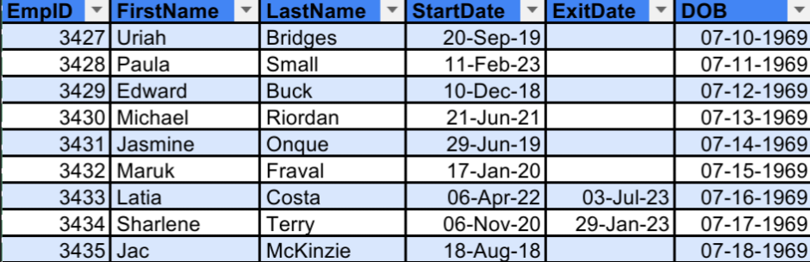

Slide 12
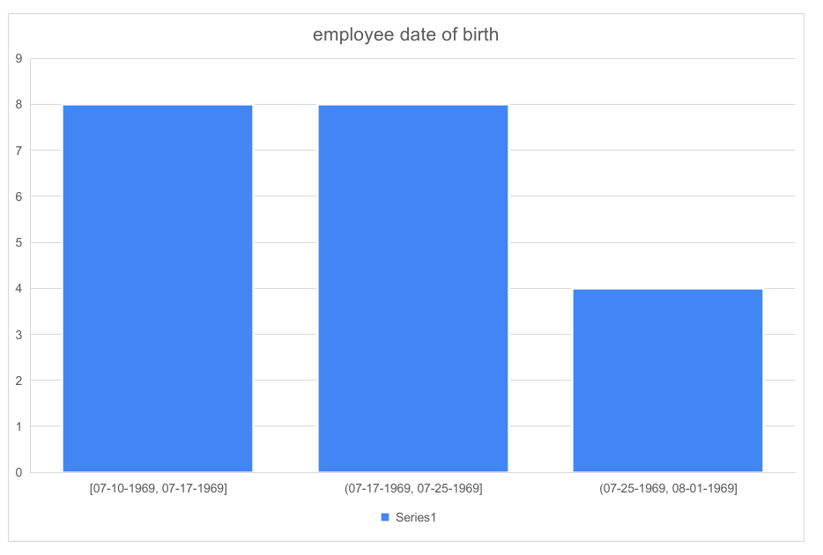
RESULTS
‹#›

Slide 13
conclusion
Employee turnover may feel inevitable, but it doesn't have to be. With careful strategy and commitment, organizations can curb attrition and retain top talent. Since, the costs of neglecting retention are too high, financially and in business performance.Awareness of your attrition rate is most certainly a good thing. That's because it allows you to identify how many employees are leaving and why they are leaving. If you have a high employee turnover rate, pay attention to it.

