Slide 1
FOREGIAN CURRENCY PREDICTION
P-63(TEAM 4)
AVINASH SONAWANE
GAURI SONAWANE
KANCHAN KACHOT
NIRMAL SHAJI
SAMEER SINGH
VIVEK KUMAR VERMA

Slide 2
Agenda
Introduction
Background of currency exchange rate (EXR)
EDA & Visualizations
MODEL building using different algorithms
Model selection based on accuracy
Future scope

Slide 3
Introduction
BUSINESS PROBLEM
Companies engaged in import & export are exposed to currency exchange risks. They would like to have a reliable model or method to predict currency movements and manage their exposure well to take an informed decision
BUSINESS OBJECTIVE
The objective is to understand the underlying structure in the dataset to come up with the suitable time series forecasting model which can effectively forecast USD/INR exchange rate for next 30 days.

Slide 4
Background of currency EXR
India has a floating exchange rate system where the exchange rate of the rupee with another currency is determined by market factors such as supply and demand.
Apart from supply and demand, the following 6 factors are widely agreed upon as being the driving force determining the exchange rate of a currency :
1.Inflation in the country
The price of goods or services will increase if they become rare (less supply, same or increased demand) or if money is in greater supply in the economy. This is what is called inflation. Inflation brings about a fall in purchasing power of the currency and thus its value.
2.Interest rate or repo rate
Interest rate of India is currently set at 6% and is decided by the RBI. It is the rate at which RBI lends money to the banks in India. A higher interest rate would mean investors would rush to buy government bonds as the returns would be higher. The rupee will be in more demand and its value will increase.

Slide 5
3.Level of current account deficit
A current account represents a country’s foreign transactions. Current account deficit implies that a
country is spending more money on importing goods and service from abroad than earning money via exports. Since importing of goods and service is more than exporting, and imports have to be paid in foreign currency, this increases the demand for that currency and hence its value appreciates with respect to the rupee.
4.Import and export of gold
India is the largest importer and holder of gold in the world?! It is estimated that the people here hold up to 25,000 tons of gold. Countries that excel in making a variety of products with gold but which don’t have large gold reserves themselves end up importing high quantities of gold. Such countries will be generally having a weaker currency. When the price of gold increases in the international market, the strength of the Indian rupee would accordingly go down.
5.Amount of public debt
A country with a huge amount of public debt carries a very high risk of inflation. It must either print new currency to pay off its debts (which again increases inflation) or increase the sale of securities to foreign investors, hence lowering their prices. If the debt is too large and investors are not confident in the country’s ability to pay back its debts, then they will not be willing to buy securities denominated in that currency. Thus inflation will go up and currency valuation will go down
6.Stability and economic growth
Foreign investors are looking to profit from their investments. Hence it is important for a country to a have a stable government and sound economic policies to attract investments. More foreign investments imply higher demand for the rupee and hence its price will appreciate.

Slide 6
Historical movements of INR against USD
The Indian currency has witnessed a slippery journey since Independence. Many geopolitical and economic developments have affected its movement in the last 66 years.
1947-1966
When India got freedom on August 15, 1947, the value of the rupee was on a par with the American dollar. There were no foreign borrowings on India's balance sheet.
To finance welfare and development activities, especially with the introduction of the Five-Year Plan in 1951, the government started external borrowings. This required the devaluation of the rupee. After independence, India had chosen to adopt a fixed rate currency regime. The rupee was pegged at 4.79 against a dollar between 1948 and 1966.
1966-1971
Two consecutive wars, one with China in 1962 and another one with Pakistan in 1965; resulted in a huge deficit on India's budget, forcing the government to devalue the currency to 7.57 against the dollar. The rupee's link with the British currency was broken in 1971 and it was linked directly to the US dollar.

Slide 7
1975
In 1975, value of the Indian rupee was pegged at 8.39 against a dollar.
1985
In 1985, it was further devalued to 12 against a dollar.
1991-1993
In 1991, India faced a serious balance of payment crisis and was forced to sharply devalue its currency. The country was in the grip of high inflation, low growth and the foreign reserves were not even worth to meet three weeks of imports. Under these situations, the currency was devalued to 17.90 against a dollar.
1993 was very important. This year currency was let free to flow with the market sentiments. The exchange rate was freed to be determined by the market, with provisions of intervention by the central bank under the situation of extreme volatility. This year, the currency was devalued to 31.37 against a dollar.
2007-2008
It was mostly at around 45 against a dollar. It touched a high of 39 in 2007.
The Indian currency has gradually depreciated since the global 2008 economic crisis. Liberalising the currency regime led to a sharp jump in foreign investment inflows and boosted the economic growth.
2013
The currency is in a free fall owing to multiple reasons in 2013, such as FIIs (foreign institutional investors) exiting the Indian market, dollar's bull run on possible US Federal Reserve rate hike, and month-end demand for the American currency.

Slide 8
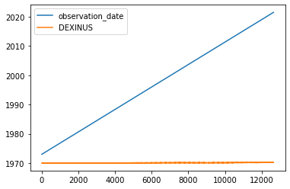
EDA & Visulizations
Handling missing values
There are 494 null values in the dataset and it has been filled by forward filled.
Correlation
It shows that there is no any correlation
between dependent and independent
variable.

Slide 9
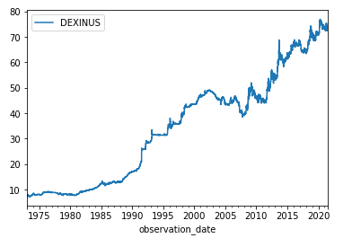
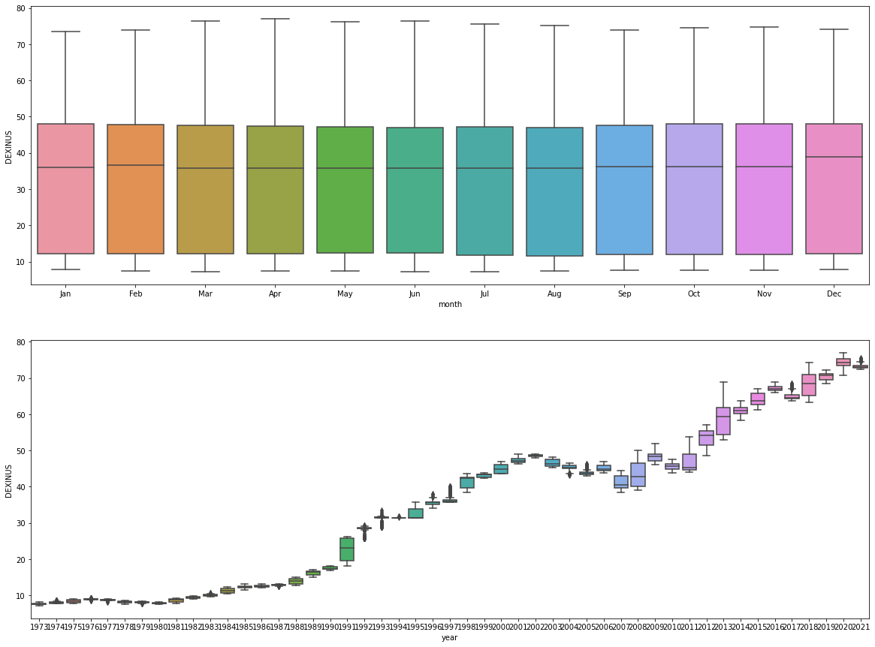
Time Series Plot & Box Plot

Slide 10
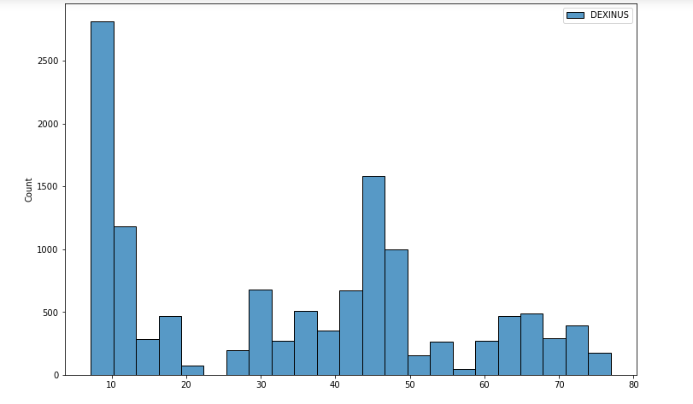
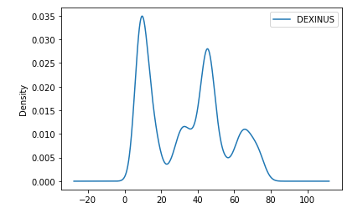
Histogram & KDE Plot

Slide 11
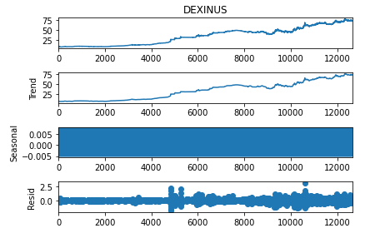
Decomposition Plot
From above decomposition plot, we can see the trend in the data. There is no seasonality in the data.

Slide 12
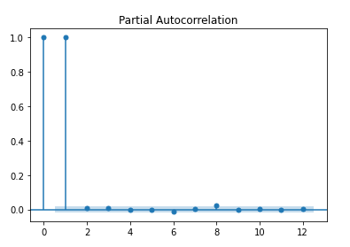
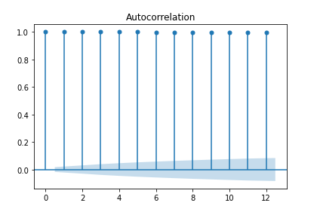
ACF & PACF Plot
Dataset having non-zero ACF lags in ACF plot whereas in PACF plot only first two PACF lags are non-zero, the rest are zero. Hence,series is autoregressive(AR).order of differencing is 2,so series is AR(2) series.

Slide 13
Stationary and Non – stationary series
Data points are often non-stationary or have means and change over time. Non-stationary behaviors can be trends, cycles, random walk, or combinations of the three.
Non-stationary data, as a rule, are unpredictable and cannot be modeled or forecasted. The results obtained by using non-stationary time series may be spurious in that they may indicate a relationship between two variables where one does not exist. In order to receive consistent, reliable results, the non-stationary data needs to be transformed into stationary data. In contrast to the non-stationary process that has a variable variance and a mean that does not remain near, or returns to a long-run mean over time, the stationary process reverts around a constant long-term mean and has a constant variance independent of time.

Slide 14
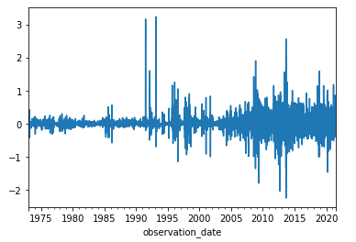
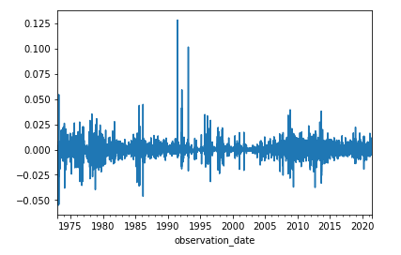
Making dataset stationary
Differencing Method
Transformation method

Slide 15
MODEL building
ARMA model
FbProphet model
RNN(LSTM) model
ARIMA model
Holt-Winters Exponential Smoothing
Linear Model

Slide 16
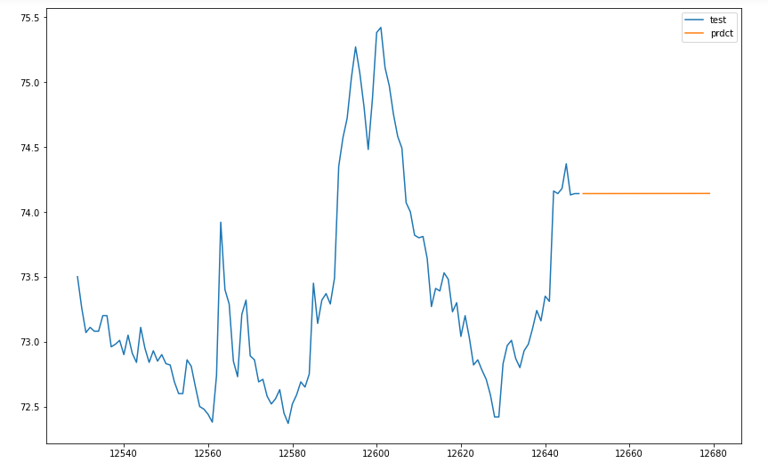
ARMA MODEL
An ARMA model, or Autoregressive Moving Average model ,often this model is referred to as the ARMA( p, q) model. where:
p is the order of the autoregressive polynomial,
q is the order of the moving average polynomial.
RMSE | 0.06196
Forecast of 30 days

Slide 17
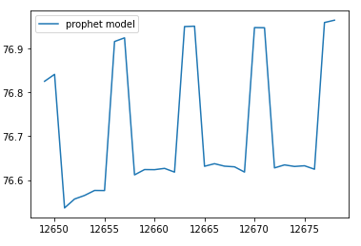
FbProphet model
The Prophet uses a decomposable time series model with three main model components: trend, seasonality, and holidays. They are combined in the following equation:
y(t)= g(t) + s(t) + h(t) + εt
g(t): piecewise linear or logistic growth curve for modeling non-periodic changes in time series
s(t): periodic changes (e.g. weekly/yearly seasonality)
h(t): effects of holidays (user provided) with irregular schedules
εt: error term accounts for any unusual changes not accommodated by the model
Forecast of 30 days

Slide 18
Recurrent Neural Network (RNN) Model
Recurrent neural networks (RNN) are a class of neural networks that is powerful for modeling sequence data such as time series or natural language.
A series of feed-forward neural networks in which the hidden nodes are connected in series.
RNNs have a problem called vanishing gradient descent Hence there are two improvements over it 1.Gated Recurrent Unit (GRU) 2.Long Short Term Memory (LSTM))
Among these more popular is LSTM more often used in time series forecasting

Slide 19
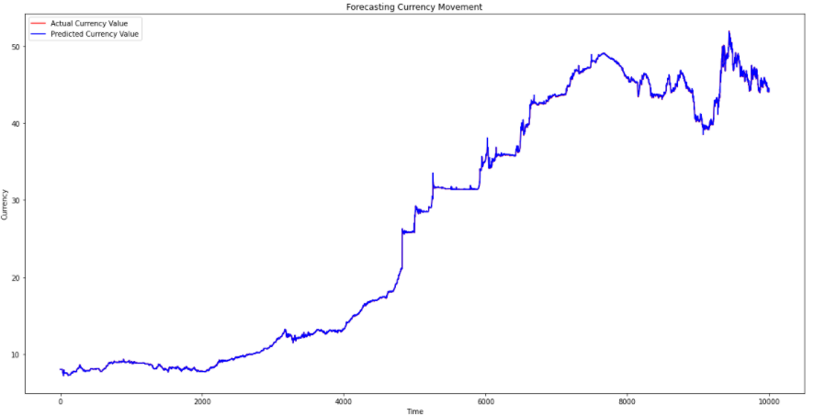
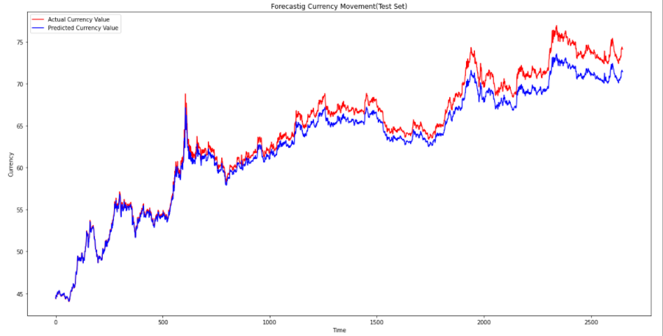
Forecasting – Based on training data
Forecasting – Based on testing data
RMSE | 1.4752

Slide 20
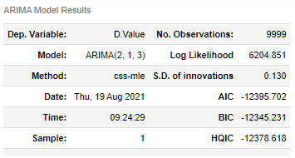
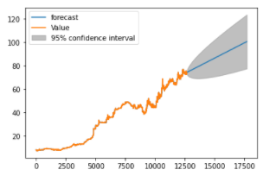
ARIMA MODEL
Auto-Regressive Integrated Moving Average
which is a forecasting algorithm based on the assumption that previous values carry inherent information and can be used to predict future values.
The ARIMA model takes in three parameters:
1. p is the order of the AR term
2. q is the order of the MA term
3. d is the number of differencing
Used statsmodel to build ARIMA model
RMSE | 15.7685

Slide 21
Holt-Winters Exponential Smoothing
The Holt-Winters algorithm is used for forecasting and It is a time-series forecasting method. Time series forecasting methods are used to extract and analyze data and statistics and characterize results to more accurately predict the future based on historical data.
The Holt-Winters forecasting algorithm allows users to smooth a time series and use that data to forecast areas of interest. Exponential smoothing assigns exponentially decreasing weights and values against historical data to decrease the value of the weight for the older data. In other words, more recent historical data is assigned more weight in forecasting than the older results.
There are three types of exponential smoothing methods used in Holt-Winters:
Single Exponential Smoothing – suitable for forecasting data with no trend or seasonal pattern, where the level of the data may change over time.
Double Exponential Smoothing – for forecasting data where trends exist.
Triple Exponential Smoothing – used for forecasting data with trend and/or seasonality.

Slide 22
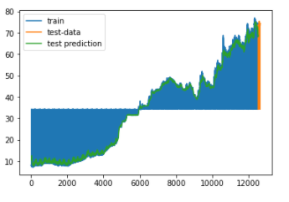
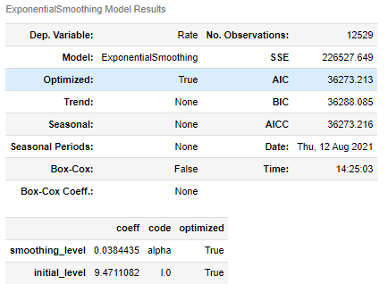
Forecasting – Plot

Slide 23
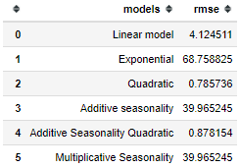
Linear Model
Linear model is a statistical tool used to help predict future values from past values. It is commonly used as a quantitative way to determine the underlying trend and when prices are overextended. A model trend line uses the least squares method to plot a straight line through prices so as to minimize the distances between the prices and the resulting trend line. This linear model indicator plots the trend line value for each data point.

Slide 24
Conclusion
We have deployed ARMA model because RMSE value of this model is low compared to other models

Slide 25
Thank You !!!

