Slide 1
Scientist Of Utopia

Slide 2
Team Gravitons
Vershita Yadav (+917011889060)
Anamika (+91 7056762922 )
Hannan Shaik A (+91 8143813994)

Slide 3


Solution 1
Assumed Earth’s gravity:
Assumed Black Hole’s gravity:
Here,
M_{e} = Mass of Earth
r = Radius of Earth
A = Amplitude
ω = Angular Frequency (rate at which Earth completes one full rotation about axis)

Slide 4
Part a. Factors causing unexpected outcomes in data:
• The total mass of the black hole is not just the mass of the black hole itself but also includes the mass of the engulfed star. As the mass of the engulfed star is not mentioned, inaccurate values are obtained.
• Schwarzschild Radius may change: The Schwarzschild radius of the black hole would change with the additional mass of the engulfed star, which affects the gravitational field strength.
• Other minor factors include:– Heavy changes in the density of Earth’s crust and mantle.– Heavy vibrational and electromagnetic forces that can cause changes in gravity.

Slide 5



Part b. Correct equation for the black hole:
Radius of star will be negligible comparing to rs. So we are considering rs as total radius.
According to Newton’s law: F =mg
So now, using the above law:
Given: G = 6.674 × 10⁻¹¹ m³ kg⁻¹ s⁻²
M_{b} = 4 × 10³³ kg
The gravitational field strength of the black hole can be expressed as:
s
s
Here, M_{s} is the mass of the engulfed star, which needs to be determined based on observational data.

Slide 6
Solution To Problem 2
Creating an artificial sun ring around earth containing compressed hydrogen gas and by providing continuous energy from black hole .

Slide 7
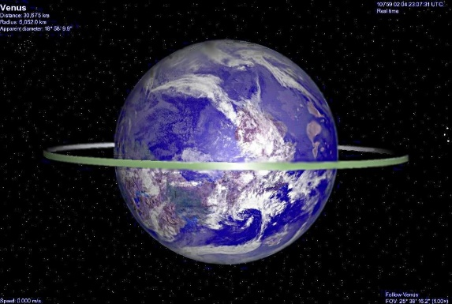
ABOUT RING:
Energy Generation: Fusion process akin to natural stars for abundant energy.
Material Durability: Selection crucial for space resilience against extreme conditions.

Slide 8
Source of Hydrogen:
Hydrogen Extraction: Sources include solar wind, interstellar medium, and celestial bodies.
Terrestrial Sources :
Utilize natural gas and electrolysis of water for hydrogen.
Advanced Spacecraft: Needed for transporting large hydrogen payloads to the ring structure.

Slide 9
Which one is better :
SPHERE
RING

Slide 10
Material Requirement: A ring requires less material than a sphere since it only partially encircles the earth. Interaction with space: in the ring we can explore space and use the sun’s energy also. Accessibility: Rings are easier to maintain and repair with their open structure, providing simpler access to different sections. They also allow for flexible design and incremental expansion or modification.
Why Ring??

Slide 11
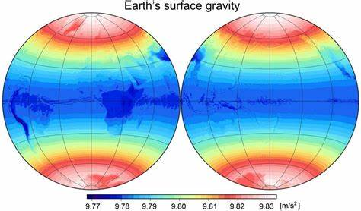
Structural Stability:
A. Earth's varying gravitational force by location poses challenges for rotating a sphere uniformly. B. The gravitational forces acting on a ring are primarily perpendicular to the plane of the ring, potentially making it structurally stable. C. Adjusting rotational velocity in a ring structure could better counteract Earth's gravitational force. D. This adjustment enhances stability by achieving a more uniform distribution of forces along the circumference of the ring.

Slide 12
Satellites around black hole:
Six satellites positioned around the black hole, one along each end of the three axes, maximize radiation absorption.
Crucial to maintain a safe distance to prevent gravitational pull into the black hole's event horizon.
Satellites equipped with specialized instruments to absorb and capture black hole radiation.

Slide 13
Satellites around black hole:
Instruments include detectors for X-rays, gamma rays, and radio waves, tailored to black hole properties.
Satellites revolve around the black hole at high velocities, utilizing absorbed energy for propulsion.
Functions designed to utilize a portion of absorbed energy for satellite operations.

Slide 14
Laser Beam Wireless Power Transmission:
Lasers used in space for long-distance energy transfer, including future concepts for powering remote satellites from solar arrays.
A laser beam sends concentrated light to a photovoltaic cell receiver through the vacuum of space

Slide 15
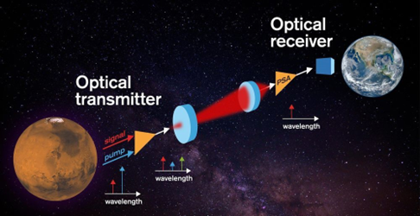
The receiver converts the energy back into electricity through these steps:
The DC power harvested in space is used to generate a single wavelength (monochromatic) light beam.
A set of optics shapes the laser light according to the required beam size.
A control system ensures that the laser is pointed at the intended receiver site on the ring.
Photovoltaic receiver operates similarly to solar cells but with higher efficiency using high-intensity laser beams.
Mirrors and telescopes enable precise aiming of laser beams at receivers for unobstructed line-of-sight transmission paths.

Slide 16

Black Hole Engulf Star
Release EM Radiations
Radiations Captured by Satellites
Transmit to Earth Ring
Ring Uses Energy for Fusion
Energy Converted to Other Forms
Ring Acts as Artificial Sun

Slide 17
Solution to Problem 3

Slide 18
Part 1( Finding escape velocity)
Assumptions:
In this problem statement we are considering all the objects as point size, relative to each other
M >>> m
The black hole which is approaching the Earth is charged
Due to opposite charges being induced on the planet, and mass being pulled towards the black hole, the density of that side has changed, the planet being electrically neutral
F= Total force on the rocket
M= Mass of Earth
m= Mass of Rocket
r= Radius of Earth
x= Arbitrarily distance between the Earth and Rocket
K= Coulomb’s constant
G= Gravitational constant
Ve=Escape velocity

Slide 19
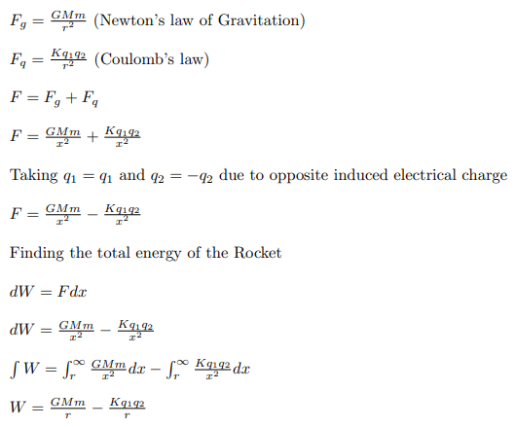
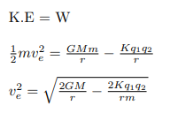
This is the work done against the gravitational attraction to take the body from the planet’s surface to infinity
To break free from the planet’s surface, the kinetic energy of the object must match the energy expended in overcoming gravity’s pull from the surface to an infinite distance.
.
This is the new escape velocity for the rocket.

Slide 20
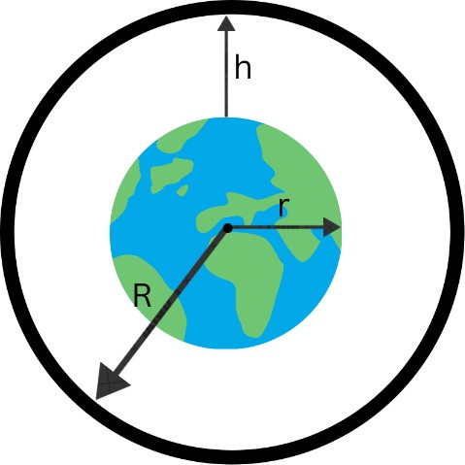
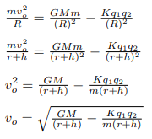
Vo=Orbital velocity R= Distance of the rocket from the Earth’s centre of mass h= Height of rocket from Earth’s surface R = r + h Centripetal force of moon = Force exerted by the earth
Part 2 (Finding the orbital velocity)
Systematic diagram showing R,r, and h

Slide 21



Now, we will compare it with the actual orbital formula for elliptical orbit,
µ= Standard Gravitation Parameter (GM, M >>> m)
R= Distance between orbiting body and centre of mass
a= Length of the semi-major axis
Taking out µ (GM) from the equation and multiplying 2/2 with 1/r, we get,

Slide 22
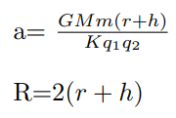
Comparing both the equation we saw,
Hence, we can conclude that the orbit will no longer remain circular but will mould itself in an elliptical path.

Slide 23
Part 3 (Upgrade in "old" gravity space craft)
Enhanced propulsion systems with the ability to modulate thrust levels
for efficient navigation within altered gravitational conditions
Strengthened structural durability to endure potential fluctuations in gravitational forces during launch and while in space
Adjustments in navigation systems and thrust configurations
Advance exercise machines for astronauts to withstand body changes

Slide 24
Part 4 (Ideas to over L1 sinusoidal component of gravity)
• Due to the instability of electric charges, electronic devices may experience
malfunctions. To mitigate this risk, we should encase sensitive devices in
conductive materials
• Execute accurate trajectory planning and control algorithms to consistently adapt the spacecraft’s path and ensure it remains in a stable orbit
around the L1 point
• Create a spacecraft equipped with resilient thermal management systems
adept at controlling internal temperatures and dispersing surplus heat
• Protect vital spacecraft components and crew quarters by surrounding
them with materials resistant to radiation, thus reducing the risk of radiation exposure

Slide 25
Solution to Problem 4

Slide 26
Given Date: 28-02-2081 and Time: 08:29:19
Password String: ”STX_w-NUL}-STX_DEL_BS_~/NUL_w:STX_v:SOH_v”
The scientists plan to restart the facility on December 31, 4354, at 16:57:55:627
(31-12-4354/16:57:55:627).
Decoding the password using ASCII values:
STX=2, NUL=0, BS=8, SOH=1
Decoding password,
We’ll write the ASCII Values of the string as it is:
2_119 0-125 2-127-8-126 0-119 2-118 1-118

Slide 27
Consider the first 3 sets as representing the date 28-02-2081 and another 3 representing time 08/29/19.
The digits that are in odd-digit positions are the same as ASCII values, but the digits in even-digit positions are not the same as ASCII values.
However, if we observe them, we can notice a pattern that if we relate given even position with original values, the summation of all original values translated and ASCII value is 127, which is the last number of the ASCII value.

Slide 28
Using this logic:
We are encoding the password using Date 31-12-4354 and time 16:57:55:627.
We will write odd positions as it is as per ASCII values.
And we’ll subtract even position digits with 127.
We’ll continue this until the end.
Then we’ll get our password as,
ETX_~ SOH}-EOT_|ENQ{SOH_y:ENQ_X:ENQ_z:ACK_d

Slide 29
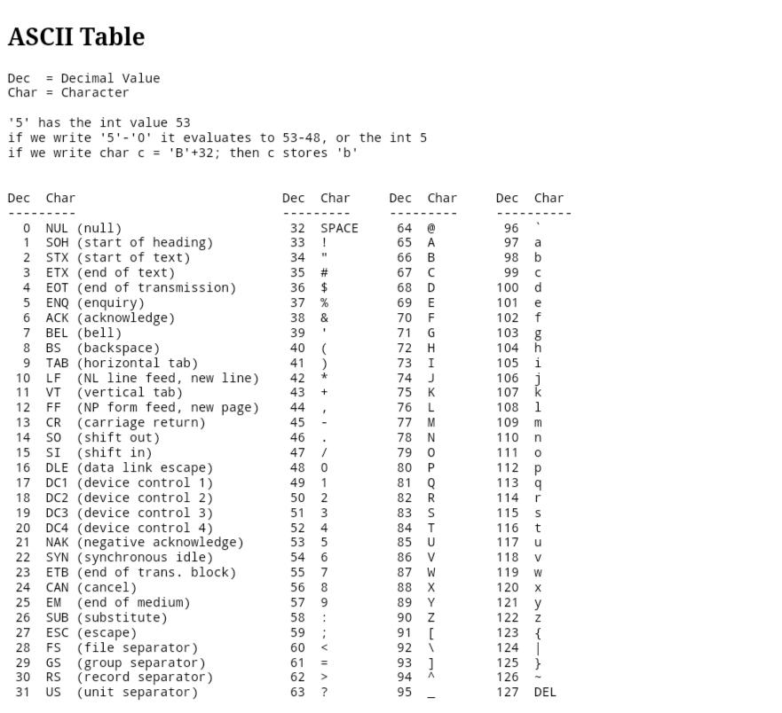

Slide 30
THANKS FOR YOUR ATTENTION

