Slide 1
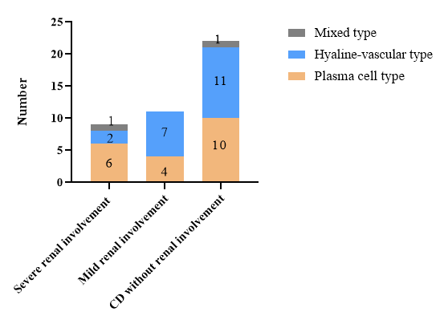
Clinical feature analysis of pediatric Castleman disease with renal involvement
AIM: To investigate the clinical features of pediatric CD with renal involvement.
DESIGN & OUTCOMES:
Renal involvement typically coincided with CD onset.
Severe: 15% acute renal failure, 20% acute nephritis, 10% nephrotic syndrome
Mild: 55% proteinuria
42 children diagnosed CD
Clinical
manifestations
Plasma cell subtype and elevated IL-6 were correlated strongly with renal involvement severity.
Renal pathology
CD with renal involvement (20)
CD without renal involvement (22)
Renal involvement improved rapidly in all patients after CD etiological treatment.
Isolated nephrotic syndrome in CD remission:
steroid-resistant, responsive to immunosuppressants
Abbreviations: CD, Castleman disease
CONCLUSION: Pediatric CD with renal involvement included proteinuria, acute nephritis, nephrotic syndrome, and acute renal failure. Renal involvement occurred simultaneously with CD and improved rapidly in all patients after etiological treatment of CD and immunosuppressants.
Yue Xi et al. 2026

