Slide 1
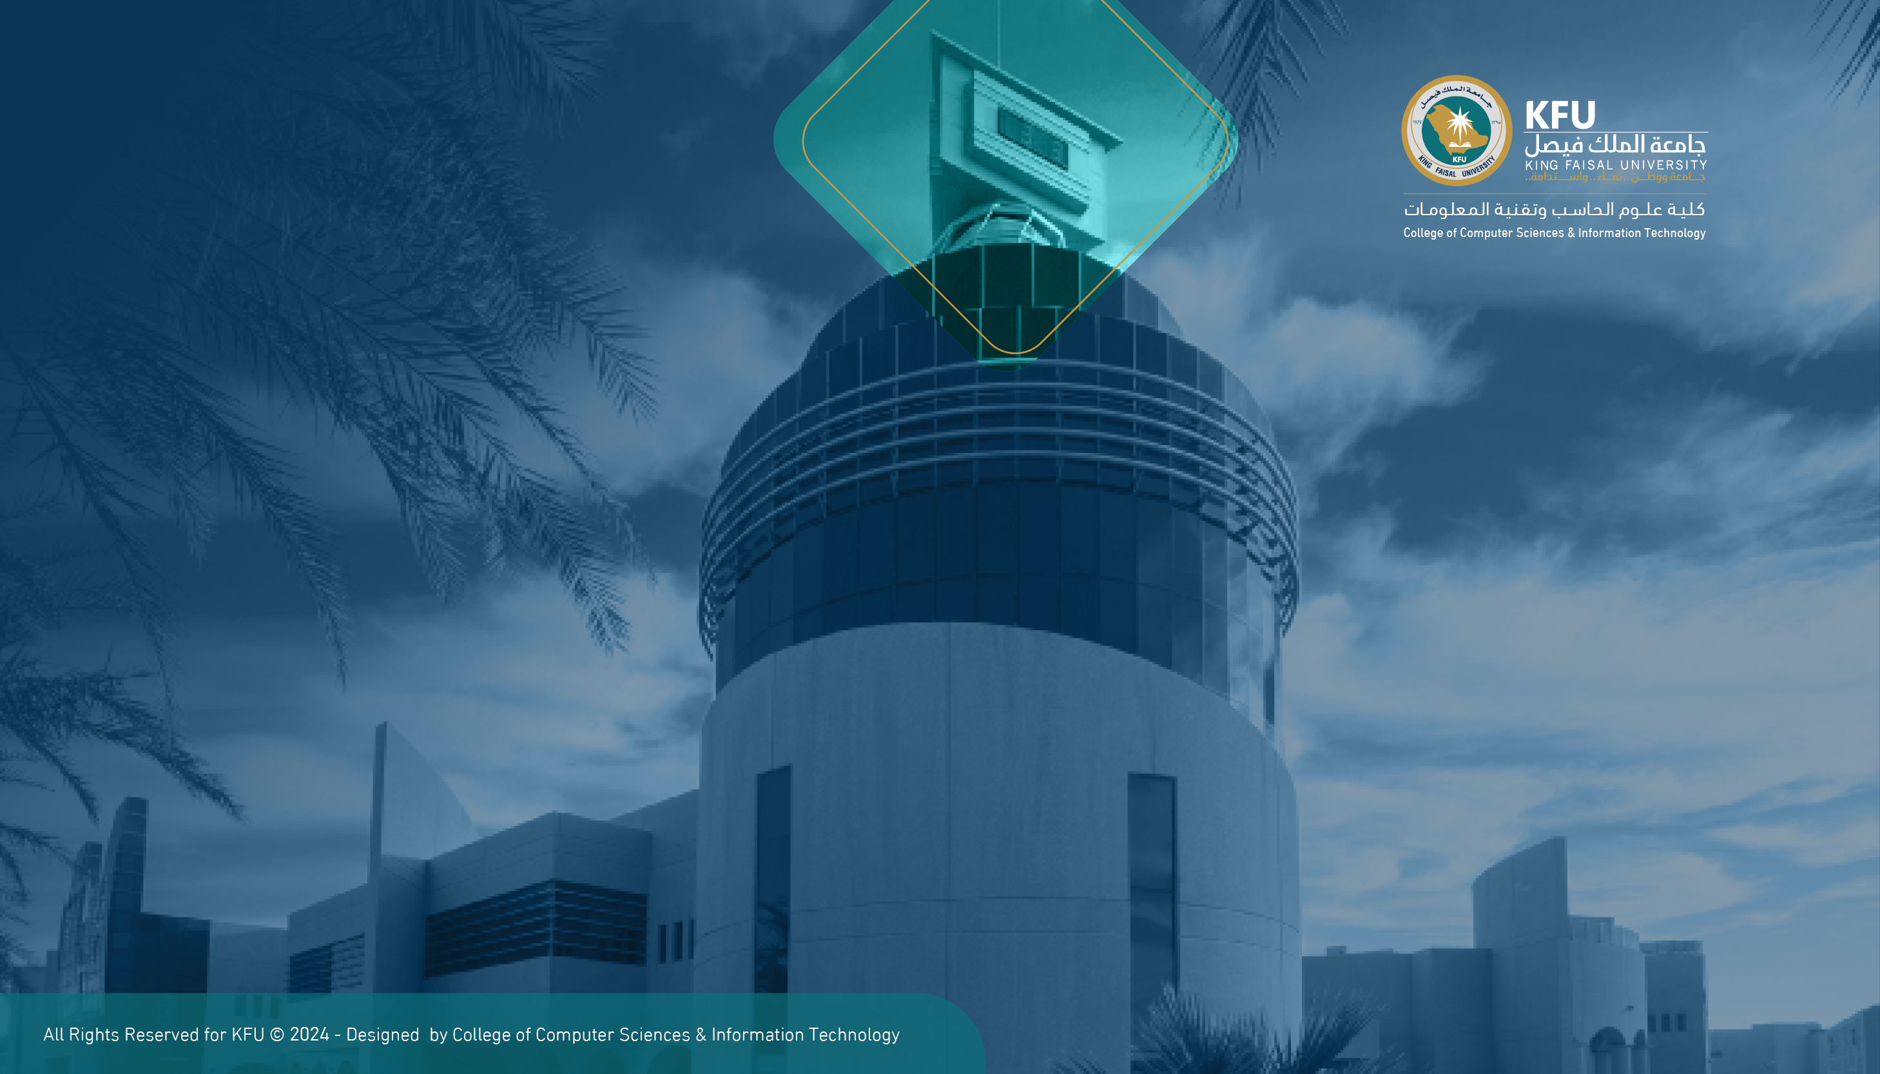
Semantic AI Framework for Palm Tree and Date Fruit Variety Classification and Knowledge Retrieval
Project Team
Anas Al-Jumaiah, Ibrahim Alborsias, Khalid Almuhaysh, Abdullah Alhasawi
Supervised by Dr.Alogosiabi

Slide 2
Agenda
Milestone 3
1
Details of partial implementation
2
Tools & Techniques used in Implementation
3
Preliminary Outcomes/Results
4
Intermediate Conclusions and What’s Next
Notes:
This is milestone 2’s agenda. Modify if needed.

Slide 3
Project Recap
Problem Context
The project addresses several pressing issues threatening the agricultural heritage of the Al-Ahsa Oasis:
Critical Knowledge Gap: The region faces a significant loss of local agricultural expertise due to an aging workforce, where 26.9% of workers are over 55, coupled with a heavy reliance on non-expert migrant labor
Identification Challenge: It is highly difficult, even for agricultural experts, to visually distinguish between similar palm tree types, which is essential for determining their economic value.
Lack of Preservation: Currently, there are no adequate digital systems in place to capture, structure, and preserve this unique agricultural heritage for future generations.

Slide 4
Project Recap
Project Overview (The Solution)
To combat these challenges, the project proposes a "Semantic AI Framework for Palm Tree Variety Classification and Knowledge Retrieval“.
Core System: The solution is an intelligent system that integrates Computer Vision (CV) with Retrieval-Augmented Generation (RAG).
Scope: The framework specifically focuses on classifying and documenting three primary Al-Ahsa palm varieties: Khalas, Shishi and Reziz.
Primary Goal: The ultimate objective is to digitally document, store, and protect the agricultural heritage of Al-Ahsa, directly supporting the goals of Vision 2030.

Slide 5
Details of Partial Implementation
Vision Module (ConvNeXt Small)
Proposed Architecture: Milestone 2 defined a pipeline starting with Preprocessing & Augmentation (resizing to 224x224, Test Time Augmentation, and normalization) feeding into an Inference Engine powered by a Fine-tuned ConvNeXt Small model.
Implementation Details: The developed module successfully executes this pipeline. We implemented the Custom Classifier Head, utilizing a dropout layer (p = 0.6) and a linear fully connected layer to map the 768-dimensional feature vector to our three target classes: Khalas, Razeez, and Shishi.
Design Conformity: The training phase adhered strictly to the proposed roadmap, utilizing 5-Fold Cross-Validation alongside MixUp augmentation and Cosine Annealing to ensure robust feature extraction and prevent overfitting.

Slide 6
Details of Partial Implementation
Semantic Knowledge Retrieval (RAG)
Proposed Architecture: The design required an Ingestion Engine for text chunking and embedding, Semantic Storage via a Vector Database, and a Retrieval Chain orchestrated by LangChain.
Implementation Details: We built the text ingestion pipeline to process the curated agricultural guides and research papers. The system successfully chunks these documents and creates vector embeddings stored in ChromaDB.
Design Conformity: The Retrieval Chain operates exactly as modeled in the RAG Sequence Diagram. User queries are converted to vectors, similarity searches retrieve the top-k document chunks, and the LLM synthesizes a natural language response based exclusively on verified agricultural context.

Slide 7
Details of Partial Implementation
System Integration & Interface
Proposed Architecture: Connecting the Vision model output directly to the RAG system and developing the User Interface for image upload and result display.
Implementation Details: The integration serves as the bridge between visual classification and actionable advice. Once an uploaded image is classified (e.g., as "Shishi"), that specific label is automatically injected into the RAG prompt. This ensures the user receives highly specialized, context-aware information rather than generic agricultural data.
Design Conformity: The app showcase photos in the milestone 3 file

Slide 8
Details of Partial Implementation
Quality Assurance & Testing Metrics
Confusion Matrices: We utilize these matrices extensively to evaluate the final integration, specifically to identify any specific pairs of palm varieties that the model might frequently confuse under real-world conditions.
Inference Latency: A critical testing metric for our UI is tracking the time required to process a single image through the full ensemble pipeline, ensuring the system remains responsive for end-users.
Semantic Validation: To guarantee reliability and safety, domain experts are involved in reviewing the LLM-generated answers to verify factual correctness and strictly prevent AI hallucinations regarding agricultural treatments.

Slide 9
Tools & Techniques used in Implementation
Hardware & Software Tools
NVIDIA GPUs (with CUDA support for accelerating matrix operations)
Python (Primary programming language)
PyTorch (Primary deep learning framework)
Scikit-Learn (Used for cross-validation data splitting)
LangChain (Orchestration framework for the RAG component)
ChromaDB (Vector database for semantic search)

Slide 10
Tools & Techniques used in Implementation
Implementation Techniques
Beyond the core software stack, the project's success relied on applying these advanced algorithmic methodologies
Training Protocol: 5-Fold Cross-Validation, AdamW optimizer, and early stopping.
Advanced Optimization: MixUp augmentation and Cosine Annealing.
Inference Enhancement: Test Time Augmentation (TTA) and Model Ensembling.
Semantic Retrieval: Retrieval-Augmented Generation (RAG).

Slide 11
Preliminary Outcomes/Results
Implementation Results & Model Evaluation
Our evaluation rigorously compared several pre-trained CNN architectures to determine the optimal vision backbone for the framework. The results clearly validate our selection of ConvNeXt Small as the primary inference engine, as it significantly outperformed alternative models across all critical evaluation metrics.
Experiment | Model | Training Data | Test Data | Accuracy
Exp 1 | ViT_b_16 | Day Images Only | Night Images Only | 55.33%
Exp 2 | ConvNext_small | Day Images Only | Night Images Only | 67.07%
Exp 3 | ViT_b_16 | Combined (Day + Night) | Night & Day (10%) | 92.00%
Exp 4 | KNN | Combined (Day + Night) | Night & Day (10%) | 91.02%
Exp 5 | SVM | Combined (Day + Night) | Night & Day (10%) | 90.88%
Exp 6 | ConvNext_small | Combined (Day + Night) | Night & Day (10%) | 98.37%

Slide 12
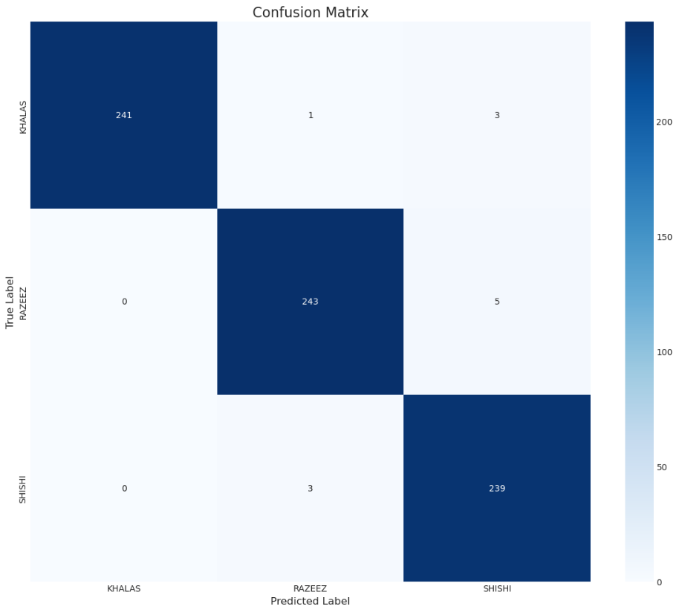
Preliminary Outcomes/Results

Slide 13
Preliminary Outcomes/Results
Implementation Results & Model Evaluation
Confusion Matrix Analysis
The confusion matrix for our optimized ConvNeXt Small model demonstrates exceptional real-world reliability and precise class separation:
Exceptional Baseline Accuracy: The model achieved near-perfect classification for the Khalas variety, correctly identifying 310 out of 315 instances with zero false positives originating from the other two classes.
Minimal Class Bleed: The matrix reveals highly stable boundaries between the visually similar Razeez and Shishi varieties. Out of 494 total samples for these two classes, there were only 10 instances of cross-confusion (7 Razeez misclassified as Shishi, and 3 Shishi misclassified as Razeez).
Operational Readiness: The high true-positive diagonal confirms that the model is highly robust and ready to confidently feed accurate visual context into the semantic RAG pipeline.

Slide 14
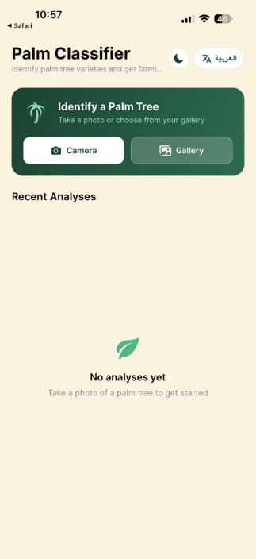
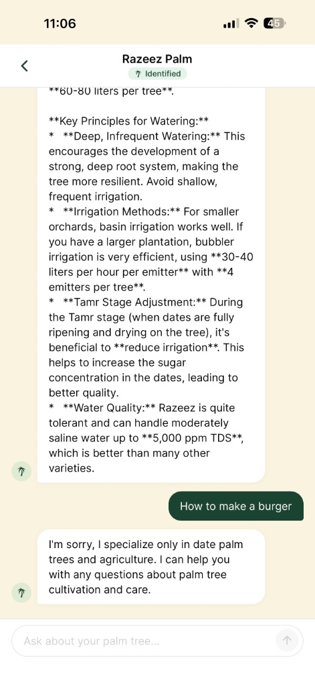
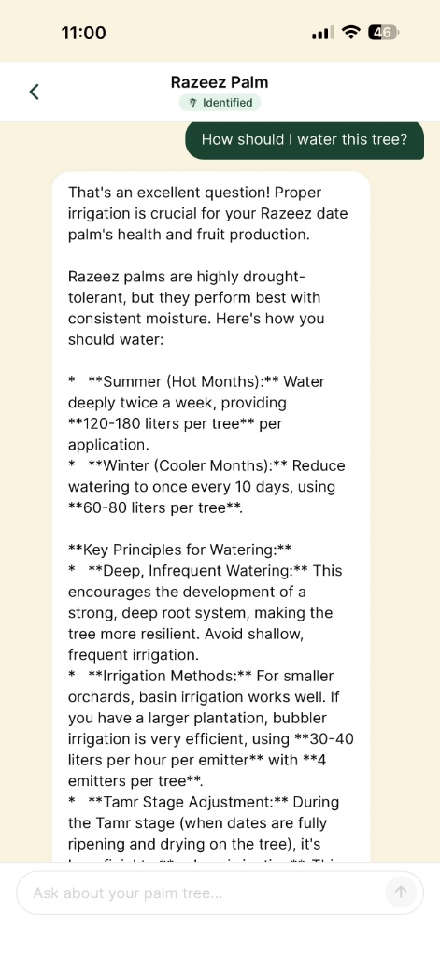
Preliminary Outcomes/Results

Slide 15
Preliminary Outcomes/Results
PalmTreeClassiferAPP: End-to-End System Integration
The developed mobile application successfully bridges our Computer Vision and RAG modules into a cohesive, functional, and user-friendly platform. Our preliminary testing demonstrates the following capabilities:
Seamless User Experience (Image Input): The interface provides intuitive access for users to either capture a live photo in the field or upload an existing image from their gallery, minimizing friction for farmers and researchers.
Real-Time Visual Classification: The integrated ConvNeXt Small inference engine actively processes the uploaded image. As demonstrated in the showcase, it successfully and rapidly outputs the correct palm variety prediction (e.g., identifying the Razeez palm).
Context-Aware Semantic Retrieval: The application establishes a direct operational link between the Vision and RAG systems. When the user asks natural language questions (e.g., "Is Razeez palm tree good?" or "What is the best irrigation practices for Razeez palm tree?"), the AI utilizes the visual prediction as contextual grounding.
Actionable Agricultural Intelligence: The LLM successfully retrieves verified data from the specialized agricultural knowledge base, generating detailed, accurate, and highly specific domain advice rather than generic responses.

Slide 16
Intermediate Conclusions
Commentary on the Results
Architectural Superiority: The comparative evaluation clearly justifies the shift from traditional models (like ResNet or MobileNet) to the ConvNeXt Small architecture. Achieving a 0.98 accuracy and 0.97 F1-score indicates that ConvNeXt’s modernized, transformer-inspired design is significantly better at extracting the fine-grained textures needed to differentiate palm leaves.
Robust Class Separation: The confusion matrix is highly encouraging. The Khalas variety is identified with near-perfect accuracy (310/315). More importantly, the historical challenge of distinguishing between the visually similar Razeez and Shishi varieties has been largely solved, with a combined error rate of roughly 2% across those two classes.
Environmental Consistency: Building on our Milestone 2 experiments, which demonstrated ConvNeXt Small's 98.37% accuracy on combined Day and Night imagery , these final metrics prove the model is not overfitting to ideal lighting conditions, but has genuinely learned the intrinsic biological features of the trees.

Slide 17
Intermediate Conclusions
Key Conclusions
Validation of the Semantic AI Framework: The dual-system design is a success. By securing a 98% visual classification accuracy, we guarantee that the RAG (Retrieval-Augmented Generation) module is fed the correct context. This prevents the "cascading error" problem where a bad visual guess leads to incorrect agricultural advice.
Readiness for Field Deployment: The high Precision (0.97) and Recall (0.98) scores indicate the system generates very few false positives or false negatives. It is highly reliable and safe for actual farmers in the Al-Ahsa Oasis to use for critical crop management decisions.
Achieving the Project Vision: The implemented system successfully meets its primary goal: it provides a highly accurate, digital, and easily accessible method to document and utilize Al-Ahsa’s agricultural heritage, directly supporting Vision 2030 initiatives.

Slide 18
What’s Next
1. RAG Data Acquisition & Integration
Task: Secure and ingest the official agricultural documents, including the confidential information
Recommended Actions:
Data Handling Protocol:Since you are handling confidential information, ensure your data ingestion pipeline operates in a secure, local, or encrypted environment before pushing anything to a broader database.
Pipeline Execution: Run the newly acquired documents through your existing LangChain text-splitter and HuggingFace embedding models .
Update Vector Database: Re-index your ChromaDB vector store with this comprehensive, high-quality data.
2. System Testing & Quality Assurance
Task: Rigorously test the RAG system after the new documents have been integrated.
Recommended Actions:
Semantic Validation: Work with domain experts to run test queries (e.g., specific treatment questions for the Razeez variety) to ensure the LLM retrieves the correct, newly added confidential data without hallucinating.
Integration Testing: Test the full end-to-end loop: Upload a photo -> Vision model predicts the class -> Class name is injected into the prompt -> RAG pulls the correct answer from the new documents.
Latency Checks: Measure how long it takes to return an answer now that the vector database is larger

Slide 19
What’s Next
3. Production Deployment & Scaling (IF-Funded)
Task: Migrate the system from a local/development environment to a production server.
Recommended Actions:
Cloud Infrastructure: Set up a secure cloud server (e.g., AWS, Google Cloud, or Azure). You will need a server environment capable of handling the GPU requirements for your ConvNeXt Small model and the memory requirements for your LLM and vector database.
API Development: Create a robust REST API to handle the communication between your mobile app front-end and your heavy AI back-end securely.
Task: Deploy the mobile application to Android and iOS users.
Recommended Actions:
Store Compliance: Review the submission guidelines for both the Apple App Store and Google Play Store, particularly focusing on data privacy policies (crucial since you are handling user locations/images and confidential database info).
Beta Testing: Before a full public launch, run a closed beta test via TestFlight (iOS) and Google Play Console (Android) with a select group of local Al-Ahsa farmers to gather real-world UI/UX feedback.

Slide 20
What’s Next
4. Final Presentation Preparation
Task: Package these achievements for Milestone 3 and potential investors.
Recommended Actions:
Clearly define the "Path to Production" for your panel, showing them exactly how the funding will be utilized (server costs, app store fees, security scaling).

