Slide 1

TheLegalHub
GOAL 16: Peace and Justice Strong Institutions
Project Mentor : Prerna Solanke
Group Number: 39
Group Members:
Nitika Nagdevani(33)
Vedika Walhe (63)
Sanika Ingale(19)
Ishwari Dehradray(14)

Slide 2
Content
Introduction
Problem Definition
Goals/ Objectives
Literature Survey
Lacuna of Existing Systems
Details of Hardware & Software
Proposed System
Evaluation Measures
Block Diagram
Methodology
Future Scope
Conclusion
References

Slide 3
Introduction to Project
TheLegalHub is a law resources platform which provides enacted laws, previous cases as well as the format of various documents.
The main objective of the website is to display and simplify information by correlating to the previous cases.
A centralised law resources website can aggregate relevant and reliable legal information, making it easily accessible to a wider audience.
TheLegalHub can offer search and filtering functionalities to help users find specific laws and relevant cases efficiently.

Slide 4
Problem Definition
Problems faced:
Limited availability of resources
Accuracy
Language Complexity
Time-consuming
Cost of legal advice
Lack of application
Inadequate Access

Slide 5
Goals
To display and simplify information by correlating it to real life scenarios with the help of the previous cases.
To assure its sustained contribution to legal education and research.
To empower underprivileged and vulnerable members of society, such as women, children, older citizens, and people with disabilities, by assisting them in understanding and exercising their rights.

Slide 6
Literature Survey
Name of paper | Published on | Name of Author | Summary
Survey On Open Access To Legal Information System | March 2020 | Miss. Kajal Zade Miss. Vrushali kakde Miss.Gauri Nampalliwar Miss. Disha Uttarwar Prof.Rupatai Lichode | The paper discusses the potential recognition of public access to legal information as a fundamental human right, which could enhance global accessibility.
Development of Online Legal Information System : Lawyers’ Perceptions | March 2019 | Raj Kumar Bhardwaj | Practicing lawyers preferred features and services, while academic lawyers leaned toward case law, research articles, and legal news.

Slide 7
Literature Survey
Name of paper | Published on | Name of Author | Summary
Developing a legal assistant website ‘Notoaturan’ using Waterfall Method | April 2021 | Melinda Utami Bita Parga Zen Yayi Sufia Rauna | Notoaturan is a website which provides notary services,searches for a lawyer and also complaint service in case of offense.The website is mainly divided in three main parts viz.clients,notary and lawyer dashboard and admin dashboard.
Online Legal Information System(OLIS) Levering Access to Legal Information Resources in Indian Environment. | January 2016 | Raj Kumar Bhardwaj M. Madhusudhan | It is an online resource for Indian law students, researchers, and the general public, providing access to various legal resources, citation search facilities, and Web 2.0 tools, fostering interdisciplinary research and learning in the field of law.

Slide 8
Lacuna of Existing Systems
The website may lack the latest legal updates due to rapid changes in legal content.
Limited technology access can hinder effective use of virtual consultations.
Users should verify local law applicability as the website's information may not be jurisdiction-specific.
While simplifying legal concepts, the website may not cover all intricate issues, necessitating personalized advice.
Search results may vary in accuracy, requiring verification.
Remote consultations may not suit all legal matters, especially those needing in-person court representation.

Slide 9
Proposed System
The objective is to build a user-friendly interface called "TheLegalHub" that will provide comprehensive information about numerous laws, rules, regulations, commissions and tribunals.
Provide a number of templates for legal papers necessary at various stages of a case, such as petitions, affidavits, contracts, and more.
We take pride in our ability to orchestrate a smooth legal experience by adhering to strict data security measures and using monetization approaches that blend accessibility with sustainability.

Slide 10
Evaluation Measures
User-friendly Interface: Allows users to easily navigate and search for specific laws and legal information.
Categorised Content: Organising laws into categories such as criminal, civil, taxation, family, intellectual property, etc., making it easier for users to find relevant information.
Search Functionality: Enables users to search for laws using keywords, act names, sections, or specific legal topics.
LegalGenie: An AI gemini chatbot to solve legal problems.

Slide 11
Hardware and Software Requirements
Web Server: Serving web pages
Processor: Multi-core CPU
Memory(RAM): Min 4GB
Network: Stable and Fast
Security: Firewalls, Encryptions and backup.
HTML: Create the main structure of web page
CSS: Make the website appealing and user friendly
Javascript: Enhance user experience
Python: AI Gemini Chatbot

Slide 12
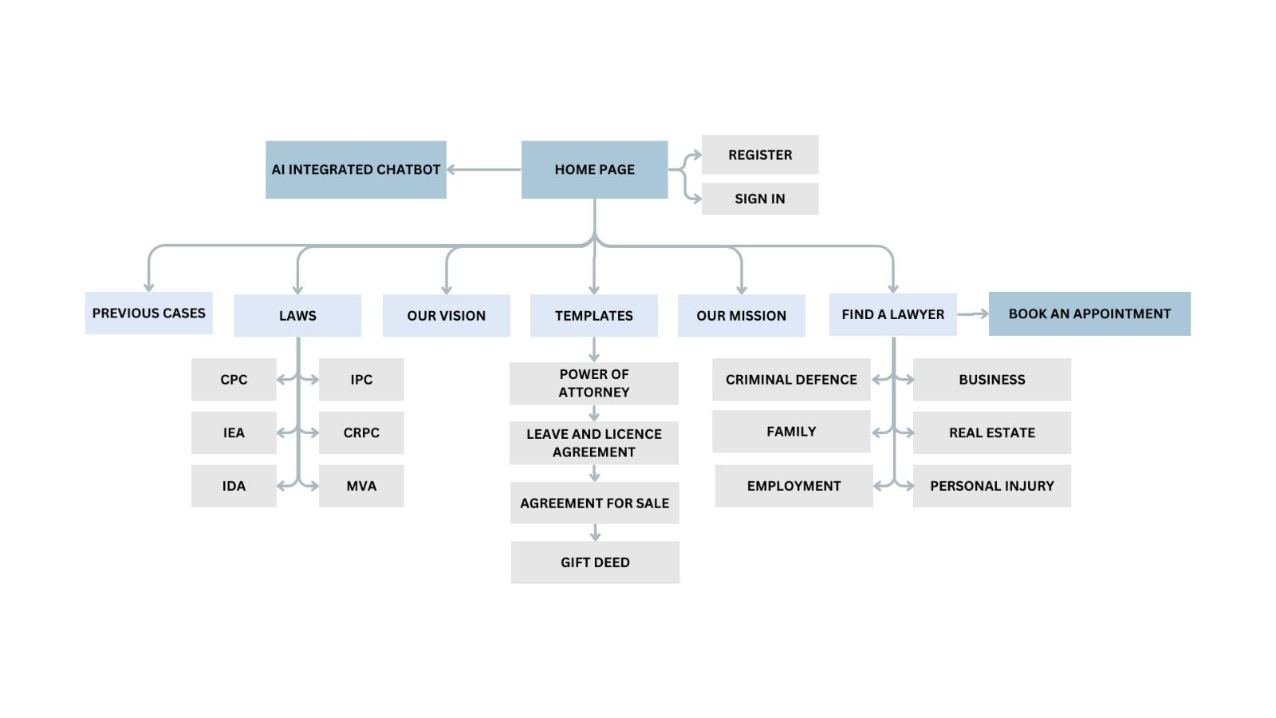
Architecture/ Framework (Block Diagram)

Slide 13
Methodology
App Framework:
The home page will provide the user with the different options to choose from such as Laws, Find a lawyer, Templates and Previous cases . The website is integrated with an AI Chatbot that can help the user understand any law related concept simply and with greater ease. The user can navigate through different law categories as well as book an online appointment with a lawyer. The law categories provided are ipc, cpc, crpc, ida, iea and mva. The website has been made user-friendly by the different filtering options provided on the previous cases page. This ensures easier navigation. Frequently used legal documents can be downloaded and printed from the template's page, these documents get used in legal proceedings. The user can learn more about the website and the vision from the Our mission and Our vision cards on the home page.

Slide 14
Methodology
Server side:
Initially, we compile relevant laws, rules, and legal documents from trusted sources like government websites, legal databases, and legislative archives. We organize this material into user-friendly sections for easier navigation and searchability. Next, a dedicated database is set up to store this legal data, enabling users to search for specific legislation using keywords after filtering. Additionally, we've integrated user registration and login features for personalized access. Moreover, users can conveniently schedule online appointments with legal experts through our website, enhancing the overall user experience and expanding the range of legal services available on our server-side platform.

Slide 15
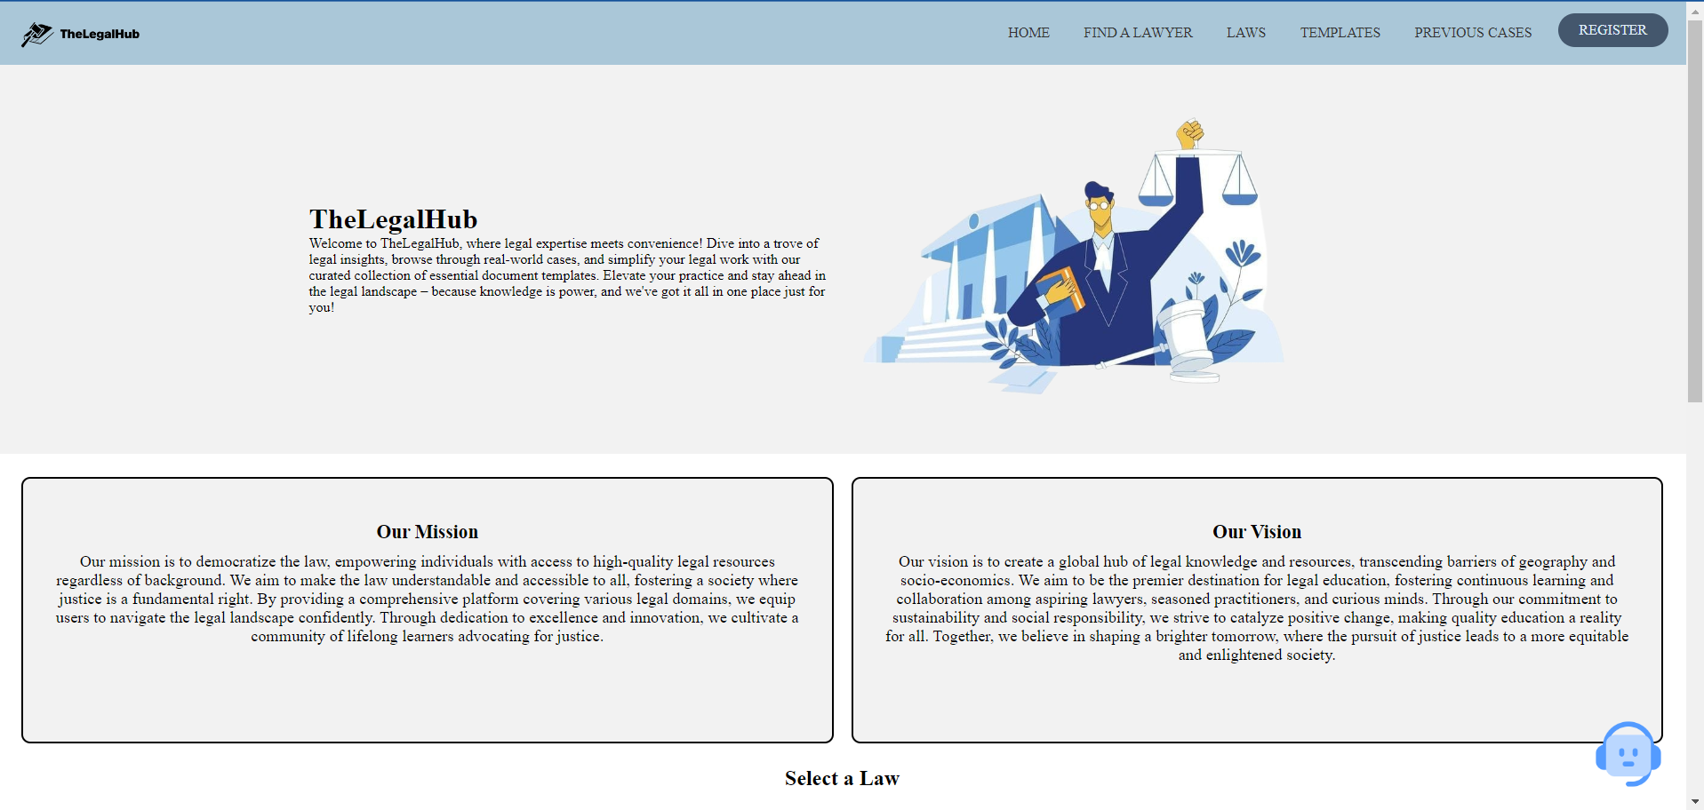
Implementation:HomePage

Slide 16
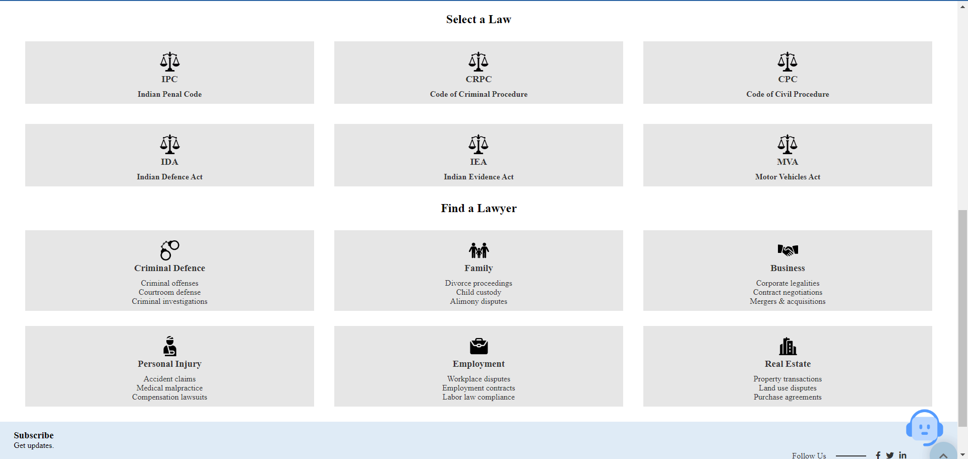
Implementation:HomePage

Slide 17
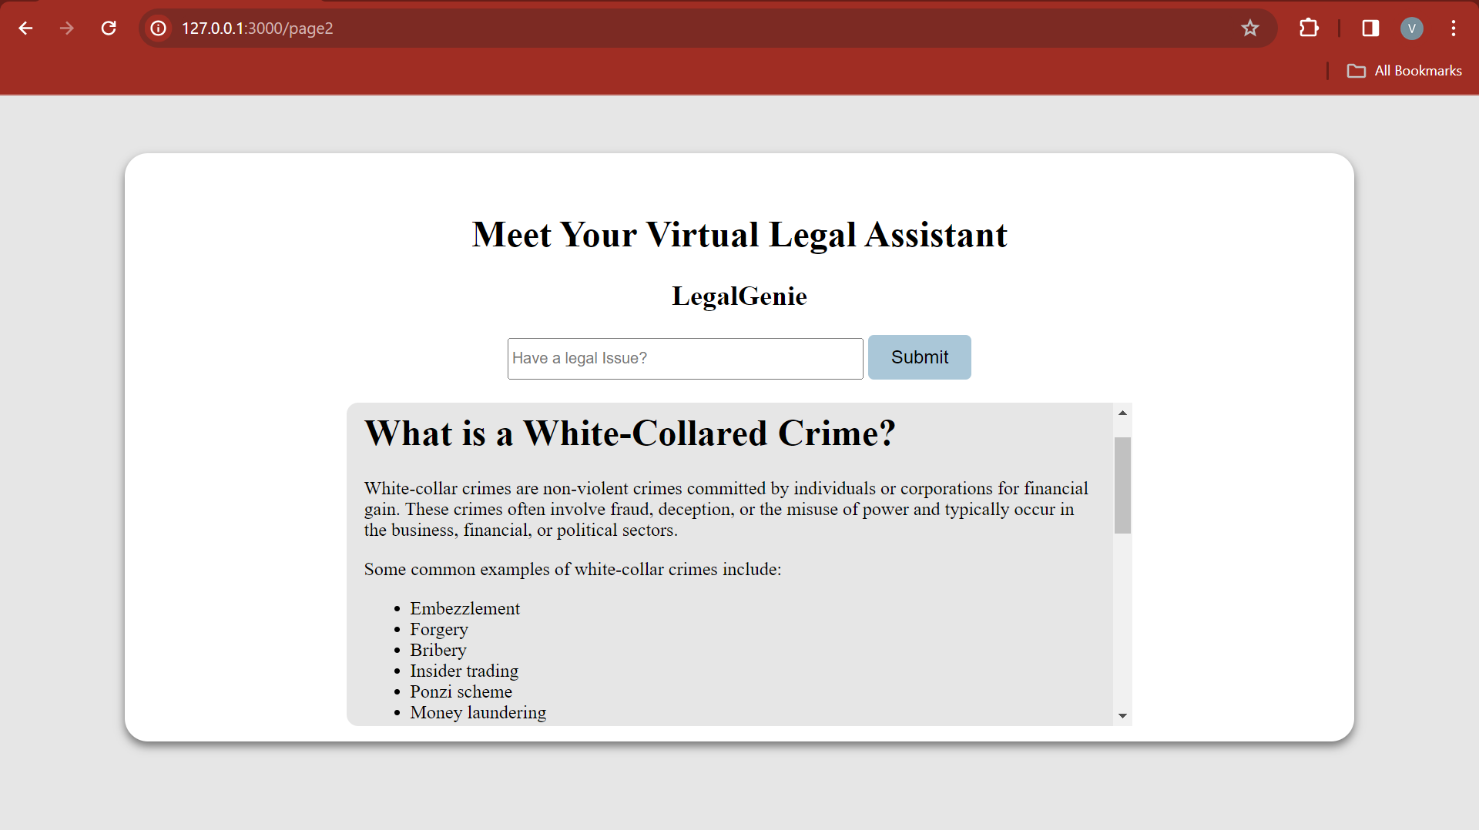
Implementation:LegalGenie

Slide 18
FUTURE SCOPE
Mobile App Development: Creating a mobile app version of the website.
Community and Forums: Building an active online community or forum where users can discuss legal issues, seek advices and share experiences.
Virtual Courtrooms: Case can be resolved online.
Collaborations and Partnerships: Partnering with law firms, legal tech startups or other legal organisations.
Document Processing and Summarization: Implement advanced algorithms to process legal documents and generate concise summaries.

Slide 19
Conclusion
TheLegalHub is an instructive and user friendly website that provides a comprehensive knowledge of the legal services available.
Unlike other platforms, it has features such as clear navigation, extensive material, accurate and dependable information.
It improves learning, keep users up to date on legal updations, fosters a connected legal community, and provides opportunities for collaboration.

Slide 20
References
[1]Raj Kumar Bhardwaj(2019). Development of Online Legal Information System Lawyers Perceptions,Development of Online Legal Information System Lawyers Perceptions
Development of Online Legal Information System Lawyers Perceptions
[2] Utami, Melinda & Zen, Bita & Rauna, Yayi. (2021). Developing a legal assistant website “Notoaturan” using Waterfall method. SinkrOn.
Developing a legal assistant website “Notoaturan” using Waterfall ...
[3] Bhardwaj, R., & Madhusudhan, M. (2016). Online Legal Information System (OLIS) Leveraging Access to Legal Information Resources in Indian Environment. DESIDOC Journal of Library & Information Technology, 36(1).
https://doi.org/10.14429/djlit.36.1.9271

