Slide 1

MapMyForest
Industry / Inhouse Project : 2024 - 25
Review - II
Group Number : 06
Group Members :
Chinmay Desai (D12C / 16)
Gautam Rai (D12C / 53)
Shaanveer Singh (D12C / 61)
Atharva Deore (D12C / 15)
Project Mentor : Dr. Mrs.Gresha Bhatia

Slide 2
Content
Introduction to Project
Lacuna in the existing systems
Problem Definition
Literature Survey
Hardware, Software, tools and the constraints
Methodology employed
Block Diagram
Modular Diagram
Architectural Diagram
Next Work Plan
Conclusion
References

Slide 3
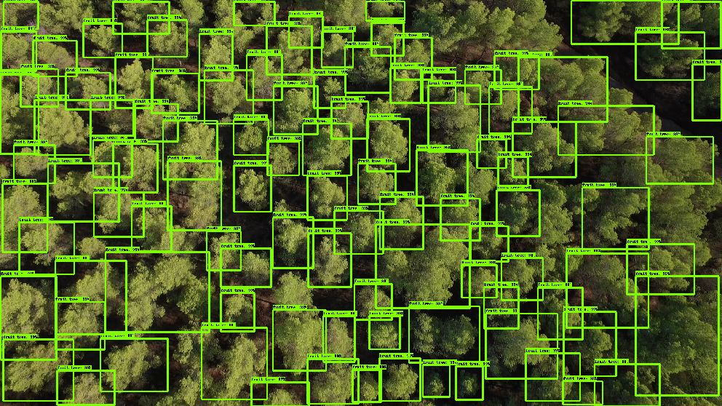
Introduction to Project
MapMyForest is a web based solution designed to support environmental agencies, government bodies, and conservation organizations by providing accurate data on tree populations in forested areas. By analyzing aerial photographs of the designated regions. MapMyForest offers detailed insights into tree density, species distribution, and overall forest health.
The primary goals of MapMyForest:
Improve the precision of environmental impact assessments
Aid in sustainable land management
Automating the process of tree enumeration
Delivering actionable data
This solution empowers better decision-making for conservation and development efforts.

Slide 4
Lacuna in the existing system
Manual Processes: Manual tree enumeration is time-consuming, labor-intensive, and prone to human error.
Scalability Issues: Current automated systems lack scalability and integration with existing forest management platforms.
Data Reliability Concerns: Existing systems struggle with accuracy due to varying image quality and environmental conditions.

Slide 5
Problem Definition
Accurately assessing tree populations in forested areas designated for land diversion is crucial for environmental impact assessments and conservation. Traditional methods, like manual surveys are not error free and also require a lot of labour to complete the enumeration.
Moreover, categorizing trees based on their species and calculating their endangered status manually is extremely tedious and unnecessary in the age of AIML.
To address these challenges, we aim to present an integrated platform that seamlessly analyzes and maps forest land assisted with the power of neural networks and LLMs.

Slide 6
Literature Survey
Title | Abstract | Methodology Used | Lacuna | Key Findings
“Satellite Image Analytics for Tree Enumeration for Diversion of Forest Land” , ssrn-4870495 Saniya Kakade et al., July 2024 | The project develops software to automate tree enumeration using satellite imagery and image analytics, replacing manual surveys. | - GIS-Based Spatial Analysis - Enhanced Vegetation Index (EVI) - Transfer Learning - Data Augmentation - Convolutional Neural Networks (CNN) | The major drawback of the paper is that it does not provide an analysis of the accuracy of the tree enumeration process. | - Automates tree enumeration with improved accuracy and efficiency. - Utilizes machine learning and robust database systems for precise monitoring.
“Intelligent Forest Assessment: Advanced Tree Detection and Enumeration with AI” , ISSN 2582-7421, Ms. Shubhangi Mahule, May 2024 | Develops a tree detection and counting system using YOLOv8 and Roboflow annotations. Achieves high precision and recall, offering an efficient and accurate method for tree enumeration. | - Convolutional Neural Networks (CNN) - YOLOv8 model and roboflow is being used | Limited Real-time Data: Insufficient real-time environmental data integration. Regional Variability: Inadequate customization for different mining regions. | YOLOv8 model achieved over 90% accuracy in tree detection and counting.

Slide 7
Literature Survey (Contd.)
Title | Abstract | Methodology Used | Lacuna | Key Findings
"Deep learning enables image-based tree counting, crown segmentation, and height prediction at national scale", PNAS Nexus, 2023, Martin Brandta et al. | The paper demonstrates a deep learning framework for tree counting, crown segmentation, and height prediction using remote sensing images, showing national-scale effectiveness. | 1. Used remote sensing images. 2. Developed and trained deep learning models. 3. Evaluated performance with accuracy metrics. | 1. Limited by image quality. 2. Needs testing in different regions. 3. High computational demands. | Utilizes deep learning for scalable tree counting, crown segmentation, and height prediction, highlighting advancements in large-scale tree analysis.
Remote Sensing Application for Analysis of Forest Change Detection, 2022 International Conference for Advancement in Technology (ICONAT) Swati Mohod, et al. | The paper uses remote sensing to monitor and analyze forest changes in Yavatmal, India.It employs techniques like NDVI to track vegetation health and changes over time. | Image Classification: K means clustering NDVI (Normalized Difference Vegetation Index) classification | Limited Discussion on Methodological Challenges Spatial Scale and Heterogeneity | Utilizes remote sensing and NDVI to detect forest cover changes, showing a reduction in negative changes to 29.44%.

Slide 8
Hardware, Software, Tools and constraints
Hardware | Software | Tools | Constraints
Developer Specs:- CPU: Intel i5 (10th gen or newer) / AMD Ryzen 5, 16GB RAM or more, 512 SSD or more
User Specs:- CPU: i3 (10th gen or newer), 8GB RAM or more, 264 GB SSD or more
Computer Vision Libraries: OpenCV (v4.8.0), TensorFlow (v2.14.0), PyTorch (v2.0.1)
Image Processing Tools: QGIS (v3.30.3), ArcGIS (v3.1.0)
Frontend Development: React (v18.2.0), Material UI (v5.14.8)
Backend Development: Node.js (v20.5.1), Express (v4.18.2) / Flask (v2.0.1), MongoDB (v8.0)
Imagery Sources: Google Earth Engine, Sentinel Hub | Data Quality: Variations in image quality and environmental conditions can affect detection accuracy
Computer Vision Tool: Rovren Flow | Processing Power: High-performance hardware is required for handling large datasets and complex algorithms
Design Tools: Figma, Canva | Integration: Ensuring seamless integration with existing forest management systems can be challenging

Slide 9

Methodology Employed
In MapMyForest, we aim to create an integrated portal to process aerial or satellite imagery of forest lands and enumerate the number of trees in that area.
Additionally, we intend to analyse and estimate the various categories of trees present in that area using an on-ground video assisted with aerial or satellite imagery.
Lastly, with this data, we will use a LLM to effectively generate a complete report and visualization about the land’s forest mapping and structure.
Development Methodology
Tree Enumeration:
For Tree Enumeration, we will use an Object Detection model using YOLO (You only Look Once) model trained specifically to detect trees from aerial or satellite imagery. This is provide an output pretty efficiently and accurately.
Tree Classification:
For Tree Classification, an on-ground video will be processed using a CNN (Convolutional Neural Network) assisted by location data to further improve accuracy.

Slide 10
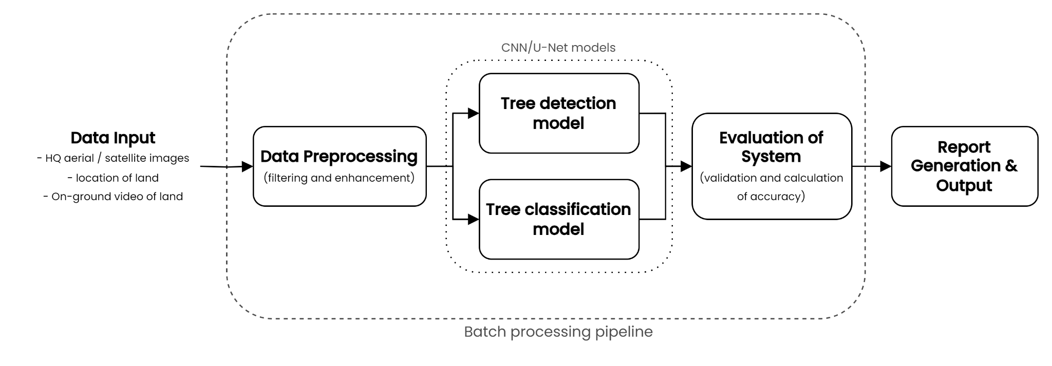
Block Diagram

Slide 11
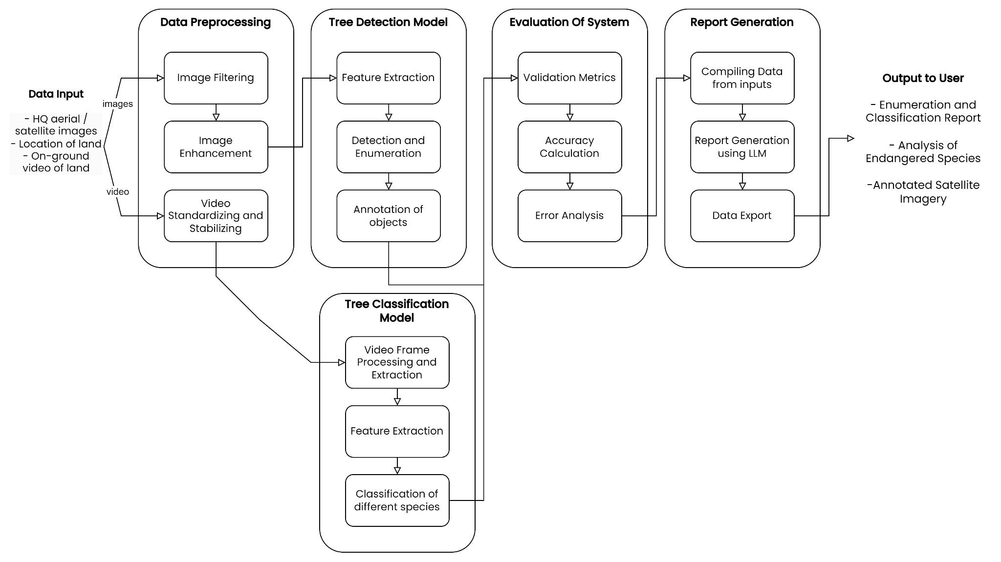
Modular Diagram

Slide 12
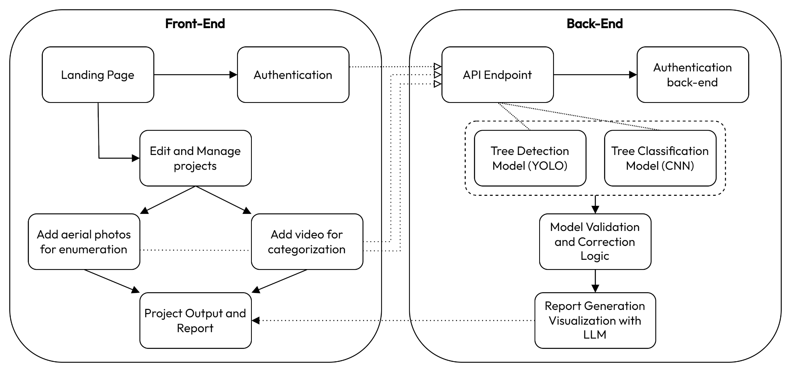
Architectural Diagram

Slide 13
Next Work Plan
Phase 1: Model Development and Dataset Collection Develop and train the core model for detecting and enumerating trees using collected datasets.
Phase 2: User Interface Creation Design and build a user-friendly interface with visualizations and control panels.
Phase 3: Integration Combine the model with the UI, ensuring seamless functionality and connectivity.
Phase 4: Testing and Evaluation Perform comprehensive testing to evaluate functionality, performance, usability, and accuracy.
Phase 5: Final Review and Documentation Complete the final system review, prepare all documentation, and close the project.

Slide 14
Conclusion
Simplify Tree Enumeration: The image analytics solution offers a simpler approach to tree enumeration by automating and scaling the process, which enhances efficiency and accuracy.
Improved Decision-Making: The automated analysis provides precise data that supports more informed decision-making regarding land use and conservation efforts.
Seamless Integration: Designed to work seamlessly with existing forest management tools, the solution integrates effortlessly into current systems, improving their functionality.
Commitment to Standards: The solution adheres to ethical and environmental standards, ensuring that forest management practices remain responsible and sustainable.

Slide 15
References
“Satellite Image Analytics for Tree Enumeration for Diversion of Forest Land” , SSRN, Saniya Kakade Et all, July 2024
Ms. Shubhangi Mahule , Thatikonda Pranathi , Thadepu Bhuvan Ranjan , Tirumani Asha Kiran , Arrolla Siddhartha “Intelligent Forest Assessment: Advanced Tree Detection and Enumeration with AI” ,ISSN 2582-7421 , May 2024
Martin Brandta, Rasmus Fensholta, “Deep learning enables image-based tree counting, crown segmentation, and height prediction at national scale” PNAS Nexus, 2023.
Remote Sensing Application for Analysis of Forest Change Detection, 2022 International Conference for Advancement in Technology (ICONAT) Swati Mohod, et al
F.Z. Bassine, A. Errami, M. Khaldoun “Real time Algorithm for Tree Detection, Recognition and Counting in a Video Sequence”, J . Mater. Environ. Sci., Volume 11, Issue 3, Page 367-377, 2020.
CHIA-YEN CHIANG, CHLOE BARNES "Deep Learning-Based Automated Forest Health Diagnosis From Aerial Images" accepted July 9, 2020, date of publication July 28, 2020, date of current version August 18, 2020.
WASSIM BOUACHIR, NIZAR BOUGUILA "Computer Vision System for Automatic Counting of Planting Microsites Using UAV Imagery" Received May 17, 2019, accepted June 8, 2019, date of publication June 19, 2019, date of current version July 9, 2019.
Y. Wang and Y. Zou, ‘‘Fast visual object counting via example-based density estimation,’’ in Proc. IEEE Int. Conf. Image Process. (ICIP), pp. 3653–3657, Sep. 2016.
S. V. Koneru et al., "Detection and Enumeration of Trees using Cartosat2 High Resolution Satellite Imagery," IEEE International Conference on Aerospace Electronics and Remote Sensing Technology (ICARES), Bali, Indonesia, 2018, pp. 1-6, doi: 10.1109/ICARES.2018.8547072, 2018.
G. Grenzdörffer, ‘‘UAS-based automatic bird count of a common gull colony,’’ Int. Arch. Photogram., Remote Sens. Spatial Inf. Sci., vol. 1, p. W2, 2013.

