Slide 1
Graphs for workflow

Slide 2
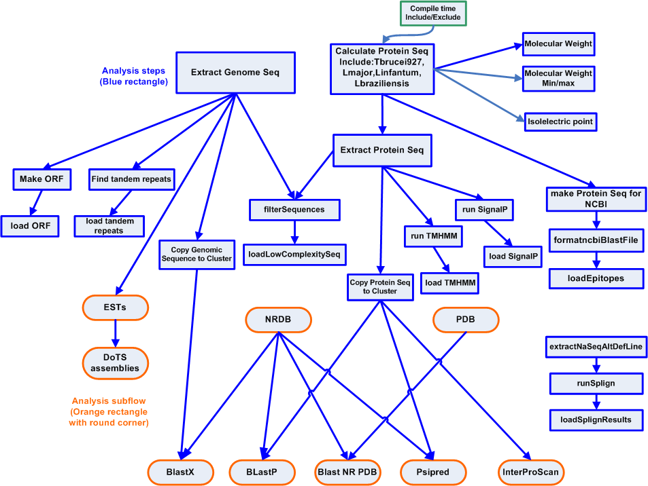
Genome Workflow

Slide 3
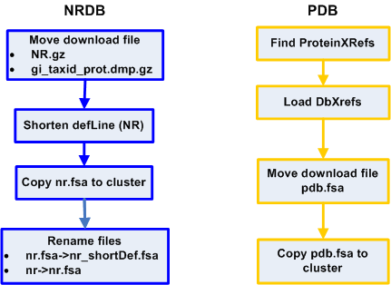
NRDB/PDB Sub-flows

Slide 4
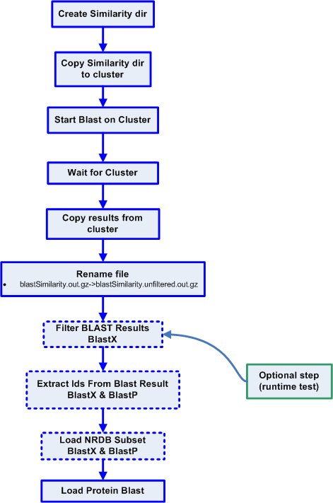
Blast Sub-flows

Slide 5
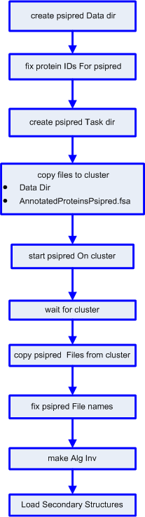
Psipred Subflow

Slide 6
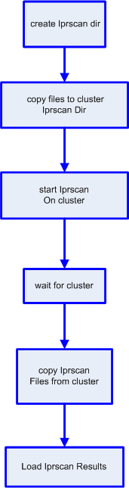
InterproScan Subflow

Slide 7
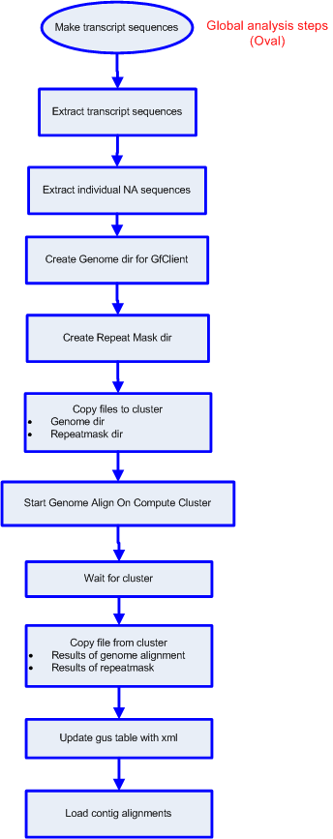
ESTs Subflow

Slide 8
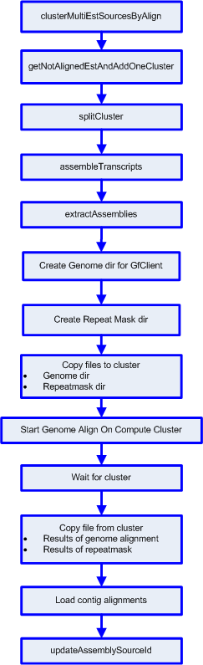
Dots Assemblies Subflow

Slide 9
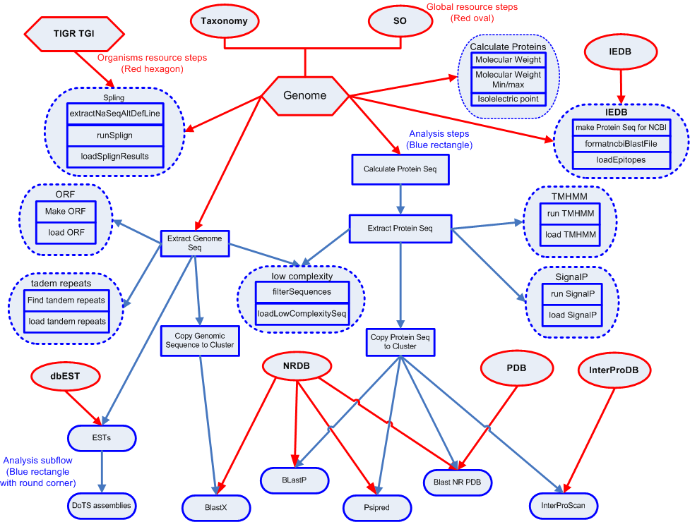
Genome Workflow

Slide 10
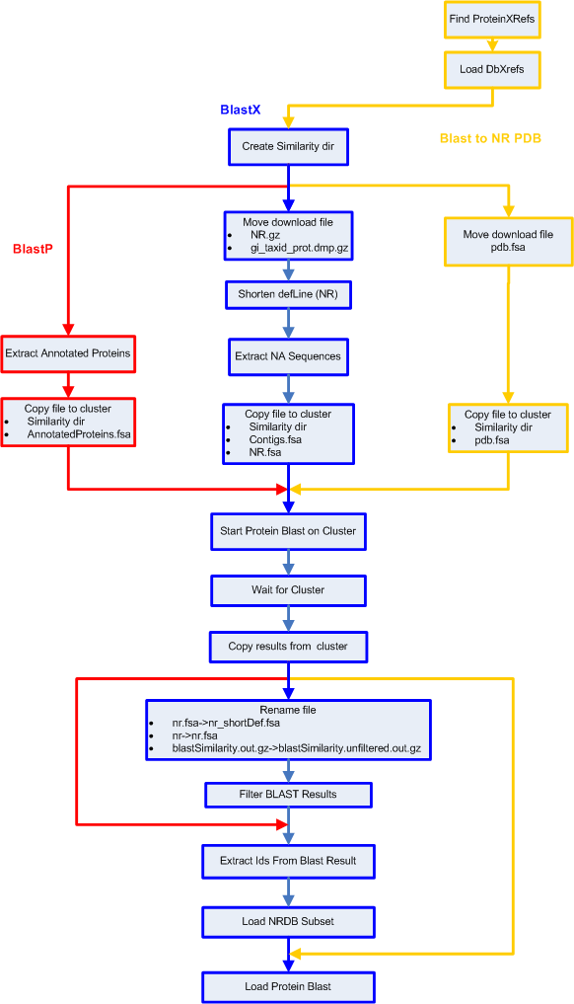
Blast Sub-flows

