Slide 1
Web Development Kit (WDK)
Y. Thomas Gan
ygan@pcbi.upenn.edu

Slide 2
Everything you need to know about WDK is here
http://gusdb.org/wdk
  Documentation: http://gusdb.org/wiki/index.php/GusWdk
  Download: http://cbil.upenn.edu/downloads/GUS-WDK
  Demo: http://gusdb.org/wdk/toy

Slide 3
Overview
Why WDK – motivation
What is it about – review of concepts
How do I use it – practical matters

Slide 4
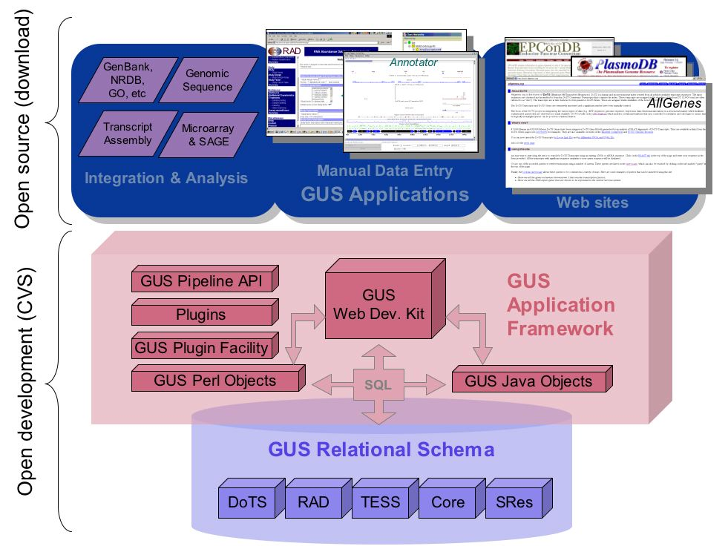
The 3 tiers of GUS platform

Slide 5
Making GUS data accessible
GUS is hosting data
  of increasingly diverse types
  of increasingly large quantities
  at increasing number of institutions
GUS data is supporting more websites
  Allgenes, plasmodb, EPConDB, RAD
  GeneDB @ Sanger
  CryptoDB, ToxoDB, ApiDB at U. Georgia
  others to come at U. Chicago, Virginia Bioinformatics Institute
Growing need to unify and simplify website development
Notes:
GUS hosts pretty diverse types of genomics and functional genomics data in pretty large quantities. Furthermore, GUS is being adopted by an increasing number of institutions.
The list of websites supported by GUS data is also expanding. Allgenes & plasmodb at PCBI, EPConDB, RAD, and ApiDoTS under CBIl, GeneDB at sanger, and others to come at University of Chicago, University of Georgia, and Virginia Bioinformatics Institute.
Therefore, there is growing need to unify and simplify website development.

Slide 6
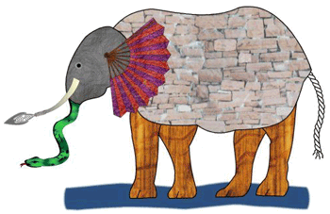
Need to support many (customizable) views on the same data
–
Notes:
We realize that each GUS website may be implemented with a Model-View-Controller design pattern.
Think of the GUS data model as a big elephant, separating the presentation logic in the views from the model allows both the freedom to evolve independently.
The consumers of the model can see the data in whatever ways they choose, how many ever ways they want.
The controller loosely ties the views with the model, and enables flexible navigation among the views.
Apparently, with enough abstraction, all GUS web applications can be implemented with on generic solution.

Slide 7
More GUS WDK motivations
Provide an abstract data model on top of GUS
  Resilient to minor changes of schema
Centralize all queries used by a website
  Develop and test in non-web context
  Easier to maintain
Helps identify key entities in a website (e.g. Gene, RNA, Experiment etc)
Notes:
GUS hosts pretty diverse types of genomics and functional genomics data in pretty large quantities. Furthermore, GUS is being adopted by an increasing number of institutions.
The list of websites supported by GUS data is also expanding. Allgenes & plasmodb at PCBI, EPConDB, RAD, and ApiDoTS under CBIl, GeneDB at sanger, and others to come at University of Chicago, University of Georgia, and Virginia Bioinformatics Institute.
Therefore, there is growing need to unify and simplify website development.

Slide 8
The goal of WDK
Make the task of building data mining websites for users to be
  Easy – as little work as possible
  Fun – focus on what you know best and what you really care about (describing your data, business logic, presentation preference)
  This is possible because WDK takes care of the rest, which is
    Not so easy
    Not so fun (for intended WDK users)
    But fun for WDK developers
    And it has to be done only once

Slide 9
Overview
Why WDK – motivation
What is it about – review of concepts
How do I use it – practical matters

Slide 10
Question-Summary-Record
(Q-S-R) paradigm
On a data mining website, we ask canned questions
We get back a summary that we can page through
We may choose to go to a detailed record page for each entry in the summary

Slide 11
Take a quick tour
WDK Toy site
CryptoDB
NOTE:
  They present different data
  The WDK works with any data model
  The WDK does NOT depend on GUS relational schema or any object layer *

Slide 12
The Model-View-Controller (MVC) pattern
Views
Models
(DTOs)
Domain
Models
Controllers

Slide 13
The WDK Model
Your model.xml file determines your model
It specifies the questions, summaries and records for the site
It also specifies the queries that underlie them

Slide 14
Understanding Questions
Inquiries the user poses
Here is the analogy
  Question is to Record set
      as
  Query is to Row set
In other words, a Question returns a set of Records

Slide 15
Understanding Records
Structured descriptions of result entries
Records have
  Attributes (simple values)
  Tables (table values)
  Nested Records (record values)
Attributes are created from AttributesQueries
  They may be embedded in blocks of text to yield textAttributes
  They may be used as cgi parameters to yield linkAttributes
Tables are created from TableQueries
Nested Records are pointers to other records (they can be single or a list)

Slide 16
Other Model concepts: Query
Query: a query to retrieve data
  Available now: sqlQuery
  To come: flatFileQuery, processQuery
sqlQuery
  Id query for a question: get a list of primary keys
  Attribute & table queries for a record: get data by id
  Controlled vocabulary queries: get parameter option items
An sqlQuery has
  paramRef: reference to parameters used by query
  column: describes a column that is part of the result
  sql: the sql statement to run. Embed parameter values by using the parameter's name surrounded by '$$', eg., '$$taxon$$'

Slide 17
Other Model concepts: Parameter
stringParameter: a parameter whose value is a string
flatVocabParameter: a parameter that provides a list of choices (through a controlled vocabulary query)

Slide 18
Other Model concepts: set, name, and reference
set: organize things
  querySet
  parameterSet
  recordClassSet
  questionSet
name: two part name setname.elementname
reference: objects in the model may refer to other objects defined in the model
  uses the unique two part name of the referent

Slide 19
Take a quick tour
toyModel.xml
toyModel.prop

Slide 20
The WDK View
Runs under tomcat (requires tomcat 5.x)
Written in JSP
The Model has a JSP Expression Language compatible API
The default view requires no work to come right up
  question.jsp
  summary.jsp
  record.jsp

Slide 21
Take a quick tour
questionSets.jsp
question.jsp

Slide 22
Overview
Why WDK – motivation
What is it about – review of concepts
How do I use it – practical matters

Slide 23
When can I benefit from WDK?
you have a relational DB (oracle or postgreSQL) and a struts-enabled webserver (eg apache + tomcat)
you need a website that enables a number of data mining questions to be asked against your DB
the questions or the schema may change frequently

Slide 24
How can I start using WDK?
Get WDK software (http://gusdb.org/wdk)
Work on your WDK Model
  Specifies the questions, summaries and records
Work on your WDK View
  Presents the questions, summaries and records
    site configuration/customization
    DB connection
    logo, header, footer, style-sheet
    custom pages if desired
Notes:
This generic solution we are working on is GUS Web Development Kit or WDK.
WDK has a model, which includes classes such as Question, QuestionSet, Query, Answer, Summary, Record. The objects are configured in a model config XML file that we will see a sample of later on.
WDK has a set of default views. We also provide apparatus for view customizations.
And WDK surely also has a controller for things like page flow control and error handling.
In addition there is a set of command line tools for development and testing of models efficiently without dealing with web servers.
Finally there is a toySite with toyDB for quick start

Slide 25
How do I write a model without a view?
Use toyModel.xml as a template
Consult the schema wdkModel.rng in the Model’s library for allowed tags
Use Model’s Unix command line tools to develop your model without having to hassle with debugging in a web context
  wdkTestDb, wdkCache
  wdkXml
  wdkRecord, wdkSummary, wdkQuery
  wdkSanityTest

Slide 26
How do I test my Model?
Use the command line tools first
  The most important is wdkSanityTest
  Because all the queries that drive your website are all in one file (yourModel.xml file), you can TEST with wdkSanityTest
  Trouble shoot with other command line tools, eg.
    wdkQuery -model toyModel -query RnaIds.ByDbESTLib -params NumEstLibs 6 AssemblyConsistency 80
    wdkRecord -model toyModel -record RnaRecordClasses.RnaRecordClass -primaryKey 92484673
Test on your website only after wdkSanityTest succeeded

Slide 27
Take a quick tour
toyModel-sanity.xml

Slide 28
How do I config my site?
Use web.xml.toy as template for web app config
Use toyModel-config.xml as template for database config
Rename header.tag.toy to header.tag and use your own logo
Rename footer.tag.toy to footer.tag and make edits as needed

Slide 29
Take a quick tour
web.xml.toy
toyModel-config.xml

Slide 30
How do I customize my view?
Use and modify style sheet that comes with the toySite
Provide JSP files that use a naming convention so that WDK can find them
For example
  customPages/EstRecordClasses/EstRecordClass.jsp, if exists, is displayed in place of record.jsp as a customized view of records of the type EstRecordClasses/EstRecordClass
To come very soon
  customPages/customRecord|Question|summary.jsp
  customPages/<QuestionSet>/<Question>.jsp
  customPages/<QuestionSet>/<Question>.summary.jsp

Slide 31
Future plans
Bug fixes
New features:
  query history
  process queries (eg. BLAST)
  query context
  graphics plugin
  improve view / controller customizability

Slide 32
Take a quick tour
Query history on plasmoDB.org

Slide 33
WDK architecture overview
browser
client
response
request
server
webapp startup
web.xml & struts config.xml
jsp pages
tags
images
style sheet
AppInitListener
ActionForms
Actions
Servlet
Session
Application
View
Controller
Tomcat servlet engine
jsp wrappers
eg WdkModelBean
modelXML
model
XML
parser
WdkModel
DB
Utils
SQL
GUS relational schema
Q-S-R
classes
Model

