Slide 1


First GUS Workshop
July 6-8, 2005
Penn Center for Bioinformatics
Philadelphia, PA

Slide 2
Workshops Goals
Work through issues
  Installing GUS
  Loading data into GUS
  Analyzing and viewing data in GUS
Coordinate future development
  Changes to schema and application framework
  New plug-ins
  New application adapters

Slide 3
A Brief History of GUS
Genomics Unified Schema
  V1.0 in 2000
  Previously had separate databases for:
    Genome annotation
    EST assemblies (DoTS)
    Microarrays and SAGE (RAD)
    Transcription element search software (TESS)
  Strengthen each effort by providing deep annotation
    e.g., cDNAs on microarray in RAD get annotation from assemblies in DoTS
  Learn and store relationships between genes, RNAs, and proteins
    Strong typing: meaningful relationships

Slide 4
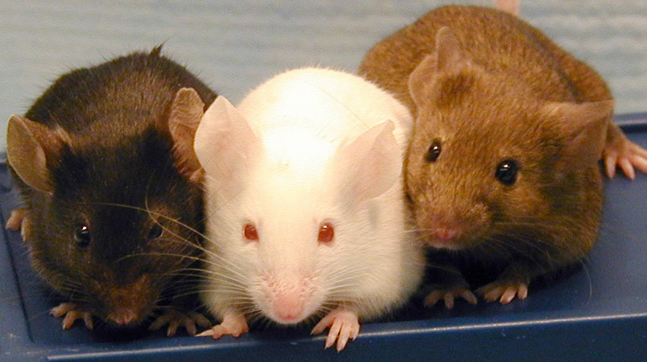
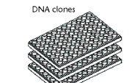
BioMaterial annotation
SRES
RAD
EST clustering
and assembly
DoTS
Identify shared
TF binding sites
Genomic alignment
and comparative
sequence analysis
TESS

Slide 5
GUS versus Chado
GUS represents biology in the database tables
  Forces applications to load and retrieve data consistently
Chado represents biology in the applications
  Allows flexibility in what can be stored but applications may not be consistent

Slide 6
GUS Project Goals
Provide:
  A platform for broad genomics data integration
  An infrastructure system for functional genomics
Support:
  Websites with advanced query capabilities
  Research driven queries and mining
Notes:
About a year and a half ago we packaged GUS for distribution.
Goals are for:
- our internal use
- and for GUS users

Slide 7
GUS 3.5 Schemas
Schemas | Domain | Features
DoTS | Sequence and annotation | EST clusters Gene models
RAD | Gene expression | MIAME
Prot | Protein expression | Mass spec mzdata
Study | Experiments | FuGE
TESS | Gene Regulation | TFBS organization
SRes | Shared resources | Ontologies
Core | Administration | Documentation, Data Provenance

Slide 8
DoTS: Central dogma and relating biological sequences
Gene
Feature
RNA
Feature
Protein
Feature
NA Sequence
AA Sequence
Load GenBank, NRDB, sequencing center files, dbEST entries
Notes:
The original paradigm in genomics was sequence and features. Sequences had many features

Slide 9
DoTS: Central dogma and relating biological sequences
Gene
RNA
Protein
Concepts that are independent of any individual sequence because sequences may be incomplete, a variant, or not well annotated.
Gene
Feature
RNA
Feature
Protein
Feature
NA Sequence
AA Sequence
Notes:
As functional, splicing and translational information became available our paradigm has shifted towards Genes, RNAs and Proteins as integrative entities.

Slide 10
DoTS: Central dogma and relating biological sequences
Gene
RNA
Protein
RNA
Multiple sequences (experimental variety)
Multiple genes
Gene 1
Gene 2
genome
NA Sequence
AA Sequence
Concepts may be related to multiple sequences due to biology, experiments, or computational predictions.
Notes:
To connect these two representations we need to deal with the cardinality issues.
The genome sequence has multiple genes; On account of experimental and prediction variety, RNAs and proteins have multiple sequences.

Slide 11
DoTS: Central dogma and relating biological sequences
Gene
RNA
Protein
Gene
Instance
RNA
Instance
Protein
Instance
Gene
Feature
RNA
Feature
Protein
Feature
NA Sequence
AA Sequence
Instances reflect our understanding of sequence associations.
Notes:
We use instances to complete the representation.
They capture the relationship and can contain evidence to explain it as needed

Slide 12
RAD: Loading/Annotation
GUS::Supported::LoadArrayDesign
Load Array Info
RAD::StudyAnnotator::Study Form
Create new study (web)
RAD::StudyAnnotator::Module I (all software) Or (some software)
GUS::Community::Plugin::InsertMAS5Assay2Quantification or GUS::Community::Plugin::InsertGenePixAssay2Quantification
Create assays, acquisitions
and quantifications
RAD::StudyAnnotator::Module II
RAD::StudyAnnotator::Module III
GUS::Supported::Plugin::LoadArrayResults Or GUS::Community::Plugin::LoadBatchArrayResults
Load quantification data
Annotate experimental design
and biomaterials (web)
GUS::Supported::Plugin::InsertRadAnalysis
Load processed data or analysis results
End

Slide 13
Prot and Study: Generalization of RAD to other technologies
RAPAD prototype made a copy of RAD and dropped/inserted tables for 2-D gels and mass spec.
  Jones et al. Bioinformatics. 2004
In GUS 3.5, Study contains descriptions of samples (BioMaterials), sample protocols, and experimental design.
  Technology-specific protocols are in RAD, Prot.
In GUS 3.5, Prot is now based on standard mzdata output of mass spectrometers
  To add soon, Peptide identification from programs like Sequest and MASCOT (held in DoTS currently)

Slide 14
TESS: TF to binding site relationships in the context of computational models
Notes:
Who - which TFs or other molecules are involved the (regulatory) activity How - how we generated training sets or did analyses, modeled after RAD Annotating - marking known or credible predictions of binding sites and other cis-signals Learning - along with training sets, the process of learning regulatory modules Predecessors - part of learning; relates simple models to incrementally more complex models. Model Families - relating redundant models to each other, e.g., PWMs What - what regulatory activity is of interest, e.g., simple TF-DNA binding, transcription in general, liver-specific transcription, etc.

Slide 15
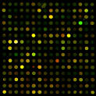
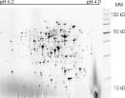
Experimental Design and Samples (Study)
Sequence
& Features
Expression (RAD)
Proteomics (Prot)
MIAME
MIAPE
New schemas for additional domains
Central Dogma
(DoTS)
Image Analysis
Image Analysis
Statistical Processing
Statistical Processing
Regulation (TESS)
Interaction
Functional Annotation of the Genome
Notes:
For ImmunoHistoChemistry, we will work with the Stem Cell Gene Anatomy Project in an effort to advance the MiFISHIE standard, and make our schema compliant

Slide 16
Future Schemas
Population genetics
  Relate polymorphisms, genotypes, phenotypes
  Currently in DoTS
Comparative genomics
  Syntenies, phylogenies
  Currently in DoTS
Metabolomics
  Small molecules
  Use Study and adapt Prot
In situs / Immunohistochemistry
  Use Study and adapt RAD

Slide 17
GUS Components
Schema
Application Framework
  Object/Relational Layer
  Plugin API
  Pipeline API
Plug-ins
Web Development
Kit (WDK)

Slide 18
GUS Application Framework
Motivation: Consistent and reusable access and manipulation of data
Object Relational: 1:1 Mapping between tables and language objects
Provides
  Relationship Management
  Cascading Operations
  Cache Management
  Basic Access Control
Automation of Data Provenance and Evidence
With APIs, foundation for advanced tools and applications.

Slide 19
Web Development Kit (WDK)
Database Independent
Facilitates development of data mining oriented websites:
  Multiple parameterized canned queries
  Sophisticated records
  Graphical views
  Boolean query facility
  Query history
  Session management, process pooling, flow control
Model, View, Controller (MVC) Design
  Separates application logic (Model) from website layout (View) and application flow (Controller)
  Model: XML-based queries and records
  View: JSP
  Controller: Struts

Slide 20
GUS Version Caveat
GUS 3.0 ~ 12/02
GUS 3.1 ~ 12/03
GUS 3.2 ~ 02/04
  Concrete Schema Versions
  Application Code in Flux
GUS 3.5 - 6/05
  First concrete release with distributable
Proposal: Separate versioning for Schema and Application Framework

Slide 21
GUS 3.5
Improved Distribution
  Installer, DBAdmin Tools
  Bootstrap Data -- Algorithm Parameters, Core.TableInfo
  Plugin Quality -- “New” API, Tested
  Documentation -- Install, User’s, and Developer’s Guides
  Requisite jars Included -- Oracle, PostgreSQL
Extended Support
  PostgreSQL Compatible
  Java Object Model -- Consistently Compiles
Schema Improvements
  Proteomics Support
  Standard Study Support
  Schema Cleanup
    Requested schema fixes primarily to DoTS
    Removal of deprecated tables -- Workflow

Slide 22
GUS 3.? -> 3.5 Migration
Not Trivial
  Many potential starting points
  Not all data has a migration path
Upgrade Possibilities
  In Place Upgrade
  Data load and transform
  Start New
Possible Routes
  GUS DBAdmin Tools
  Third party (OEM) Tools
  Everyone for themselves

Slide 23
GUS 3.5.1
Small Schema Changes
  TESS, Attribute Changes
Improved Developer’s and User’s Guides
Additional Supported Plug-ins
DBAdmin Code Cleanup
Upgrade Scripts
Expected early August

Slide 24
GUS 4.0 and beyond
Object Layer Improvements
  Class::DBI-- Perl O/R Layer
  Hibernate -- Java O/R Layer
Improved Subclassing
  Multiple Layers
  Eliminate Performance Issues
Refactor DoTS
Redistribute tables between RAD, Prot, and Study
Additional Biological Domains

Slide 25
GUS Project Resources
Website -- http://www.gusdb.org
  News, Documentation, Distributable, GUS-based Projects

Slide 26
GUS Project Resources
Mailing List
http://lists.sourceforge.net/lists/listinfo/gusdev-gusdev
  ~ 90 Subscribers
  1700 Messages over 3 years
GUS Wiki -- http://www.gusdb.org/wiki
  User Notes and Documentation
    Central Dogma Schema Design
    Subclassing System
    Data Provenance
    Development Tracking: 3.5 Roadmap, 4.0 Schema Ideas
    WDK Documentation

Slide 27
GUS Project Resources
Subversion Source Control System
  Anonymous Read Access for “Bleeding Edge” releases
  Web-based Code Review -- https://www.cbil.upenn.edu/svnweb/
  “Commits” Mailing List
Schema Browser
http://www.gusdb.org/cgi-bin/schemaBrowser
  Online Schema and Relationships Review
GUS Issue Tracker -- https://www.cbil.upenn.edu/tracker/
  Bugzilla Based

Slide 28
GUS Project Coordination - Areas of Focus
Administration
  Installer, Data Bootstrapping, dba Utilities
Schema
  Data model, Subclassing Techniques, Data Provenance
Framework
  Object/Relational Technologies, Plugin & Pipeline APIs
Plug-in
  Data loading mechanisms

Slide 29
GUS Project Coordination - Areas of Focus
Documentation
  Installation, User’s, and Developer’s Guides
  Wiki
Web Development Kit
  Well established working group
Tool adapters
  GBrowse, Apollo, etc. Integration
Later: Development Priorities Discussion
  Where should we focus our efforts?

