Slide 1
Running GBrowse and DAS/1 on GUS
Haiming Wang
Jessica Kissinger Laboratory, Genetics C210
University of Georgia
GUS Workshop
August 8, 2005

Slide 2
Outline
Background information
  - overview of GFF3 (Generic Feature Format)
  - overview of DAS/1 and DAS/2
  - overview of GBrowse
GUS-GBrowse adaptor
- design principle and system architecture
- customize configuration file
- turn a GUS instance into a DAS/1 server
- generate GFF3 data from GUS
- customize popup tooltips
- generate images embedded into WDK

Slide 3
Generic Feature Format Version 3 - GFF3
9 columns, tab-delimited flat file format
Controlled vocabulary for feature types
    Either SO term or SO accession number
    gene SO:0000704
    mRNA SO:0000234
Hierarchical grouping of features and subfeatures
Allow a single feature, such as exon, to belong to more than one group at a time

Slide 4
Generic Feature Format Version 3 - GFF3
##gff-version 3
##sequence-region ctg123 1 1497228
ctg123 genbank gene 1000 9000 . + . ID=gene00001;Name=EDEN
ctg123 genbank TF_binding_site 1000 1012 . + . ID=tfbs00001;Parent=gene00001
ctg123 genbank mRNA 1050 9000 . + . ID=mRNA00001;Parent=gene00001;Name=EDEN.1
ctg123 genbank mRNA 1050 9000 . + . ID=mRNA00002;Parent=gene00001;Name=EDEN.2
ctg123 genbank mRNA 1300 9000 . + . ID=mRNA00003;Parent=gene00001;Name=EDEN.3
ctg123 genbank exon 1300 1500 . + . ID=exon00001;Parent=mRNA00003
ctg123 genbank exon 1050 1500 . + . ID=exon00002;Parent=mRNA00001,mRNA00002
ctg123 genbank exon 3000 3902 . + . ID=exon00003;Parent=mRNA00001,mRNA00003
ctg123 genbank exon 5000 5500 . + . ID=exon00004;Parent=mRNA00001,mRNA00002,mRNA00003
ctg123 genbank exon 7000 9000 . + . ID=exon00005;Parent=mRNA00001,mRNA00002,mRNA00003
ctg123 genbank CDS 1201 1500 . + 0 ID=cds000001;Parent=mRNA0001;Name=edenprotein.1
ctg123 genbank CDS 3000 3902 . + 0 ID=cds000001;Parent=mRNA0001;Name=edenprotein.1
ctg123 genbank CDS 5000 5500 . + 0 ID=cds000001;Parent=mRNA0001;Name=edenprotein.1
ctg123 genbank CDS 7000 7600 . + 0 ID=cds000001;Parent=mRNA0001;Name=edenprotein.1
ctg123 genbank CDS 1201 1500 . + 0 ID=cds000002;Parent=mRNA0002;Name=edenprotein.2
ctg123 genbank CDS 5000 5500 . + 0 ID=cds000002;Parent=mRNA0002;Name=edenprotein.2
ctg123 genbank CDS 7000 7600 . + 0 ID=cds000002;Parent=mRNA0002;Name=edenprotein.2
ctg123 genbank CDS 3301 3902 . + 0 ID=cds00003;Parent=mRNA0003;Name=edenprotein.3
ctg123 genbank CDS 5000 5500 . + 2 ID=cds00003;Parent=mRNA0003;Name=edenprotein.3
ctg123 genbank CDS 7000 7600 . + 2 ID=cds00003;Parent=mRNA0003;Name=edenprotein.3
ctg123 genbank CDS 3391 3902 . + 0 ID=cds00004;Parent=mRNA0003;Name=edenprotein.4
ctg123 genbank CDS 5000 5500 . + 2 ID=cds00004;Parent=mRNA0003;Name=edenprotein.4
Ctg123 genbank CDS 7000 7600 . + 2 ID=cds00004;Parent=mRNA0003;Name=edenprotein.4

Slide 5
Generic Feature Format Version 3 - GFF3
##gff-version 3
##sequence-region ctg123 1 1497228
ctg123 genbank gene 1000 9000 . + . ID=gene00001;Name=EDEN
ctg123 genbank TF_binding_site 1000 1012 . + . ID=tfbs00001;Parent=gene00001
ctg123 genbank mRNA 1050 9000 . + . ID=mRNA00001;Parent=gene00001;Name=EDEN.1
ctg123 genbank mRNA 1050 9000 . + . ID=mRNA00002;Parent=gene00001;Name=EDEN.2
ctg123 genbank mRNA 1300 9000 . + . ID=mRNA00003;Parent=gene00001;Name=EDEN.3
ctg123 genbank exon 1300 1500 . + . ID=exon00001;Parent=mRNA00003
ctg123 genbank exon 1050 1500 . + . ID=exon00002;Parent=mRNA00001,mRNA00002
ctg123 genbank exon 3000 3902 . + . ID=exon00003;Parent=mRNA00001,mRNA00003
ctg123 genbank exon 5000 5500 . + . ID=exon00004;Parent=mRNA00001,mRNA00002,mRNA00003
ctg123 genbank exon 7000 9000 . + . ID=exon00005;Parent=mRNA00001,mRNA00002,mRNA00003
ctg123 genbank CDS 1201 1500 . + 0 ID=cds000001;Parent=mRNA0001;Name=edenprotein.1
ctg123 genbank CDS 3000 3902 . + 0 ID=cds000001;Parent=mRNA0001;Name=edenprotein.1
ctg123 genbank CDS 5000 5500 . + 0 ID=cds000001;Parent=mRNA0001;Name=edenprotein.1
ctg123 genbank CDS 7000 7600 . + 0 ID=cds000001;Parent=mRNA0001;Name=edenprotein.1
ctg123 genbank CDS 1201 1500 . + 0 ID=cds000002;Parent=mRNA0002;Name=edenprotein.2
ctg123 genbank CDS 5000 5500 . + 0 ID=cds000002;Parent=mRNA0002;Name=edenprotein.2
ctg123 genbank CDS 7000 7600 . + 0 ID=cds000002;Parent=mRNA0002;Name=edenprotein.2
ctg123 genbank CDS 3301 3902 . + 0 ID=cds00003;Parent=mRNA0003;Name=edenprotein.3
ctg123 genbank CDS 5000 5500 . + 2 ID=cds00003;Parent=mRNA0003;Name=edenprotein.3
ctg123 genbank CDS 7000 7600 . + 2 ID=cds00003;Parent=mRNA0003;Name=edenprotein.3
ctg123 genbank CDS 3391 3902 . + 0 ID=cds00004;Parent=mRNA0003;Name=edenprotein.4
ctg123 genbank CDS 5000 5500 . + 2 ID=cds00004;Parent=mRNA0003;Name=edenprotein.4
Ctg123 genbank CDS 7000 7600 . + 2 ID=cds00004;Parent=mRNA0003;Name=edenprotein.4
Column 1: “seqid”
The ID of the landmark used to establish the coordinate system for the current feature.
Typically this is the name of a contig or chromosome.

Slide 6
Generic Feature Format Version 3 - GFF3
##gff-version 3
##sequence-region ctg123 1 1497228
ctg123 genbank gene 1000 9000 . + . ID=gene00001;Name=EDEN
ctg123 genbank TF_binding_site 1000 1012 . + . ID=tfbs00001;Parent=gene00001
ctg123 genbank mRNA 1050 9000 . + . ID=mRNA00001;Parent=gene00001;Name=EDEN.1
ctg123 genbank mRNA 1050 9000 . + . ID=mRNA00002;Parent=gene00001;Name=EDEN.2
ctg123 genbank mRNA 1300 9000 . + . ID=mRNA00003;Parent=gene00001;Name=EDEN.3
ctg123 genbank exon 1300 1500 . + . ID=exon00001;Parent=mRNA00003
ctg123 genbank exon 1050 1500 . + . ID=exon00002;Parent=mRNA00001,mRNA00002
ctg123 genbank exon 3000 3902 . + . ID=exon00003;Parent=mRNA00001,mRNA00003
ctg123 genbank exon 5000 5500 . + . ID=exon00004;Parent=mRNA00001,mRNA00002,mRNA00003
ctg123 genbank exon 7000 9000 . + . ID=exon00005;Parent=mRNA00001,mRNA00002,mRNA00003
ctg123 genbank CDS 1201 1500 . + 0 ID=cds000001;Parent=mRNA0001;Name=edenprotein.1
ctg123 genbank CDS 3000 3902 . + 0 ID=cds000001;Parent=mRNA0001;Name=edenprotein.1
ctg123 genbank CDS 5000 5500 . + 0 ID=cds000001;Parent=mRNA0001;Name=edenprotein.1
ctg123 genbank CDS 7000 7600 . + 0 ID=cds000001;Parent=mRNA0001;Name=edenprotein.1
ctg123 genbank CDS 1201 1500 . + 0 ID=cds000002;Parent=mRNA0002;Name=edenprotein.2
ctg123 genbank CDS 5000 5500 . + 0 ID=cds000002;Parent=mRNA0002;Name=edenprotein.2
ctg123 genbank CDS 7000 7600 . + 0 ID=cds000002;Parent=mRNA0002;Name=edenprotein.2
ctg123 genbank CDS 3301 3902 . + 0 ID=cds00003;Parent=mRNA0003;Name=edenprotein.3
ctg123 genbank CDS 5000 5500 . + 2 ID=cds00003;Parent=mRNA0003;Name=edenprotein.3
ctg123 genbank CDS 7000 7600 . + 2 ID=cds00003;Parent=mRNA0003;Name=edenprotein.3
ctg123 genbank CDS 3391 3902 . + 0 ID=cds00004;Parent=mRNA0003;Name=edenprotein.4
ctg123 genbank CDS 5000 5500 . + 2 ID=cds00004;Parent=mRNA0003;Name=edenprotein.4
Ctg123 genbank CDS 7000 7600 . + 2 ID=cds00004;Parent=mRNA0003;Name=edenprotein.4
Column 2: “source”
Free text qualifier intended to describe the algorithm or operating procedure that generates this feature.
Typically, this is the name of a piece of software, such as “Genescan” or a database name, such as “Genbank”.

Slide 7
Generic Feature Format Version 3 - GFF3
##gff-version 3
##sequence-region ctg123 1 1497228
ctg123 genbank gene 1000 9000 . + . ID=gene00001;Name=EDEN
ctg123 genbank TF_binding_site 1000 1012 . + . ID=tfbs00001;Parent=gene00001
ctg123 genbank mRNA 1050 9000 . + . ID=mRNA00001;Parent=gene00001;Name=EDEN.1
ctg123 genbank mRNA 1050 9000 . + . ID=mRNA00002;Parent=gene00001;Name=EDEN.2
ctg123 genbank mRNA 1300 9000 . + . ID=mRNA00003;Parent=gene00001;Name=EDEN.3
ctg123 genbank exon 1300 1500 . + . ID=exon00001;Parent=mRNA00003
ctg123 genbank exon 1050 1500 . + . ID=exon00002;Parent=mRNA00001,mRNA00002
ctg123 genbank exon 3000 3902 . + . ID=exon00003;Parent=mRNA00001,mRNA00003
ctg123 genbank exon 5000 5500 . + . ID=exon00004;Parent=mRNA00001,mRNA00002,mRNA00003
ctg123 genbank exon 7000 9000 . + . ID=exon00005;Parent=mRNA00001,mRNA00002,mRNA00003
ctg123 genbank CDS 1201 1500 . + 0 ID=cds000001;Parent=mRNA0001;Name=edenprotein.1
ctg123 genbank CDS 3000 3902 . + 0 ID=cds000001;Parent=mRNA0001;Name=edenprotein.1
ctg123 genbank CDS 5000 5500 . + 0 ID=cds000001;Parent=mRNA0001;Name=edenprotein.1
ctg123 genbank CDS 7000 7600 . + 0 ID=cds000001;Parent=mRNA0001;Name=edenprotein.1
ctg123 genbank CDS 1201 1500 . + 0 ID=cds000002;Parent=mRNA0002;Name=edenprotein.2
ctg123 genbank CDS 5000 5500 . + 0 ID=cds000002;Parent=mRNA0002;Name=edenprotein.2
ctg123 genbank CDS 7000 7600 . + 0 ID=cds000002;Parent=mRNA0002;Name=edenprotein.2
ctg123 genbank CDS 3301 3902 . + 0 ID=cds00003;Parent=mRNA0003;Name=edenprotein.3
ctg123 genbank CDS 5000 5500 . + 2 ID=cds00003;Parent=mRNA0003;Name=edenprotein.3
ctg123 genbank CDS 7000 7600 . + 2 ID=cds00003;Parent=mRNA0003;Name=edenprotein.3
ctg123 genbank CDS 3391 3902 . + 0 ID=cds00004;Parent=mRNA0003;Name=edenprotein.4
ctg123 genbank CDS 5000 5500 . + 2 ID=cds00004;Parent=mRNA0003;Name=edenprotein.4
Ctg123 genbank CDS 7000 7600 . + 2 ID=cds00004;Parent=mRNA0003;Name=edenprotein.4
Column 3: “type”
The type of the feature, previously called the “method”.
This is constrained to be either: (a) a term from the “lite” sequence ontology, SOFA; or
(b) a SOFA accession number, such as SO:0000704

Slide 8
Generic Feature Format Version 3 - GFF3
##gff-version 3
##sequence-region ctg123 1 1497228
ctg123 genbank gene 1000 9000 . + . ID=gene00001;Name=EDEN
ctg123 genbank TF_binding_site 1000 1012 . + . ID=tfbs00001;Parent=gene00001
ctg123 genbank mRNA 1050 9000 . + . ID=mRNA00001;Parent=gene00001;Name=EDEN.1
ctg123 genbank mRNA 1050 9000 . + . ID=mRNA00002;Parent=gene00001;Name=EDEN.2
ctg123 genbank mRNA 1300 9000 . + . ID=mRNA00003;Parent=gene00001;Name=EDEN.3
ctg123 genbank exon 1300 1500 . + . ID=exon00001;Parent=mRNA00003
ctg123 genbank exon 1050 1500 . + . ID=exon00002;Parent=mRNA00001,mRNA00002
ctg123 genbank exon 3000 3902 . + . ID=exon00003;Parent=mRNA00001,mRNA00003
ctg123 genbank exon 5000 5500 . + . ID=exon00004;Parent=mRNA00001,mRNA00002,mRNA00003
ctg123 genbank exon 7000 9000 . + . ID=exon00005;Parent=mRNA00001,mRNA00002,mRNA00003
ctg123 genbank CDS 1201 1500 . + 0 ID=cds000001;Parent=mRNA0001;Name=edenprotein.1
ctg123 genbank CDS 3000 3902 . + 0 ID=cds000001;Parent=mRNA0001;Name=edenprotein.1
ctg123 genbank CDS 5000 5500 . + 0 ID=cds000001;Parent=mRNA0001;Name=edenprotein.1
ctg123 genbank CDS 7000 7600 . + 0 ID=cds000001;Parent=mRNA0001;Name=edenprotein.1
ctg123 genbank CDS 1201 1500 . + 0 ID=cds000002;Parent=mRNA0002;Name=edenprotein.2
ctg123 genbank CDS 5000 5500 . + 0 ID=cds000002;Parent=mRNA0002;Name=edenprotein.2
ctg123 genbank CDS 7000 7600 . + 0 ID=cds000002;Parent=mRNA0002;Name=edenprotein.2
ctg123 genbank CDS 3301 3902 . + 0 ID=cds00003;Parent=mRNA0003;Name=edenprotein.3
ctg123 genbank CDS 5000 5500 . + 2 ID=cds00003;Parent=mRNA0003;Name=edenprotein.3
ctg123 genbank CDS 7000 7600 . + 2 ID=cds00003;Parent=mRNA0003;Name=edenprotein.3
ctg123 genbank CDS 3391 3902 . + 0 ID=cds00004;Parent=mRNA0003;Name=edenprotein.4
ctg123 genbank CDS 5000 5500 . + 2 ID=cds00004;Parent=mRNA0003;Name=edenprotein.4
Ctg123 genbank CDS 7000 7600 . + 2 ID=cds00004;Parent=mRNA0003;Name=edenprotein.4
Column 4 & 5: “start” and “end”
The start and end of the feature, in 1-based integer coordinates relative to the landmark give in column 1.
Start is always less than or equal to end.

Slide 9
Generic Feature Format Version 3 - GFF3
##gff-version 3
##sequence-region ctg123 1 1497228
ctg123 genbank gene 1000 9000 . + . ID=gene00001;Name=EDEN
ctg123 genbank TF_binding_site 1000 1012 . + . ID=tfbs00001;Parent=gene00001
ctg123 genbank mRNA 1050 9000 . + . ID=mRNA00001;Parent=gene00001;Name=EDEN.1
ctg123 genbank mRNA 1050 9000 . + . ID=mRNA00002;Parent=gene00001;Name=EDEN.2
ctg123 genbank mRNA 1300 9000 . + . ID=mRNA00003;Parent=gene00001;Name=EDEN.3
ctg123 genbank exon 1300 1500 . + . ID=exon00001;Parent=mRNA00003
ctg123 genbank exon 1050 1500 . + . ID=exon00002;Parent=mRNA00001,mRNA00002
ctg123 genbank exon 3000 3902 . + . ID=exon00003;Parent=mRNA00001,mRNA00003
ctg123 genbank exon 5000 5500 . + . ID=exon00004;Parent=mRNA00001,mRNA00002,mRNA00003
ctg123 genbank exon 7000 9000 . + . ID=exon00005;Parent=mRNA00001,mRNA00002,mRNA00003
ctg123 genbank CDS 1201 1500 . + 0 ID=cds000001;Parent=mRNA0001;Name=edenprotein.1
ctg123 genbank CDS 3000 3902 . + 0 ID=cds000001;Parent=mRNA0001;Name=edenprotein.1
ctg123 genbank CDS 5000 5500 . + 0 ID=cds000001;Parent=mRNA0001;Name=edenprotein.1
ctg123 genbank CDS 7000 7600 . + 0 ID=cds000001;Parent=mRNA0001;Name=edenprotein.1
ctg123 genbank CDS 1201 1500 . + 0 ID=cds000002;Parent=mRNA0002;Name=edenprotein.2
ctg123 genbank CDS 5000 5500 . + 0 ID=cds000002;Parent=mRNA0002;Name=edenprotein.2
ctg123 genbank CDS 7000 7600 . + 0 ID=cds000002;Parent=mRNA0002;Name=edenprotein.2
ctg123 genbank CDS 3301 3902 . + 0 ID=cds00003;Parent=mRNA0003;Name=edenprotein.3
ctg123 genbank CDS 5000 5500 . + 2 ID=cds00003;Parent=mRNA0003;Name=edenprotein.3
ctg123 genbank CDS 7000 7600 . + 2 ID=cds00003;Parent=mRNA0003;Name=edenprotein.3
ctg123 genbank CDS 3391 3902 . + 0 ID=cds00004;Parent=mRNA0003;Name=edenprotein.4
ctg123 genbank CDS 5000 5500 . + 2 ID=cds00004;Parent=mRNA0003;Name=edenprotein.4
Ctg123 genbank CDS 7000 7600 . + 2 ID=cds00004;Parent=mRNA0003;Name=edenprotein.4
Column 6: “score”
The score of the feature. It is strongly recommended that E-values be used for sequence similarity
features, and that P-values be used for gene prediction features.

Slide 10
Generic Feature Format Version 3 - GFF3
##gff-version 3
##sequence-region ctg123 1 1497228
ctg123 genbank gene 1000 9000 . + . ID=gene00001;Name=EDEN
ctg123 genbank TF_binding_site 1000 1012 . + . ID=tfbs00001;Parent=gene00001
ctg123 genbank mRNA 1050 9000 . + . ID=mRNA00001;Parent=gene00001;Name=EDEN.1
ctg123 genbank mRNA 1050 9000 . + . ID=mRNA00002;Parent=gene00001;Name=EDEN.2
ctg123 genbank mRNA 1300 9000 . + . ID=mRNA00003;Parent=gene00001;Name=EDEN.3
ctg123 genbank exon 1300 1500 . + . ID=exon00001;Parent=mRNA00003
ctg123 genbank exon 1050 1500 . + . ID=exon00002;Parent=mRNA00001,mRNA00002
ctg123 genbank exon 3000 3902 . + . ID=exon00003;Parent=mRNA00001,mRNA00003
ctg123 genbank exon 5000 5500 . + . ID=exon00004;Parent=mRNA00001,mRNA00002,mRNA00003
ctg123 genbank exon 7000 9000 . + . ID=exon00005;Parent=mRNA00001,mRNA00002,mRNA00003
ctg123 genbank CDS 1201 1500 . + 0 ID=cds000001;Parent=mRNA0001;Name=edenprotein.1
ctg123 genbank CDS 3000 3902 . + 0 ID=cds000001;Parent=mRNA0001;Name=edenprotein.1
ctg123 genbank CDS 5000 5500 . + 0 ID=cds000001;Parent=mRNA0001;Name=edenprotein.1
ctg123 genbank CDS 7000 7600 . + 0 ID=cds000001;Parent=mRNA0001;Name=edenprotein.1
ctg123 genbank CDS 1201 1500 . + 0 ID=cds000002;Parent=mRNA0002;Name=edenprotein.2
ctg123 genbank CDS 5000 5500 . + 0 ID=cds000002;Parent=mRNA0002;Name=edenprotein.2
ctg123 genbank CDS 7000 7600 . + 0 ID=cds000002;Parent=mRNA0002;Name=edenprotein.2
ctg123 genbank CDS 3301 3902 . + 0 ID=cds00003;Parent=mRNA0003;Name=edenprotein.3
ctg123 genbank CDS 5000 5500 . + 2 ID=cds00003;Parent=mRNA0003;Name=edenprotein.3
ctg123 genbank CDS 7000 7600 . + 2 ID=cds00003;Parent=mRNA0003;Name=edenprotein.3
ctg123 genbank CDS 3391 3902 . + 0 ID=cds00004;Parent=mRNA0003;Name=edenprotein.4
ctg123 genbank CDS 5000 5500 . + 2 ID=cds00004;Parent=mRNA0003;Name=edenprotein.4
Ctg123 genbank CDS 7000 7600 . + 2 ID=cds00004;Parent=mRNA0003;Name=edenprotein.4
Column 8: “phase”
For features of type “exon”, the phase indicates where the feature begins with reference to
the reading frame.

Slide 11
Generic Feature Format Version 3 - GFF3
##gff-version 3
##sequence-region ctg123 1 1497228
ctg123 genbank gene 1000 9000 . + . ID=gene00001;Name=EDEN
ctg123 genbank TF_binding_site 1000 1012 . + . ID=tfbs00001;Parent=gene00001
ctg123 genbank mRNA 1050 9000 . + . ID=mRNA00001;Parent=gene00001;Name=EDEN.1
ctg123 genbank mRNA 1050 9000 . + . ID=mRNA00002;Parent=gene00001;Name=EDEN.2
ctg123 genbank mRNA 1300 9000 . + . ID=mRNA00003;Parent=gene00001;Name=EDEN.3
ctg123 genbank exon 1300 1500 . + . ID=exon00001;Parent=mRNA00003
ctg123 genbank exon 1050 1500 . + . ID=exon00002;Parent=mRNA00001,mRNA00002
ctg123 genbank exon 3000 3902 . + . ID=exon00003;Parent=mRNA00001,mRNA00003
ctg123 genbank exon 5000 5500 . + . ID=exon00004;Parent=mRNA00001,mRNA00002,mRNA00003
ctg123 genbank exon 7000 9000 . + . ID=exon00005;Parent=mRNA00001,mRNA00002,mRNA00003
ctg123 genbank CDS 1201 1500 . + 0 ID=cds000001;Parent=mRNA0001;Name=edenprotein.1
ctg123 genbank CDS 3000 3902 . + 0 ID=cds000001;Parent=mRNA0001;Name=edenprotein.1
ctg123 genbank CDS 5000 5500 . + 0 ID=cds000001;Parent=mRNA0001;Name=edenprotein.1
ctg123 genbank CDS 7000 7600 . + 0 ID=cds000001;Parent=mRNA0001;Name=edenprotein.1
ctg123 genbank CDS 1201 1500 . + 0 ID=cds000002;Parent=mRNA0002;Name=edenprotein.2
ctg123 genbank CDS 5000 5500 . + 0 ID=cds000002;Parent=mRNA0002;Name=edenprotein.2
ctg123 genbank CDS 7000 7600 . + 0 ID=cds000002;Parent=mRNA0002;Name=edenprotein.2
ctg123 genbank CDS 3301 3902 . + 0 ID=cds00003;Parent=mRNA0003;Name=edenprotein.3
ctg123 genbank CDS 5000 5500 . + 2 ID=cds00003;Parent=mRNA0003;Name=edenprotein.3
ctg123 genbank CDS 7000 7600 . + 2 ID=cds00003;Parent=mRNA0003;Name=edenprotein.3
ctg123 genbank CDS 3391 3902 . + 0 ID=cds00004;Parent=mRNA0003;Name=edenprotein.4
ctg123 genbank CDS 5000 5500 . + 2 ID=cds00004;Parent=mRNA0003;Name=edenprotein.4
Ctg123 genbank CDS 7000 7600 . + 2 ID=cds00004;Parent=mRNA0003;Name=edenprotein.4
Column 9: “attributes”: A list of feature attributes in the format tag=value. Multiple tag=value pairs are
separated by semicolons. Reserved tags:
ID: Indicate the name of the features. IDs must be unique
Name: Display name for the feature. There is no requirement that the Name be unique.
Parent: Indicates the parent of the feature. A parent ID can be used to group exons into transcripts, transcripts into genes.

Slide 12
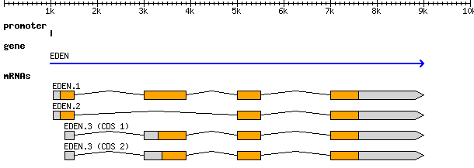
ctg123 genbank gene 1000 9000 . + . ID=gene00001;Name=EDEN
ctg123 genbank TF_binding_site 1000 1012 . + . ID=tfbs00001;Parent=gene00001
ctg123 genbank mRNA 1050 9000 . + . ID=mRNA00001;Parent=gene00001;Name=EDEN.1
ctg123 genbank mRNA 1050 9000 . + . ID=mRNA00002;Parent=gene00001;Name=EDEN.2
ctg123 genbank mRNA 1300 9000 . + . ID=mRNA00003;Parent=gene00001;Name=EDEN.3
ctg123 genbank exon 1300 1500 . + . ID=exon00001;Parent=mRNA00003
ctg123 genbank exon 1050 1500 . + . ID=exon00002;Parent=mRNA00001,mRNA00002
ctg123 genbank exon 3000 3902 . + . ID=exon00003;Parent=mRNA00001,mRNA00003
ctg123 genbank exon 5000 5500 . + . ID=exon00004;Parent=mRNA00001,mRNA00002,mRNA00003
ctg123 genbank exon 7000 9000 . + . ID=exon00005;Parent=mRNA00001,mRNA00002,mRNA00003
ctg123 genbank CDS 1201 1500 . + 0 ID=cds000001;Parent=mRNA0001;Name=edenprotein.1
ctg123 genbank CDS 3000 3902 . + 0 ID=cds000001;Parent=mRNA0001;Name=edenprotein.1
ctg123 genbank CDS 5000 5500 . + 0 ID=cds000001;Parent=mRNA0001;Name=edenprotein.1
ctg123 genbank CDS 7000 7600 . + 0 ID=cds000001;Parent=mRNA0001;Name=edenprotein.1
ctg123 genbank CDS 1201 1500 . + 0 ID=cds000002;Parent=mRNA0002;Name=edenprotein.2
ctg123 genbank CDS 5000 5500 . + 0 ID=cds000002;Parent=mRNA0002;Name=edenprotein.2
ctg123 genbank CDS 7000 7600 . + 0 ID=cds000002;Parent=mRNA0002;Name=edenprotein.2
ctg123 genbank CDS 3301 3902 . + 0 ID=cds00003;Parent=mRNA0003;Name=edenprotein.3
ctg123 genbank CDS 5000 5500 . + 2 ID=cds00003;Parent=mRNA0003;Name=edenprotein.3
ctg123 genbank CDS 7000 7600 . + 2 ID=cds00003;Parent=mRNA0003;Name=edenprotein.3
ctg123 genbank CDS 3391 3902 . + 0 ID=cds00004;Parent=mRNA0003;Name=edenprotein.4
ctg123 genbank CDS 5000 5500 . + 2 ID=cds00004;Parent=mRNA0003;Name=edenprotein.4
Ctg123 genbank CDS 7000 7600 . + 2 ID=cds00004;Parent=mRNA0003;Name=edenprotein.4
Notes:
The Canonical Gene:
This is to illustrate how a canonical gene is represented. This indicates a gene named EDEN extending from position 1000 to position 9000. It encodes three alternatively-spliced transcripts named EDEN.1, EDEN.2 and EDEN.3, the last of which has two alternative translational start sites leading to the generation of two protein coding sequences.
There is also has an identified transcriptional factor binding site located 50 bp upstream from the transcriptional start site of EDEN.1 and EDEN.2.

Slide 13
Overview of DAS/1 and DAS/2
The Distributed Annotation System (DAS)
- a lightweight protocol to allow the positional feature data to be requested using HTTP requests, with the response being returned as XML.
Two kinds of DAS server
- reference servers provide sequence data and where appropriate scaffolding information
- annotation servers provide feature information only.
A DAS client
an application that is able to connect to at least one reference server and one annotation server and merge the information from these servers in a unified display.

Slide 14
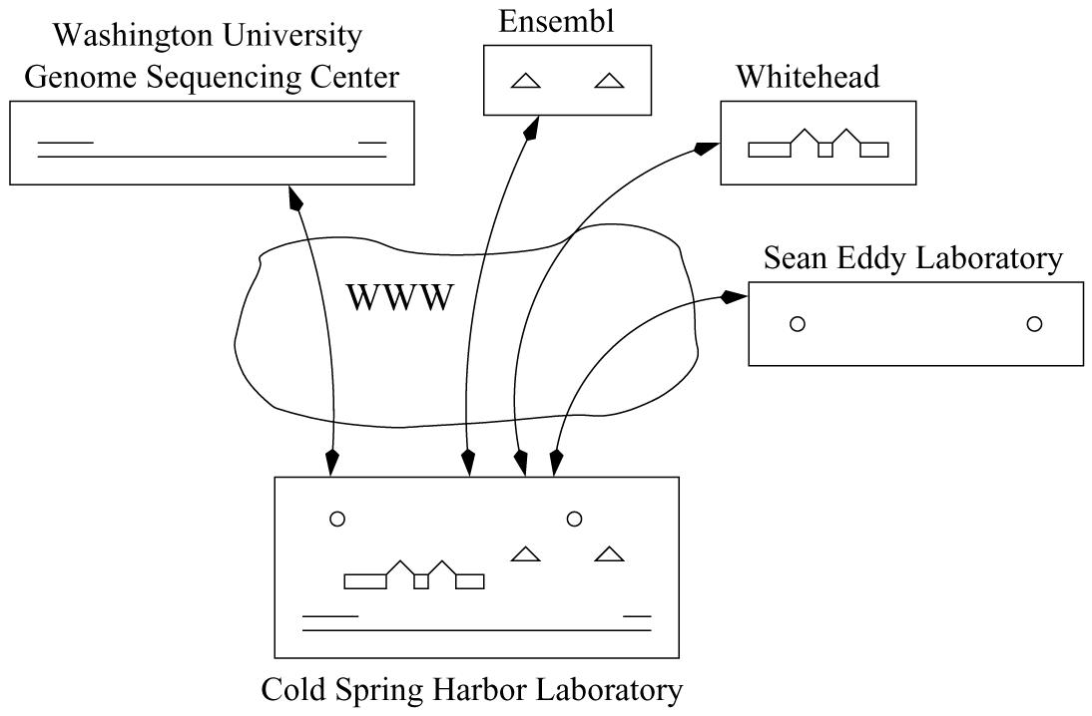
Distributed Annotation System Architecture
Dowell et al., 2001 BMC Bioinformatics
Notes:
Basic distributed annotation system architecture
One server is the designated reference server, in this case the Washington University Genome Sequencing Center. One or more annotation servers, shown above as Ensembl, Whitehead, and the Sean Eddy Laboratory, provide annotations relative to the reference sequence. The client, at Cold Spring Harbor Laboratory in our example, fetches data from multiple servers and automatically generates an integrated view.

Slide 15
DAS/2 new features
  More SOAP compliant
  Annotation and editing rather than just viewing
  Better support for hierarchical structures
  Sequence Ontology is used on DAS/2 objects.
  DAS/2 is still under development.

Slide 16
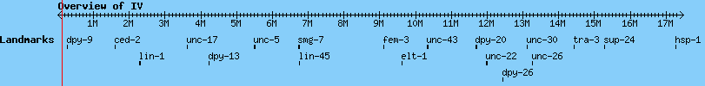
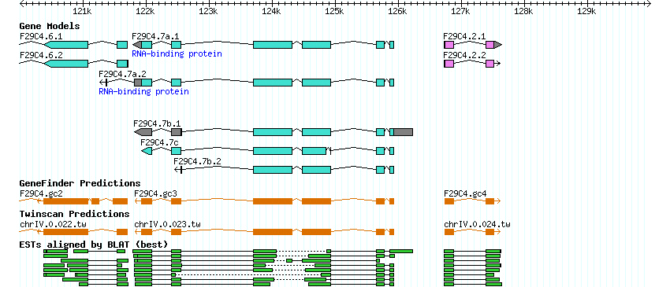
GBrowse: Genomic Visualization and Navigation

Slide 17
GBrowse: Genomic Visualization and Navigation
GBrowse is implemented in Perl, use Bio::DB::GFF data adaptors to access data
- memory adaptor: GFF, indexed FASTA flat files
- DBI adaptor: simple “dbGFF” schema (mysql, Oracle)
Bio::DasI-compliant adaptors
Bio::DB::BioSQL
Bio::DB::Das::Chado
GBrowse itself can act as either a DAS client or server
(Aaron Mackey CBIL Lab Meeting 2004)

Slide 18
GBrowse: Genomic Visualization and Navigation
Upload custom/private features
Integrate features from remote servers
“everything” is customizable
Feature export (FASTA, GFF, GenBank, etc)
SVG output
(Aaron Mackey CBIL Lab Meeting 2004)

Slide 19
GUS-GBrowse Adaptor - Architecture
Accessed by Humans
GBrowse
Adaptor
GUS
Bio::DasI compliant
DAS
Strong Typing SO Compatible
Accessed by Programs
GBrowse/DAS API
GUS schema/query

Slide 20
GUS GBrowse Adaptor - Objects
Sequence features have locations and are sequence-sensitive
e.g. exons, promoters
Two types of objects in the adaptor:
segment object - e.g. contig, chromosome [ name, start, stop ]
feature object - subclass of segment object, e.g. exon, CDS
[name, start, end, type, source, scorestrand, attributes]
segment object
feature object
Sub-feature object is a feature object

Slide 21


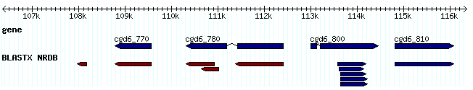
GUS GBrowse Adaptor – Data Flow
Step 1: Get a segment object
Name -> Segment Object
segment na_feature_id
Step 2: Find all features in that range on this segment
feature na_feature_id
Step3: Find every subfeature for each feature object recursively

Slide 22
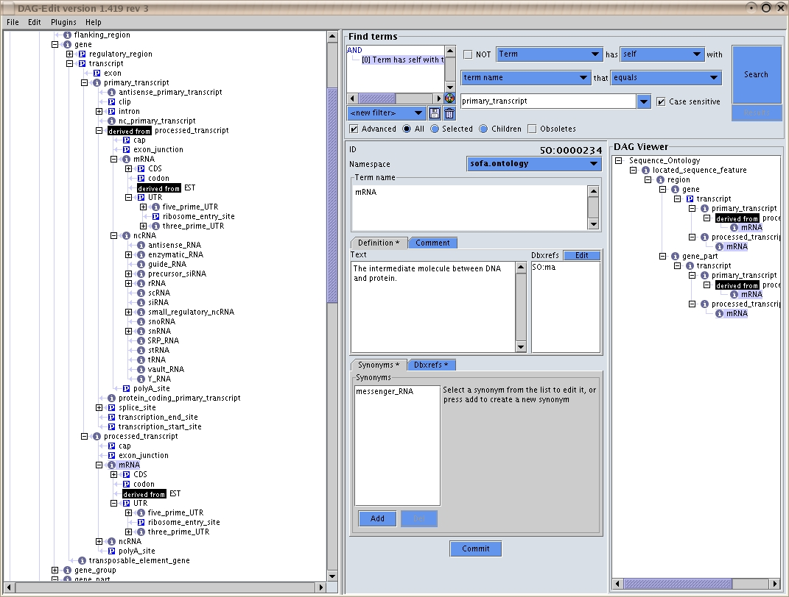
GUS GBrowse Adaptor – SO Terms
Use the Sequence Ontology to find feature relationships, e.g.
A CDS is part of an mRNA, an mRNA is part of a transcript, a transcript is part of a gene

Slide 23
GUS GBrowse Adaptor - Modules
The adapter consists of three PERL modules:
ApiComplexa::DAS::GUS
- connect to the database
ApiComplexa::DAS::GUS::Segment
- create a segment object
ApiComplexa::DAS::GUS::Segment::Feature
- subclass of Segment.pm, create feature/sub-feature objects

Slide 24
GUS GBrowse Adaptor – A Template
The DAS adaptor is more like a template.
Specific customization in queries may be necessary.

Slide 25
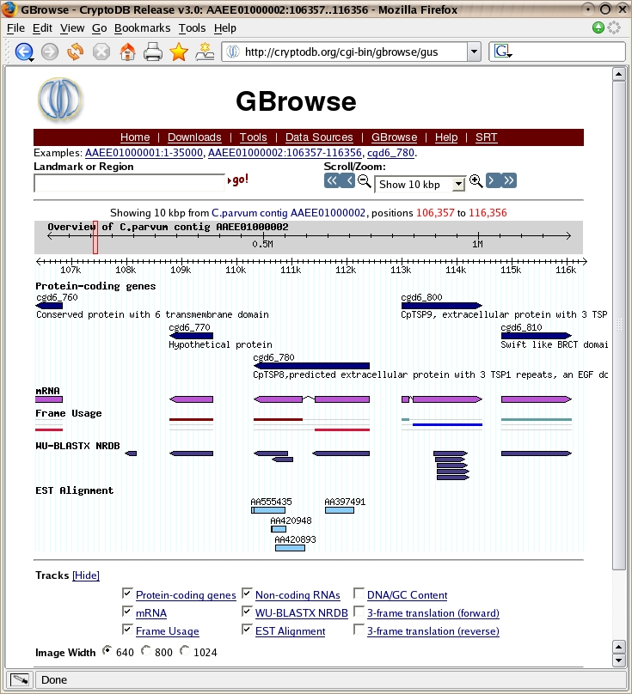

Slide 26
Configuration – General Track
[GENERAL]
Description = CryptoDB Release 3.0
db_adaptor = ApiComplexa::DAS::GUS
database = dbi:Oracle:sid=CRYPTOA;host=kiwi.rcc.uga.edu;port=1521
user = gususer
pass = pass
reference class = contig

Slide 27
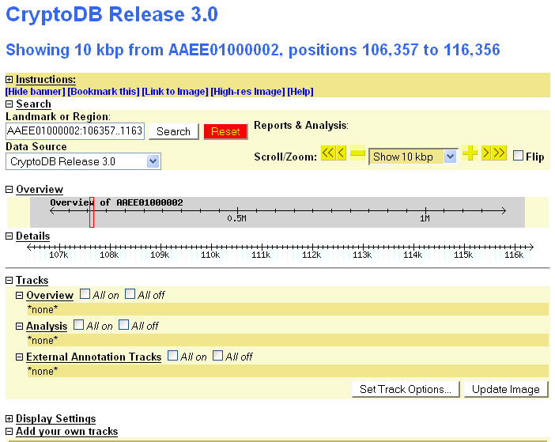

Slide 28
ApiComplexa::DAS::Segment
# Create a segment object
SELECT nal.na_feature_id srcfeature_id,
nal.start_max startm,
nal.end_min end,
nae.source_id name,
'contig' type
FROM dots.SOURCE s, dots.NAENTRY nae, dots.NALOCATION nal
WHERE nal.na_feature_id = s.na_feature_id and
nae.na_sequence_id = s.na_sequence_id and
upper(nae.source_id) = ‘AAEE01000002’
return bless { factory => $factory,
start => $start,
end => $stop,
srcfeature_id => $$hashref{'SRCFEATURE_ID'},
length => $length,
class => $$hashref{ 'TYPE‘ },
name => $$hashref{ 'NAME‘ }, }, ref $self || $self;

Slide 29
Configuration – Feature Track
[GENERAL]
description = CryptoDB Release 3.0
db_adaptor = ApiComplexa::DAS::GUS
database = dbi:Oracle:sid=CRYPTOA;host=kiwi.rcc.uga.edu;port=1521
user = gususer
pass = pass
reference class = contig
[Gene]
feature = gene:Genbank
glyph = segments
bgcolor = navy
font2color = black
label = 1
key = gene

Slide 30
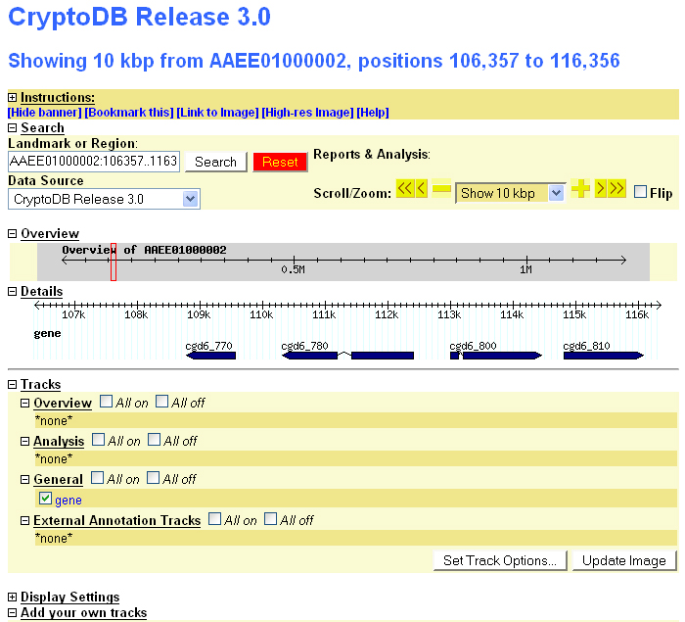

Slide 31
ApiComplexa::DAS::GUS::Segment
# get gene features on the reference segment
my $gene_Genbank_sql = <<EOSQL;
SELECT gen.na_feature_id feature_id,
gen.name type,
'Genbank' source,
gen.source_id name,
null phase,
'.' score,
src.na_feature_id parent_id,
nal.start_max startm,
nal.end_min end,
decode (nal.is_reversed, 0, '+1', 1, '-1', '.') strand
FROM dots.GENEFEATURE gen,
dots.NALOCATION nal,
dots.SOURCE src
WHERE gen.na_feature_id = nal.na_feature_id and
src.na_sequence_id = gen.na_sequence_id and
nal.start_max >= $base_start and nal.end_min <= $rend and
src.na_feature_id = $srcfeature_id
[Gene]
feature = gene:Genbank
glyph = segments
… …

Slide 32
ApiComplexa::DAS::GUS::Segment::Feature
# Create a new feature object
sub new {
my $package = shift;
my ($factory, $parent, $srcseq, $start, $end, $type,$score,
$strand, $phase, $group, $atts, $uniquename, $feature_id) = @_;
my $self = bless { }, $package;
$self->factory($factory);
$self->parent($parent) if $parent;
$self->seq_id($srcseq);
$self->start($start);
$self->end($end);
$self->score($score);
...
return $self;
}

Slide 33
ApiComplexa::DAS::GUS::Segment::Feature
# get subfeatures from gene feature.
my $gene_exon_query = <<EOSQL;
SELECT exf.na_feature_id feature_id,
exf.name type,
'Genbank' source,
exf.na_feature_id name,
exf.coding_start || '' phase,
‘.' score,
nal.start_max startm,
nal.end_min end,
decode (nal.is_reversed, 0, '+1', 1, '-1', '.') strand
FROM dots.EXONFEATURE exf,
dots.RNATYPE rntp,
dots.NALOCATION nal
WHERE exf.parent_id = rntp.na_feature_id and
exf.na_feature_id = nal.na_feature_id and
rntp.parent_id = $parent_id
EOSQL

Slide 34
Configuration – Customized colors
[GENERAL]
description = CryptoDB Release 3.0
db_adaptor = ApiComplexa::DAS::GUS
database = dbi:Oracle:sid=CRYPTOA;host=kiwi.rcc.uga.edu;port=1521
user = gususer
pass = pass
reference class = contig
[Gene]
feature = gene:Genbank
glyph = segments
bgcolor = sub { my $feat = shift;
my $strand = $feat->strand;
if($strand == 1) {
return “navy”;
} else {
return “maroon”;
}
}
key = gene

Slide 35
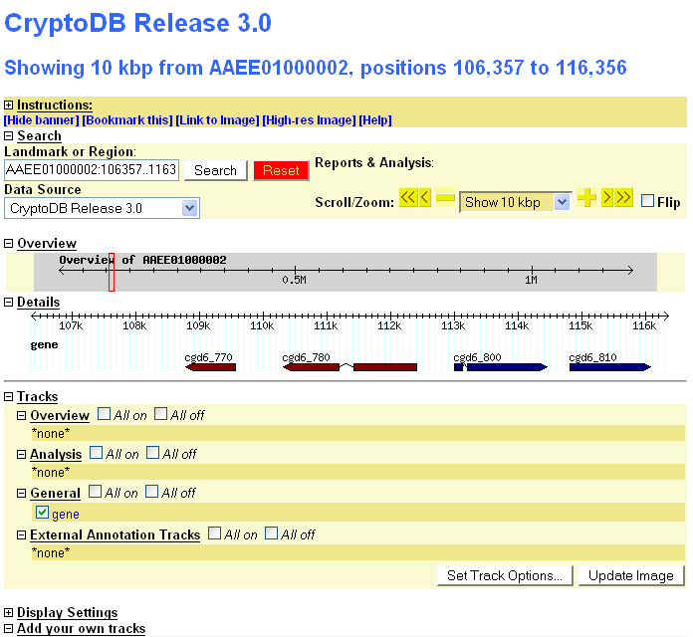

Slide 36
Configuration - Tooltips
[GENERAL]
# Various places where you can insert your own HTML -- see configuration docs
html5 =
html6 = <script language="JavaScript" type="text/javascript" src="/gbrowse/wz_tooltip.js"></script>
init_code = use HTML::Template;
sub hover {
my $name = shift;
my $data = shift;
my $tmpl = HTML::Template->new(filename => '/var/www/cgi-bin/hover.tmpl');
$tmpl->param(DATA => [ map { { Key => $_->[0],
Value => $_->[1], } } @$data
]);
my $str = $tmpl->output;
$str =~ s/'/\\'/g;
$str =~ s/\s+$//;
my $cmd = "this.T_STICKY=true;this.T_TITLE='$name'";
return "$cmd;return escape('$str')";
}

Slide 37
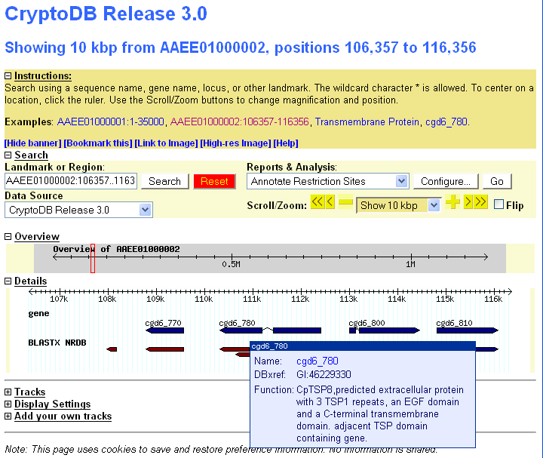
Running GBrowse and DAS/1 on GUS

Slide 38
Turn a GUS instance into a DAS/1 Server
[GENERAL]
Description = CryptoDB Release 3.0
db_adaptor = ApiComplexa::DAS::GUS
database = dbi:Oracle:sid=CRYPTOA;host=kiwi.rcc.uga.edu;port=1521
user = gususer
pass = pass
reference class = contig
# DAS reference server
das mapmaster = http://peach.ctegd.uga.edu/cgi-bin/das/cryptodb
das landmark = AAEE01000001
[Gene]
feature = gene:Genbank
glyph = segments
bgcolor = navy
font2color = black
das category = transcription
key = gene

Slide 39
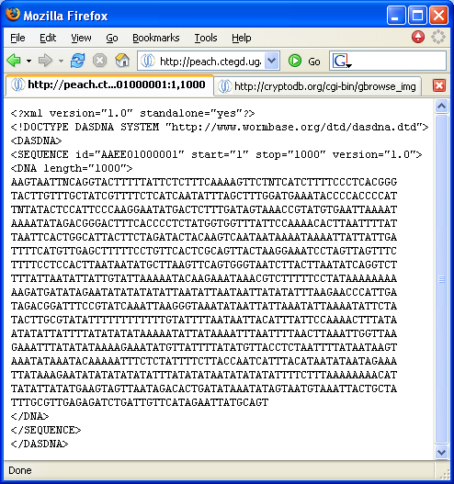
Turn a GUS instance into a DAS/1 Server
http://peach.ctegd.uga.edu/cgi-bin/das/cryptodb/dna?segment=AAEE01000001:1,1000

Slide 40
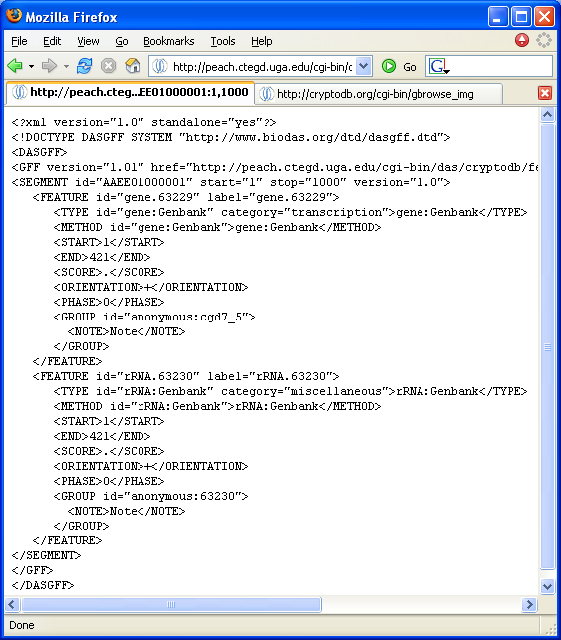
http://peach.ctegd.uga.edu/cgi-bin/das/cryptodb/featurs?segment=AAEE01000001:1,1000

Slide 41
TO DO
Improve performance, indexing database, cache images…
Use stored procedures instead of sqls
Use SO terms to search instead of hardcode (gene:Genbank)
Test DAS/1 server - most DAS/1 clients are out of date
Retrieve protein features via the DAS adaptor

Slide 42
Acknowledgement
Steve Fischer CBIL UPenn
Aaron Mackey UPenn
Ed Robinson Kissinger Lab, UGA
Mark Heiges Kissinger Lab, UGA
All others in ApiComplexan Database Team.

