Slide 1
Web and Tool Integration Architectures Discussion
July 8, 2005
Presenters: Doug Marcey, Carey Gire

Slide 2
Goals of This Discussion
Goals
  This is a “birds of a feather” meeting – open discussion
  List the web and tool integration features required by the BRC community
  Relate those features to features required by the overall GUS community (discussion)
  Discuss options for implementing required features
  Discuss architectural options – pros and cons

Slide 3
Generic Features of Interest
General Features
  Standards-based – proven architectures
Web Features
  Thin-client implementation
  Built against business service layer interfaces
  Easily extensible to new platforms, browsers, services
Architectural Features
  Ease of integration of new data tools
  Easily scalable for new applications, capacity
  Built to data access layer interfaces
Database Features
  Easily add new data entities, attributes, relationships
  Allow vendor-specific database extensions
Notes:
Much of this sounds obvious – but as shown by too many failed projects, it isn’t. We can’t just build tools or just collect/generate data – we must build an integrated system of data and tools.
We get few points for building neat tools – those tools must be integrated into an overall approach, and available to all users via natural APIs
The system can’t support good science unless researchers are involved throughout the process.
How do we involve researchers if we can’t locate them? How do we identify those who are “really interested”?
How can we retain buy-in from the science community if we can’t understand and react to their needs quickly enough?

Slide 4
Conceptual Architecture Diagram
Presentation Tier
Java Business Tier
Perl/other Business Tier
Data Access Tier
Data Load Layer
Database
Load
S/W

Slide 5
Some Candidate Specific Features
Pass parameters between tools
Save and manage context of tools between sessions
“Easily” integrate tools from the science community
“Easily” embed services within query interfaces
  E.g., visualizations of homologies/multi-alignments from within gene-related query results
Share API externally – with development community
Trigger asynchronous processing
  E.g., user-initiated blast pipeline
Provide multi-threaded services
  Multiple open windows with interactions between

Slide 6
Design Questions
Can the Data Access Tier be fully/partially integrated for the Java and perl/other interfaces?
How does the “Data Load Layer” relate to the Data Access Tier?
What kinds of science tools (e.g., genome browser, annotation/editing, etc.) are currently envisioned for integration?
What mechanisms are envisioned for “publishing” interfaces for external use (e.g. web services)?

Slide 7
Some Candidate Solutions
Pure Java Objects/MVC
J2EE/EJB
Spring/Hibernate
Other TBD Approaches?
Notes:
We have explored the existing literature on how BRC-like systems behave
- GUS use cases
- Celera experience
- BioMoby (Lincoln Stein)
We also went looking for interested scientists and interesting science problems to solve
We’re just starting to contact the community directly with assistance from our UTSW colleagues
We need these scientists to refine and improve the system we’re building for them

Slide 8
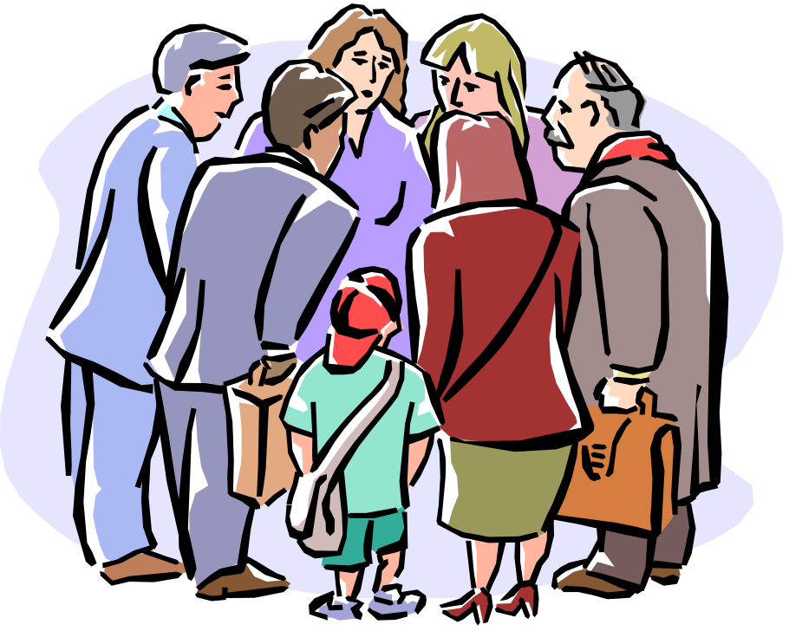

Discussion
Notes:
We used all of that requirements analysis to find “gaps” – and to propose prototypes to fill them
We started with GUS (pseudo-randomly) but are also interested in GMOD (and maybe Toolbus/PathPort)
We’ll throw in a lot of real science data – otherwise, scientists won’t be interested
We’ll look at some interesting data – pathways, epidemiological
We’ll throw some existing tools in and let the interested scientists have at it
We’ll also start building in some infrastructure – evidence data, software infrastructure

Slide 9
Future Directions
Candidate Prototypes
  We’re working on a POJO/Hibernate prototype
  We’re also looking at some simple Spring implementation
  What are other groups investigating?
Architecture discussion via GUSDEV list serve
  Who would be interested in these directions?
Other followup steps
  What tasks are most important?
  What groups should be involved?

