Slide 1
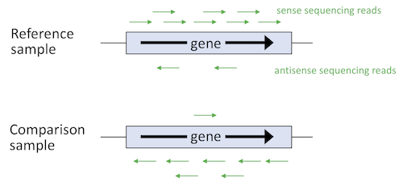
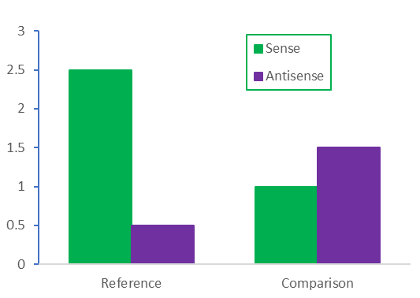
The EuPathDB Sense/Antisense search is available for any RNA sequence data set based on strand specific data. For each gene, the search compares the fold change in sense reads to the fold change in antisense reads (A) and returns genes that have simultaneous changes in sense vs antisense expression between two samples (B). Versatile search parameters allow for choosing the direction and magnitude of the change in sense and antisense transcripts. The search result page lists genes and indicates the paired Reference->Comparison samples that meet the criteria, and offers two graphs to help interpret the search results (FPKM vs sample bar graph, antisense FC vs sense FC scatter plot).
This tutorial demonstrates the Sense/Antisense search using the PlasmoDB data set Intraerythrocytic cycle transcriptome (3D7), a time course strand specific RNA sequence analysis of 8 time points. We will configure the search to return protein coding genes whose sense transcripts decrease 2 fold while their antisense transcripts increase 2 fold between any time points in the Intraerythrocytic cycle transcriptome experiment.
A
Reference (Sample 1)
vs
Comparison (Sample 2)
Sense reads decrease in comparison vs reference while antisense reads increase in comparison vs reference.
B
Sense fold change = 2.5X decrease
Antisense fold change = 3X increase

Slide 2
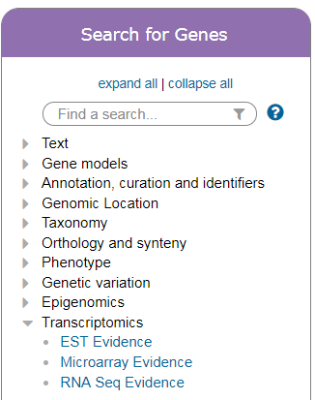
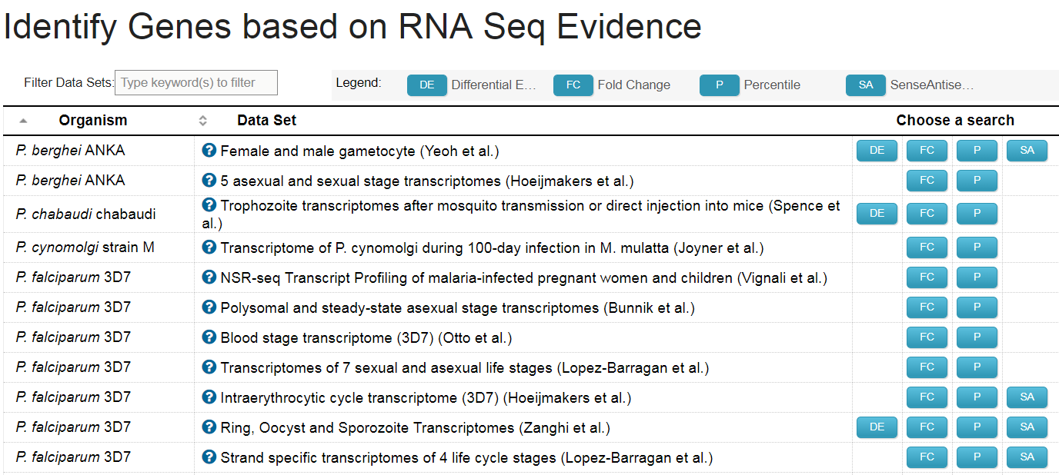
Navigate to the ‘Identify Genes by RNA Sequence Evidence’ page and choose the Sense/Antisense (SA) search for thedata set called ‘Intraerythrocytic cycle transcriptome (3D7) (Hoeijmakers et al.)’.

Slide 3
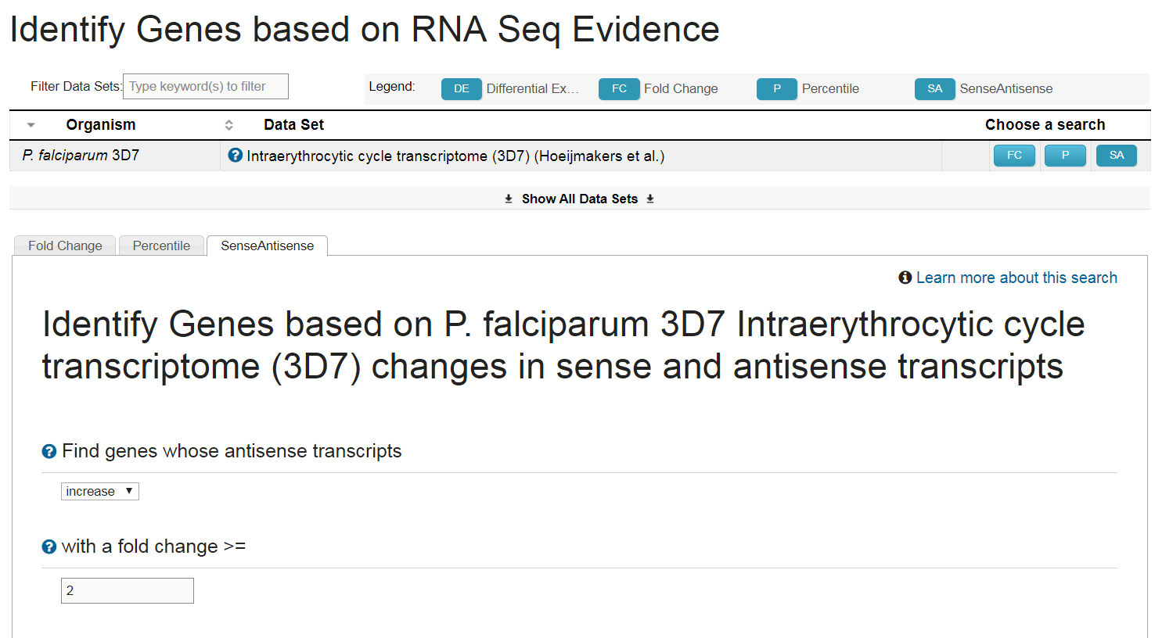
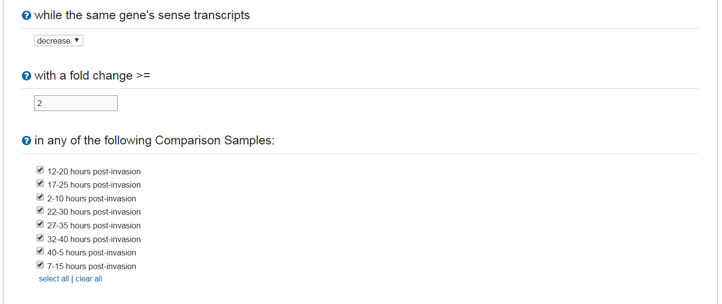
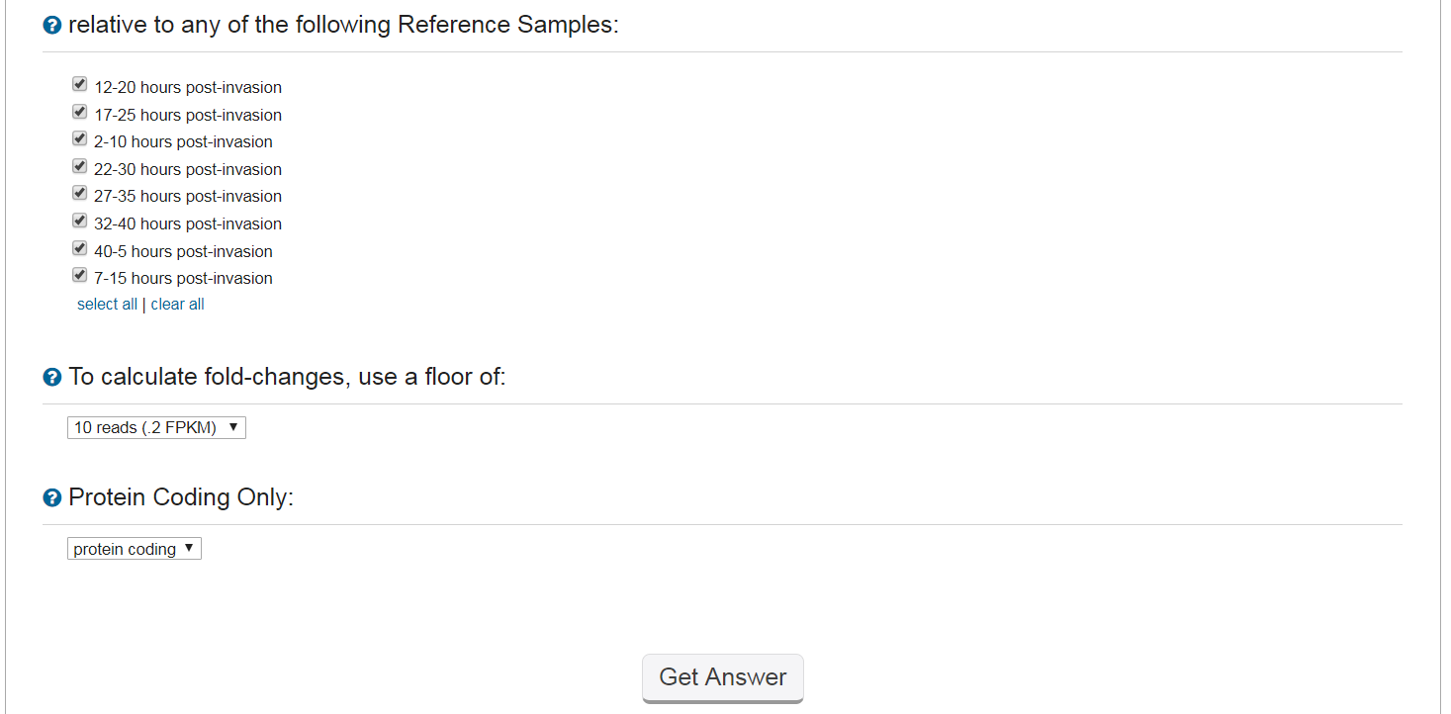
Arrange the search parameters according to the figure below to return all genes whose antisense transcripts increase by 2-fold while their sense transcripts decrease by 2-fold in all possible pairwise combinations of reference and comparison samples.
Find genes whose antisense transcripts increase
with a fold change >= 2
The search calculates the fold change in sense mapped reads for each gene
while the same gene's sense transcripts decrease
with a fold change >= 2
The search calculates the fold change in antisense mapped reads for each gene
in any of the following Comparison Samples: all samples
Choose any or all samples according to the biological comparison you want to make. The search considers all possible pairwise combinations.
relative to any of the following Reference Samples: all samples
Choose any or all samples according to the biological comparison you want to make. The search considers all possible pairwise combinations.
To calculate fold-changes, use a floor of: 10 reads (.2 FPKM)
Choose the default setting of 10 reads or greater to avoid misleading FC values when FPKM values are close to zero.
Protein Coding Only: protein coding
Choose to query all genes or the subset of protein coding

Slide 4
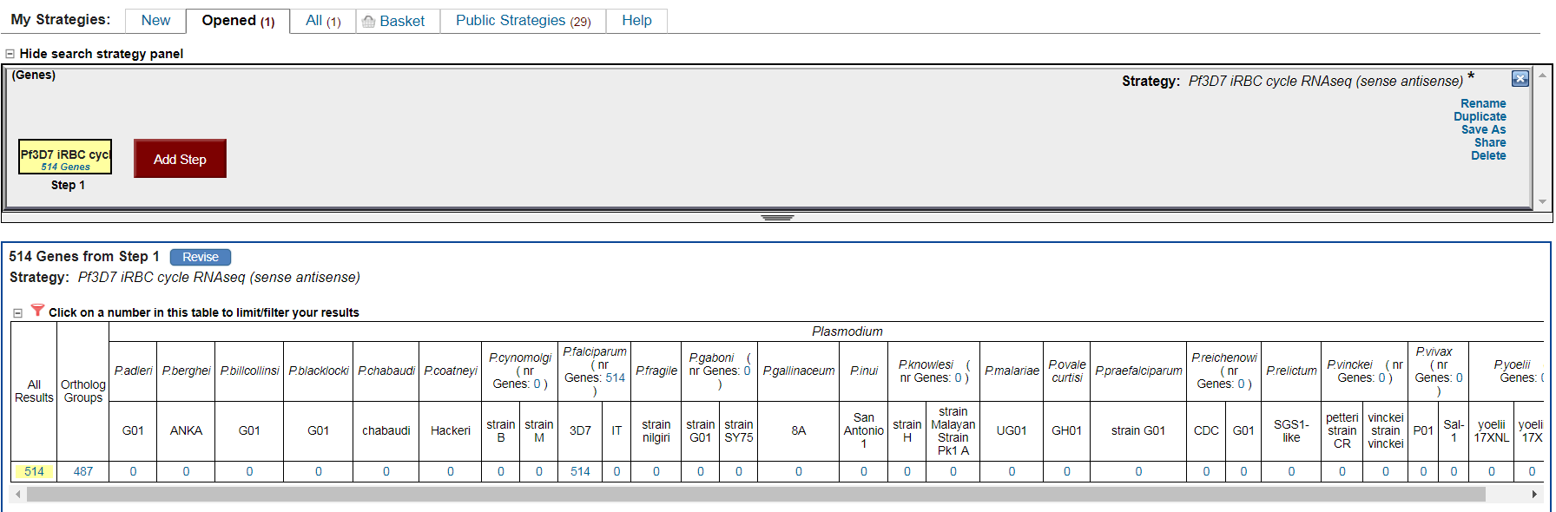

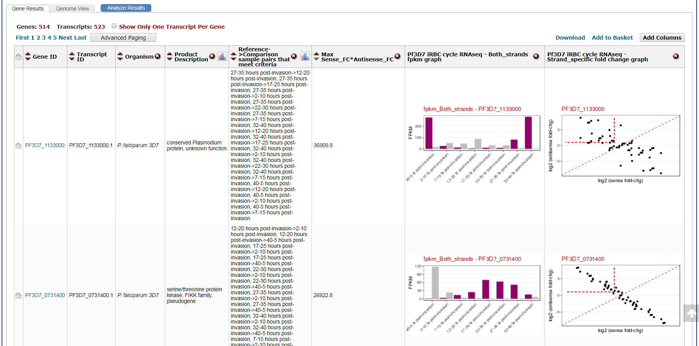
Explore your results. The search returns over 500 genes (1) with at least a 2-fold increase in antisense transcripts and a 2-fold decrease in sense transcripts between samples in the iRBC experiment. Four search specific result columns appear in the result table: Reference->Comparison sample pairs that meet criteria (2), Max Sense_FC*Antisense_FC (3), expression graph (FPKM vs Sample) (4), and Strand specific fold change graph (log2 antisense vs log2 sense) (5). See the next page for details about each result column.
1
2
3
4
5

Slide 5
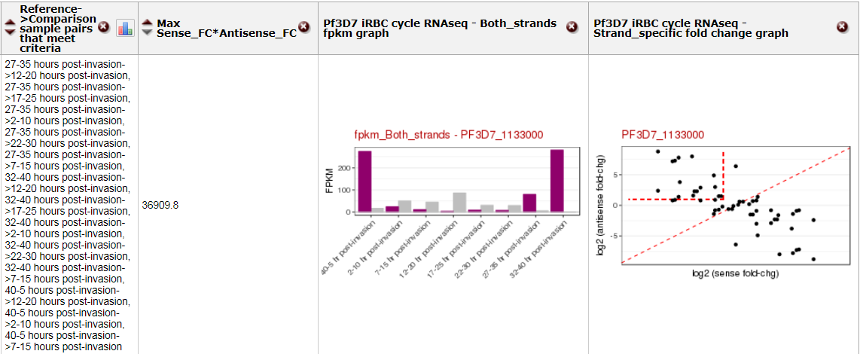
Reference->Comparison sample pairs that meet criteria – Because we arranged the search to query all samples, the search returns all possible combinations of reference and comparison that meet the criteria (2X increase antisense, 2X decrease in sense). For the gene, PF3D7_1133000, thirteen sample combinations meet the criteria.
Max Sense_FC*Antisense_FC – This column is an in-house metric derived from multiplying ‘Max sense strand fold change’ and ‘Max antisense fold change’ for that gene. This metric can be used to roughly rank the genes according to the magnitude of differential between sense and antisense transcription.
Pf3D7 iRBC cycle RNAseq- Both_strands fpkm graph – This graph, FPKM vs sample, is a visual representation of the simultaneous changes detected by the search. For example, comparing the 17-25 hr sample to the 12-20 hr sample, sense transcripts decrease (green arrows) while the antisense transcripts increase (purple arrows). This graph is also available on the gene page in the transcriptomics section.
Pf3D7 iRBC cycle RNAseq – Strand_specific fold change graph – Each point shows the sense vs antisense fold change between a pair of samples. Points on the diagonal represent sample pairs with equivalent fold change between samples. Points within the red box meet your search criteria. Clicking on the graph opens a new tab with an enlarged graph which retrieves sample pair details on mouseover.

