Slide 1
Measuring Efficiency on Milk Production Farms on the Cities of the Agreste Region of Pernambuco
Vitor Ferreira Lins

Slide 2
1. Introduction

Slide 3
1.1. Objective
This study intends to conduct a efficiency analysis on the cow milk production in the cities of the Agreste region of the state of Pernambuco, in Brazil.
Efficiency frontier
Efficiency scores
Improvement points
Geographical clustering of the industry

Slide 4
2. Data

Slide 5
2.1. Discriptive statistics
Variables | Mean | SD | 1st Quartile | Median | 3rd Quartile
l_prod_milk | 5643.84 | 9654.70 | 657.50 | 1379.00 | 4540.25
n_settlements | 831.41 | 597.42 | 419.25 | 736.00 | 1040.50
a_pasture | 9306.26 | 8348.71 | 3828.13 | 7171.40 | 10452.69
n_milk_cows_percent | 15.39 | 11.10 | 7.99 | 12.28 | 22.12
Source: IBGE, own elaboration

Slide 6
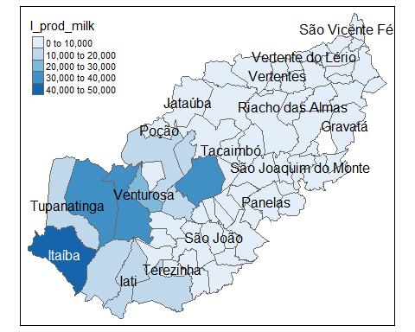
2.2. Biggest and smallest producers
 | City | Milk Produced (liters) | Total milk production
3 | Itaíba | 42042 | 10.64%
4 | Pedra | 39711 | 10.05%
37 | São Bento do Una | 34195 | 8.66%
2 | Buíque | 31689 | 8.02%
6 | Venturosa | 26598 | 6.73%
5 | Tupanatinga | 19520 | 4.94%
1 | … | … | …
11 | João Alfredo | 126 | 0.03%
52 | Cupira | 114 | 0.03%
13 | Machados | 73 | 0.02%
43 | Barra de Guabiraba | 58 | 0.01%
21 | Toritama | 50 | 0.01%
16 | Salgadinho | 36 | 0.01%
18 | São Vicente Férrer | 14 | 0%
Source: IBGE, own elaboration.

Slide 7
3. Model

Slide 8
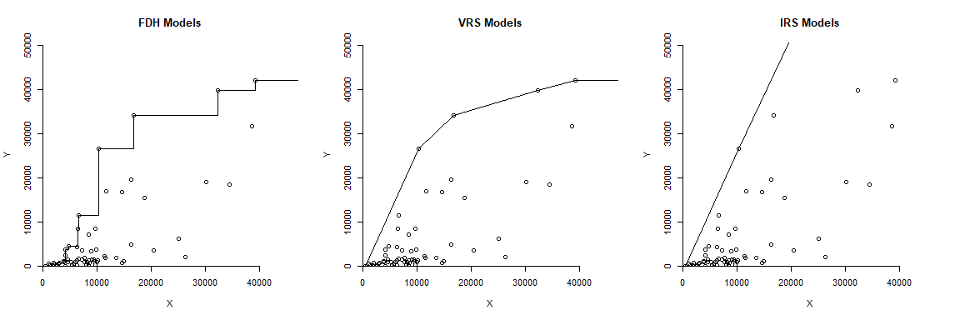
3.1. Estimating possible models

Slide 9
3.2. Choosing a model
Credits and methodology:
Before choosing a model, statistical tests performed with Wilson, Paul W. (2008)’s FEAR pakcage developed for R.
And models were estimated with Peter Bogetoft and Lars Otto’s Benchmarking package developed for R.
The possible models contemplated (FDH and VRS) were chosen from the tests obtained for Convexity of the production and return to scale, respectively.
The tests rejected both the Convexity hypothesis and Constant Return to Scale, so the models tested will follow at least one of the opposing assumptions.
Models:
Free Disposability Hull (FDH) with fixed number of settlements and oriented for input and output;
Same as model 1, but only oriented for input;
Variable Return to Scale (VRS) with fixed number of settlements and oriented for input and output;
Same as model 3, but only oriented for input.

Slide 10
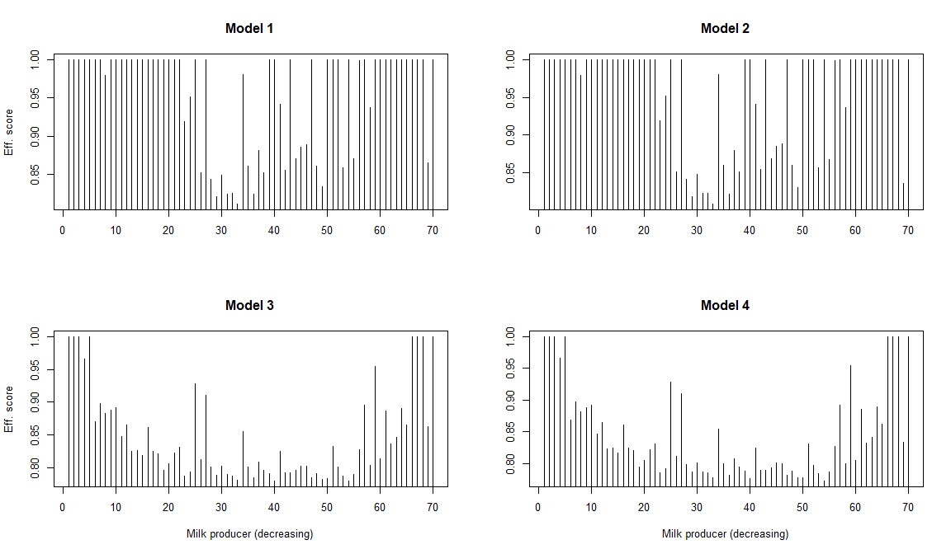
3.3. Efficiency scores

Slide 11
4. Bootstraping and Separability

Slide 12
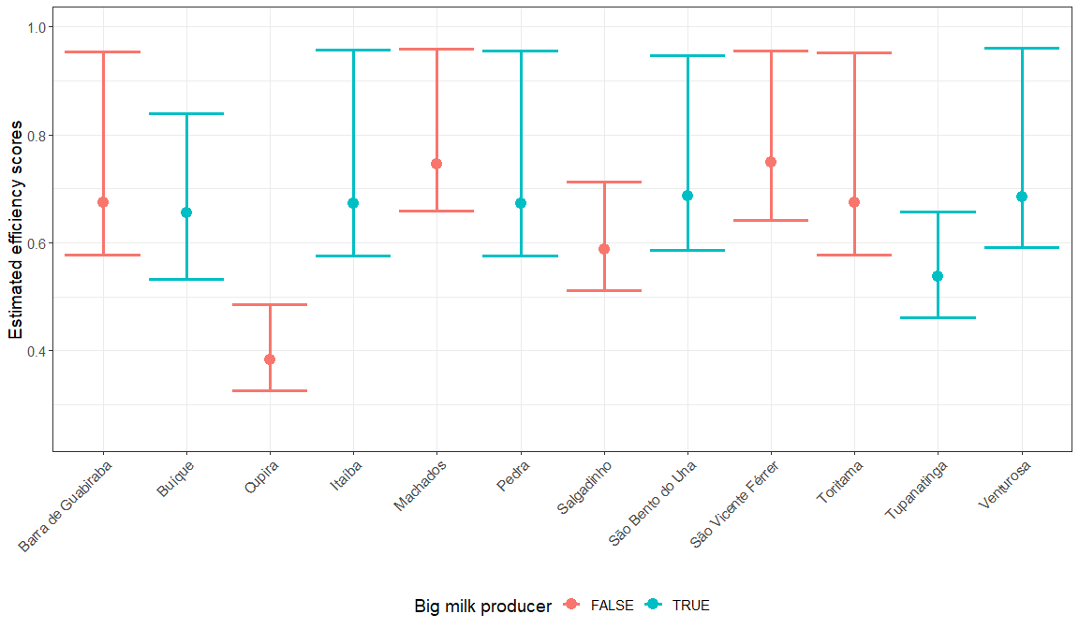
4.1. Bootstraping results for the biggest and smallest productions

Slide 13
4.2. Separabily results
The separability tests included geographical placement of the cities, and the results generally reject the hypothesis of Geogrphic impact over the efficiency of the cities;
The results are shown at the right side:
P-values with Latitude and Longitude: 0.252, 0.509;
P-values with Longitude only: 0.029, 0.076;
P-values with Latitude only: 0.139, 0.123.

