Slide 1




Wanted:
More Processing Speed!
By Jody L Meyer
VFPx Award

Slide 2



About this session
ParallelFox is the brain-child of Joel Leach. Joel has made parallel processing easier and more approachable for all VFP developers by developing this powerful tool. Jody will walk you through the main components of ParallelFox and demonstrate the basics. She will then show you how you might be able to apply ParallelFox to real-world process such as error-handling, data dictionary rebuilds, and time-consuming reports. The possibilities are endless. ParallelFox is a must have in your developer toolkit to get more speed out of your Visual FoxPro application.

Slide 3








About this session…
You will learn:
What ParallelFox is
The basics of using ParallelFox
Possible uses for such a powerful tool
Prerequisites: None

Slide 4




About me
CREDENTIALS
Developer for 26+ years
Developing with Fox for 23+ years
Developed framework for Manufacturing vertical application
MISCELLANEOUS
User Groups:
  GRAFUG (grafug.com)
  DAFUG (dafug.org)
Conference Speaker
Twitter (JodyMeyer)
JLMeyer@WhiteLightComputing.com
PERSONAL STUFF
Mom to David
Wife to Jeff
Pack Leader to Beau
Volleyball player for 34+ years
Lovin’ Life! Check out www.JodyMeyer.BlogSpot.com

Slide 5
Agenda
Why you want to look at ParallelFox
Basics
  Parallel Processing
  Hyper-Threading
  Synchronous vs Asynchronous
ParallelFox Requirements

Slide 6

Agenda
Installing ParallelFox
How ParallelFox works (basic flow)
ParallelFox some detail:
  Class Parallel
  Class Worker
Running the code… is it really faster?
Example inside an application

Slide 7


Why ParallelFox?
Bottom-Line… SPEED!
  Complaints the system isn’t fast enough
  Code is Rushmore optimized
  Code is concise
  Are there processes that aren’t dependent on other processes?
  Free from VFPx and Joel Leach

Slide 8
Terms to Know
Parallel Processing…According to Wikipedia (http://en.wikipedia.org/wiki/Parallel_processing), Parallel processing is defined as: “The simultaneous use of more than one CPU or processor core to execute a program or multiple computational threads. Ideally, parallel processing makes programs run faster because there are more engines (CUPs or cores) running it. In practice, it is often difficult to divide a program in such a way that separate CPUs or cores can execute different portions without interfering with each other. Most computers have just one CPU, but some models have several, and multi-core processor chips are becoming the norm. There are even computers with thousands of CPUs.”

Slide 9
Terms to Know…
Hyper-Threading…According to Wikipedia (http://en.wikipedia.org/wiki/HyperTreading): “Hyper-threading works by duplicating certain sections of the processor—those that store the architectural state—but not duplicating the main execution resources. This allows a hyper-threading processor to appear as two "logical" processors to the host operating system, allowing the operating system to schedule two threads or processes simultaneously. When execution resources would not be used by the current task in a processor without hyper-threading, and especially when the processor is stalled, a hyper-threading equipped processor can use those execution resources to execute another scheduled task. (The processor may stall due to a cache miss, branch misprediction, or data dependency.)”

Slide 10
Terms to Know…
Synchronous…According to Microsoft Technet (http://technet.microsoft.com/en-us/library/cc978253.aspx): “Synchronous processes wait for one to complete before the next begins.”
One line of code at a time
Sequential: Step 1 … Step 2 … Step 3 …
Control returns when called program (step) is complete
Step 1
Step 2
Step 3

Slide 11
Terms to Know…
Asynchronous…According to Wikipedia (http://en.wikipedia.org/wiki/Asynchrony) , Asynchronous is defined as: “In programming, asynchronous events are those occurring independently of the main program flow. Asynchronous actions are actions executed in a non-blocking scheme, allowing the main program flow to continue processing.”
Step 1, Step 2, Step 3 … Can run at the same time
Step 3 may finish before Step 1. Step 2 may complete after Step 5.
Control returns immediately once the call (to a step) is made. No waiting involved.
Definitely a mindset
Step 3
Step 1
Step 2
Step 5
different

Slide 12

Requirements
Visual FoxPro 9.0 SP2
CPUs – even if you have 1 CPU… you can take advantage of the Hyper-Threading.

Slide 13
About My Computer
Toshiba Qosmio X500-0895S
Intel® Core™ i7CUP Q740 @ 1.73 GHz
Quad Core Process
Installed memory - 6GB
64-bit Operating System
Windows 7 Professional
Hard disk – Diminishing

Slide 14
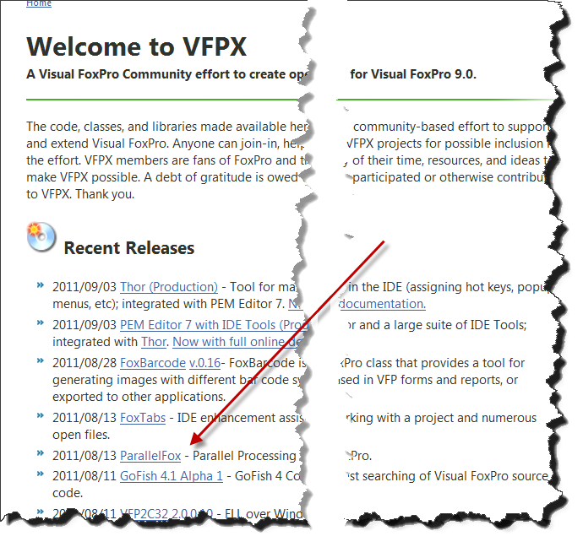
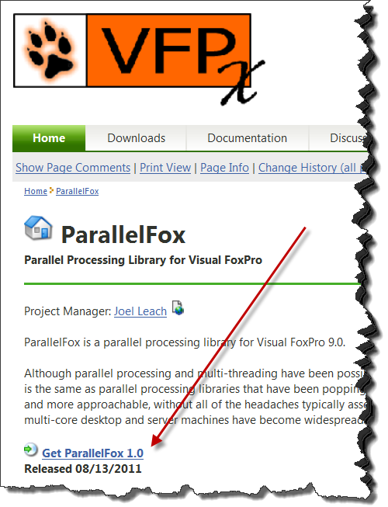
Installation
Go to VFPx: http://vfpx.codeplex.com/
Under Recent Releases, click on ParallelFox
ParallelFox page, click:
  Get ParallelFox 1.0
Follow the instructions:
  Put the zip file some where on your hard drive.
  For me: c:\VFPx\ParallelFox

Slide 15
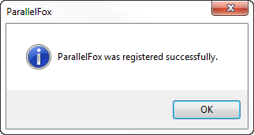
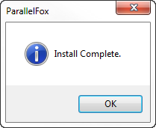
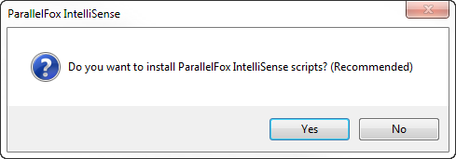
After Download
Unzip to a directory
  For me: C:\VFPx\ParallelFox
Open up Visual FoxPro as Administrator
  Doug Hennig’s Session “Developing VFP Applications for Windows 7”
In the command window:
  SET DEFAULT TO ___________
  For me: SET DEFAULT TO C:\VFPx\ParallelFox
  DO Install.prg
  Register ParallelFox. ParallelFox.exe com object
1
3
2

Slide 16
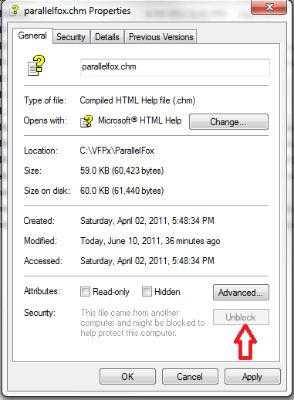
Whatcha Got…
ParallelFox.Exe (COM object)
ParallelFox project & source code
Examples
Help! ParallelFox.Chm
IntelliSense
Install.prg
Uninstall.prg
Training Videos! Found on VFPx
Notes:
http://www.west-wind.com/weblog/posts/2008/Dec/16/Problems-with-opening-CHM-Help-files-from-Network-or-Internet

Slide 17
Good thinks to know…
You should know about:
Parallel Object: This object is used in the main process. It provides functionality for sending commands and managing the parallel processing. For example:
  Local Parallel as Parallel
  Parallel = NewObject("Parallel", "ParallelFox.vcx")
Worker Object: This object provides features for use inside of workers such performing the work and communicating with the main process. Use the Parallel object to start the workers. For example:
  Parallel.StartWorkers(“MyApplication.exe")

Slide 18
Good thinks to know too…
  You should know about continued:
  Worker processes
    Workers are separate instances of VFP (1 for each logical processor) that assists the main process and runs code in parallel. The workers are separate processes and not threads within the main process.
    See Kevin Ragsdale’s Session “Easy Multi-Threading with Visual FoxPro”
Main process (A local instance of the Parallel object is here)
  The Main process queues command
  The Main process sends the command to the Worker
  The Worker executes the command
  The Worker notifies the main process when the command is completed
  While the Worker is processing, the Main process can continue on to do other commands.

Slide 19
In the Beginning of App…
Setting up the Workers via the Parallel Object
  Highly recommended to have _Vfp.AutoYield = .T.
  Parallel.DetectHyperThreading(): Is Hyper-Threading Enabled?
  Parallel.CPUCount: Number of logical processors. If Hyper-Threading is enabled, there are 2 logical cores per physical core.
  Parallel.SetWorkerCount(): Sets the number of workers. Defaulted to ParallelCPUCount. For example:
  Parallel.SetWorkerCount(1)
  Parallel.StartWorkers(): Start the workers. For example:
  Parallel.StartWorkers(“MyApp.exe",,.t.)
Note: .t. puts the worker in debug mode. You will see a separate visible instance of VFP.

Slide 20
…Somewhere in the Middle…
In a process, set up the LOCAL Parallel Object:
  Local Parallel as Parallel
  Parallel = NewObject("Parallel", "ParallelFox.vcx")
  Parallel.StartWorkers("SGSetup_Parallel.prg",,.t.)
Queue/Process the workers in the a process
Any number of Parallel Methods can be called:
  Parallel.Do(): Execute a program or procedure on worker.
  Parallel.Call(): Execute/call a function on worker.
  Parallel.CallMethod(): Execute/call a class method on worker.
  Parallel.DoCmd(): Execute a single command on worker.
  Parallel.ExecScript(): Execute a script on worker.

Slide 21
…The End of the Middle…
If you want to WAIT until all the queued work has been completed:
  Parallel.Wait(): Will pause the programming until all the current instance of the Parallel object is completed.
  --- Other processing or MessageBox()

Slide 22
…End of the Application
On the Shutdown of your Application: You will want to STOP the workers. By default, ParallelFox will wait until all pending commands are completed before stopping the workers.
  Parallel.StopWorkers(): Stop the workers.
  …. Other shutdown tasks….
  Parallel.Wait(): Waiting to shutdown is complete for all the workers.
  …. Clear Events()

Slide 23
But… there’s More!
    Class Worker
  Workers are separate instances of VFP (1 for each logical processor) that assists the main process and runs code in parallel. The workers are separate processes and not threads within the main process.
  The Worker class provides an avenue to raise events and communicate with the main process.
Worker.ReturnCursor(): Returns a cursor to the main process.
Worker.ReturnData (): Returns data to the main process
Worker.UpdateProgress(): Sends progress update to the main process
Worker.CPUCount: Number of logical cores on the computer
Worker.ProgressInterval: Minimum number of seconds between progress updates

Slide 24
Worker Class… cont’d
Worker Events
  ParallelFox sends commands to the workers to run programs in parallel or in the background. Messages can be sent back to the main progress from the workers by means of worker events. To do this, the main process must bind to the worker events via Parallel.BindEvent().
The available worker events are (4):
  Complete: Fires when a program has finished running on a worker. The event includes the return value of the program.
  ReturnData: Fires when Worker.ReturnData() is called. Used to send data (up to 26 parameters, include objects) from the worker to the main process.

Slide 25
Worker Class… cont’d
The available worker events are:
  UpdateProgress: Fires when Worker.UpdateProgress() is called. Used to send the main process progress updates when a long process is running on the worker. Worker.ProgressInterval controls how often the updates are sent.
  ReturnCursor: Fires when Worker.ReturnCursor() is called. Used to send a cursor from the worker to the main process.

Slide 26
As you can see, it can be faster!
Synchronous (not Parallel) | 4 Workers | 8 Workers
CPU: Pegged at 12% | CPU: Pegged at 50% | CPU: Pegged at 100%
20.717 seconds | 12.824 seconds | 8.467 seconds
20.826 seconds | 12.152 seconds | 8.569 seconds
20.623 seconds | 10.860 seconds | 8.449 seconds
20.576 seconds | 12.855 seconds | 8.418 seconds

Slide 27
Brain Storming
Can you imagine:
Report Processing…
Month-End processing…
Processing data to Excel / Word
Processing Rebuilding Tables or Indexes
? ? ? ? ? ?

Slide 28
Deployment
Include ParallelFox.vcx in your project.
Worker code will be compiled into your main app/exe.
If you create a separate app/exe for your worker code, include ParallelFox.vcx in that project as well.
ParallelFox.exe should be installed and registered. This is an EXE, so RegSvr32 does not work with it. If your install program doesn't handle it, register by executing ParallelFox.exe /regserver.
VERY IMPORTANT NOTE: Registering ParallelFox requires elevation on Windows Vista/7. Without elevation, ParallelFox.exe /regserver will fail, but it will not notify the user of the failure! Your installation package will likely have already requested elevation, so this shouldn't be a problem. If you will be using FoxPro code to register ParallelFox, see INSTALL.PRG for an example of how to handle this.
VERY IMPORTANT NOTE:

Slide 29
What We Didn’t Talk About…
All that ParallelFox provides
On Errors Handling
Transactional Processing
Terminal Server
Critical programming where workers might need to create a table and the other workers must wait.
We never looked “under the hood” to see how ParallelFox works… but you can! Joel has provided the source code.

Slide 30

Your To Do List…
Do your homework…. Totally check out the videos and the help!
  4 Videos
  21 Program Examples
  Extensive, well-written help
Investigate your application
Thank Joel!
VFPx Award

Slide 31



Summary
ParallelFox can Speed up your customer’s application
Joel Leach has made ParallelFox Easy to use
It’s Free
It’s a total MUST HAVE in your developer’s toolkit
Please remember to fill out your evaluation.
Session slides, white paper, and code samples
will be updated.

