Slide 1
PRACTICAL THEORY
SPSS first steps: describe variables, then describe apparent associations.
Core rule
The measurement level decides the graph, summary, and association measure.
Theory deck for Worksheet 1: NHANES 1999-2003, descriptive statistics, crosstabs, risk measures, scatterplots, covariance, Pearson, and Spearman.
Worksheet objective: choose, compute, interpret
In a cross-sectional study, describe associations carefully. Do not turn them into causal conclusions.
01
Inspect
02
Classify
03
Plot
04
Compare
Variable view, coding, units
Nominal, ordinal, metric
Match graph to variable type
Use crosstabs or correlations
Source: worksheet 1, Practical QB Scientific Work; NHANES 1999-2003
01

Slide 2
STUDY FRAME
NHANES describes population health, so interpretation starts with study design.
NHANES 1999-2003
Important !!
Restricted population
The practical asks for descriptive associations.
You can say variables are associated in this dataset; you cannot infer that diabetes causes periodontitis or weight causes height.
National Health and Nutrition Examination Survey
Cross-sectional random sample used to describe health status in the United States.
Worksheet analysis uses people aged 30-85 years.
Oral health
Demographics
Lifestyle
nteeth, cal_mean, perio, perio2, bop
male, age, edu
smk, smk2, alcg
Body measures
Health outcome
Height, Weight, bmi, wc
diab, mortstat, perm_exm
Source: worksheet 1, Practical QB Scientific Work; NHANES 1999-2003
02

Slide 3
MEASUREMENT LEVELS
Measurement level determines what “summarize” and “compare”
Variable
Level
What values mean
Good summaries
Good graphics
Sex (male)
Nominal
Categories, no order
Counts, percentages
Bar chart
BMI category
Ordinal
Ordered groups
Counts, percentages, median if coded carefully
Bar chart
BMI
Metric, numeric, continuous
Numeric distance is meaningful
Mean, SD, median, IQR
Histogram, boxplot
Number of teeth
Discrete metric
Count from 0 to 32
Mean/median, distribution, floor effects
Bar or histogram
Height
Metric, numeric, continuous
Measured in cm
Mean, SD, range
Histogram, boxplot
SPSS check: open Variable View and confirm Measure is set consistently with the actual coding.
Key distinction: number of teeth is a count with bounded integer values; height and BMI are continuous measurements.
Source: worksheet 1, Practical QB Scientific Work; NHANES 1999-2003
03

Slide 4
GRAPH CHOICE
Choose the graph from the question and the variable type before using Chart Builder.
Bar chart
if categories
Categorical
Show counts or percentages by category.
Names or groups, with no meaningful numeric distance.
Variable type?
Start here. Decide whether the variable is categorical or quantitative.
Histogram
Use for distribution shape, spread, skew, or modality.
if numbers
Quantitative / metric
Numbers where distances or ordered magnitudes carry information.
Boxplot
Use for median, IQR, whiskers, and outliers.
Count with few values
Q-Q plot
Number of teeth: bar chart or histogram.
Use when approximate normality matters.
SPSS path: Graphs -> Chart Builder. Pick the chart family first, then drag the variable to the axis.
Source: worksheet 1, Practical QB Scientific Work; NHANES 1999-2003
04

Slide 5
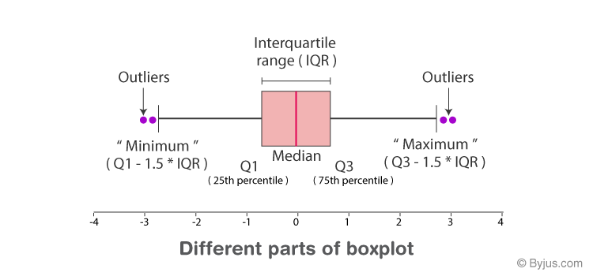
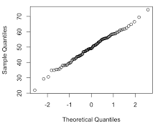
READING ONE VARIABLE
Distribution graphics answer different questions about the same metric variable.
Histogram
Boxplot
Q-Q plot
What is the shape?
Where are median, IQR, and outliers?
Does the distribution roughly follow normality?
Use for BMI, attachment loss, height, or weight when you need shape and spread.
Boxplots compress the distribution into median, quartiles, whiskers, and possible outliers.
Points close to the diagonal support approximate normality; curved patterns suggest deviations.
Interpret first, compute second: a plot can reveal coding errors, outliers, skewness, and impossible values before formal analysis.
Source: worksheet 1, Practical QB Scientific Work; NHANES 1999-2003
05

Slide 6
TWO CATEGORICAL VARIABLES
A crosstab turns diabetes and periodontitis into conditional risks.
Periodontitis yes
Periodontitis no
Row total
Diabetesyes
a
b
a + b
Diabetes no
c
d
c + d
Column total
a + c
b + d
n
SPSS path: Analyze -> Descriptive Statistics -> Crosstabs. In Cells, request row percentages. In Statistics, select Risk.
A useful convention is to put the outcome across the top and the exposure in rows.
Source: worksheet 1, Practical QB Scientific Work; NHANES 1999-2003
06

Slide 7
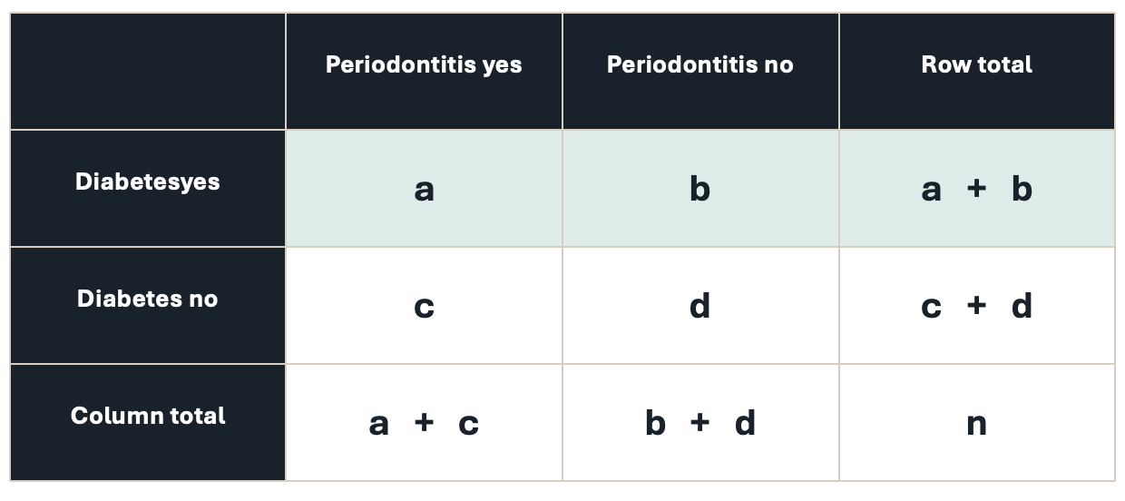
RISK MEASURES
Difference, ratio, and odds answer three different association questions.
RD = [a/(a+b)] – [c/(c+d)]
Risk difference
Use percentage points, not percent.
How many percentage points higher or lower?
RR = [a/(a+b)] / [c/(c+d)]
Relative risk
RR = 1 means no association.
How many times as high is the risk?
OR = (a/b) / (c/d) = ad/bc
Odds ratio
OR approximates RR only for rare outcomes.
How many times as high are the odds?
Hand-check SPSS: subtract row percentages for RD, divide row percentages for RR, and verify the odds ratio from the four table cells.
Source: worksheet 1, Practical QB Scientific Work; NHANES 1999-2003
07

Slide 8
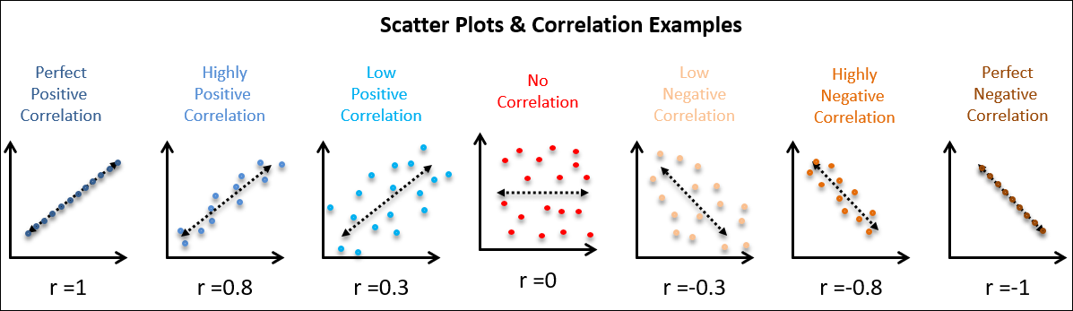
QUANTITATIVE ASSOCIATION
A scatterplot shows the relationship before a coefficient compresses it.
Source: CQE Academy (2021)
08

Slide 9
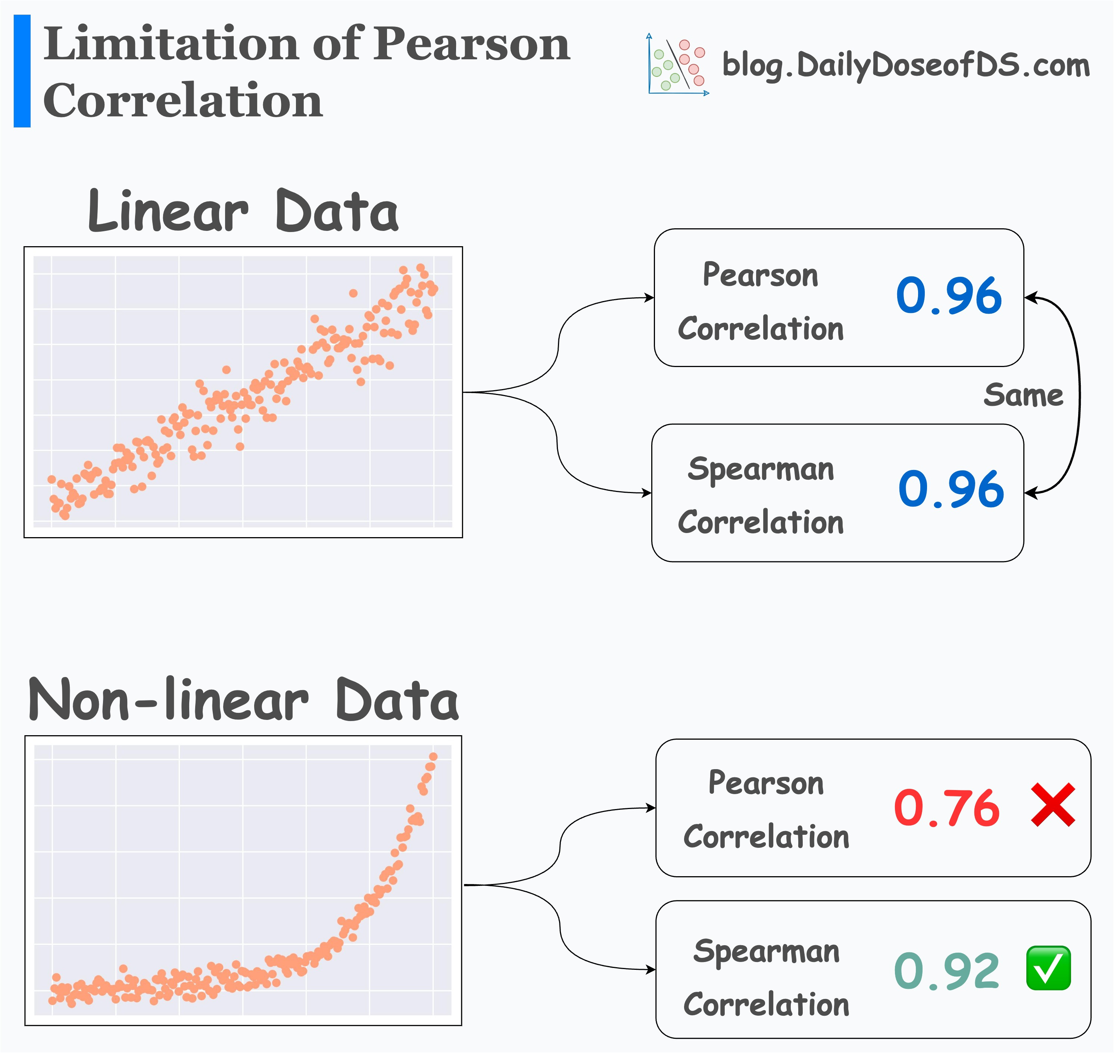
Pearson vs Spearman correlation.
Use Pearson correlation when your goal is to measure a linear relationship between two continuous variables under fairly standard statistical assumptions:
Variables are continuous.
Relationship is roughly linear.
The distribution is not strongly skewed and doesn’t include extreme outliers.
The Spearman’s test can be used to analyse ordinal level, as well as continuous level data, because it uses ranks instead of assumptions of normality.
Spearman correlation is helpful when the data or relationship does not fit Pearson’s assumptions:
Ordinal or rank-based data.
Monotonic relationships that may not be linear.
Non-normal or skewed distributions or outliers sensitive

