Slide 1






DIRECT DETECTION OF EXOPLANETS USING TUNABLE KERNEL-NULLING
Vincent Foriel^{1*}, Frantz Martinache¹, David Mary¹
¹ Université Côte d'Azur, Observatoire de la Côte d'Azur, CNRS, Laboratoire Lagrange, France * vincent.foriel@oca.eu

Slide 2
Content
1. Context
Exoplanet detection
Challenges
Current techniques
2. Introduction
Interferometry
Nulling Interferometry
Kernel-Nulling
3. Materials
VLTI / ASGARD / NOTT
Multi-Mode Interferometers (MMI)
Thermo-Optic Phase Shifters (TOPS)
Tunable Architecture
4. Calibration methods
Genetic
Obstruction
Machine Learning
5. Statistical analysis
Output distribution
Time-dependant response
Sky contribution map
6. Futurs prospects
Amplitude control
Achromatic solution
Image reconstruction
More statistical analysis

Slide 3
Context
Why are we working so hard?

Slide 4
Exoplanet detection
Why?

Slide 5
Challenges
High angular resolution
High contrast
High sensitivity

Slide 6
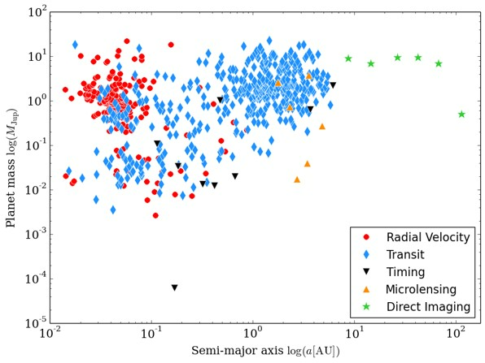
Current methods
Transit (4342)
Radial Velocity (1098)
Gravitational microlensing (235)
Direct imaging (82)
Astrometry (3)
https://exoplanets.nasa.gov/alien-worlds/ways-to-find-a-planet/

Slide 7
Introduction
These giants on whose shoulders we stand.

Slide 8
Interferometry

Slide 9
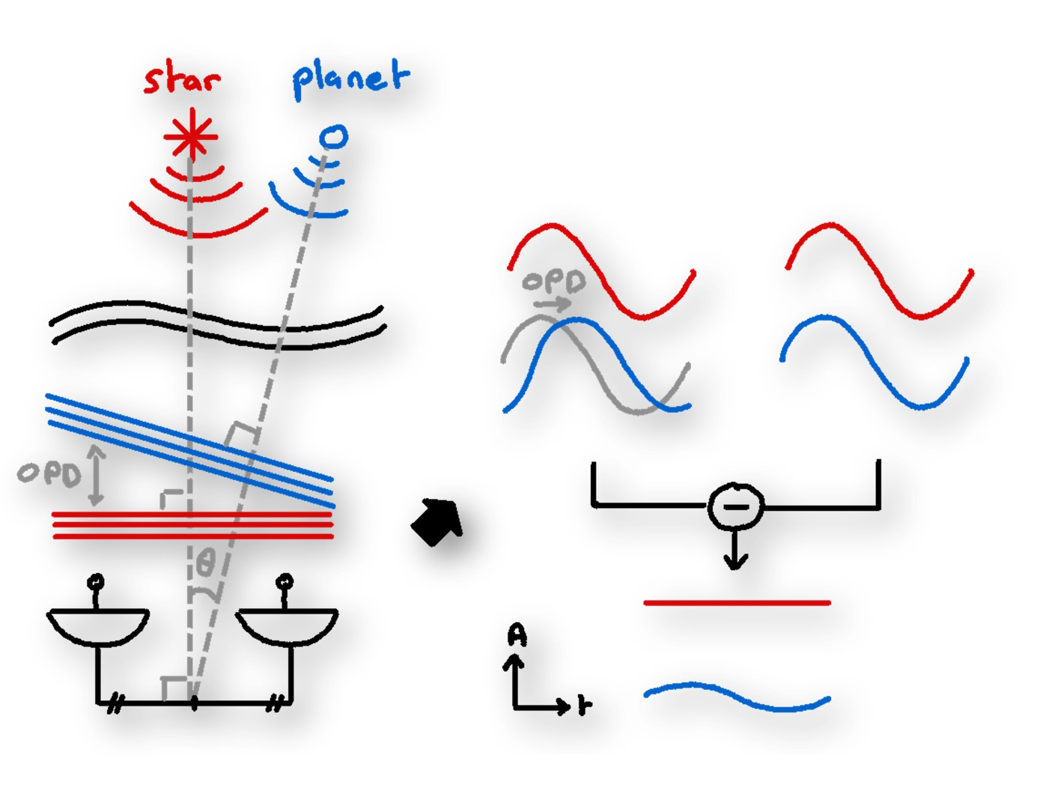
Nulling Interferometry
Descructive interference

Slide 10
Kernel-Nulling

Slide 11
Materials
The very cool toys we are playing with!

Slide 12
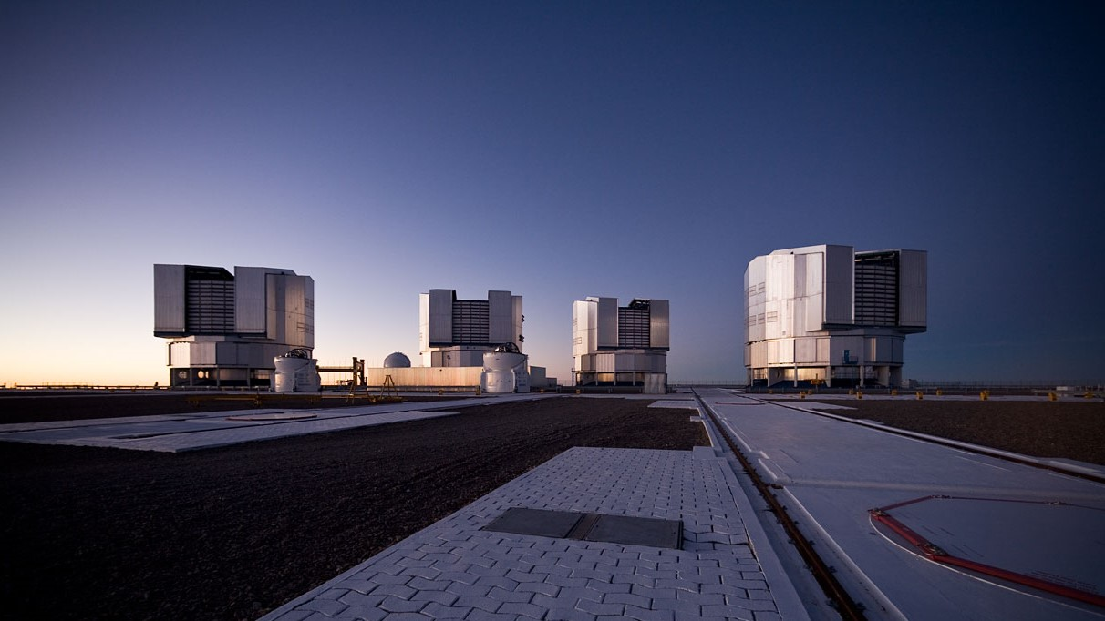
VLTI / ASGARD / NOTT

Slide 13
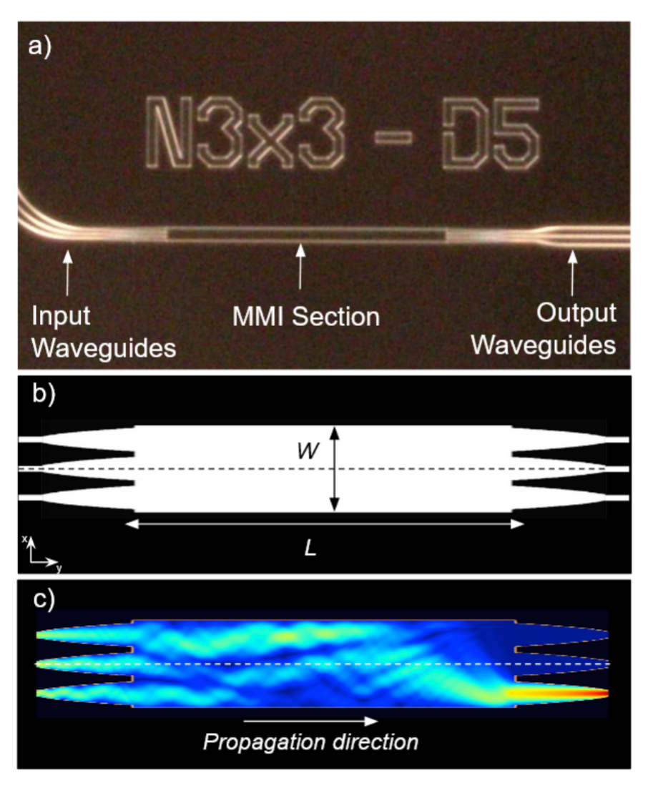
MMI: Multi Mode Interferometer
Cvetojevic, N. et al., 2022. 3-beam self-calibrated Kernel nulling photonic interferometer. arXiv e-prints. https://doi.org/10.48550/arXiv.2206.04977

Slide 14
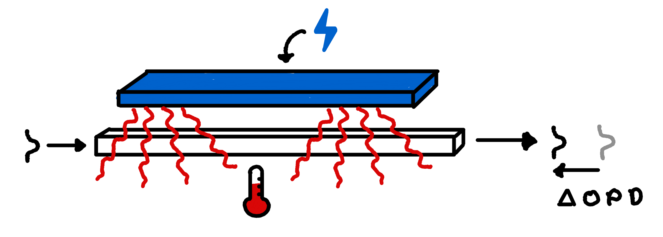
Phase control Using TOPS (Thermo-Optic Phase Shifters)
Recipe
Electric resistance
⤷ Heat
⤷ Optical index modification
⤷ Phase delay
Response time ~ 1 μs

Slide 15
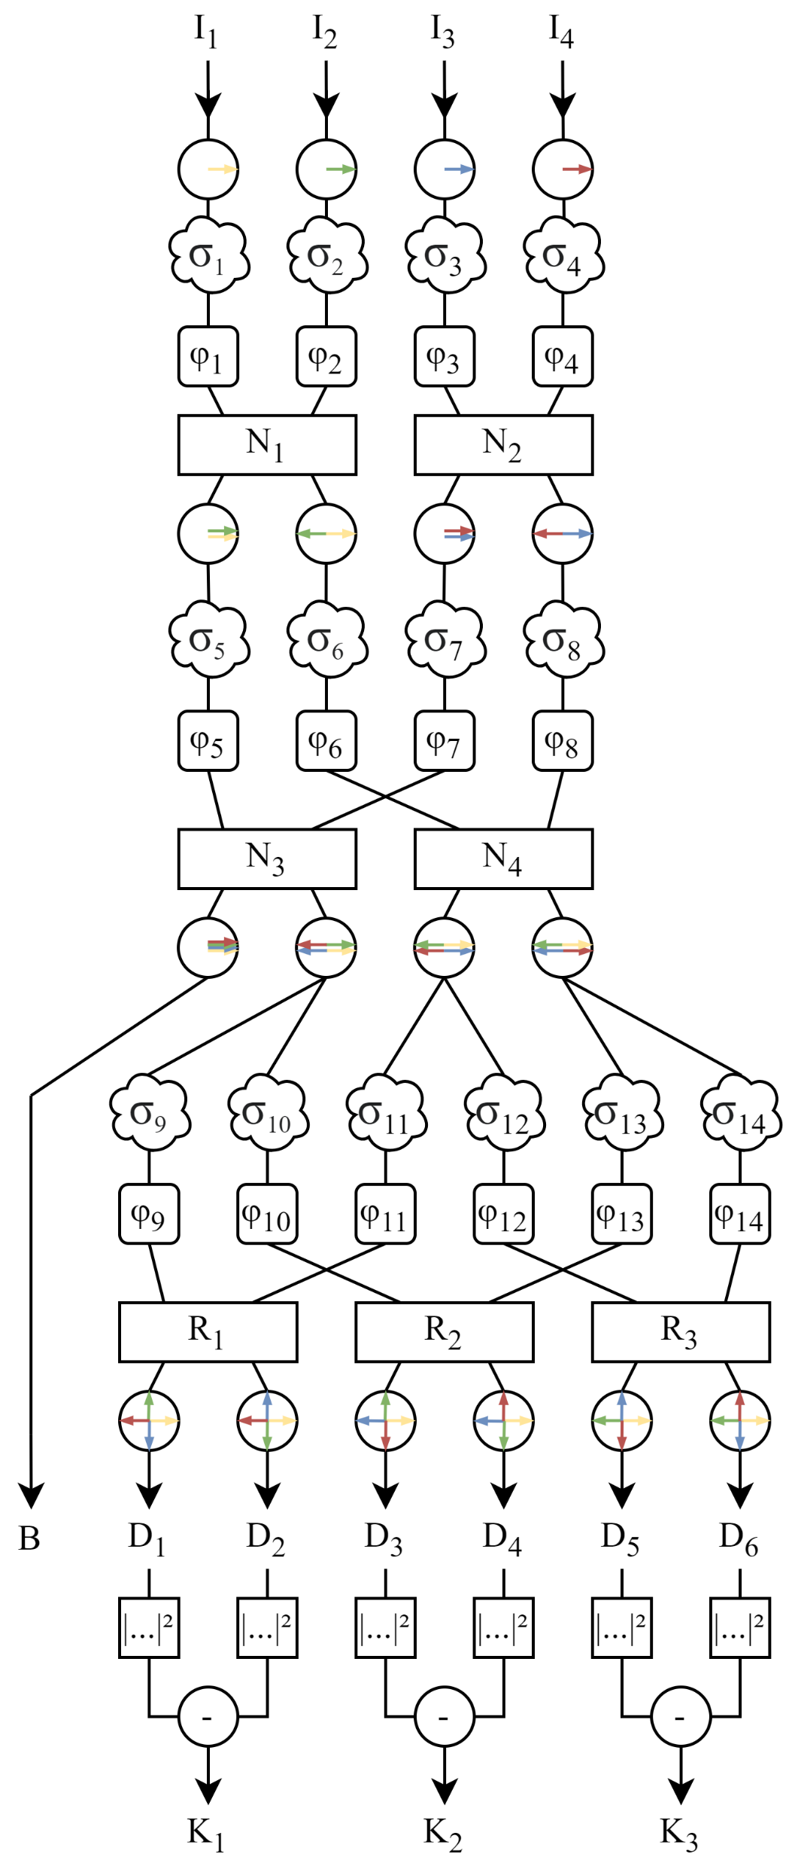
Tunable architecture

Slide 16
Calibration algorithms
These wizard tricks to make the impossible… very hard.

Slide 17
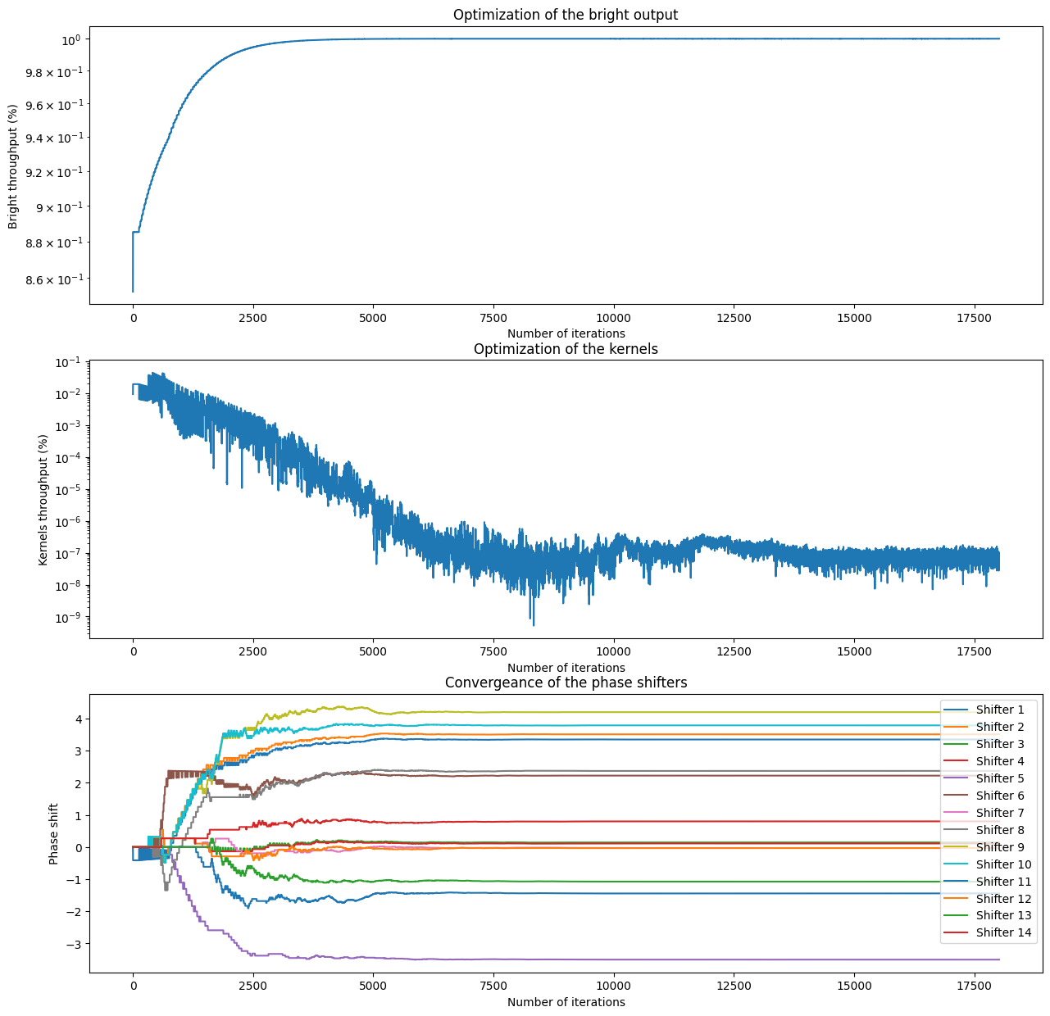
Genetic

Slide 18
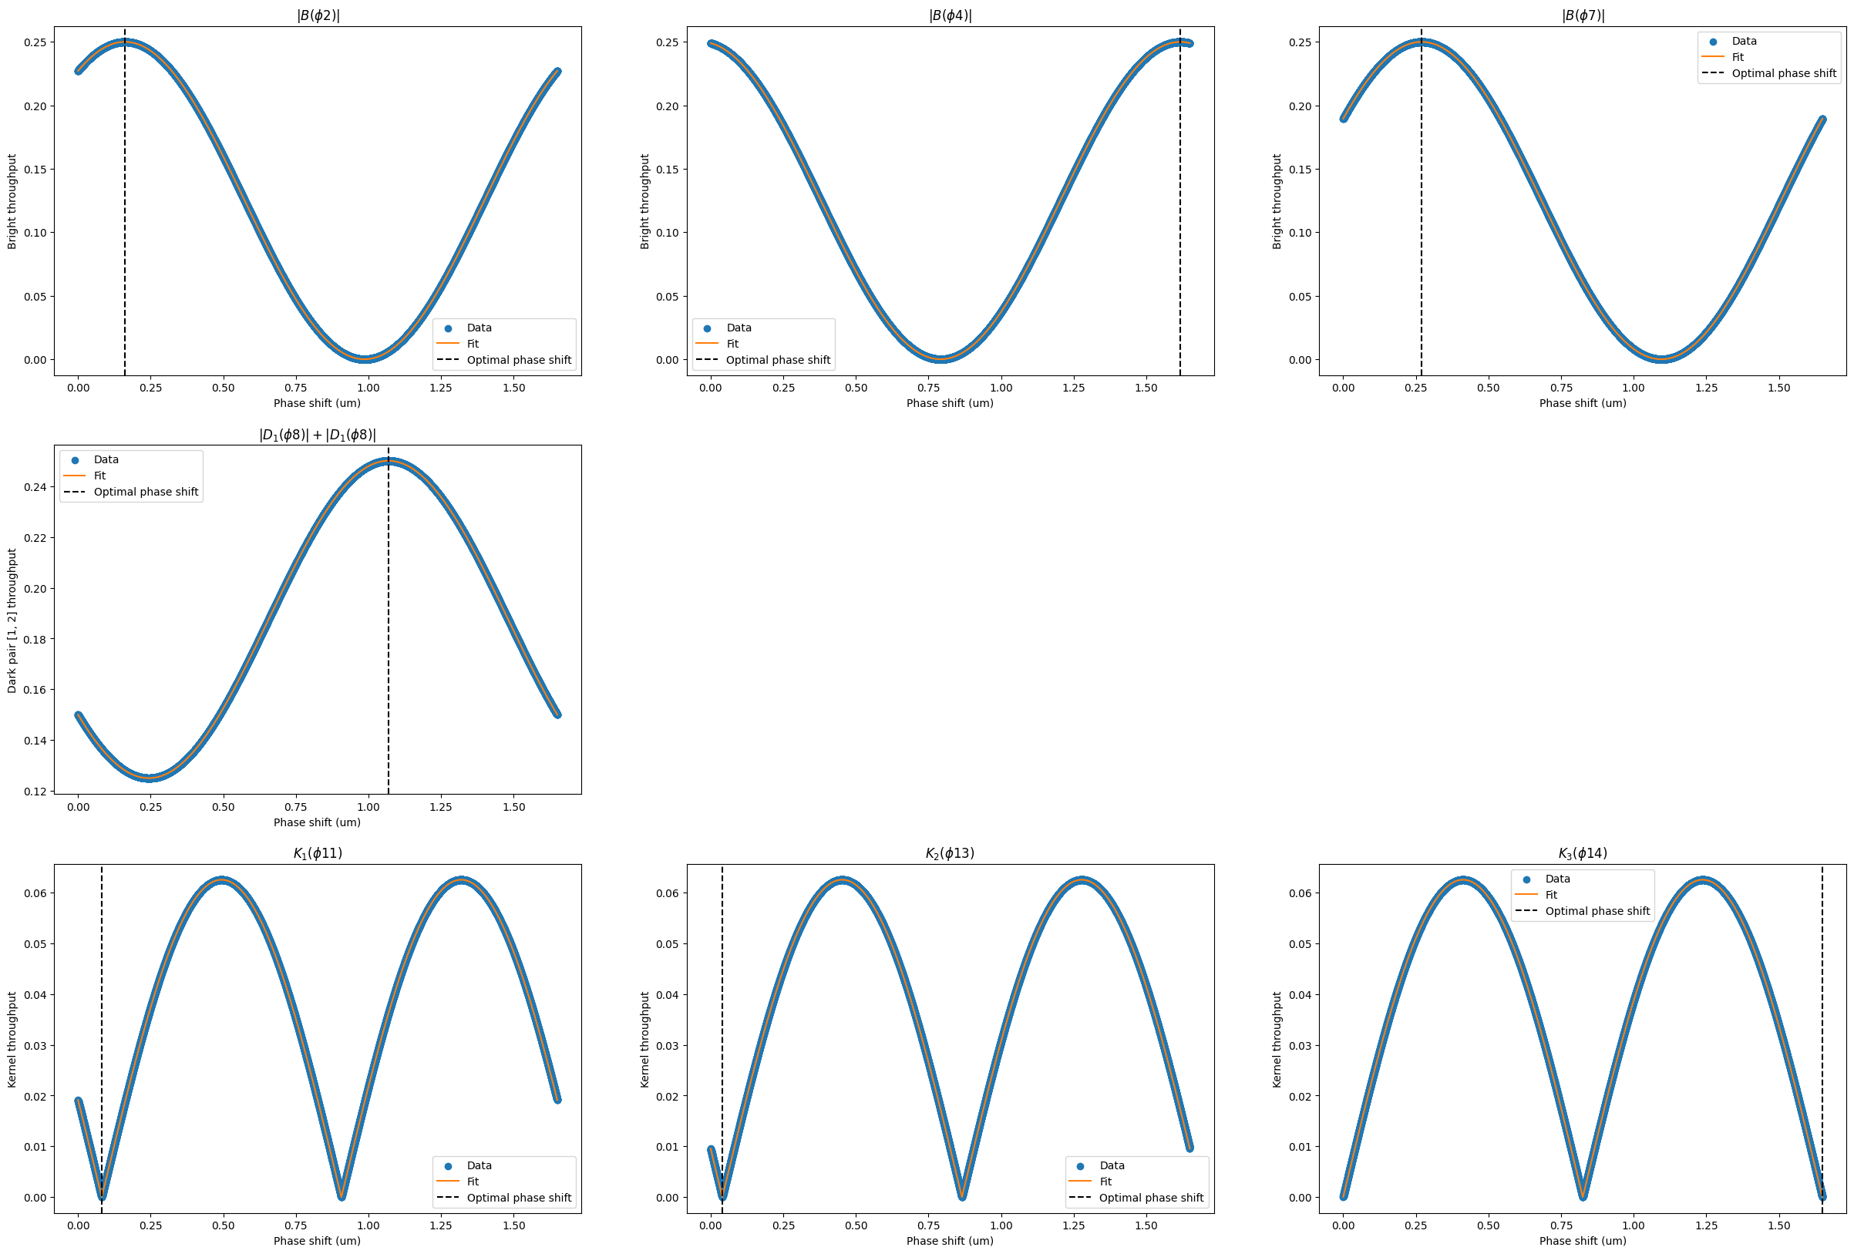
Obstruction

Slide 19
Machine Learning

Slide 20
Statistical analysis
Some maths to show we are serious.

Slide 21
Output distribution

Slide 22
Time-dependant response

Slide 23
Sky contribution map

Slide 24
Futurs prospects
When there is no more, there is still more!

Slide 25
Amplitude control

Slide 26
Achromatic solution

Slide 27
Image reconstruction

Slide 28
More statistical analysis

