Slide 1
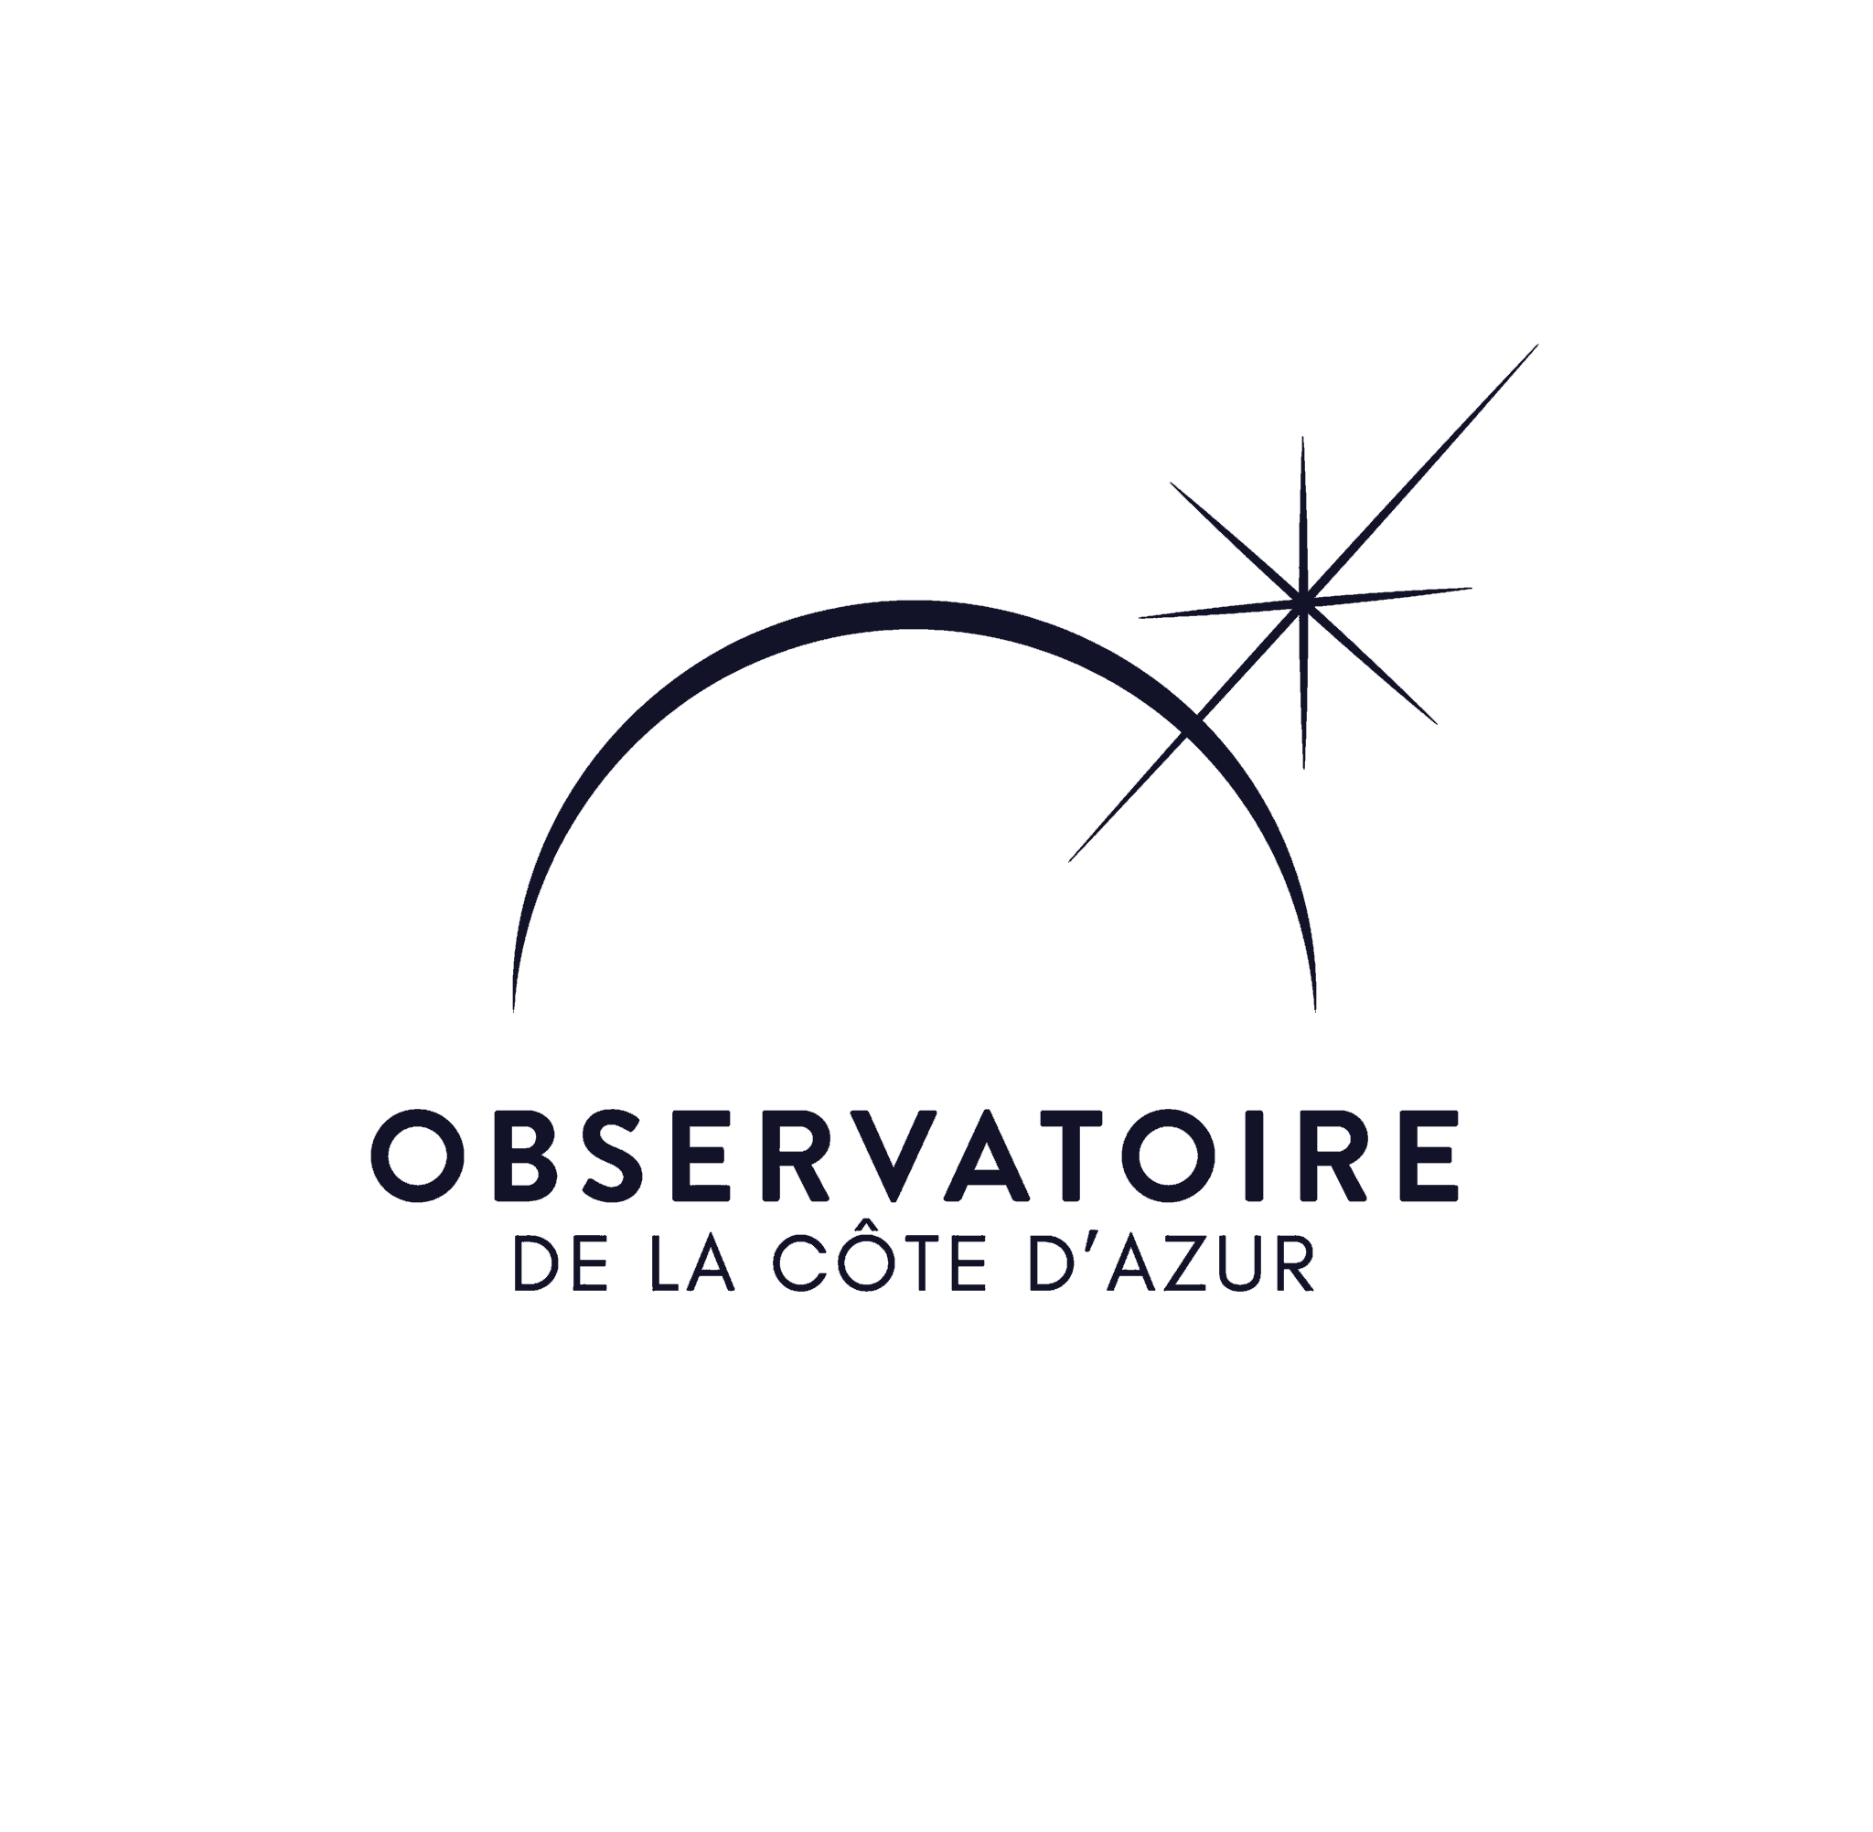





IMPROVING NULLING INTERFEROMETRY WITH A TUNABLE KERNEL-NULLING FOR DIRECT DETECTION OF EXOPLANETS
Vincent Foriel^{1*}, Frantz Martinache¹, David Mary¹
Nick Cvetojevic¹, Romain Laugier², Marc-Antoine Martinod¹
Content:
1) Numerical simulation & tools 2) Calibration methods 3) Statistical analysis
¹ Université Côte d'Azur, Observatoire de la Côte d'Azur, CNRS, Laboratoire Lagrange, France
² KU Leuven university, Leuven, Belgium * vincent.foriel@oca.eu

Slide 2
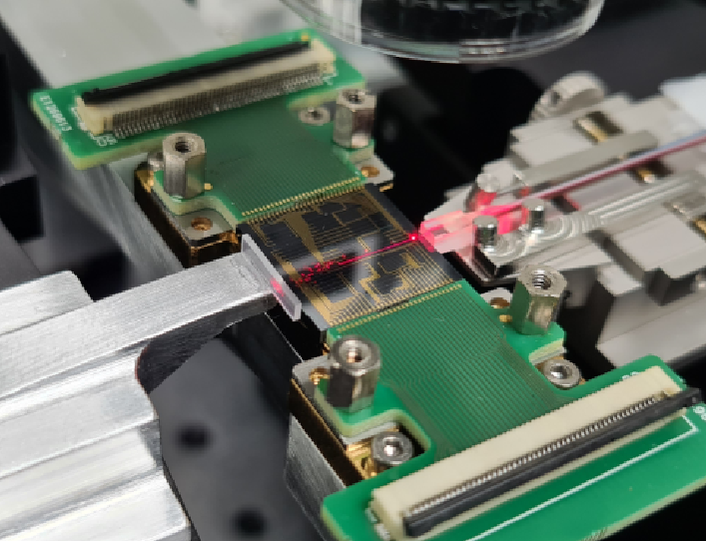
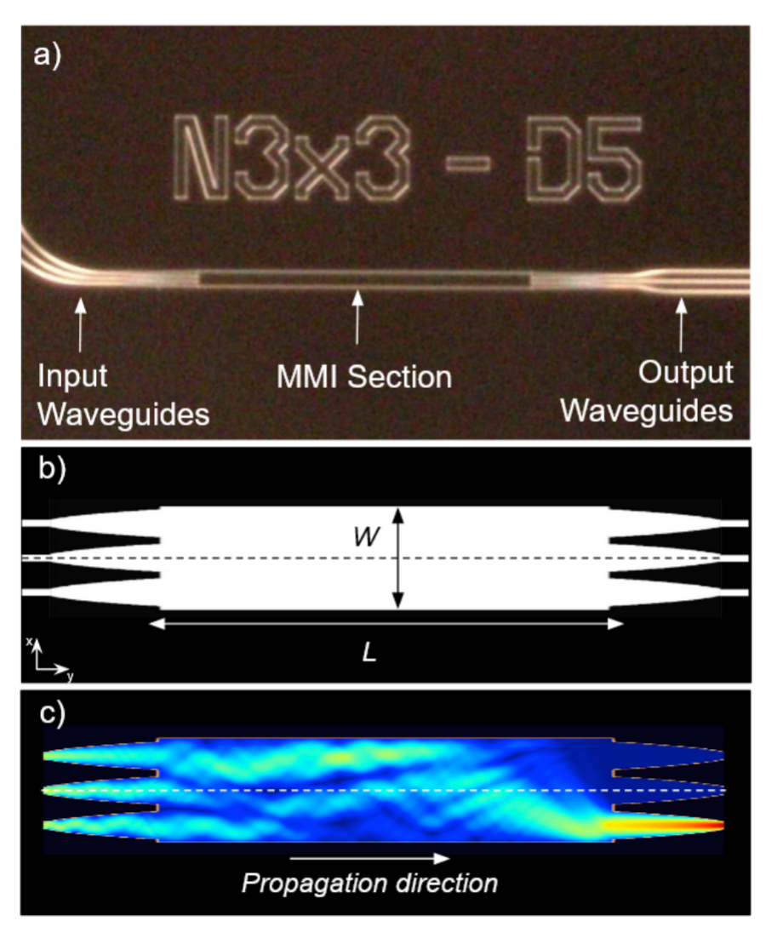
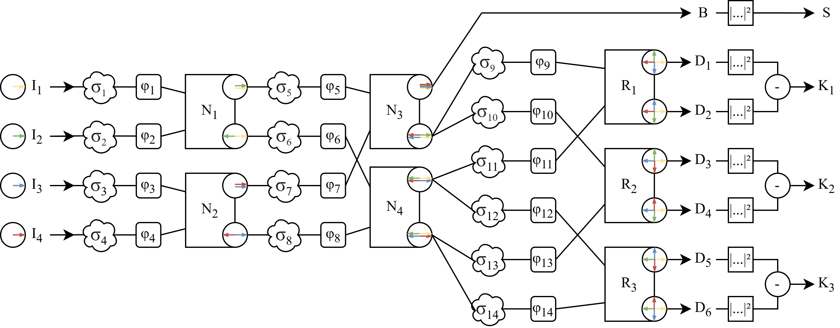
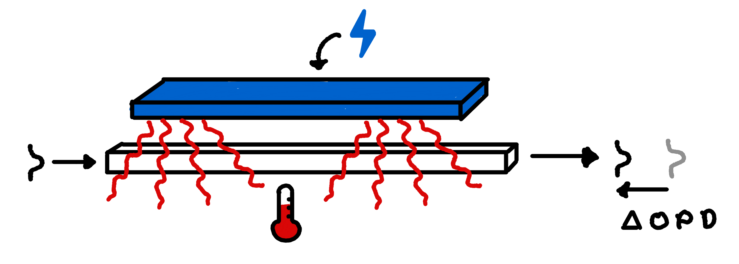

Tunable Kernel Nuller
Fig. 1: Photonic chip made of SiN (16mm large)
$$λ_{0}=1,65μm$$
Objective: Improve exoplanet detection capabilities
Methods:
Optimize starlight cancellation by calibrating an active photonic device
Set up dedicated detection tests and data treatment framework
Materials:
One of the first active photonic devices applied inastronomy Fig. 1 & 2
Takes four input signals (4-telescope architecture)
Interferences are performed by 7 MMI (Multi Mode Interferometer) Fig. 3
Contains 14 electro-optic phase shifters Fig. 4
Creates 3 different kernel outputs (difference in intensity between two symmetric cross-combined inputs signals)
A test bench
Fig. 3: Wave propagation simulation in a multi mode waveguide 📚 Cvetojevic et al. (2022)
Fig. 2: Scheme of the studied Tunable Kernel-Nulling architecture
Fig. 4: Scheme of an electro-optic phase shifter
Vincent Foriel

Slide 3
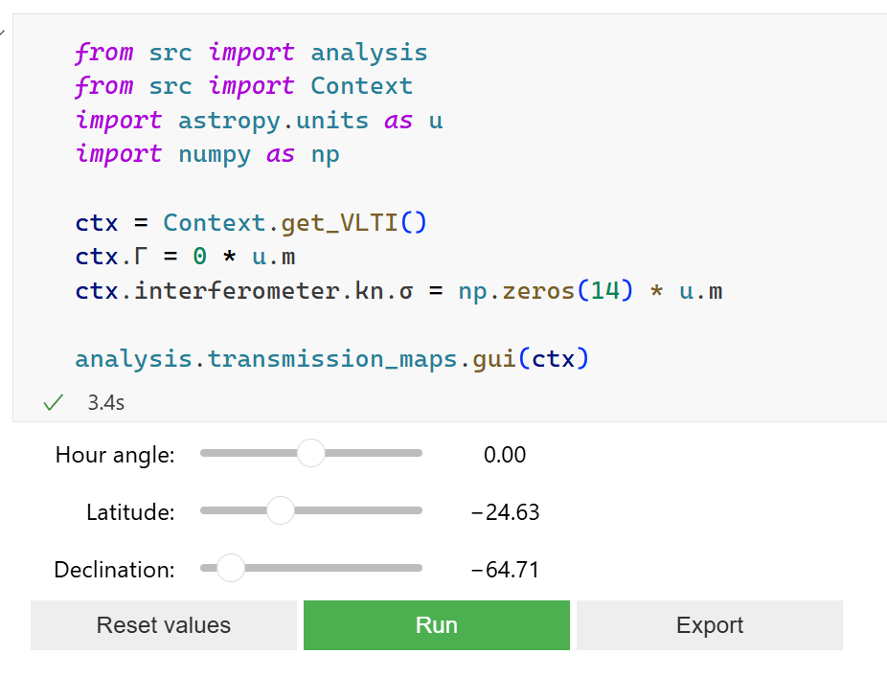
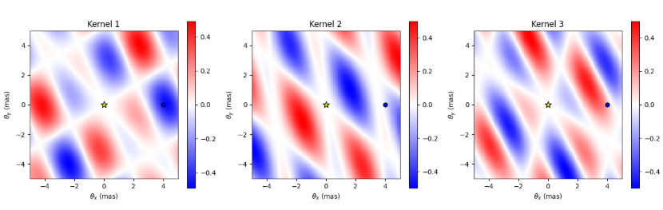
Work 1: Numerical simulation & tools
Development of a python end-to-end simulation framework
Allows to study of various scenarios Possibility to define:
Source(s) position and flux
Telescopes configurations (position, size, location)
Time of observation (taking Earth’s rotation into account) and number of samples taken
Noise sources (atmosphere, manufacturing defects, photon noise etc.)
Injected phases
Wavelength (monochromatic mode) or bandwidth (polychromatic mode) of observation
Camera integration time
Development of various analyses based on that framework Fig.1
Development of interfaces to control the equipment on the test bench
Fig. 1: Example of the use of the Kernel-Nulling framework showing the transmission maps using a VLTI configuration

Slide 4
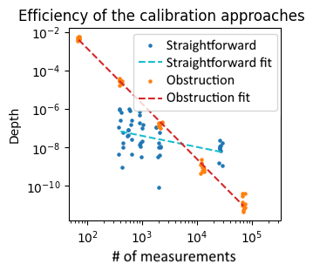
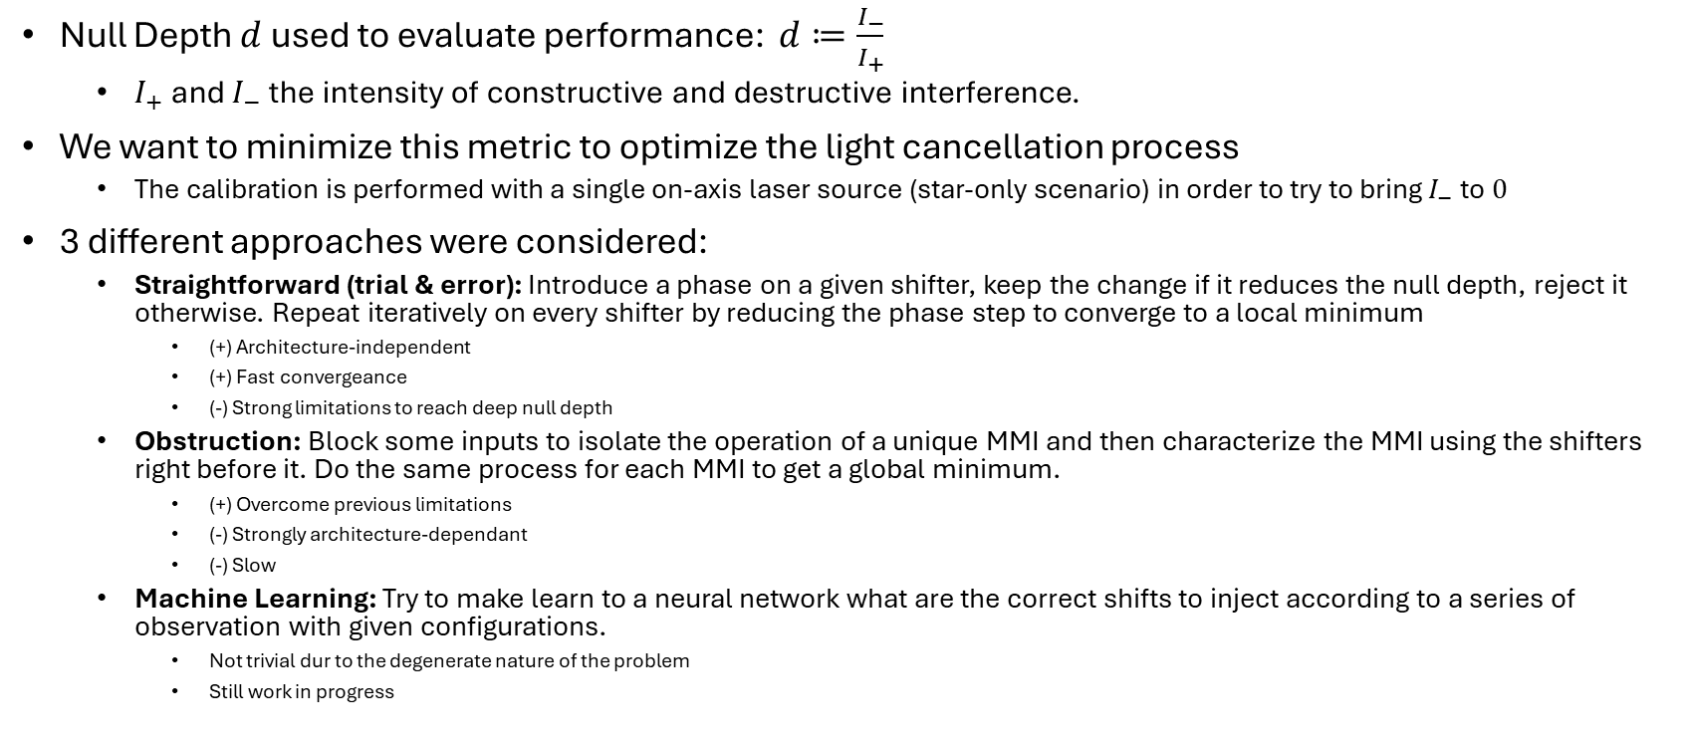
Work 2: Calibration methods
Physical limit
to determine
in lab
Null Depth $d$ used to evaluate performance: $d≔\frac{I_{−}}{I_{+}}$
$I_{+}$ and $I_{−}$ the intensity of constructive and destructive interference.
We want to minimize this metric to optimize the light cancellation process
The calibration is performed with a single on-axis laser source (star-only scenario) in order to try to bring $I_{−}$ to $0$
3 different approaches were considered:
Straightforward (trial & error): Introduce a phase on a given shifter, keep the change if it reduces the null depth, reject it otherwise. Repeat iteratively on every shifter by reducing the phase step to converge to a local minimum
(+) Architecture-independent
(+) Fast convergeance
(-) Strong limitations to reach deep null depth
Obstruction: Block some inputs to isolate the operation of a unique MMI and then characterize the MMI using the shifters right before it. Do the same process for each MMI to get a global minimum.
(+) Overcome previous limitations
(-) Strongly architecture-dependant
(-) Slow
Machine Learning: Try to make learn to a neural network what are the correct shifts to inject according to a series of observation with given configurations.
Not trivial dur to the degenerate nature of the problem
Still work in progress
Fig. 1: Results of a comparison between the two calibration methods already available

Slide 5
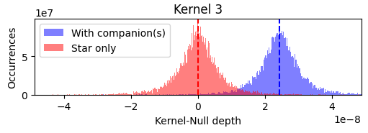
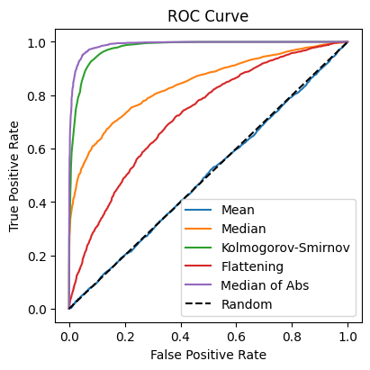
Work 3: Statistical analysis
Kernel outputs follow a unknown distribution(s)
Searching for parametric model(s) that describes these distributions
It may be necessary to use several models
Companions affect these distributions Fig. 1
Expected distribution shift
Unexpected distribution spread
Maybe other faint effects?
What impact of a companion on edges of a transmission zone?
What impact of several companions?
In practice, because the planet signal is very faint we have a SNR << 1
Studying various statistical tests and comparing there performances Fig. 2
Location based tests (mean, median, mode etc.)
Distribution shape tests (Kolmogorov-Smirnov, Cramer von Mises, Anderson-Darling etc.)
Specific tests (flattening, median of absolute values etc.) Generalized Likelhyhood Ratio (work in progress)
Determining the theoretical limit of detection capability
Likelyhood ratio on comparable analytical models
Fig 1: Distributions obtained after a series of observation in two different scenarios (with and without companion)
Fig. 2: ROC curves used to visualize and compare the performance of different considered statistical tests. We are searching for a test that maximizes the True Positive Rate while minimizing the False Positive Rate, I.e. a test that lies in the top left of the plot.
Vincent Foriel

