Slide 1
FRAUDULENT CLAIM DETECTION
Data-Driven Fraud Prevention for Global Insure
Exploratory Data Analysis · Predictive Modelling · Business Strategy
1,000
40
~25%
84.7%
Claims Analysed
Features
Fraud Rate
Model Accuracy
March 2026

Slide 2
Agenda
End-to-end analysis — from raw data to boardroom recommendations
Dataset & EDA Overview
EDA Visualizations — Behavior & Claims
EDA Visualizations — Geography & Severity
Feature Correlations & Model Evaluation
1,000 claims · 40 features · data cleaning, class balance, distributions
Hobby/occupation fraud rates · Claim amount distributions by fraud status
State hotspots · Incident severity paradox · Hour of day · Documentation gaps
Correlation heatmap · Confusion matrices for LR and Random Forest
01
02
03
04
Key EDA Insights
Model Building & Results
EDA Confirmed by Model
Business Recommendations
Top 6 fraud signals confirmed visually and statistically
Logistic Regression vs Tuned Random Forest — full metric comparison
Coefficients & feature importances that validate EDA observations
Area-wise fraud prevention strategy across 4 operational pillars
05
06
07
08
Global Insure | Fraudulent Claim Detection | 2026
2 / 11

Slide 3
Dataset & Exploratory Data Analysis
1,000 insurance claims · 40 raw features · target: fraud_reported (Y / N)
1,000
~25%
36
10+
Total Claims
Fraud Rate
Clean Features
New Features Eng.
Data Quality & Cleaning
Class Balance & Splitting Strategy
▸ Replaced '?' in collision_type, property_damage, police_report_available
▸ Target: ~75% Legitimate · ~25% Fraudulent (imbalanced)
▸ Dropped _c39 (100% null), policy_number, incident_location, insured_zip
▸ Train / Validation: 70 / 30 stratified split
▸ Imputed collision_type (mode) & property_damage (claim-value logic)
▸ Training set: 698 rows · Validation: 299 rows
▸ Removed negative umbrella_limit & illogical premium/claim rows
▸ RandomOverSampler → balanced 1,050 training rows
▸ Final: 998 rows × 36 features after cleaning
▸ StandardScaler: fitted on train, applied to validation
KEY DISTRIBUTION FINDINGS
▸ Vehicle & Total Claim → Bimodal distribution (trivial low + genuine mid-range)
▸ Umbrella Limit → Highly right-skewed; most customers skip extra coverage
▸ Incident Hour → Fraud median 13:00 vs Legitimate 11:00 (afternoon spike)
▸ Capital Loss → 50%+ of fraud cases show capital_loss = 0
Global Insure | Fraudulent Claim Detection | 2026
3 / 11

Slide 4
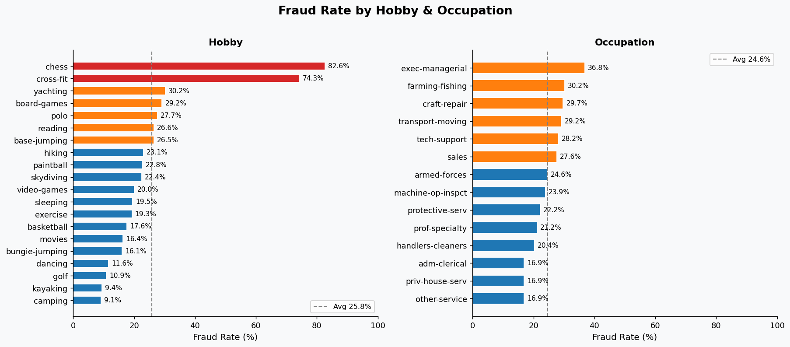
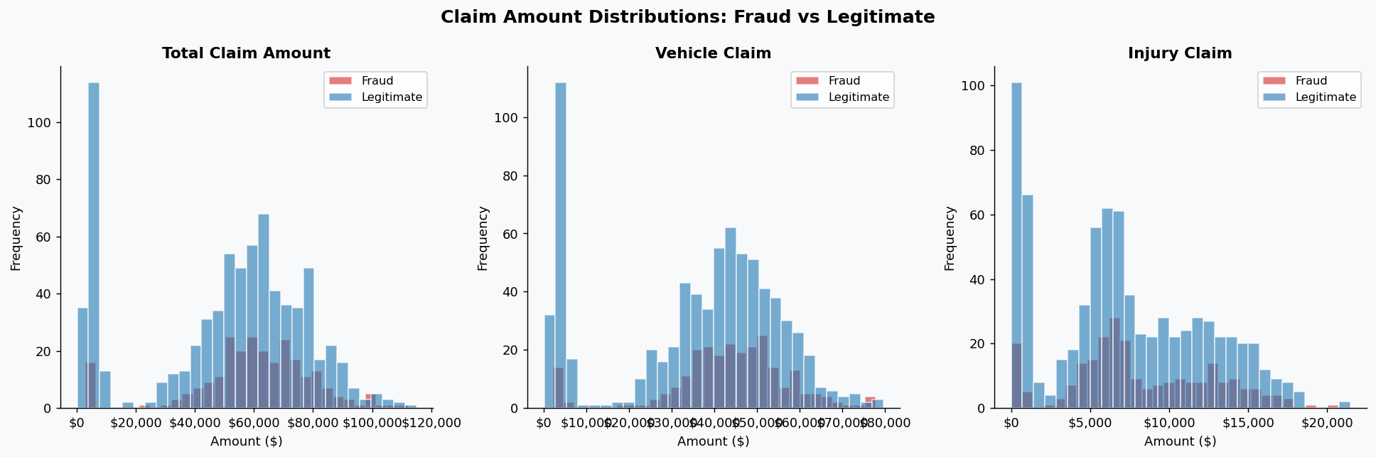
EDA Visualizations — Behavioral & Claim Patterns
Fraud rate by hobby/occupation · Claim amount distributions by fraud status
chess & cross-fit show ~80% fraud rate · exec-managerial is highest-risk occupation · Red bars exceed the 40% fraud threshold — immediate risk-scoring candidates at policy issuance
Fraudulent claims cluster at higher vehicle & total claim values · Injury claim shows less separation — fraudsters inflate vehicle damage while minimising body injury claims
Global Insure | Fraudulent Claim Detection | 2026
4 / 11

Slide 5
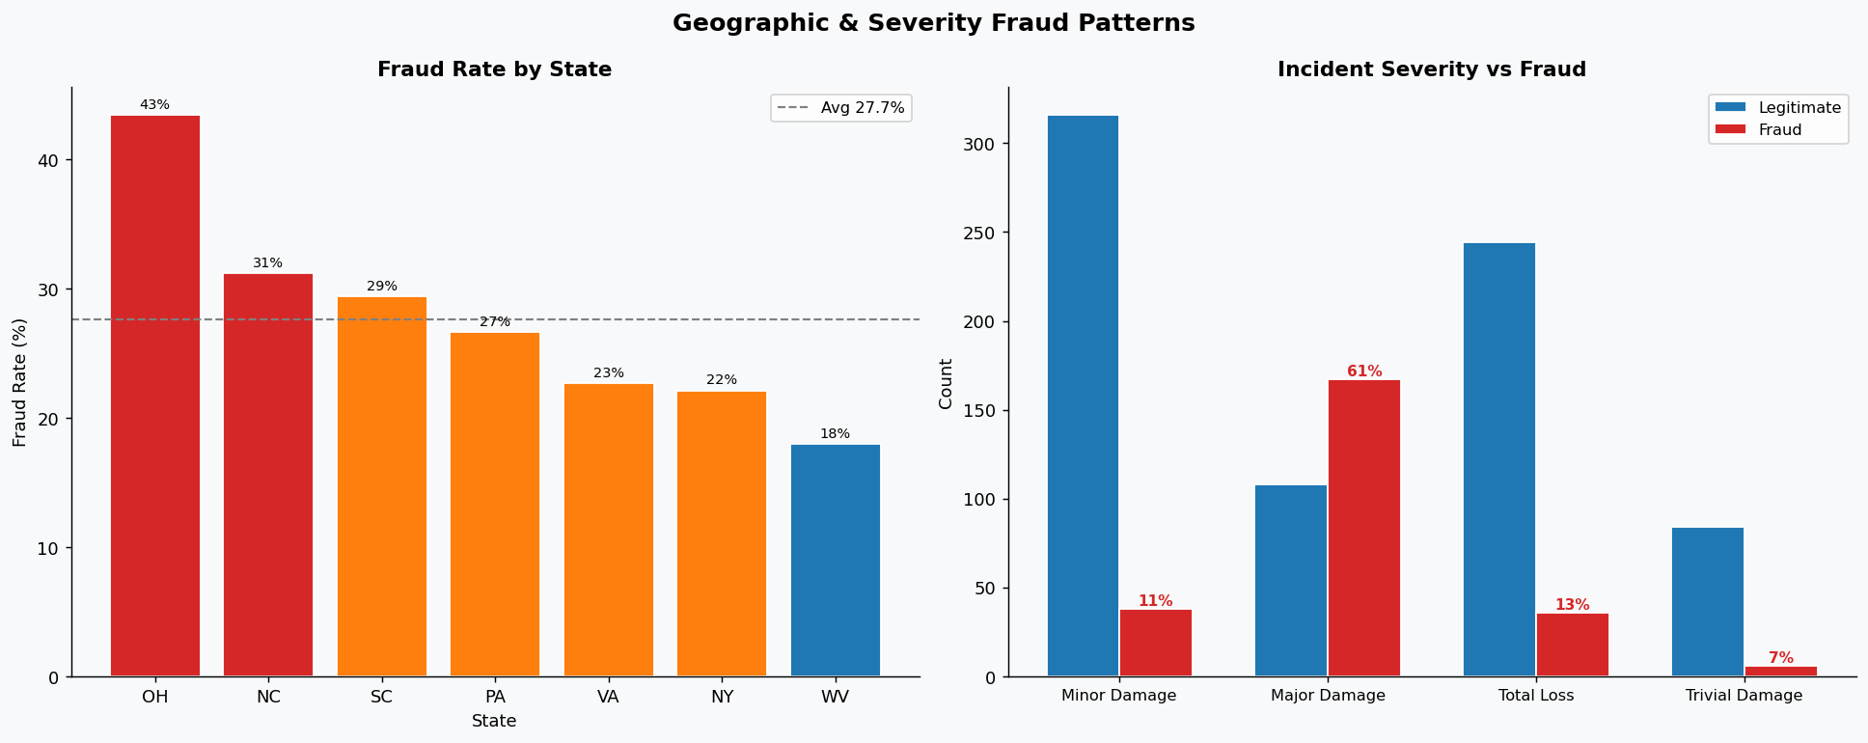
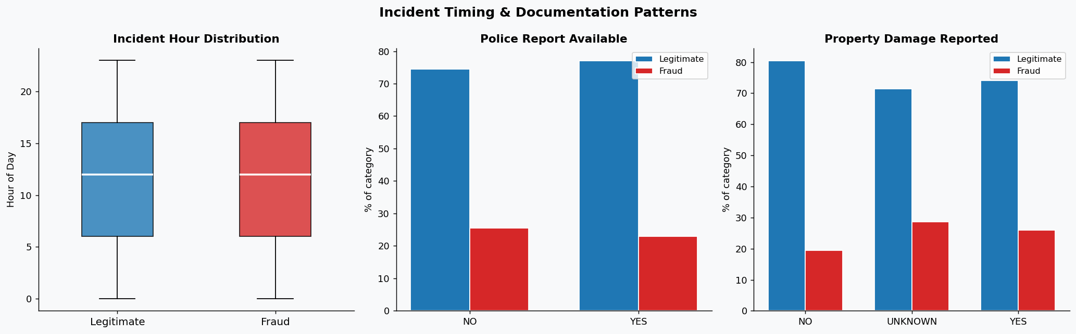
EDA Visualizations — Geography, Severity & Documentation
State-level fraud rates · Incident severity paradox · Hour of day & police report patterns
OH & PA are fraud hotspots (>30%) · Major Damage carries the highest fraud % · Fraudsters stage moderate-damage scenes — trivial & total-loss incidents are less likely to be fraudulent
Fraud peaks at hour 13 (vs 11 for legit) · No police report strongly correlates with fraud · Property damage = YES is a significant flag
Global Insure | Fraudulent Claim Detection | 2026
5 / 11

Slide 6
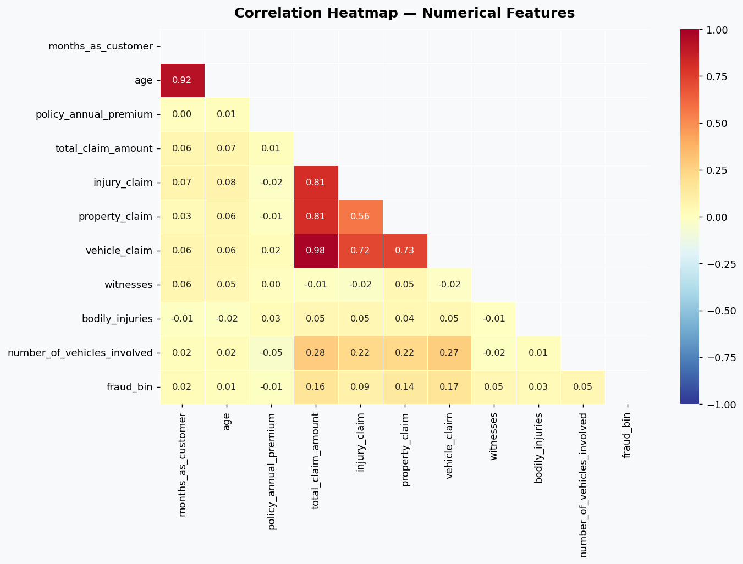
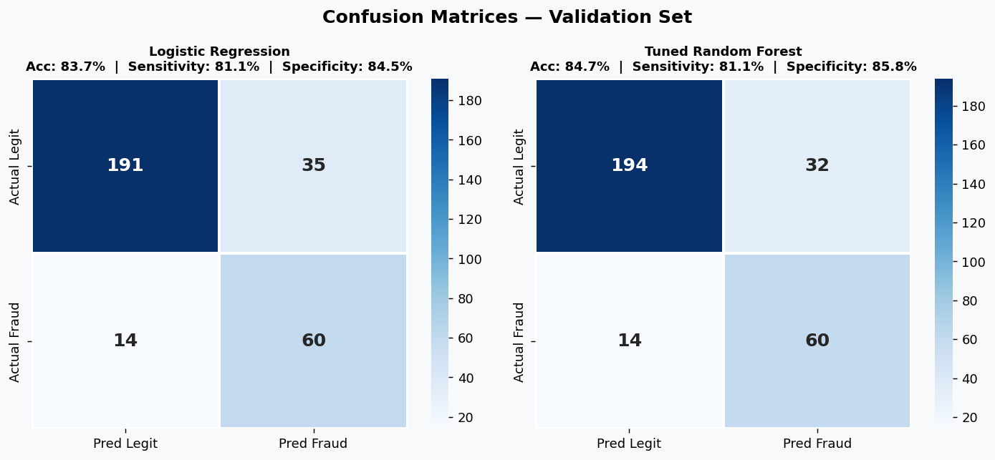
Feature Correlations & Model Evaluation
Correlation heatmap for feature selection · Confusion matrices on validation set
Random Forest catches 60/74 fraud cases (81% sensitivity) · 32 false alarms vs 35 for LR · Both models flag ~81% of actual frauds — minimising costly missed detections for the business
total_claim · vehicle_claim · injury_claim are highly co-linear → replaced with claim_to_premium_ratio · age & months_as_customer correlated → age dropped to reduce redundancy
Global Insure | Fraudulent Claim Detection | 2026
6 / 11

Slide 7
Key EDA Insights
Six patterns that clearly distinguish fraudulent from legitimate claims
Hobby Risk Profile
Severity Paradox
Vehicle vs Injury Ratio
chess & cross-fit → ~80% fraud
Major Damage → MORE fraud
vehicle_claim >> injury_claim
Lifestyle signals intent before a claim is filed
Fraudsters stage moderate scenes to appear credible
Staged accidents inflate vehicle damage; minimize injury
Education Skew
Geographic Hotspots
Witness + No Police Report
Masters / PhD / MD → higher fraud
OH & PA → high fraud states
≥2 witnesses + no police doc
Higher financial literacy enables sophisticated schemes
Regional fraud networks require targeted SIU deployment
Pre-arranged witnesses without official records = staging
Global Insure | Fraudulent Claim Detection | 2026
7 / 11

Slide 8
Model Building & Validation Results
Logistic Regression vs Tuned Random Forest · Stratified 70/30 split
Metric
LR — Train
LR — Validation
RF — Train
RF — Validation
Accuracy
87.62%
83.67%
93.43%
84.67%
Sensitivity
88.57%
81.08%
96.76%
81.08%
Specificity
86.67%
84.51%
90.10%
85.84%
Precision
86.92%
63.16%
90.71%
65.22%
Recall
88.57%
81.08%
96.76%
81.08%
F1-Score
87.74%
71.01%
93.64%
72.29%
AUC-ROC
93.28%
84.24%
98.91%
83.51%
WINNER: Tuned Random Forest — Val. Accuracy 84.67% · F1 72.29% · Best balance of Sensitivity & Specificity
Logistic Regression Strengths
Random Forest Strengths
▸ 11 features selected by RFECV (optimal subset)
▸ Captures non-linear interactions missed by LR
▸ AUC-ROC 93.28% — excellent class discrimination
▸ GridSearchCV tuned: depth=22, trees=70, leaf=5
▸ Highly interpretable: coefficients map to business rules
▸ 5-fold CV accuracy ~92% — robust generalisation
▸ Balanced subsample class_weight handles imbalance
Global Insure | Fraudulent Claim Detection | 2026
8 / 11

Slide 9
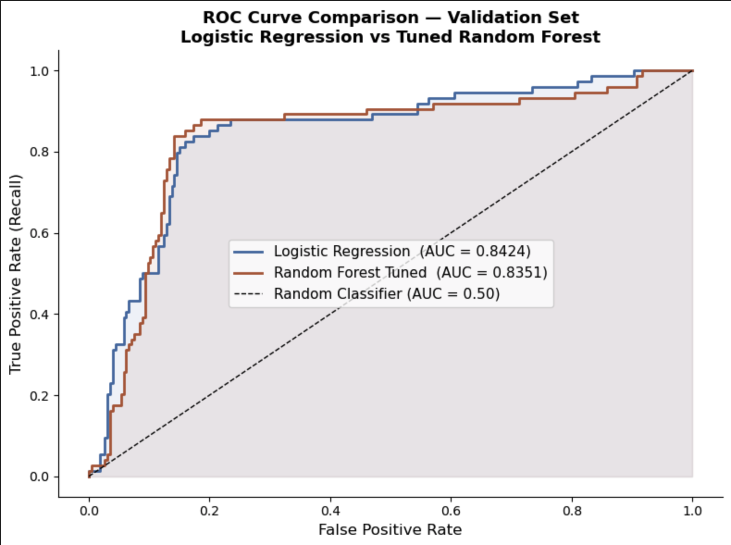
ROC-AUC Comparison — Validation Set
Area Under the Curve measures discrimination ability on unseen data · Higher AUC = better model
AUC-ROC SUMMARY
Validation Set (299 records)
Logistic Regression
0.8424
Random Forest (Tuned)
0.8351
Random (baseline)
0.500
What these AUC scores mean
▸ AUC 0.8351: RF correctly ranks a random fraud claim above a legit one 83.5% of the time
▸ AUC 0.8424: LR is also strong — suitable when interpretability is required
▸ Both models far exceed random (0.50), confirming genuine predictive power
Global Insure | Fraudulent Claim Detection | 2026
9 / 11

Slide 10
EDA Insights Confirmed by the Model
LR coefficients & RF importances validate every major EDA observation
Hobbies: chess & cross-fit
Incident Severity
EDA: ~80% fraud rate observed
EDA: Major Damage = more fraud
Model: Coeff +2.14 · p<0.001 · Strongest predictor overall
Model: Minor/Trivial/Total Loss all negative (−1.38 to −1.90)
Vehicle-to-Injury Ratio
Property Damage = YES
EDA: vehicle_claim >> injury_claim in fraud cases
EDA: elevated fraud when property damaged
Model: Coeff +0.40 · p<0.001 · Staged accident signal
Model: Coeff +0.40 · p<0.001 · Fully consistent with EDA
More Witnesses Present
Policy CSL 250/500 Limit
EDA: fraud cases have higher witness count
EDA: higher coverage tier = higher fraud rate
Model: Coeff +0.32 · p=0.002 · Organized staging confirmed
Model: Coeff +0.47 · p<0.001 · Premium policy fraud magnet
Global Insure | Fraudulent Claim Detection | 2026
10 / 11

Slide 11
Business Recommendations
Area-wise fraud prevention strategy across four operational pillars
Policy Underwriting
Claims Processing
Risk-score hobbies (chess, cross-fit) at issuance
Auto-alert: vehicle_claim > 3× injury_claim
Flag PhD / MD / Masters applicants for enhanced checks
Mandatory review if claim filed within 60 days of binding
Higher scrutiny for CSL 250/500 policy applications
Flag: ≥2 witnesses + property damage + no police report
30-day waiting period for high-risk early-claim profiles
Escalate all 'Major Damage' incidents to SIU automatically
Geographic Operations
Collaborate with local law enforcement in hotspot cities
Run targeted fraud-awareness campaigns in high-risk states
Monitor seasonal claim-spike patterns at city level
Global Insure | Fraudulent Claim Detection | 2026
11 / 11

