Slide 1
Lending Club Case Study: Analysing Loan Defaults
Overview
The company lends loans to urban customers, for the loan provided to the customer there are two probable outcomes:
The loan is paid up fully
The loan is charged off (customer unable to pay loan)
To optimize the decision of approving loan in order to :
Not approve loans to the customers who are likely to default
Like most other lending companies, lending loans to ‘risky’ applicants is the largest source of financial loss (called credit loss).
This case study presents the analysis of historic loan data to present the factors which could lead to higher loan defaults.
Data Analyzed
Loan data set for all loans issued through the time period 2007 to 2011.

Slide 2
Data Preparation
Data Cleansing
Data has 39717 rows and 111 columns
For the sake of having a clearer view we set a threshold of 75% non-null values to keep it in scope of analysis
On deleting columns with more than 75% null values, 55 columns remain in the scope of analysis
On taking a deeper look at the columns 8 more columns can be dropped,
['pymnt_plan','initial_list_status','collections_12_mths_ex_med','policy_code','application_type','acc_now_delinq','chargeoff_within_12_mths','tax_liens’]
Because all of these columns has one single value in all rows.
Null value/ Data Type processing also creating Derived Columns
Columns: term, int_rate, revol_util are object in data set and are be converted to numeric types int64 and float64
emp_length_int (int64) is created from emp_length (object)
earliest_cr_line is MON_YER (JAN-07) kind of date in data set, converted it to year
pub_rec_bankruptcies null values are filled with 0

Slide 3
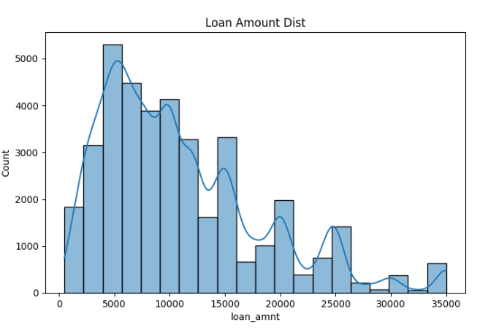
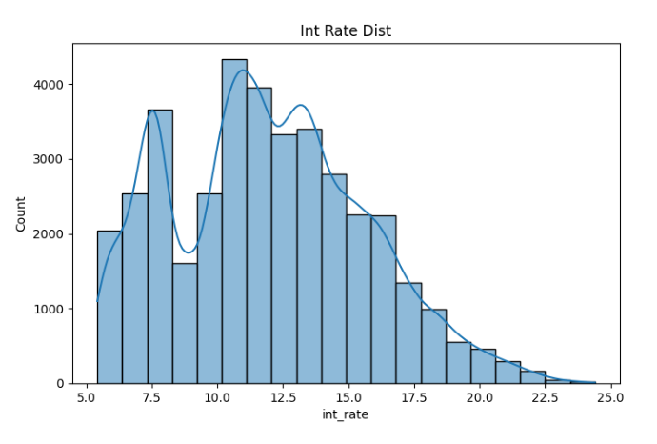
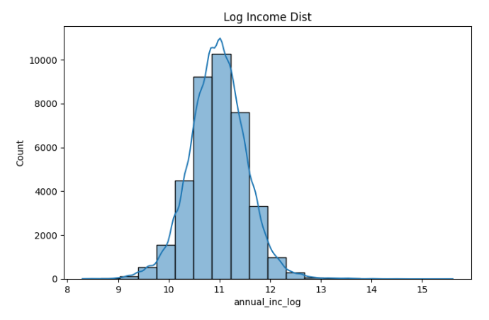
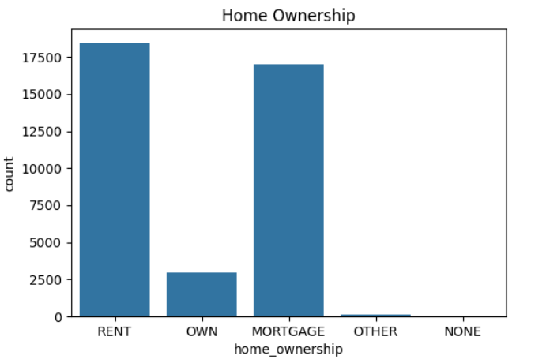
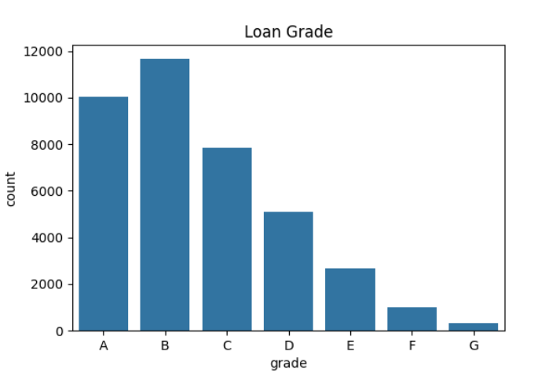
Univariate Analysis
Looked at distributions of single variables.
Loan Amount Distribution (Histogram): Most loans are $5,000-$15,000, peaking at $10,000. Few above $30,000.
Interest Rate Distribution (Histogram): Rates cluster 10-15%, some up to 25%. Shows varied risk pricing
Log Annual Income Distribution (Histogram): Peaks around 11 (about $60,000), normal shape after log transform.
Home Ownership (Count Plot): Renters highest (~18,000), then mortgage (~16,000), own (~3,000), others negligible.
Loan Grade (Count Plot): B most common (~12,000), then A, C decreasing to G
26 columns are found to have outliers, summary of outliers is shown in python notebook

Slide 4
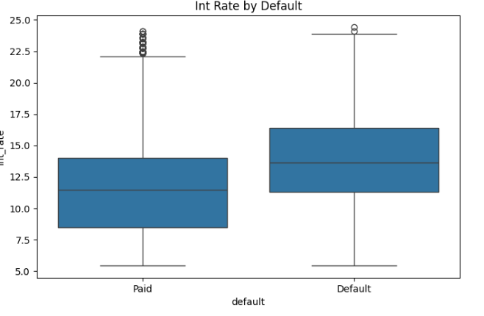
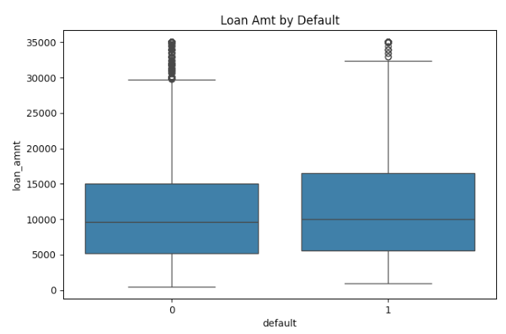
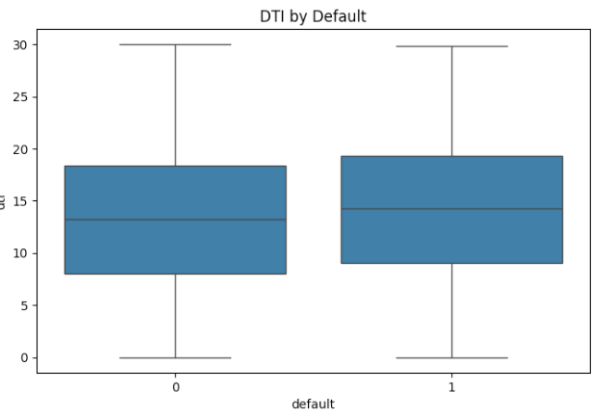
Segmented Univariate Analysis
Distributions split by groups like default status or grade.
Loan Amount by Default (Box Plot): Defaulters took larger loans (median ~$12,000) than non-defaulters (~$10,000).
DTI by Default (Box Plot): Defaulters show higher DTI (median ~17) vs ~15 for paid.
Interest Rate by Default (Box Plot): Defaulters had higher rates (median ~15%) vs ~11% for paid.

Slide 5
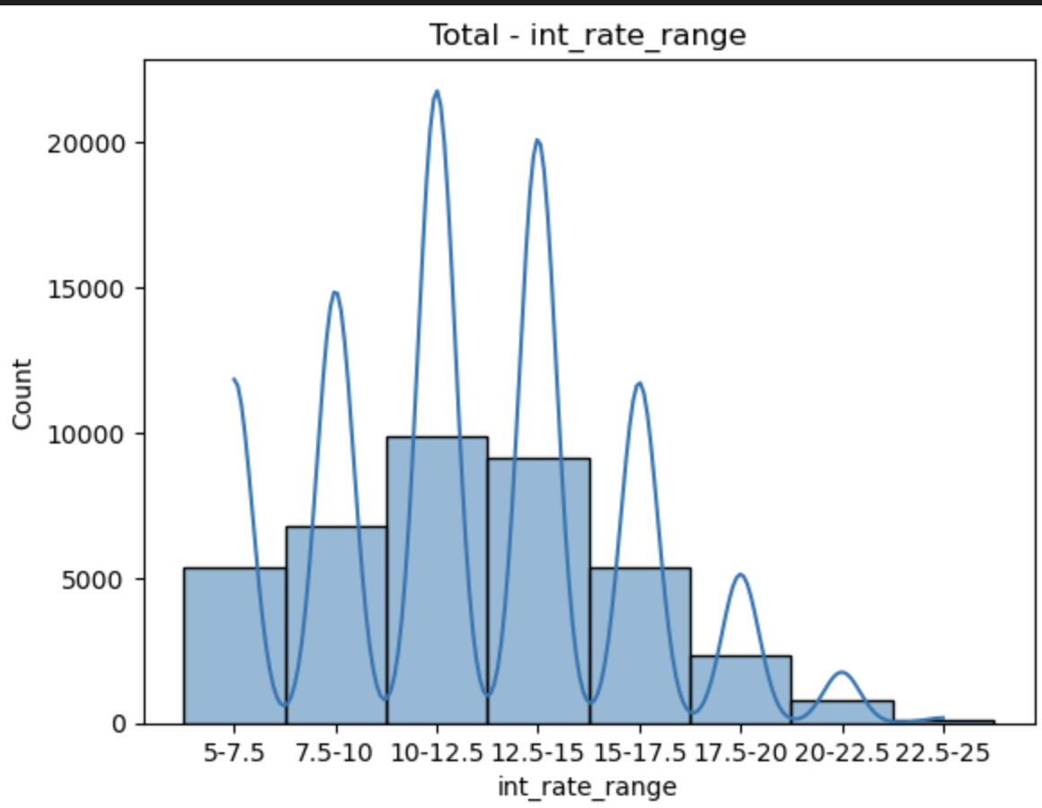
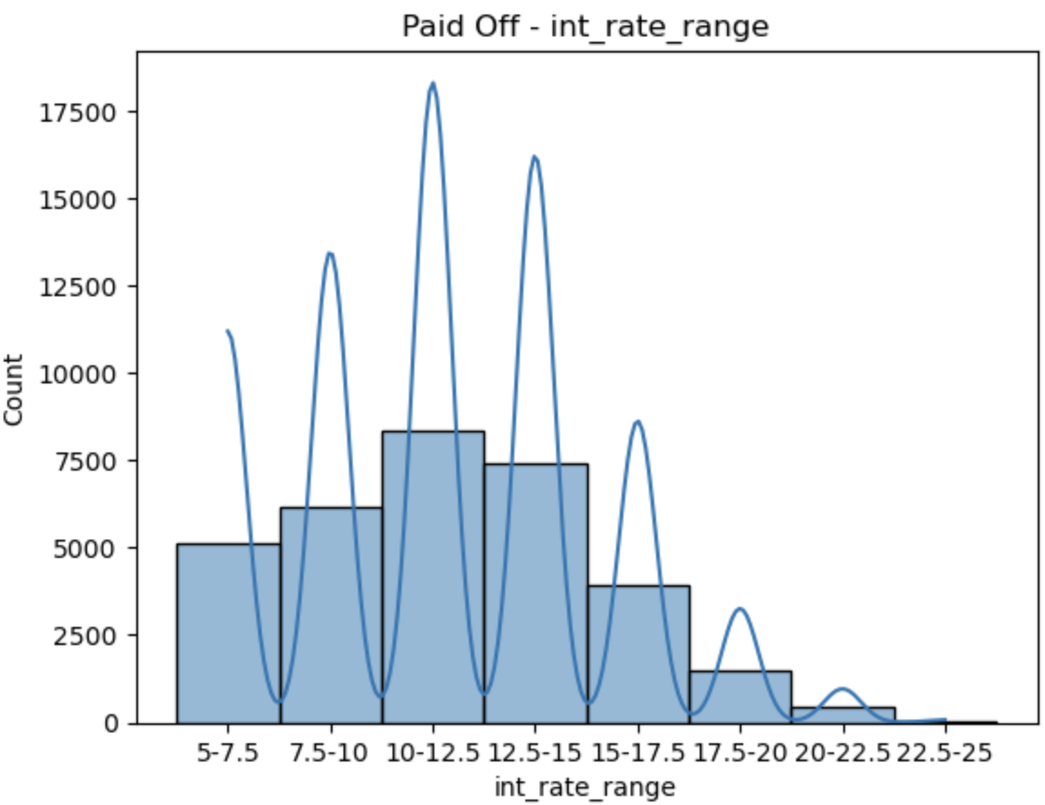
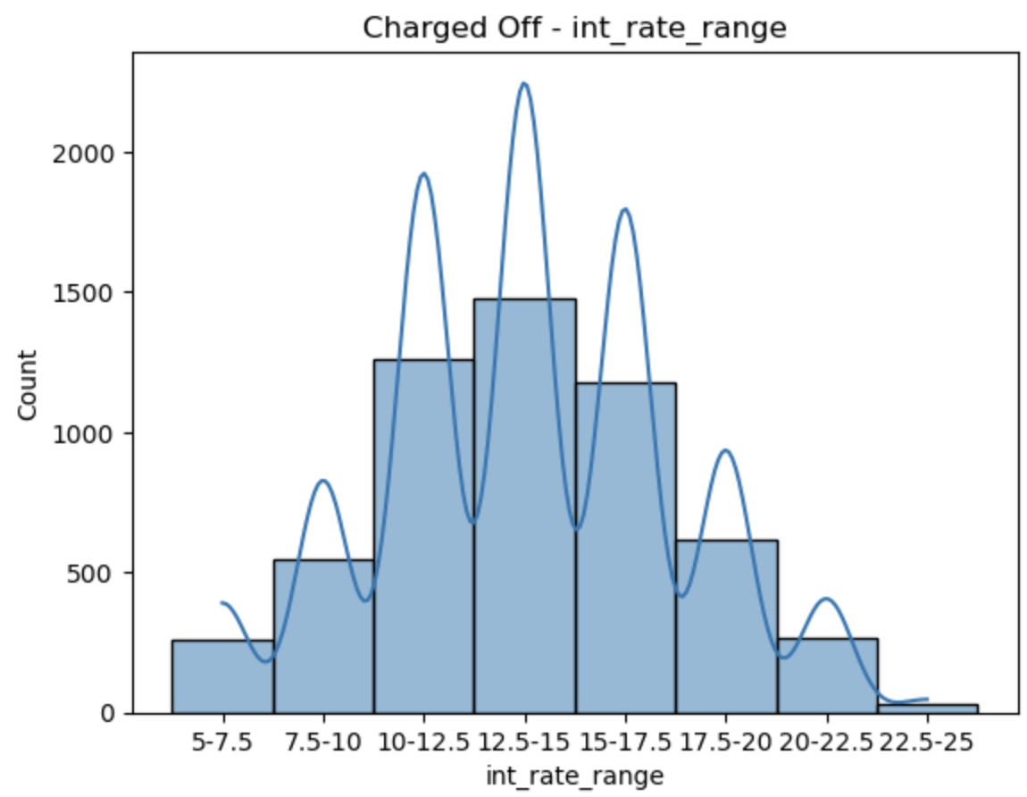
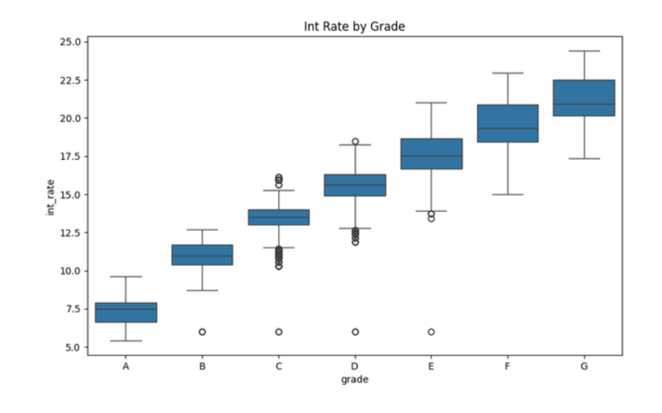
Bivariate Analysis
Quantitative Variables
'int_rate':
Highest frequency of loans observed in interest range of 10-12.5 % interest rates
Highest loan defaults observed by interest rate range 22.5-25(38%), 20-22.5(33%), 17.5-20 (26%), 15-17.5(22%)
Loans from 15-25 % interest rates are most defaulted

Slide 6
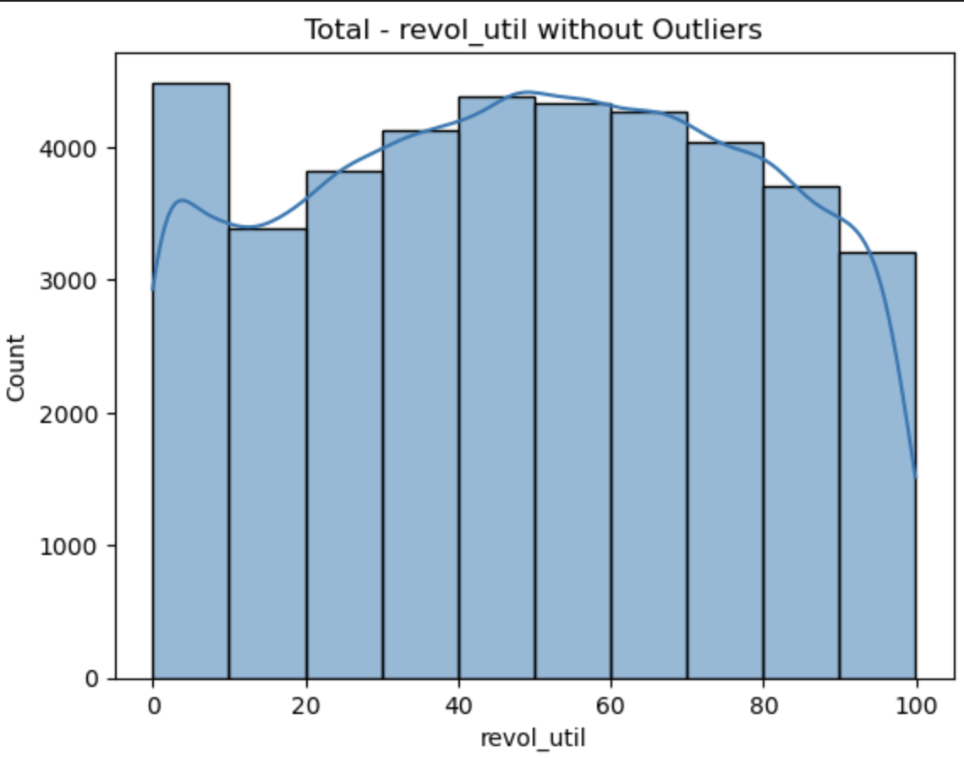
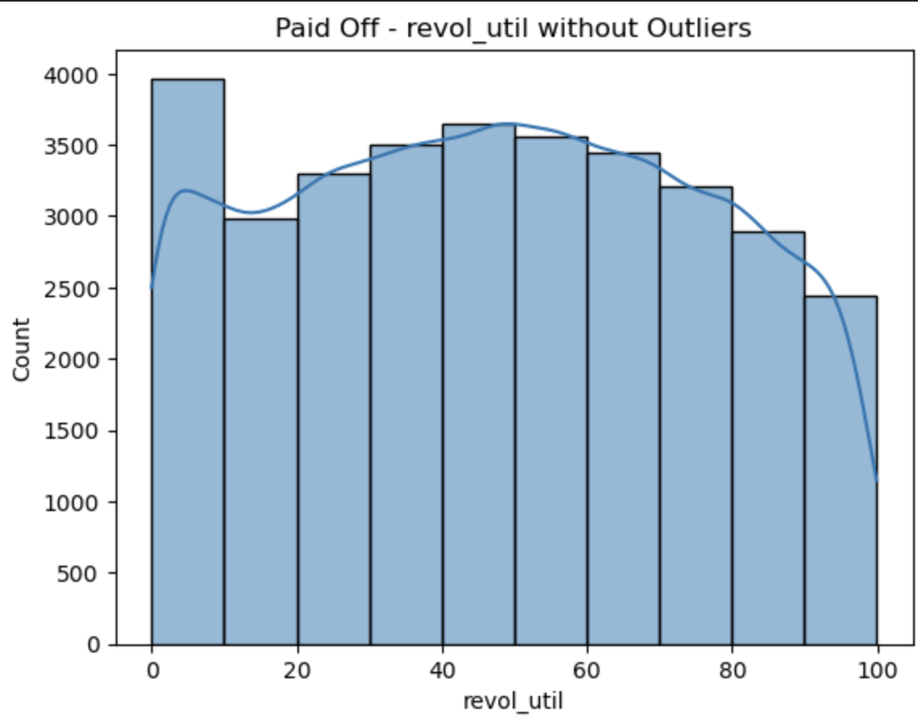
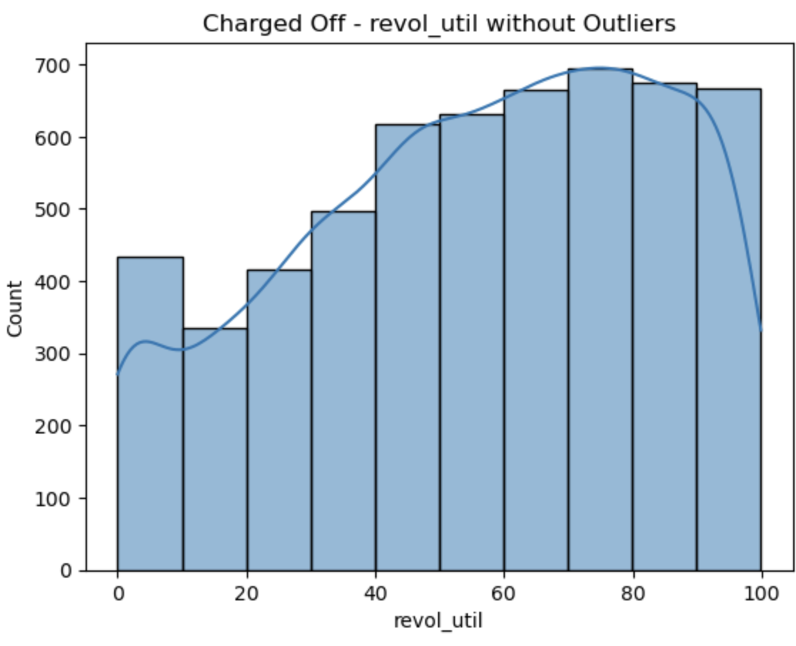
'revol_util':
More charge offs(compared to general data pattern) is observed in range of 50-95
A high revolving balance on a loan means you are carrying over a large p debt from one month to the next on a revolving credit account, such as a credit card or a revolving line of credit. Instead of paying your balance in full, you are only making minimum payments
revol_util = revol_bal/total_credit

Slide 7
Categorical Variables
- 'term’
60 Month term loan is more charged off
General trend is people opt for 36 month loan more hence 36 month loans are more in number as well as more charged off
General trend is people opt for 36 month loan more hence 36 month loans are more in number as well as more charged off
But Although 60 month loans are opted less but whoever opts it has more chances of defaulting
in terms of approx ratio 36M - 3000/30000 (10%), 60M - 2500/10000 (25%)
- 'grade'
General trend of loans given is B > A > C > D > E > F > G
Charge off % by grade G(32%) > F(30%) > E(25%) > D (21%) > C (16.6%) > B (11.8%) > A (6%)
80% grade G loans (worst performing) are of 60 months
mean revol_util for grade G loans is 71.4
- 'home_ownership'
Most charge offs are done by 'OTHER' category with 18.4% charge off
OTHER is a confusing category, there is also a NONE, this needs to be clarified if it is conclusive enough.
- 'purpose'
Most charge offs done by loans with purpose: small_business with 25% charge offs
- 'addr_state'
Most charege offs by state - NV at 22% deviation from general pattern fo 12-17 percent
'earliest_cr_line’
Most defaulting customer started their credit relations in 2007 (20%), 2006(19%), 1973 (18%)

Slide 8
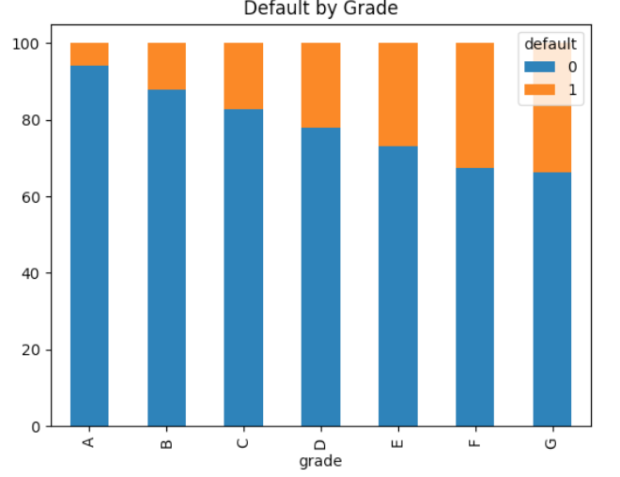
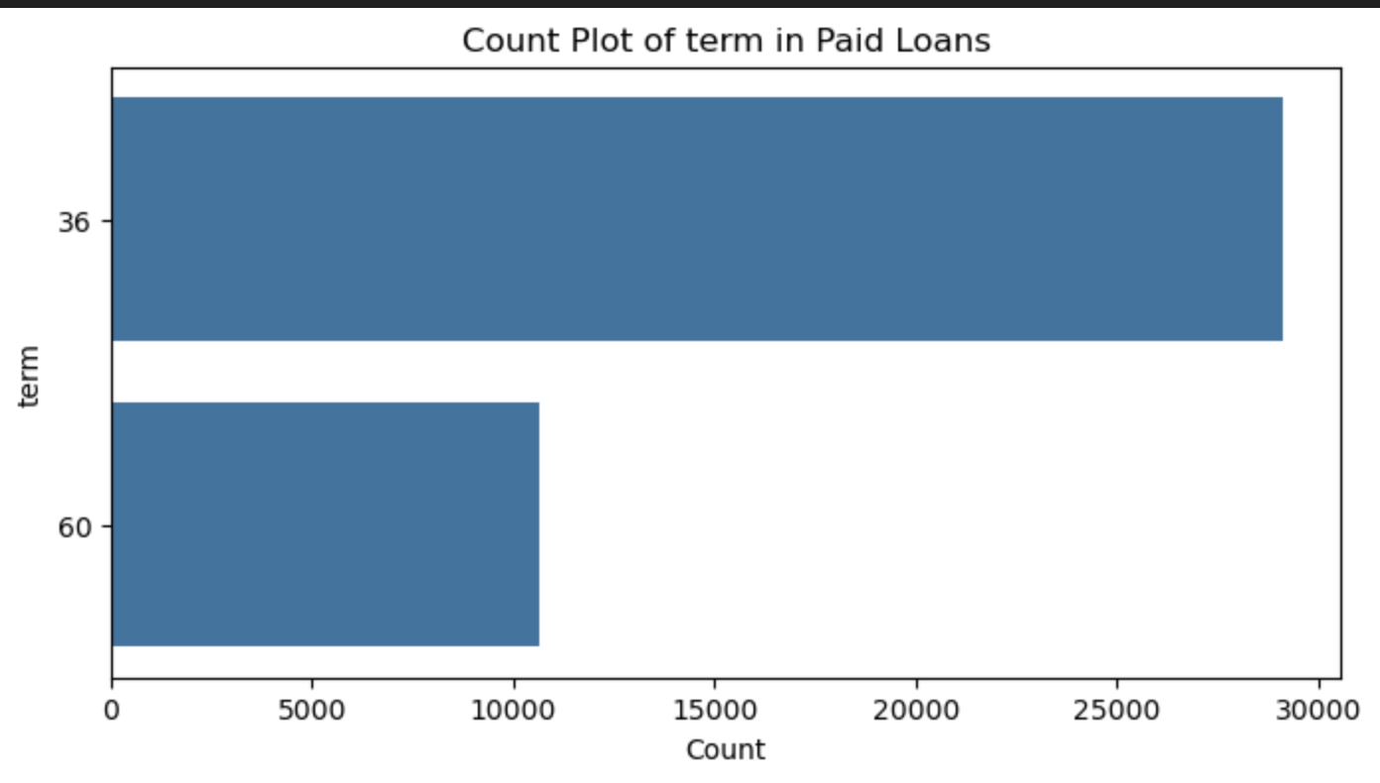
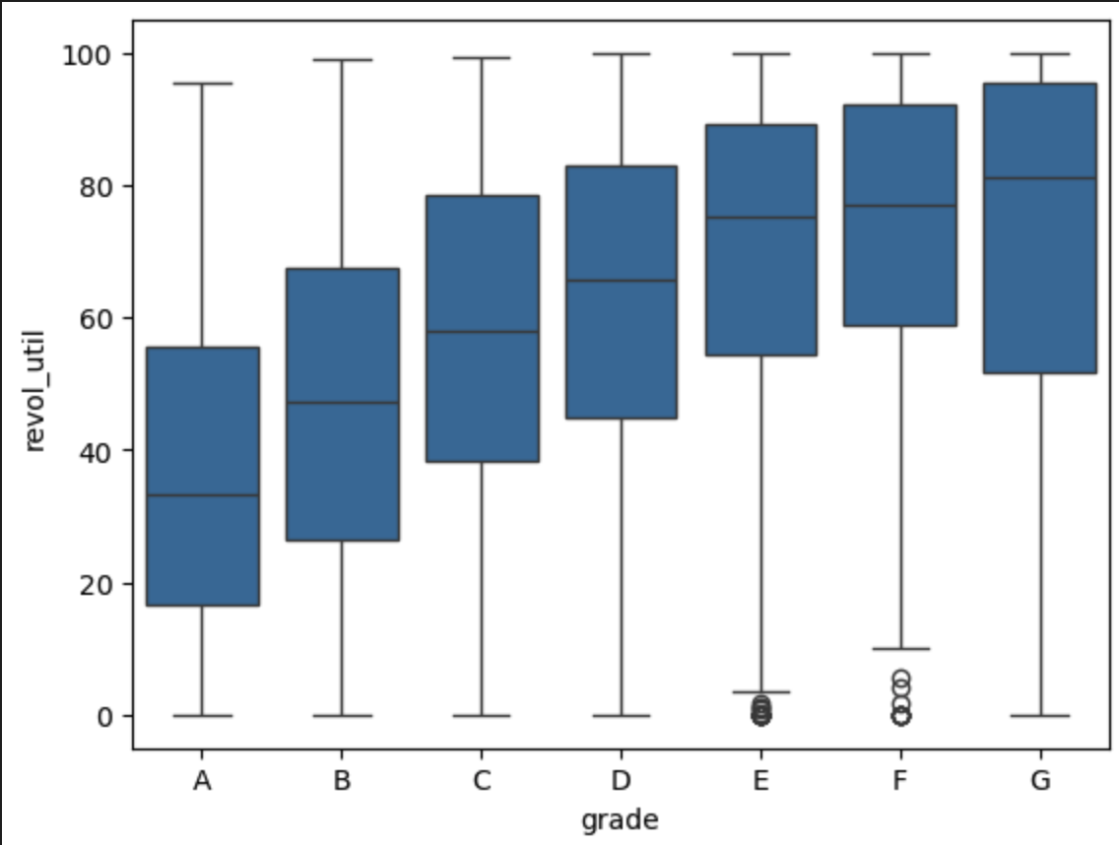
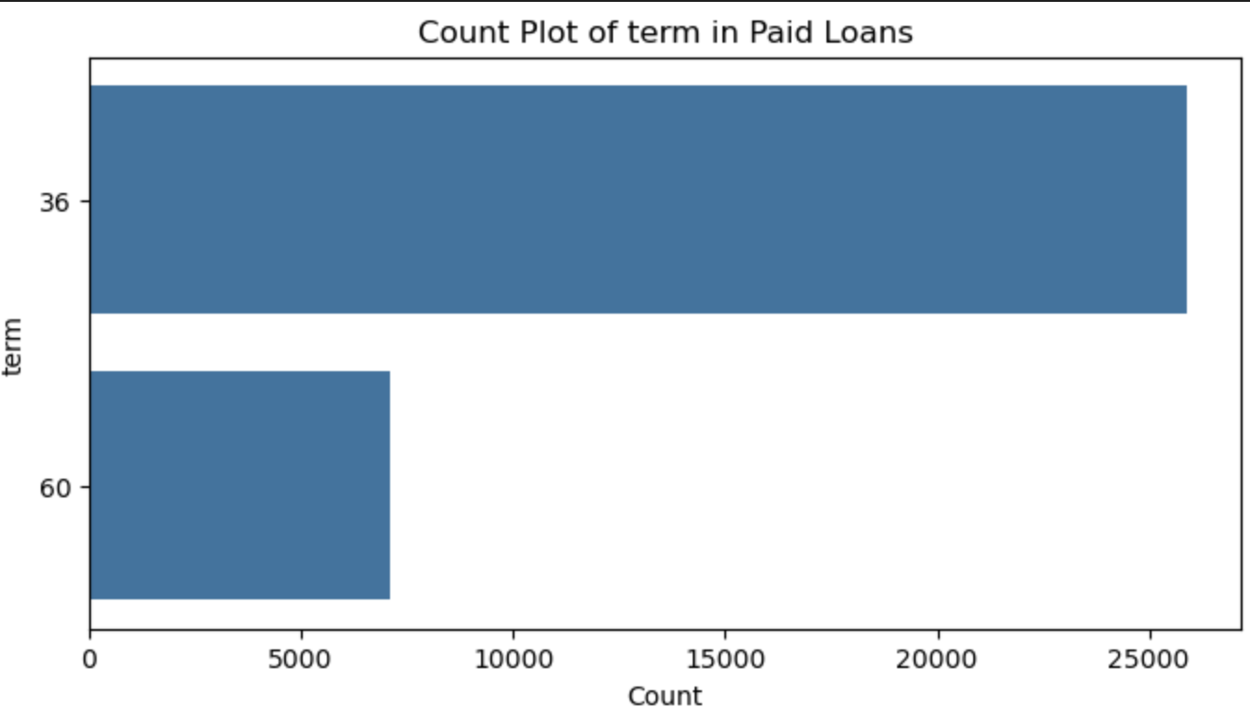
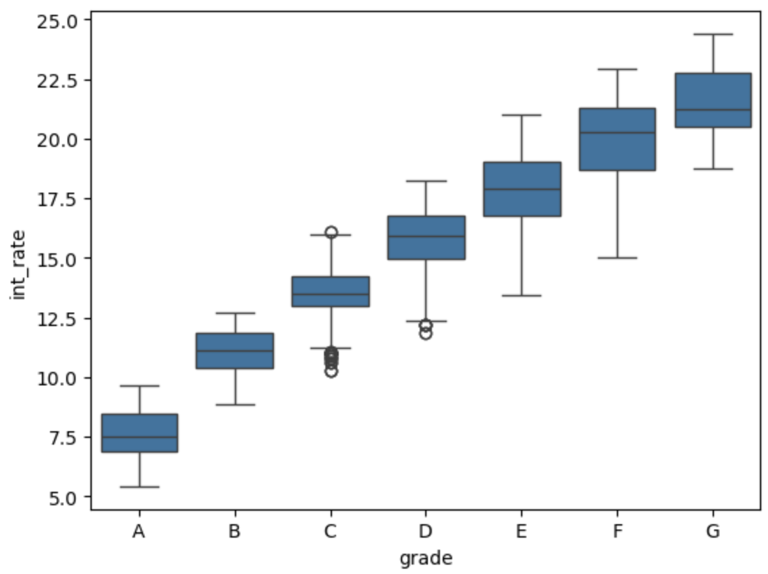
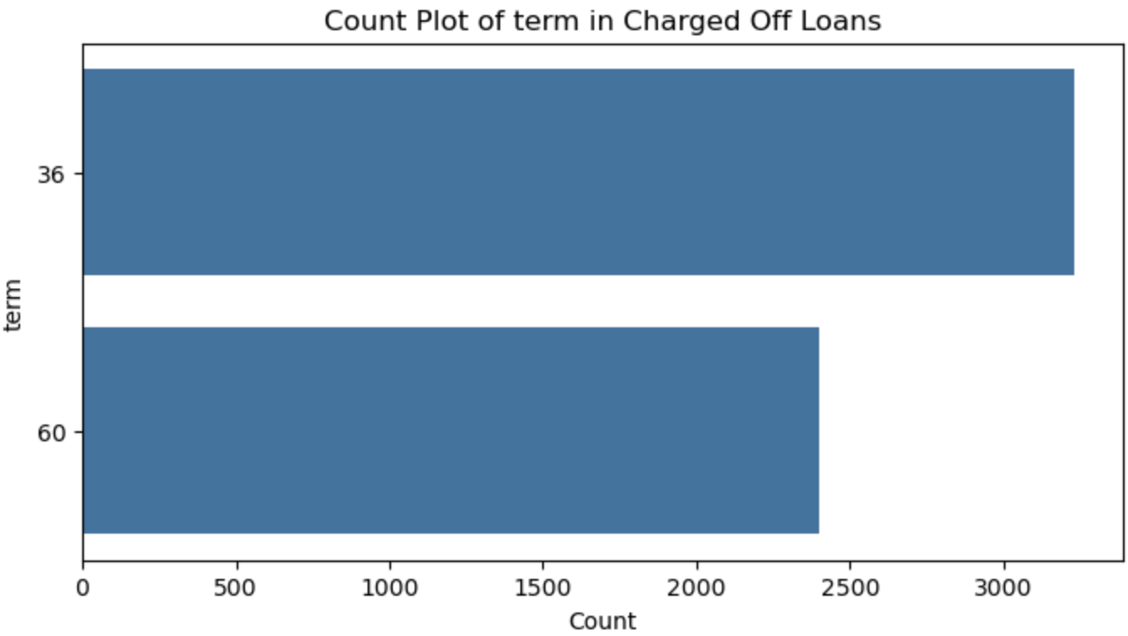
Graphs
Comparison of loan terms for
total loans vs paid loans vs charged off
60M loans are charged of more
Grades
Grades by most default
G>F>E>D>C>B>A
Revolving utilization increases with grade A<B<C<D<E<F<G
Interest rates increase with grade A<B<C<D<E<F<G
That should mean more defaults are happening with high interest rate and high revolving utilisation

Slide 9
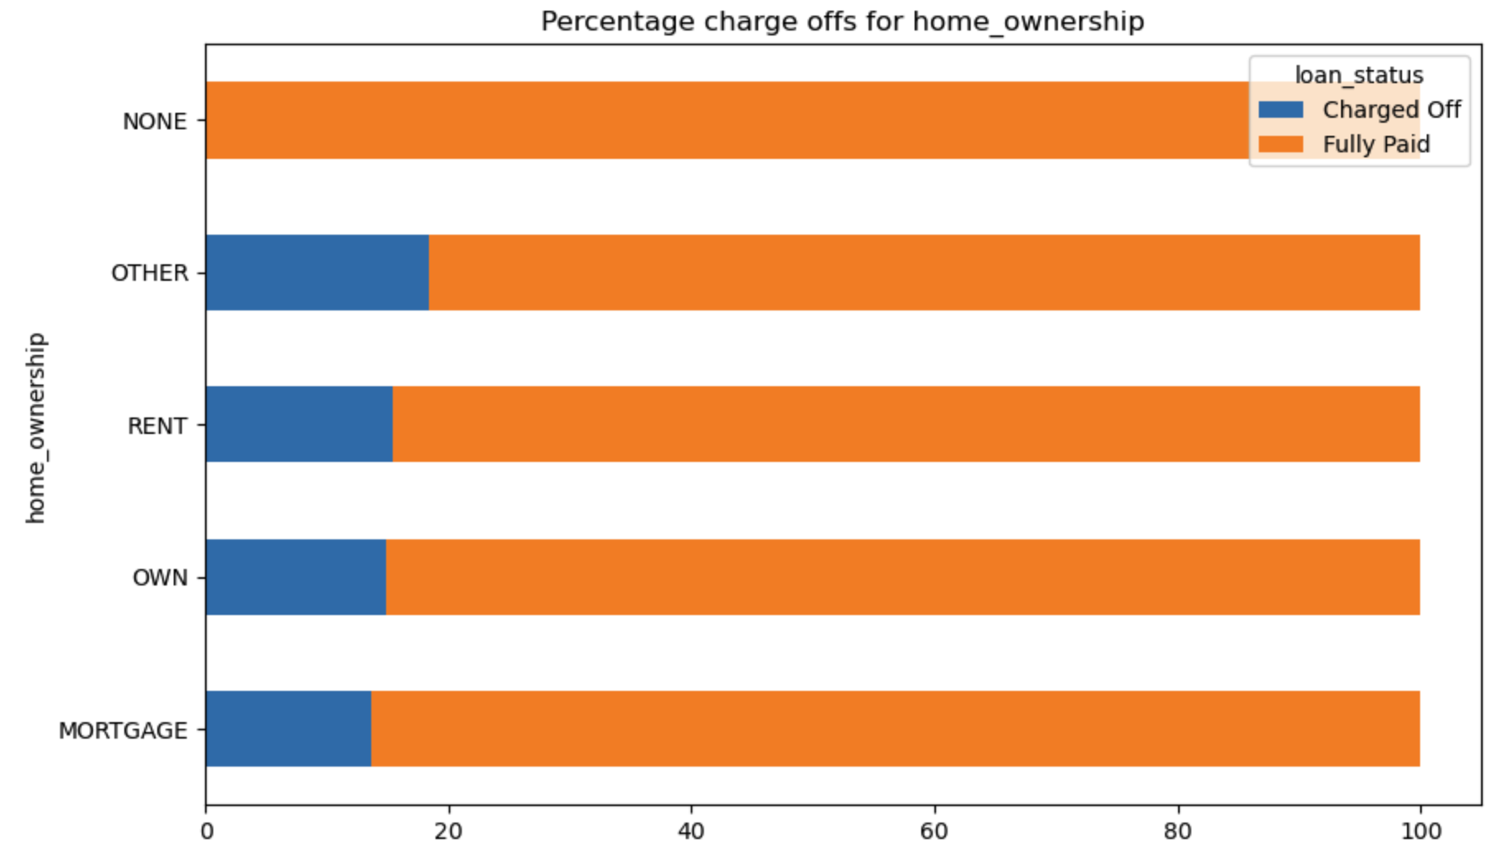
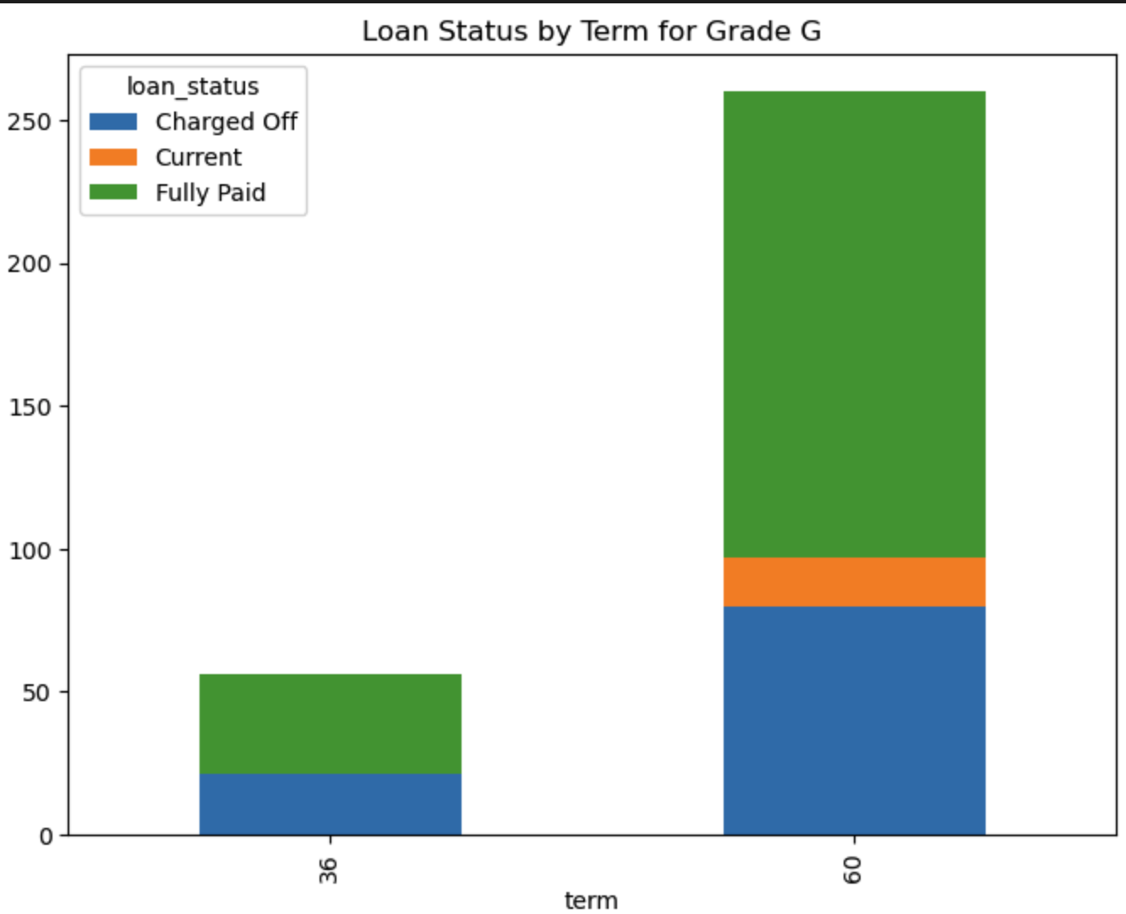
Home Ownership Split by loan status
Other Category has highest charge offs
Rent is second highest charge off category
Other is very less in quantity
Conclusion would be to be more careful for RENT category while approving loan
Loan Status by Term For Grade G
More Charge offs observed in 60M category
Grade G mostly have 60M term loans
It is very clear that the financier wants to monetize more on Grade G with higher interest rates, term and loan amount
But Grade G also comes with risk of more defaults

Slide 10
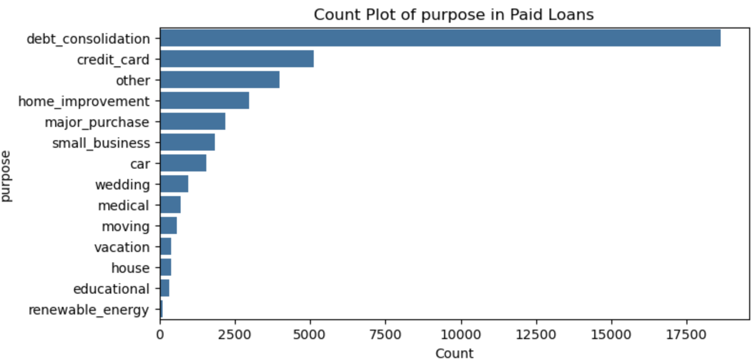

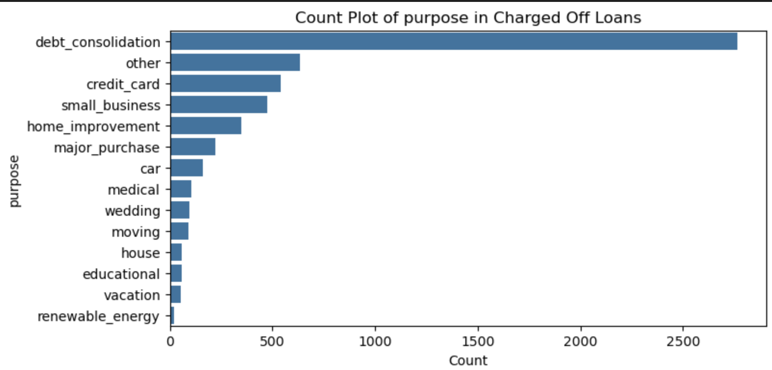
‘purpose’ small business is the riskiest category with 25% charge offs

Slide 11
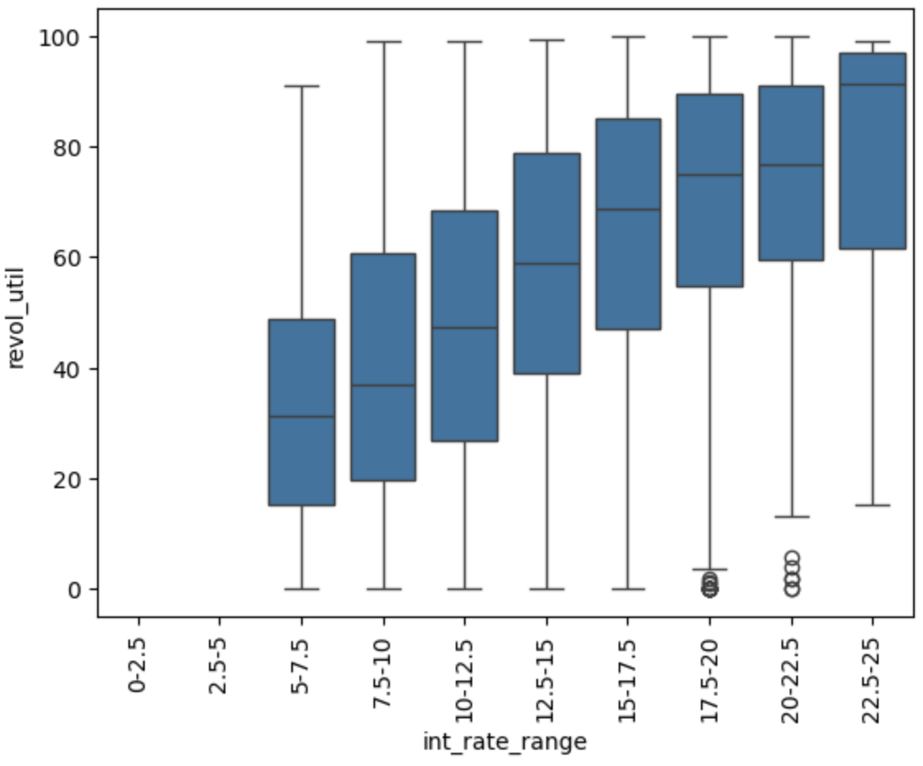
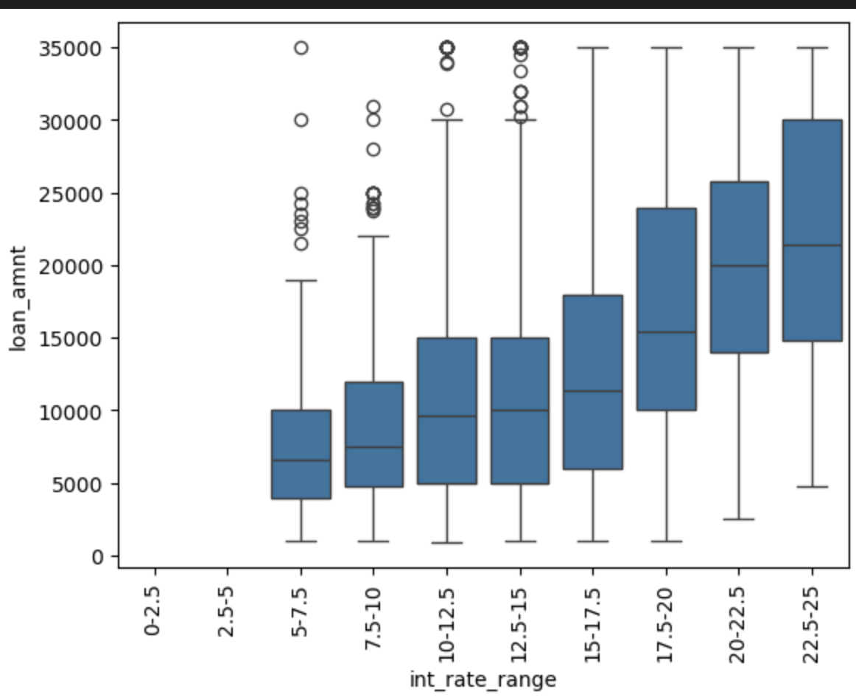
Interest rate ranges from, 15-25 has highest default ranges
May be the interest rates are high due to revol_util of customer
But high interest rates are also observed with high loan amounts
Loans at higher risk of default are exposing more money at risk

Slide 12
Conclusion
Interest rate, revolving utilization, term, grade, home_ownership, purpose, address_state and earliest_cr_line seem to have direct impactful relationship with high ‘Charge offs’
Interest ranges between 15-25 have highest loan default percentage (charge off/total loan records)
Loan amounts are also increasing in range 15-25 with highest loan amounts being in 22.5-25% interest rate category
Recommendation would be to put a cap loan amounts at higher interest rate to limit the losses
Loan term significantly impacts default rates. Although 36-month loans are more common, 60-month loans have a much higher proportion of defaults—about 25% of 60-month loans default compared to only 10% of 36-month loans. This indicates that longer-term loans are riskier and more likely to result in charge-offs.
Credit grade is a strong indicator of loan default risk. Lower credit grades (such as F and G) have significantly higher default rates, with grade G experiencing defaults in over 30% of cases, compared to only 6% for grade
High Revolving utilization for a customer is also an indicator of risk
If revolving utilization crosses 70-75 mark it is safer to reject loans
Loans with purpose of small_business(25%) and renewable energy(18%) has highest charge off rate
‘earliest_cr_line ’ seems to have interesting pattern where people starting their credit relations in 2007 (20%), 2006(19%), 1973 (18%) has the most charge offs, it should be investigated what is common from new accounts policy perspective in these years
Older credit relations are trusted with more loan amount earliest_cr_line with 1973 had an average loan amount of ~13000 whereas for 2006-07 average loan amount is ~7000-7500.

