Slide 1
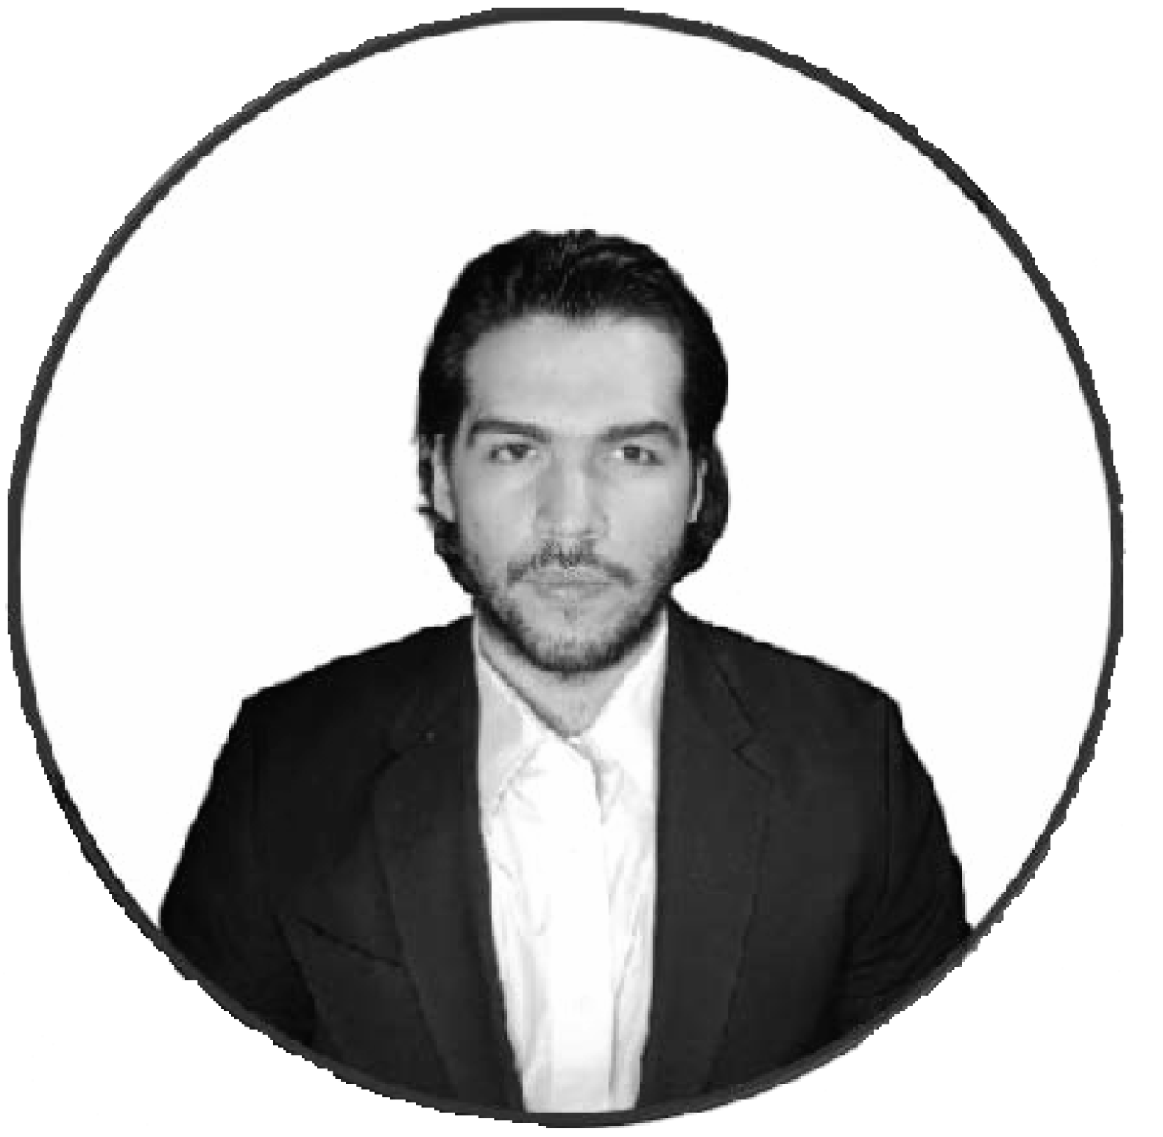





JOB EXPERIENCE
VA LWIS Digital – Project
Web Developer
Automation workflows. • Web development. • Tech support • Remote PC
troubleshooting support • Recruitment • CRM and software setup
Apr 2023 – Sept 2023
MIR Partners Inc
Onboarding Team Lead Supervisor/Tech Support Representative
Supervisor for onboarding project • Incoming traffic controller for chats and tickets + tech support for streaming software • Fraud investigation skills
Mar 2021 – Dec 2022
CHIME
Customer Support Representative
Bank Policies, tech support. Fraud investigation skills. Customer service/Tech
support via chat/ emails.
Jul 2020 – Dec 2020
Cash App
Tech Support Representative
Problem-solving skills, teamwork, Logical thinking. Fraud investigation duties. Tech support/Customer support.
Jul 2019 – May 2020.
The Office Gurus
Bilingual Customer Service Representative
Package logistics follow-up, payment processing duties, chat/email/calls support:
Data entry, re-activations, and cancellations procedures.
Jul 2019 – May 2020.
Francisco Vaquero
front end technician Web Developer
Bilingual front-end technician & web developer with hands-on experience building sites, automating workflows (Zapier), and leading onboarding/support teams. Comfortable owning CRM setups, troubleshooting PCs remotely, and resolving high-volume chat/ticket queues. Known for clear communication and a builder’s mindset; ready to contribute to a fast-moving team.
I've always been organized and responsible, but these qualities always felt like a burden to me until I got my first job as a virtual assistant, I was able to experience the fantastic feeling of getting projects completed in a reasonable time, working, and organizing different tasks and projects for my clients to meet the end goals. Nothing like getting all the checkboxes completed!
I've learned a lot from leading as well as following leads and having the opportunity to communicate with different clients from different countries and cultures. All these experiences have taught me the importance of empathy and clear communication when it comes to teamwork.
EDUCATION
Computer Maintenance
2008 – 2010
Customs Economics
2016 – 2018
Liceo Professor Luis Alonso Pino
High School diploma
2008 – 2010
franciscovaquero93@gmail.com
SKILLS:
Antiguo Cuscatlan, El Salvador.
English
CRM Management
+503 7335 4418
Microsoft Office
(Google Workspace)
JavaScript
franciscojavier.vaqueroguardado
Web Development
Self-Management
https://www.linkedin.com/in/francisco-vaquerog/
CSS
Visual Studio Code
Zapier &
Automations
Problem-solving

