Slide 1
Attrition, Job Role, and Salary
Varun Gopal

Slide 2
Naïve Bayes and Predicting Attrition
Likelihood of A given B
Features Eliminated
ID, Employee Count, Employee Number, Over 18, Standard Hours
Accuracy – 0.8352
Sensitivity – 0.8447
Specificity – 0.7857

Slide 3
Permutation Feature Importance
Shuffle features
Measure impact of shuffling
Repeat process

Slide 4
Factors related to Attrition
Overtime
Age
Job Role

Slide 5
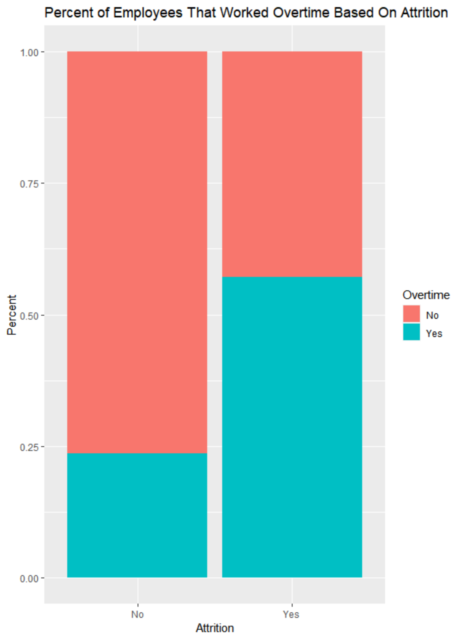
Overtime
Overtime and Attrition seem to be related
Those who worked overtime were more likely to stay

Slide 6
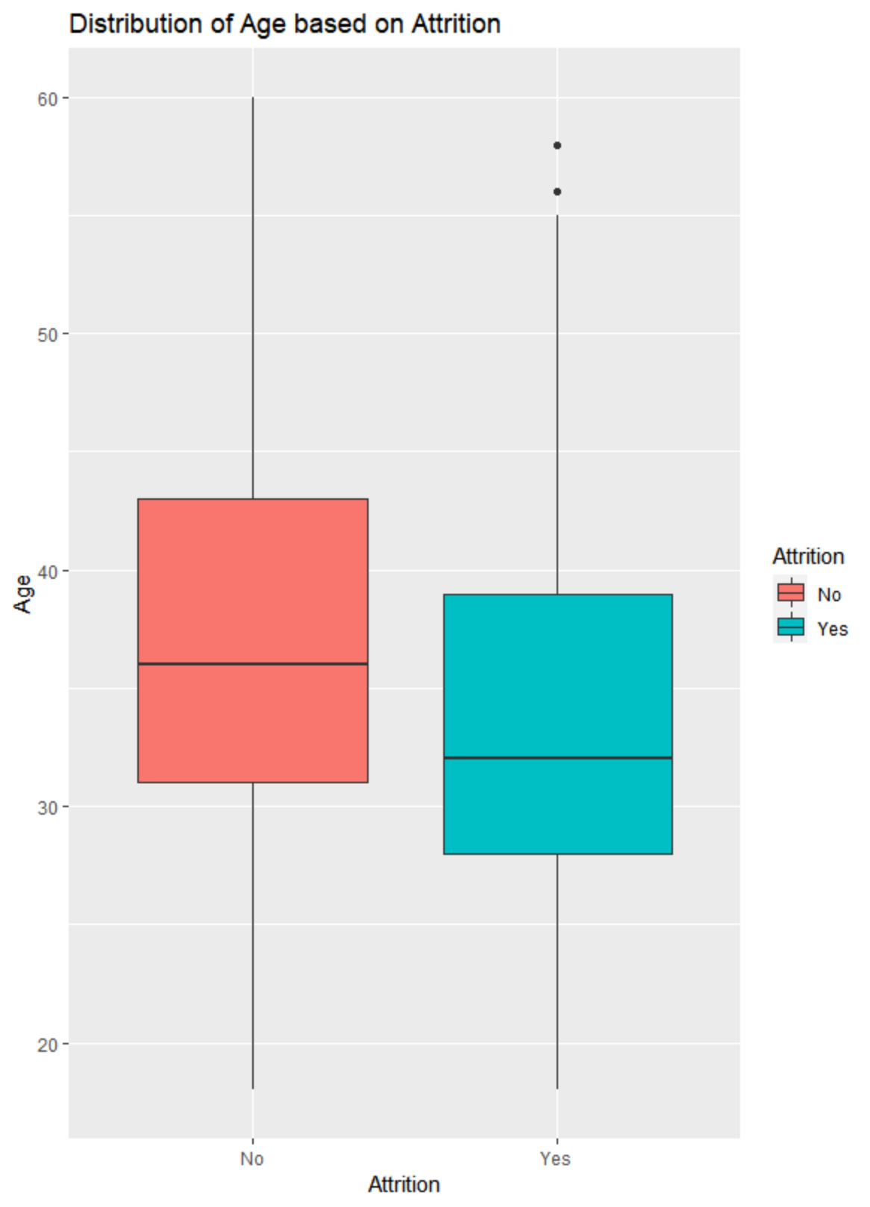
Age
Apparent relationship between age and attrition
Those who were younger were more likely to stay

Slide 7
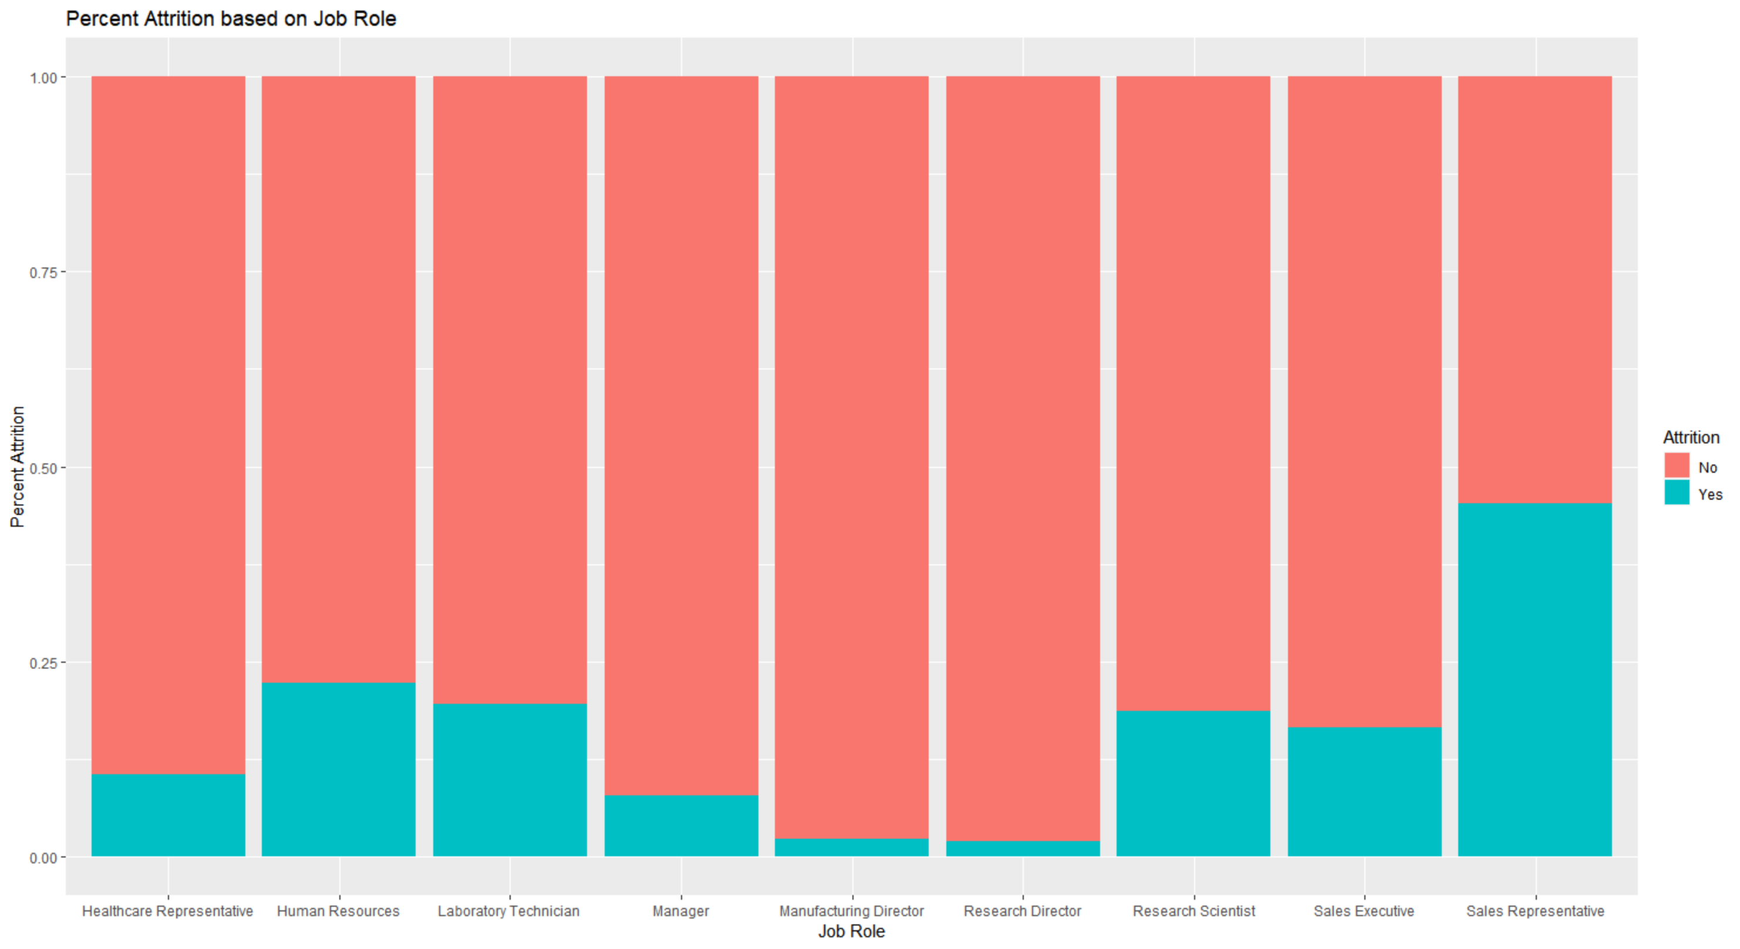
Job Role
Attrition seems role specific
Lowest attrition seen in managers and directors
Highest attrition seen in sales representatives

Slide 8
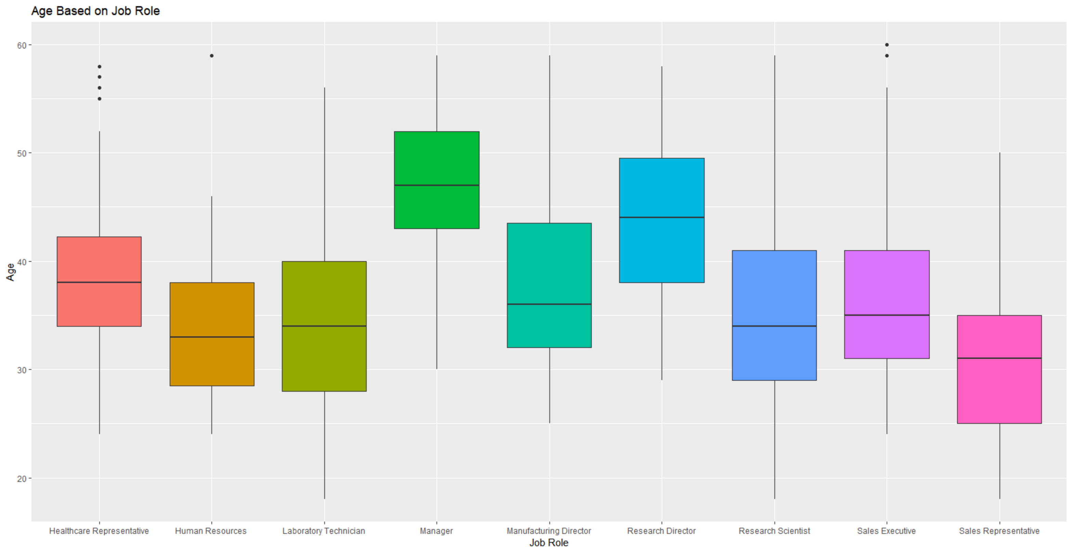
Job Role VS Age
Those in executive positions tend to be older
Reinforces age as a predictor of attrition

Slide 9
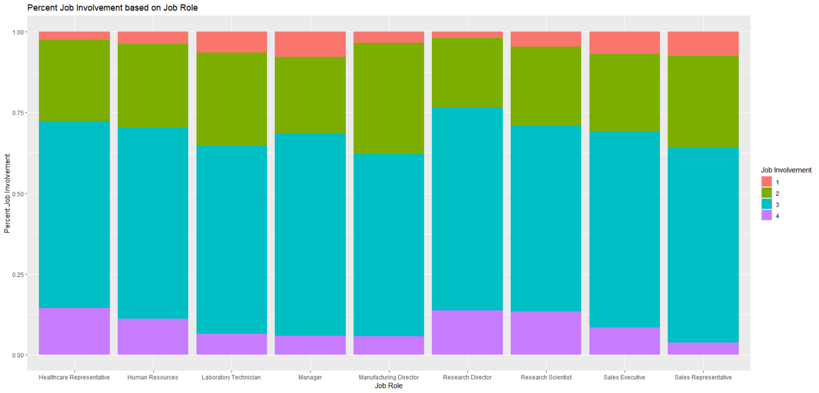
Job Role VS Job Involvement

Slide 10
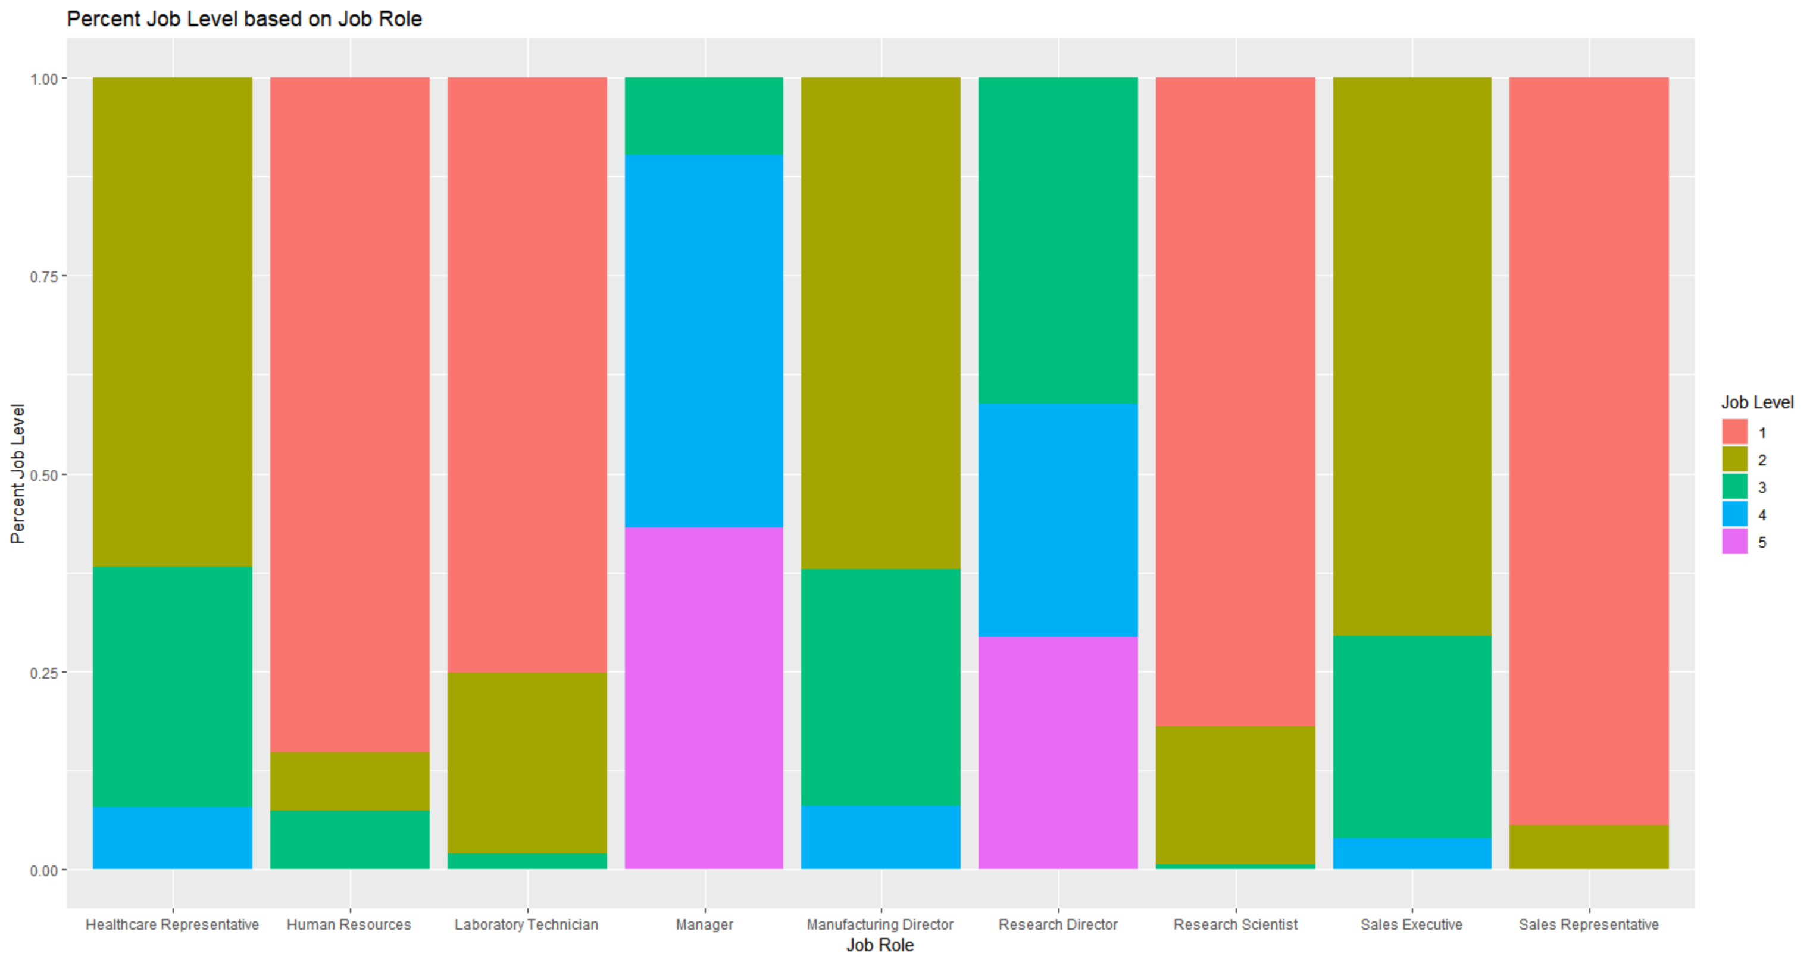
Job Role VS. Job level

Slide 11
Linear Regression – Predicting Salary
The model tries to establish a linear relationship between features
RMSE = 2.90625e-9

Slide 12
Questions?
Contact Info
Phone – 614-531-2768
Email – varung@smu.edu

