Slide 1
United States Breweries and Beer
Varun Gopal, Roslyn Smith and David George
March 5, 2022

Slide 2
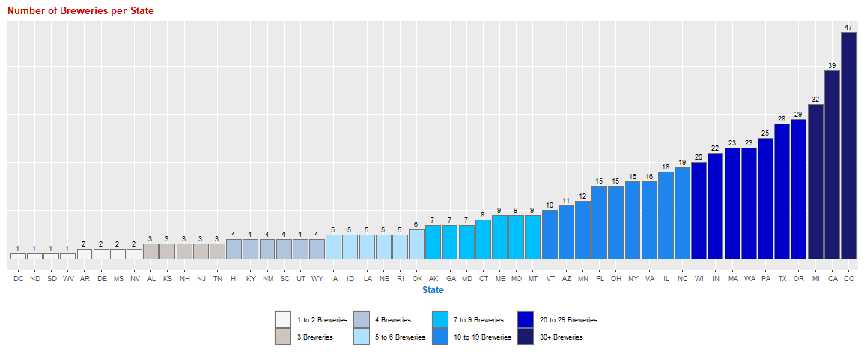
Breweries in the United States by State
There is at least 1 brewery in each state in the United States. Colorado, California and Michigan lead with more than 30 breweries each. 50% of the states have 7 or less breweries with only 20% of the states have 20 or greater breweries.

Slide 3
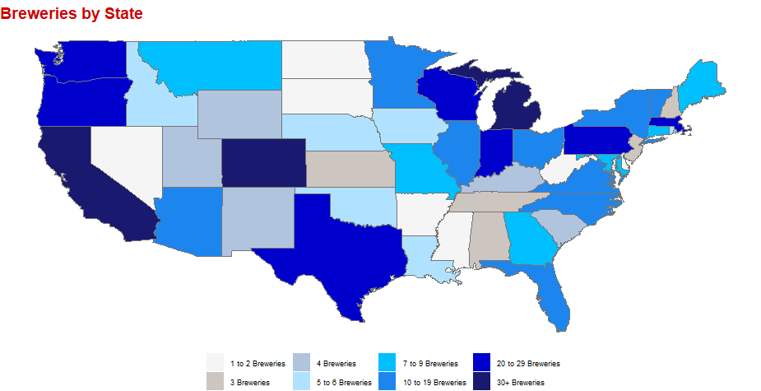
Breweries in the United States by State
There is at least 1 brewery in each state in the United States. Colorado, California and Michigan lead with more than 30 breweries each. 50% of the states have 7 or less breweries with only 20% of the states have 20 or greater breweries.

Slide 4
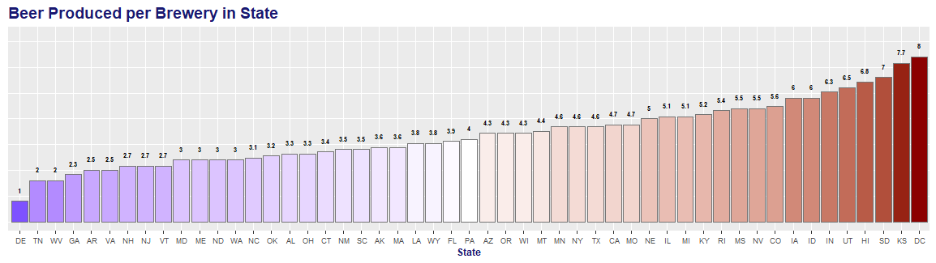
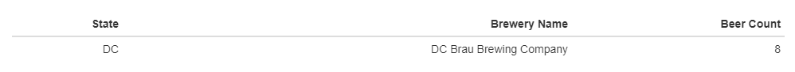
Brewery Productivity by State
DC leads in brewery productivity with 1 brewery producing 8 beers. Kansas is a close second with 3 breweries producing 23 beers in total for an average of 7.7 beers produced per brewery.

Slide 5
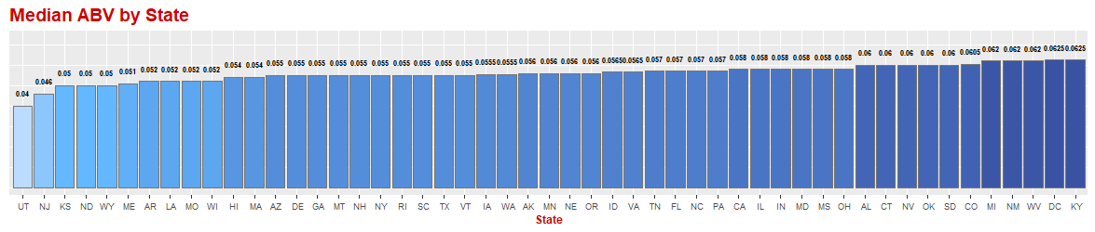
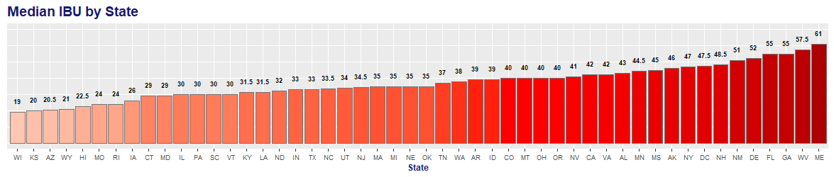
Alcohol by Volume (ABV) and International Bitterness Unit (IBU)
In the data provided, of the 2,410 beers, 3% (62) of the beers did not have an ABV rating and 42% (1,005)of the beers did not have an IBU rating. The blank values for each group was excluded for the analysis for each individual metric. ABV was evaluated with the remaining 2,348 beers and IBU was evaluated with the remaining 1,405 beers.

Slide 6
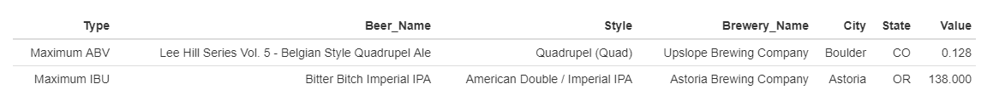
Maximum Alcoholic Beer (ABV) and Most Bitter Beer (IBU)
The beer with the maximum ABV (0.128) was brewed in Colorado and was a Quadrupel style
The beer with the maximum IBU (138) was brewed in Oregon and was an America Double / Imperial IPA

Slide 7
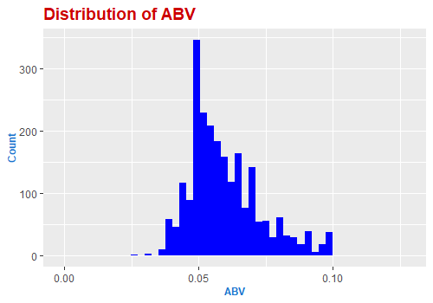
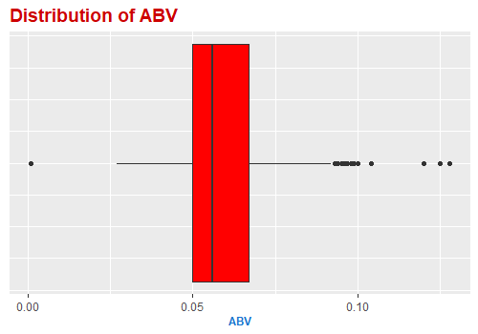
Alcohol by Volume (ABV)
The average ABV is 0.05977 with the lowest ABV at 0.001 and the highest at 0.128. The interquartile range of the beers is between 0.05 and 0.068.

Slide 8
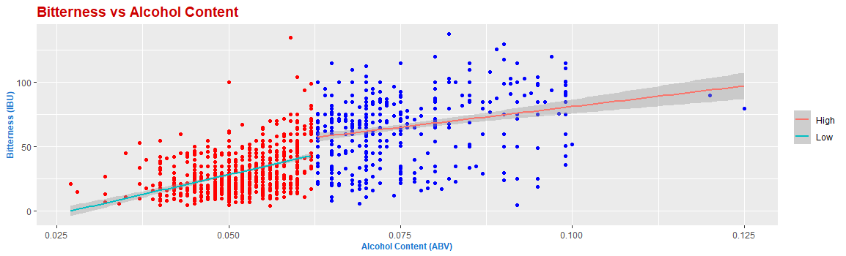
Relationship between International Bitterness Unit (IBU) and Alcohol by Volume (ABV)
There appears to be a positive correlation between alcohol content and bitterness. It is of note, that the correlation appears weaker at the higher ABV and IBU.

Slide 9
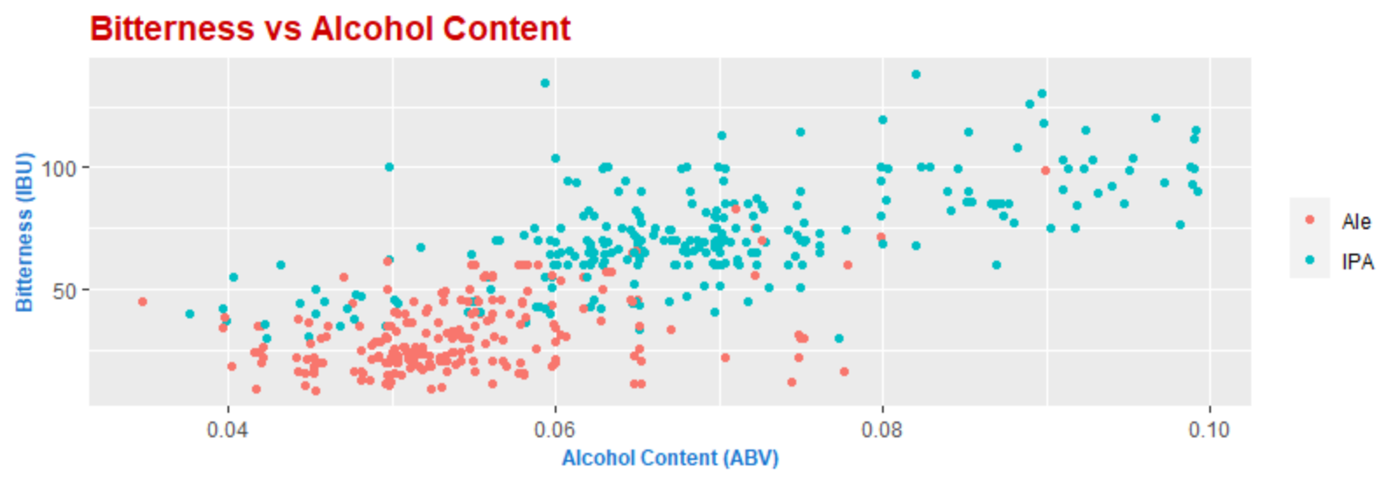
Explaining K-NN

Slide 10
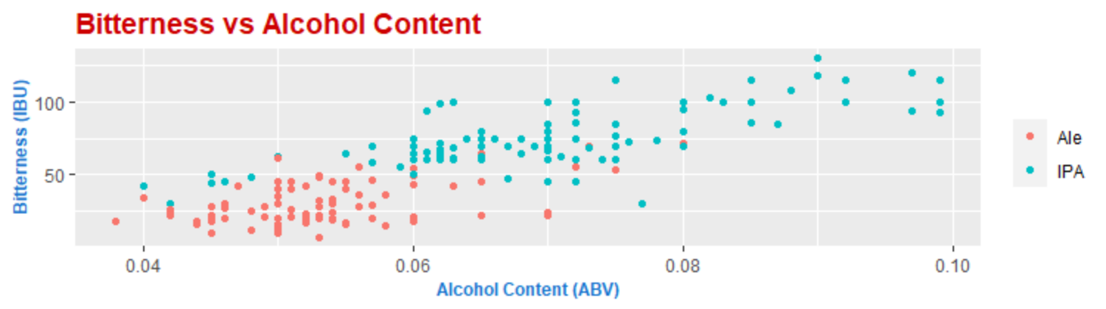
Actual Classifications
The accuracy of this specific model was 0.8837, the sensitivity was 0.8835, and the specificity was 0.8839

Slide 11
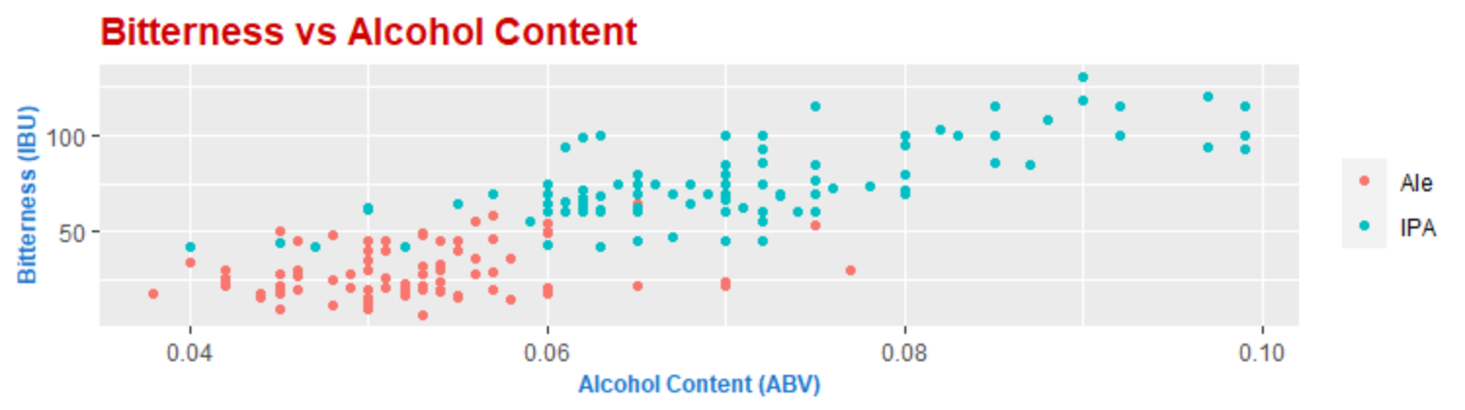
Predicted Classifications (3-NN)
The accuracy of this specific model was 0.8837, the sensitivity was 0.8835, and the specificity was 0.8839

Slide 12
Questions?
Please contact us at Varun Gopal (varung@mail.smu.edu), Roslyn Smith (roslyns@mail.smu.edu) and David George (davidg@mail.smu.edu).
Thank You!

Slide 13
YouTube Links for Final Presentation
Roslyn Smith: https://youtu.be/UIOtqGZd3Nw
David George: https://youtu.be/ub32q9s6oiI
Varun Gopal:

