Slide 1

Pager Rotations Duties
By Victor Gregory Matos
CSD380-H330
Professor Sampson

Slide 2

On-Call Rotations in DevOps
On-call rotations involve scheduling team members to be available during off-hours to address critical system issues.
This ensures continuous system reliability and swift incident response when system is down.

Slide 3

Benefits of Effective On-Call Rotations
This type of role can quickly address and resolve incidents to minimize downtime.
People with these type of roles and responsibilities during incidents. Prompt issue resolution leads to happier users.

Slide 4

Implement DevOps Practices
Break down silos between development and operations for seamless issue resolution.
Developers support the code they write, leading to more robust software (Best Practices for Your Team’s On-call Rotations, n.d.).

Slide 5
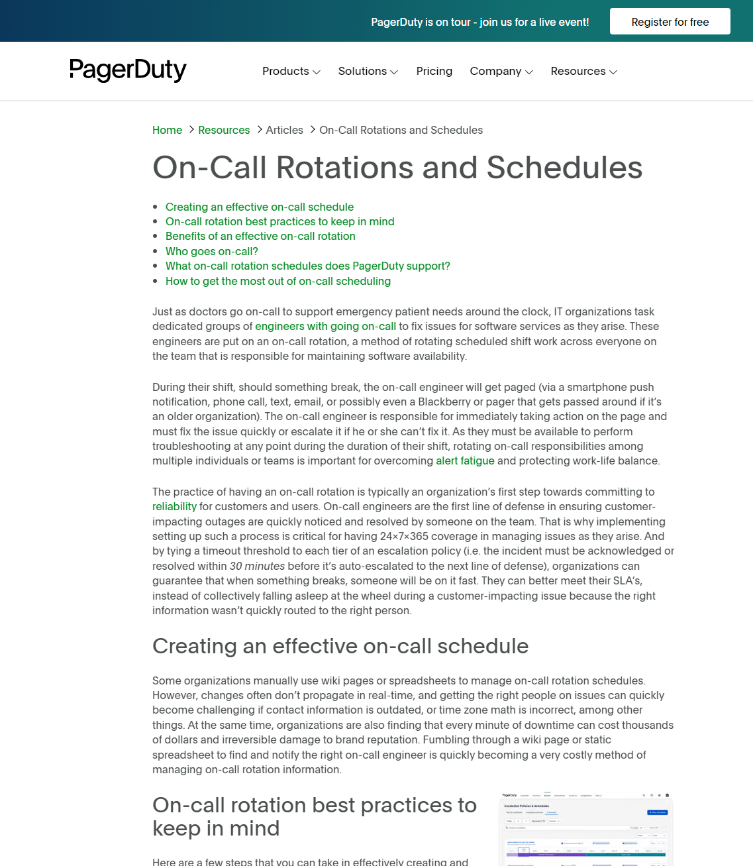
Team Roles
Assign specific services to dedicated teams for focused expertise.
Clearly outline responsibilities for primary responders and escalation paths (On-Call Rotations and Schedules | Articles | PagerDuty, 2023).

Slide 6

Automating, Scheduling, and Notifications
Implement tools to automate on-call schedules and reduce manual errors. In my workplace we use Service Now and Jira. These services can help us make tickets or incident for our support to assist and find the root cause of the issue.
Set up systems to notify on-call engineers through preferred channels (e.g., email, SMS, Messaging) (On-Call Rotations and Schedules | Articles | PagerDuty, 2023)

Slide 7
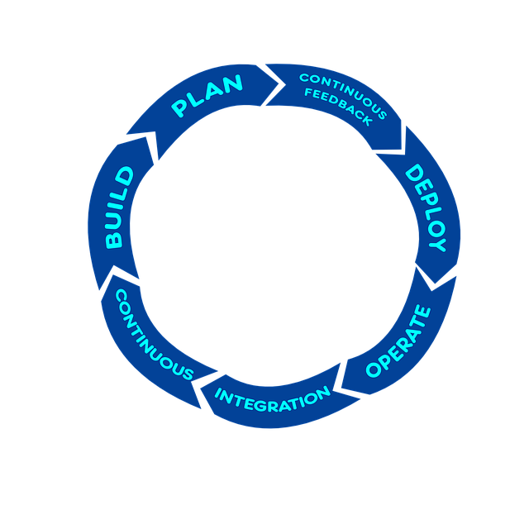
Escalation Policies
Create a structured approach for escalating unresolved issues.
Set time limits for issue acknowledgment to ensure timely responses (On-Call Rotations and Schedules | Articles | PagerDuty, 2023).

Slide 8

Optimizing Page Load
Monitor the frequency and timing of pages to identify patterns.
Filter non-critical alerts to prevent alert fatigue among engineers (Cook et al., n.d.).

Slide 9

“Our on-call engineer gets paged about a hundred times in a typical 24-hour shift. A lot of pages get ignored, while the real problems are buried under the pile. Where should we start?” - Cook et al. (n.d.)

Slide 10

Fostering a Culture of Continous Improvement
Conduct post-incident analyses to identify improvement areas.
Encourage open discussions to refine on-call practices and address concerns.

Slide 11

Prioritizing Engineer's Well-Being
Ensure fair distribution of on-call duties to prevent burnout.
Provide resources and support for engineers handling high-stress incidents.

Slide 12

Effective on-call rotations are vital for system reliability and team health.
Implement these best practices to enhance your DevOps on-call processes.
In Conclusion, by implementing these best practices, organizations can have a sustainable on-call rotation that provides system uptime and promotes a healthy work life for engineers. Making sure that we continue monitoring our On-Call.

