Slide 1
IM Semester Project
Depth Maps Recovery from RGB-video
Giorgio Mariani

Slide 2
Semester Project Goal
Partial implementation of the depth-maps recovery approach described by Zhang et al. in “Consistent Depth Maps Recovery from a Video Sequence” and published in Transaction on Pattern Analysis and Machine Intelligence.
The implementation was done through the Python language. The NumPy library and the OpenCV python bindings were used in order to achieve reasonable performance.

Slide 3
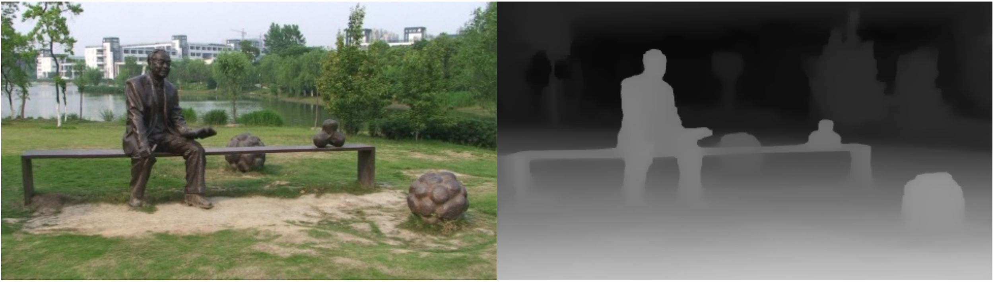
Problem Statement
Given a source video over a static scene, estimate each frame’s depth-map.

Slide 4
How are depth-maps useful?
This depth-maps can used in several different of tasks; scene reconstruction and layer separation are two such examples.
Having the depth values for all images in a video could also allow the usage of more sophisticated image processing techniques, an example could be the addition of virtual shadows in the source video.

Slide 5
Original Approach
The original approach makes use of a four step procedure:
Camera Calibration
Disparity Initialization
Bundle Optimization
Space-Time Fusion

Slide 6
Camera Calibration
Using a Structure-From-Motion (SFM) approach it is possible to estimates the camera parameters for any frame in the source video.
Three camera parameters are taken into consideration:
Intrinsic Matrix K: it determines the camera’s focal length and principal point.
Rotation Matrix R: it determines the rotation of the camera in the scene.
Translation Vector T: it determines the position of the camera in the scene.

Slide 7
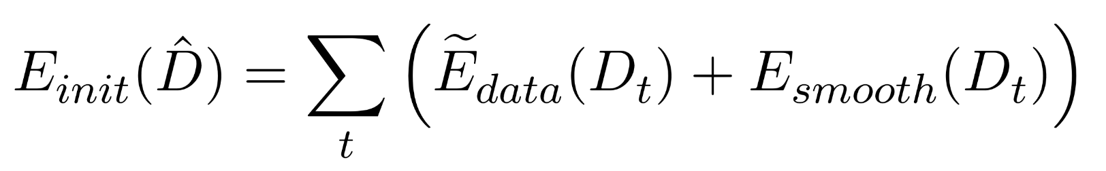
Disparity Initialization
NOTE: the disparity of a pixel is the reciprocal of its depth
During Disparity Initialization, an initial estimation of the frames disparity-maps is executed. This is done using an energy function which is minimized through Loopy Belief Propagation (LBP).
The used energy function is

Slide 8
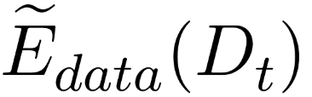
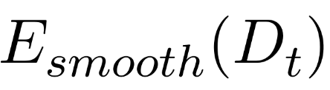
Referred to as the data cost, it is inversely proportional to the likelihood that a certain pixel x has disparity d, with d = D_{t} (x).
Referred to as the discontinuity cost, it encodes the cost that two adjacent pixels, x and y, have different disparities. This is proportional to |D_{t}(x) - D_{y}(y)|.

Slide 9
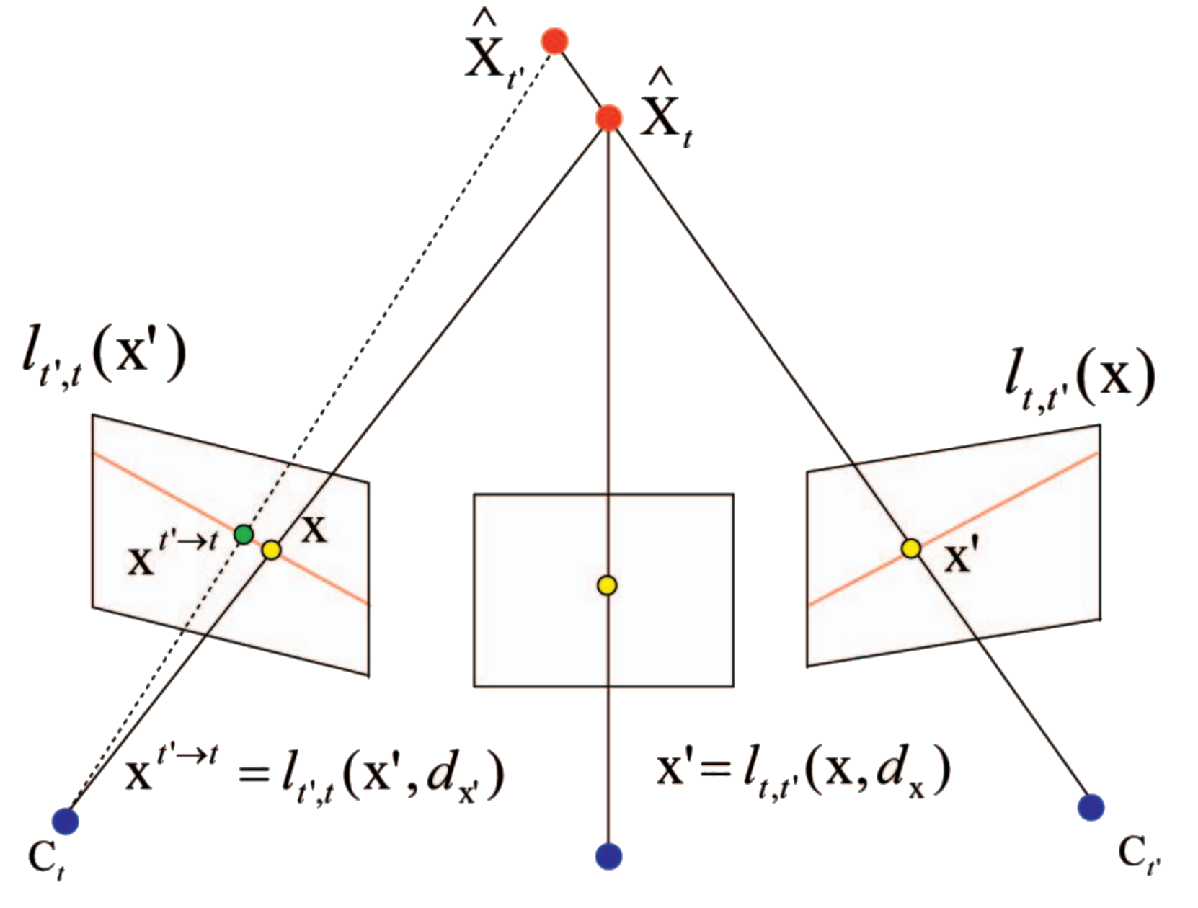
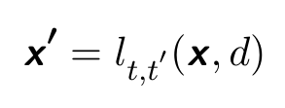
Conjugate Pixel
x’ is the projection of the pixel x (taken from frame t) to frame t’, using the disparity d.

Slide 10
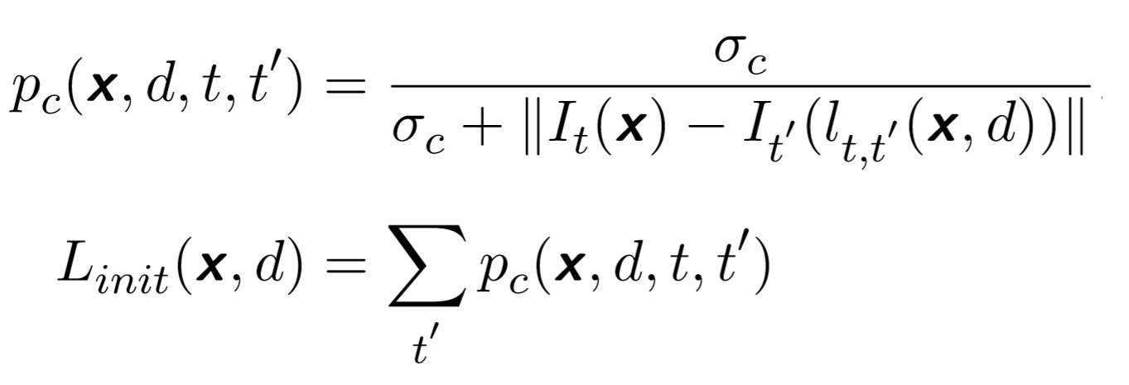
Disparity Likelihood
The term L_{init}(x,d) represents the likelihood that a certain pixel x has disparity d, it is computed by summing the p_{c} term for each image t’.
The term p_{c}(x, d,t,t’) indicates how much the projection of pixel x (using disparity d) at time t’ is similar to x itself.

Slide 11
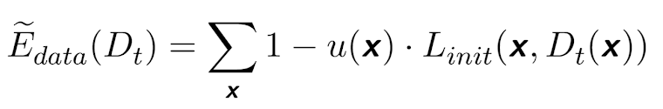
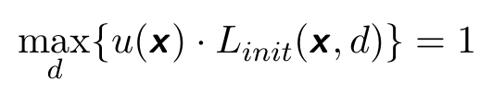
Data Cost
The data cost is computed by normalizing (through u(x) ) the likelihood and, since Loopy Belief Propagation minimizes the energy function, subtracting the likelihood from 1.

Slide 12
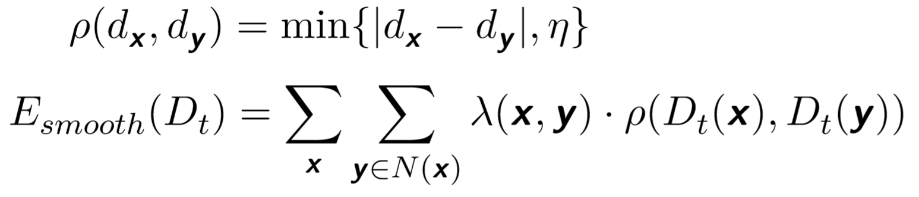
Discontinuity Cost
Impose, in the target energy function, that adjacents pixels should have similar disparity values.
The edge-dependent weight λ(x,y) is used to relax the constraint if x and y have really different color values.

Slide 13
Disparity Planes Fitting
Using mean-shift segmentation, images are divided into segments, which are subsequently fitted to the estimated disparity-maps D_{t}:
First, the depth of the plane is selected by using the disparity that minimizes the energy function (the slope is assumed to be 0 during the fitting process).
Then, by using Levenberg-Marquardt algorithm, the planes' slopes are estimated.

Slide 14
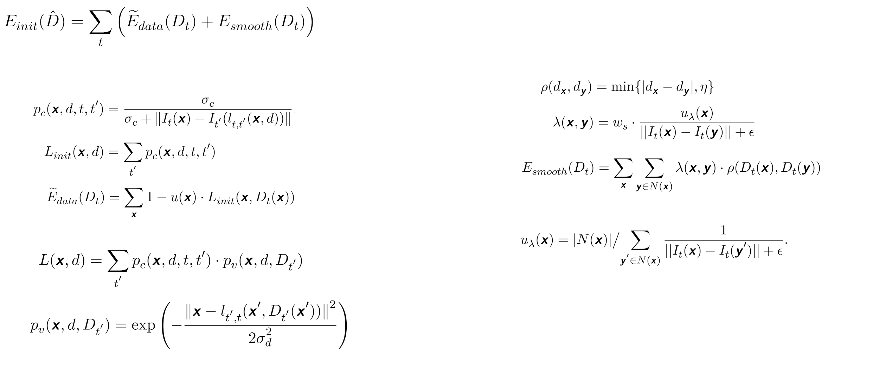
Bundle Optimization
Bundle Optimization is used to refine the previously estimated disparity-maps by applying a geometric coherence constraint p_{v}.
This step also utilizes LBP optimization, with a new energy function that makes use of an improved likelihood function L.

Slide 15
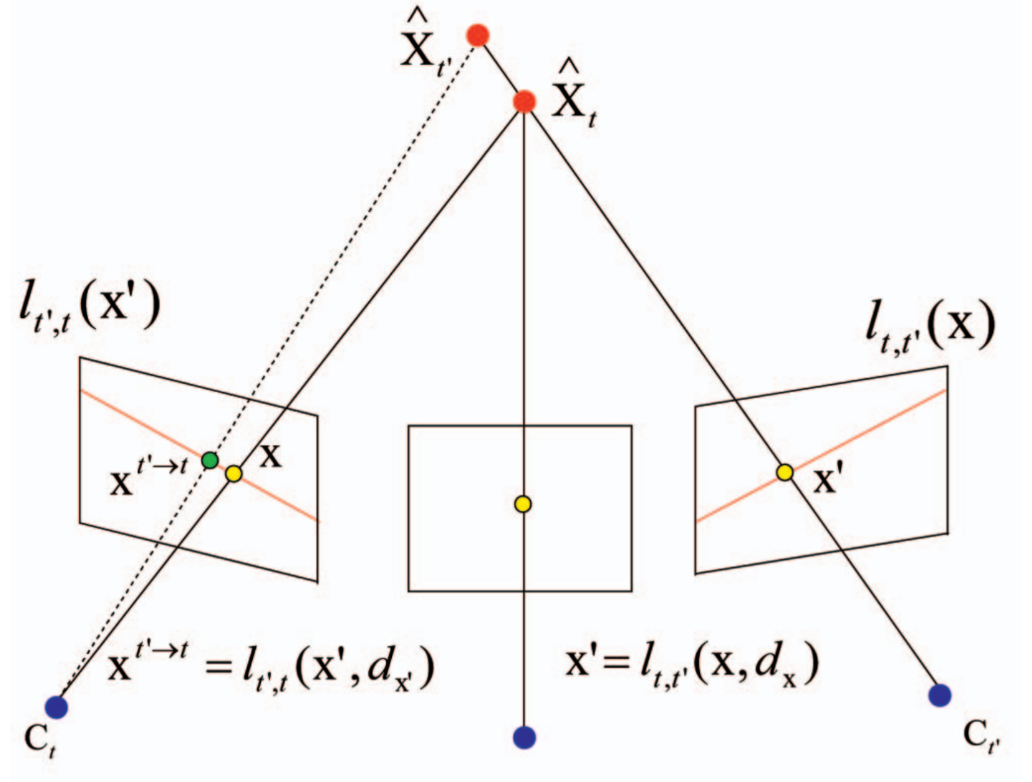
Geometric Coherence Constraint
The geometric constraint p_{v} applies a normal distribution over the distance between the pixel x and the “double projected” pixel l_{t’,t}(x’, D(x’)).
p_{v} encodes, in the energy function E, the necessity of consistent depth values.
Fig. Visualization of the “double projection” executed while computing the p_{v} term.

Slide 16
Space-Time Fusion
This step of the algorithm is used to convert the discrete disparity labels into continuous disparity values.
This is done using Conjugate Gradient Method, an iterative optimization technique somewhat similar to the well known Gradient Descent.
During Space-Time Fusion three constraints are used:
Spatial Continuity
Temporal Coherence
Sparse Feature Correspondences

Slide 17
Project Implementation
The project’s implementation uses only two out of four steps:
Disparity Initialization (partially implemented)
Bundle Optimization
The camera parameters are assumed known (which is a reasonable assumption), and the plane fitting part of the disparity initialization is not executed.

Slide 18
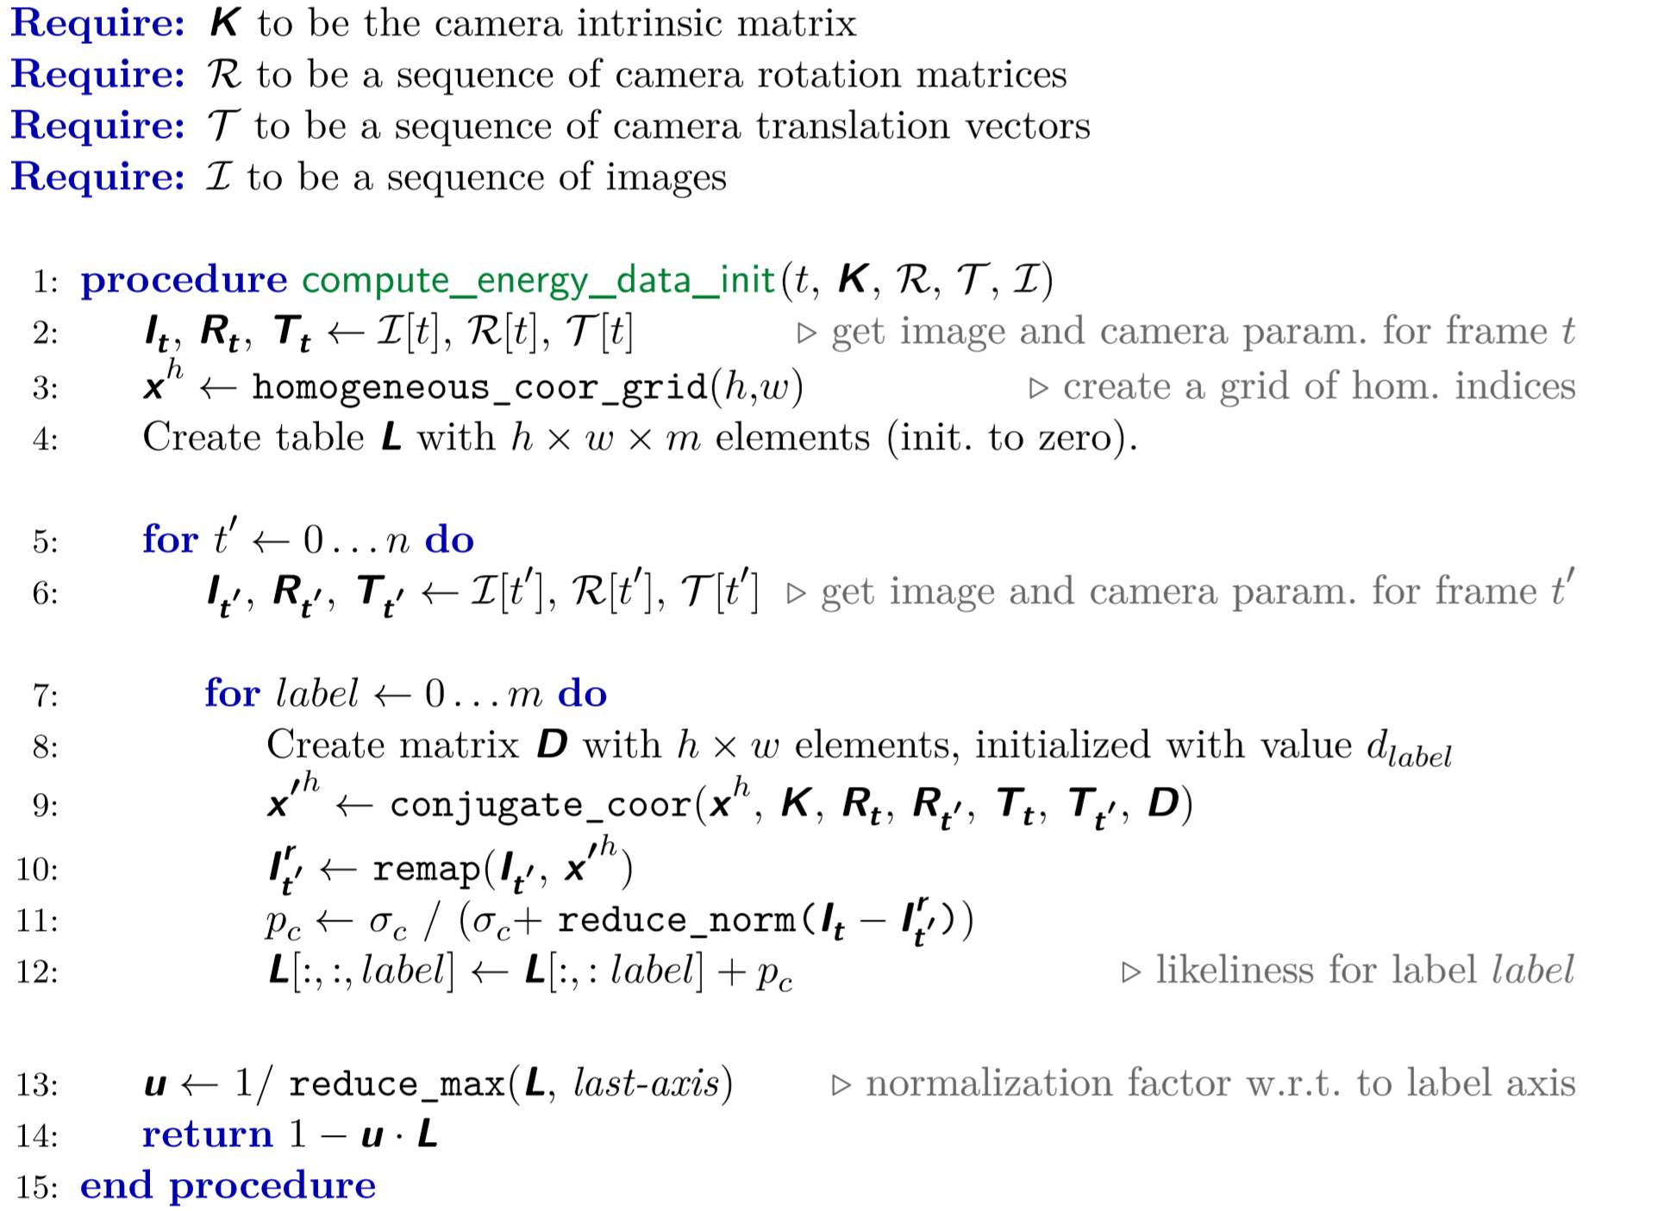

Slide 19
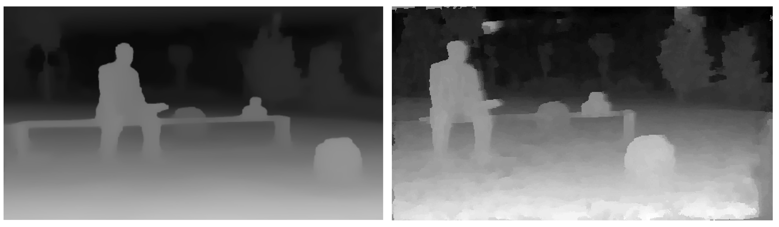
Comparison
Here a comparison between the output of the project implementation, and the output returned by the original implementation:

Slide 20
End of Presentation
Thank you for your attention!
Any questions?

