Slide 1
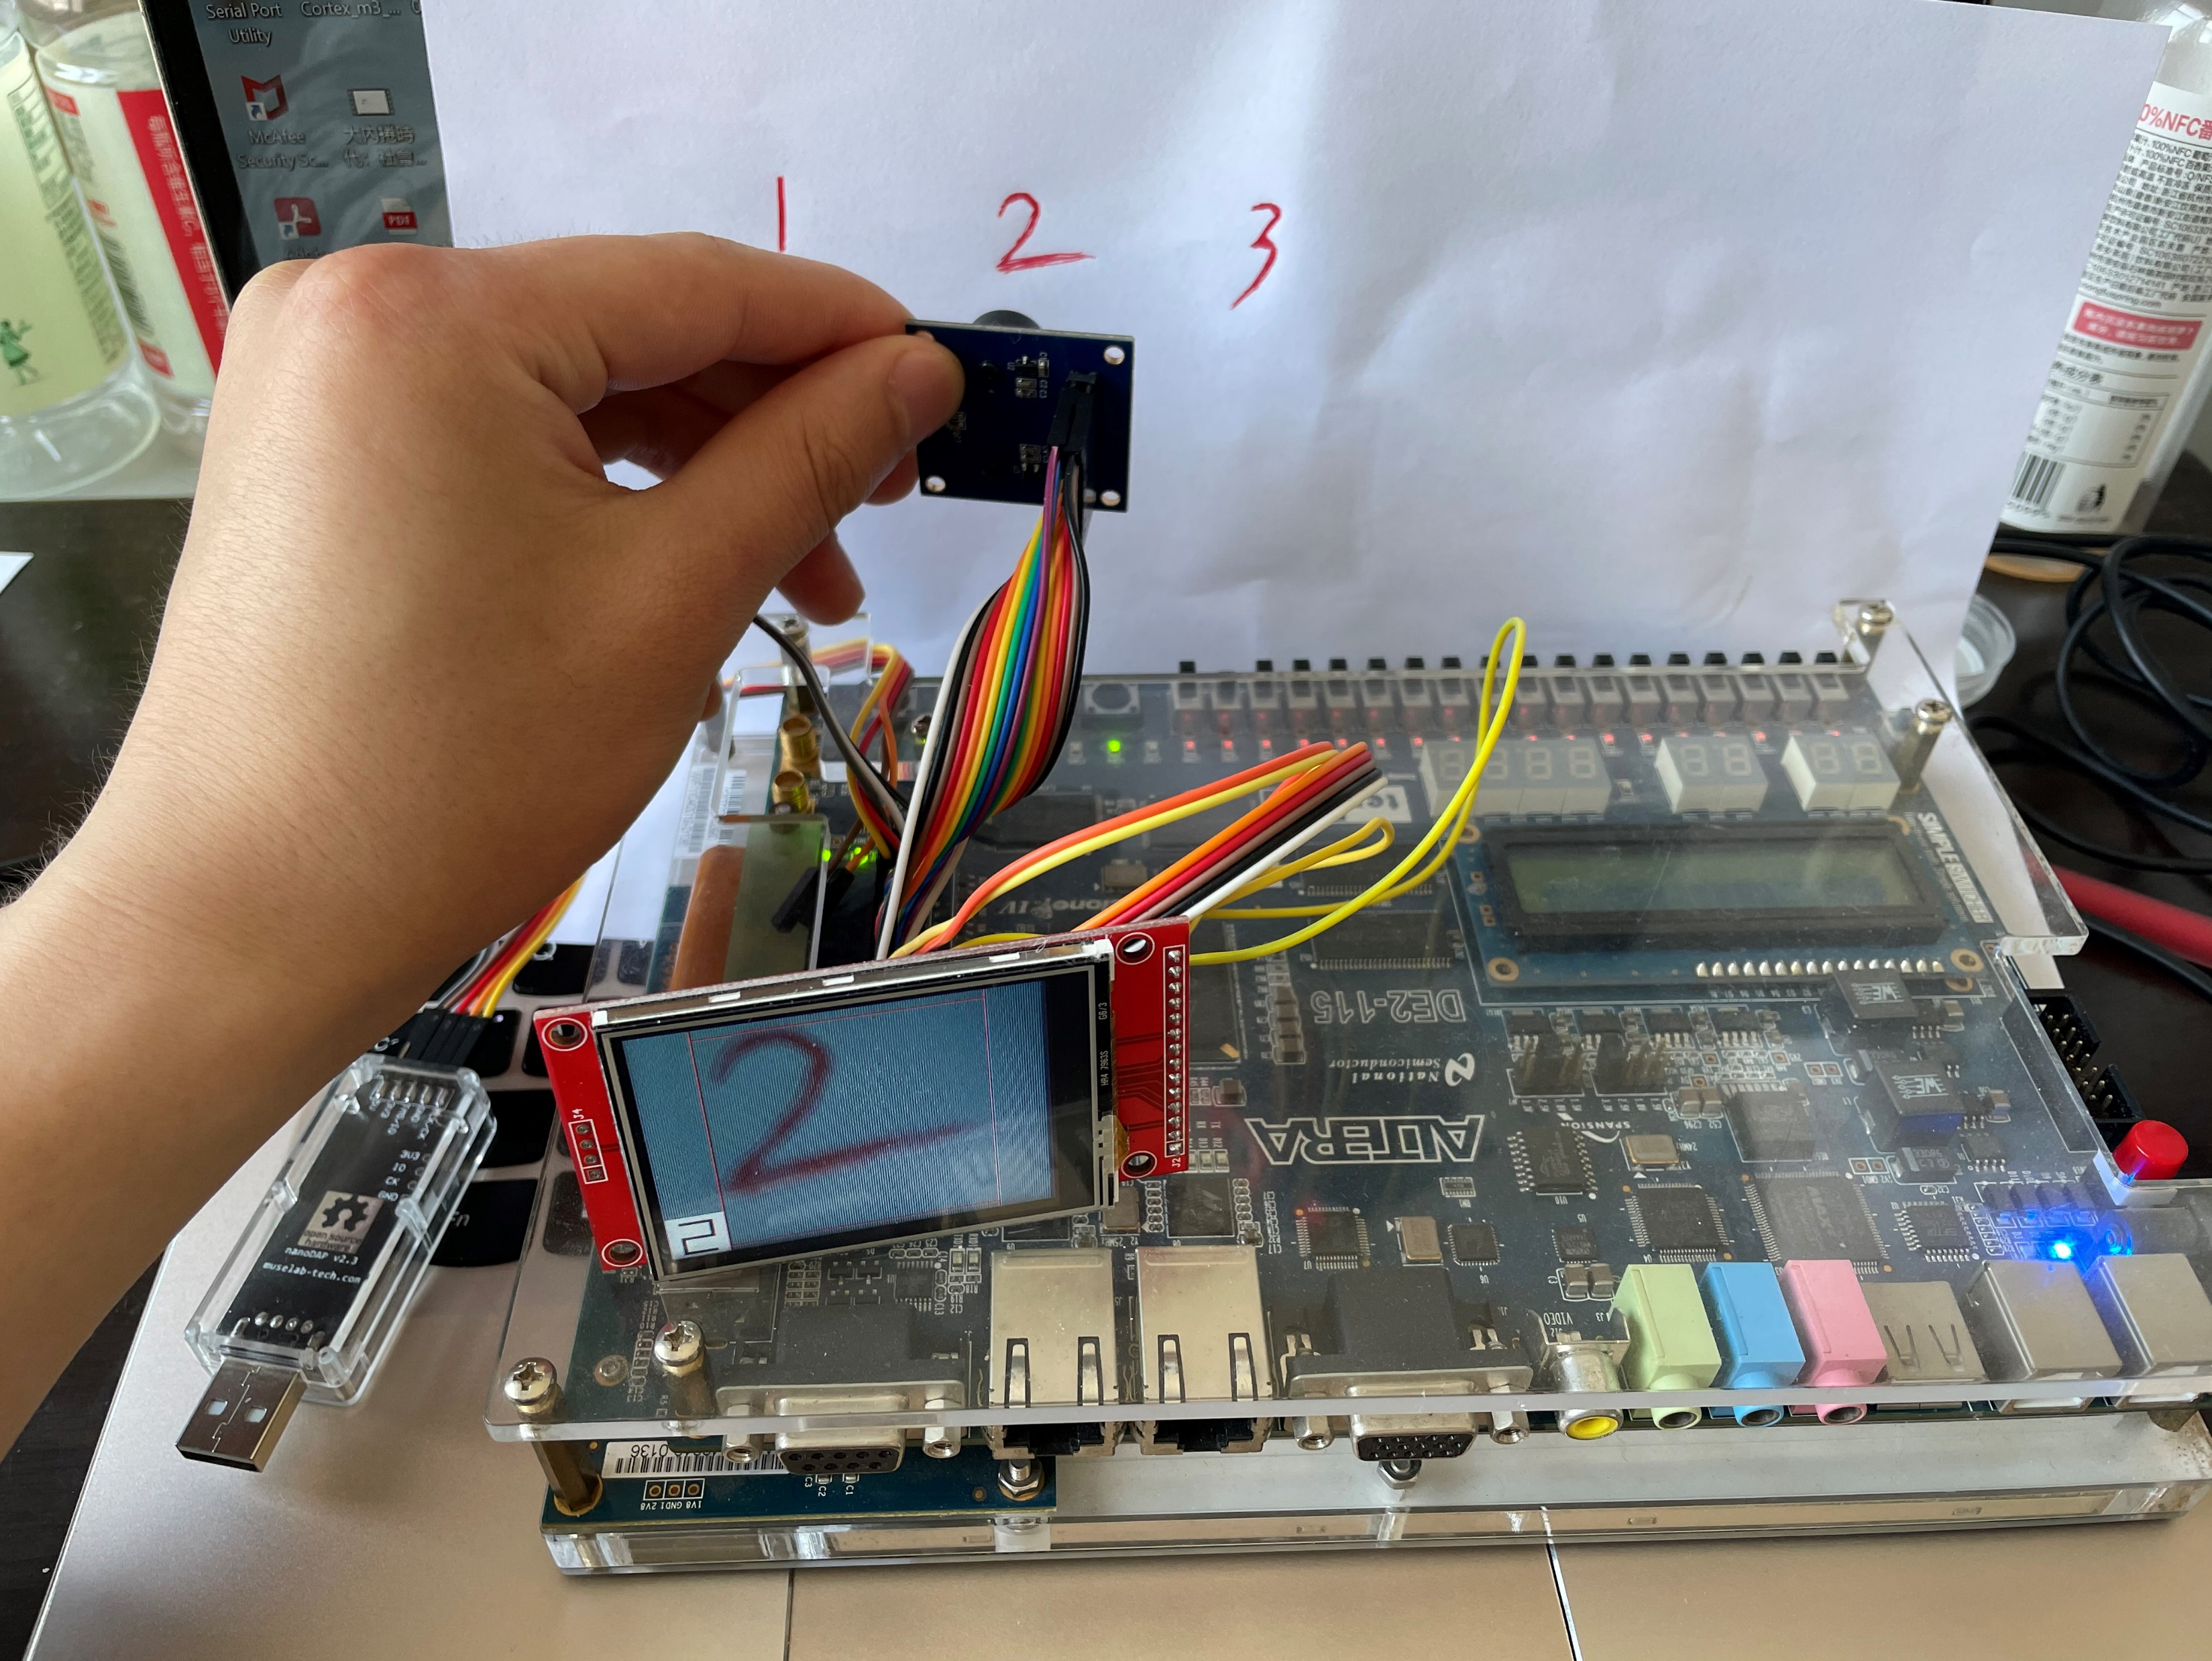

Slide 2
Application
Processors
Cortex-A73
Cortex-R52
Cortex-A35
Cortex-R57
Cortex-A32
System capability
& performance
Cortex-A15
Cortex-A17
Cortex-A12
Cortex-A9
Cortex-A7
Real time
Processors
Cortex-A8
Cortex-R52
Cortex-A5
Cortex-R8
Cortex-R7
ARM11TMseries
Cortex-R5
Cortex-R4
Cortex-M4
Cortex-M7
Microcontrollers and deeply embedded Processors
ARM926TM
Cortex-M33
ARM920TTM
ARM940TTM
ARM946TM
ARM966TM
Cortex-M3
Cortex-M0+
Cortex-M23
Cortex-M0
Cortex-M1 (FPGA)
ARM7TMseries
Classic ARM Processors
ARM Cortex Processors

Slide 3
Arbiter
HADDR
HADDR
HWDATA
Slave1
Master1
HRDATA
HWDATA
HRDATA
HADDR
HWDATA
Slave2
HADDR
HRDATA
Master2
Address and
control mux
HWDATA
HADDR
HRDATA
Write data mux
HWDATA
Slave3
HRDATA
Read data mux
Decoder

Slide 4
Cortex-M3 Integration
ACC
S0
S1
S2
S3
L1 AHB Bus Matrix
M0
M1
M2
M3
0x00000000
-0x0000ffff
AHB to Sram
0x20000000
-0x2000ffff
AHB to Sram
0x40000000
-0x4fffffff
AHB to APB
0x50000000
-0x5fffffff
AHB Bridge
ITCM
DTCM
0x00000
-0x0ffff
GPIO
0x10000
-0x1ffff
UART
0x20000
-0x2ffff
VGA
0x00000
-0x0ffff
LCD
0x0010000
-0xdffffff
SDRAM
0xe000000
-0xe00ffff
Camera
apb subsystem
DMA

Slide 5
Cortex m3 pipeline
Clock
Instruction N
Fetch
Decode
Execute
Instruction N+1
Fetch
Decode
Execute
Instruction N+2
Fetch
Decode
Execute

Slide 6
Spatial Array
Filter
Filt
Input Image
Img
Off
chip
memory
Decomp
Buffer
SRAM
Psum
Output Image
Comp
ReLU
Psum
Compression Example
Filt
Spatial Array
Input:
0 0 12 0 0 0 53 0 0 22
Img
Off
chip
memory
Buffer
SRAM
Output:
2 12 3 53 2 22
Psum
Psum

Slide 7
Data Gating
Processing Engine
Img
Image
12X16bREG
==0
Zero
buffer
Enable
2-stage pipelined
multiplier
Accumulate
Input Psum
==0
Filt
Filter
225X16bSRAM
0
Input
Psum
1
Images
.
.
.
.
.
.
.
.
.
Partial Sum
12X16bREG
Reset Accumulate
卷积复用
图像复用
卷积核复用
Filters
Image
Image
.
.
.
.
.
.
.
.
.
.
.
.
.
.
.
.
.
.
.
.
.
.
.
.
.
.
.
.
.
.
.
.
.
Filter
Filter
.
.
.
.
.
.
.
.
.
.
.
.
.
.
.
.
.
.

