Slide 1



Veterans Health Administration
Notes:
Welcome to the VA LEAF Monthly demo. Please keep your microphones muted during the demo. The demo will take about 25 minutes without interruption, so we’d like you to hold your questions until the end. You CAN feel free to post questions in the chat window as we go, and we’ll circle back to them at the end.

Slide 2
LEAF Mission
“To empower VA employees and business lines with rapid development of scalable and cost-effective business solutions, achieving standardization and transparency of operations to deliver world-class service to Veterans”

Slide 3
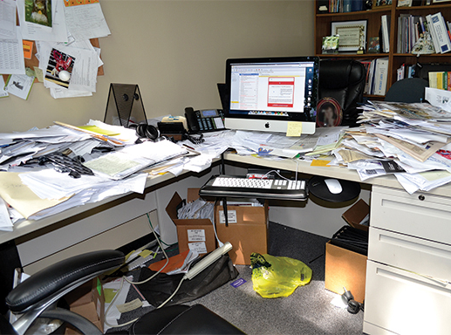

Before LEAF
After LEAF
Notes:
Today in VA, while most of our desks hopefully don’t look like this, our business processes are often fragmented. They are split between paper-based forms, excel spreadsheets, email, Sharepoint sites, and a variety of other tools. This often leads to confusion, lost requests, poor data security, and inefficiency.
LEAF began at Washington VAMC back in 2008. The Associate Director wanted an online, streamlined tool for various processes at the medical center.

Slide 4
PLATFORM INFORMATION
VA LEAF is a secure intranet web app helping VA facilities/teams to rapidly digitize existing processes.
Cleared to manage and store non-sensitive information.
Authorization to Operate (ATO) in place with full 508 compliance.
Can be used as a stand alone tool, or in conjunction with other tools such as SharePoint and VA Pulse.
Centralized server with full GAL integration. No local IT server support required.
Enabled to support Digital Signing.
No licensing costs. 100% open source component technologies.
Mission: To empower VA employees in digital process improvement.

Slide 5

Backlog LEAF 2018
Secure Digital Signature functionality
ATO remediation work
Architecture finalized for migration to VA Enterprise Cloud
Prod is migrated to VA Enterprise Cloud
ATO submitted for VAEC Duplicate/Clone Forms functionality
Flexibility to route to one, multiples or all
Setup User Access Groups so that an Outlook email distribution List can be used
If/Then Logic
Provide automated linkages between HR Smart and LEAF
JUNE
JULY
AUG
SEPT
OCT
NOV-DEC
Dev and Pre-Prod Migrated to VA Enterprise Cloud
ATO remediation work completed
LEAF-S
Completing transition to VA Enterprise Cloud
Flexibility to route to one, multiples or all
Ability to modify auto-generated email
Auto-generate Email Reminders which respond to Due Dates set
ONGOING
Bug Squishing | Testing Automation | Code refactoring and User Interface update

Slide 6
LEAF NATIONAL NUMBERS – July 2018
307% Year-over-Year growth
July 17 to July 18 – 210,026 transactions
July 16 to July 17 – 68,412 transactions
Over 50 medical centers and program offices
Over 24,500 active monthly users
Over 1,128 total form types
Over 1,085 LEAF Portals

Slide 7
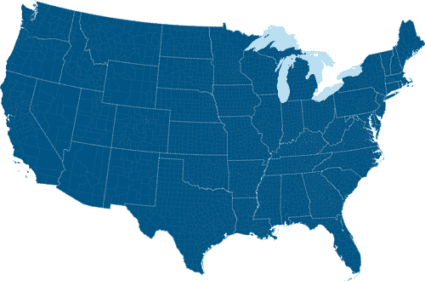


















Geographic Footprint
July 2018
Seattle
Ft. Harrison
White River Junction
Montrose
Mather
Boston
Sacramento
Salt Lake City
Cheyenne
Battle Creek
Bronx
Martinez
Columbus
San Francisco
Reno
Glendale
Baltimore
Chillicothe
Columbia
Las Vegas
Denver
Topeka
Louisville
Martinsburg
Washington DC
Loma Linda
Salem
Hampton
Long Beach
Oklahoma City
Columbia
Lexington
Los Angles
Prescott
Mountain Home
Salisbury
San Diego
Muskogee
Murfreesboro
Phoenix
Augusta
Dallas
Fayetteville
Atlanta
Charleston
Tucson
Arlington
Decatur
El Paso
Temple
Montgomery
5,000 + annual requests
Big Springs
Austin
1,001 – 4,999 annual requests
San Antonio
Tampa
< 1,000 annual requests
St. Petersburg
Miami
Harlingen
Honolulu
LEAF is used by more than 50* facilities, and more are coming online each month.

Slide 8

Committee Minutes
Resource
Management
Committee
Vacancy
Tracking
Travel
Requests
Org Charting
ADMINISTRATIVE
HUMAN RESOURCES
Policy
Updates
Special
Projects
Task
Tracking
On-boarding and Clearing
Consolidate
Classification
Unit
EXISTING PROCESSES
Clinic Profile
Management
Medical
Media
Public Affairs Actions
Space & Interior
Design
OTHER SERVICE LINES
Tuition Reimbursement
IT Equipment
And Menus
Union
Actions
Informatics

Slide 9
Case Study: LEAF for Resource Management Committees Salisbury VAMC, December 2016
We examined 50 hiring requests – 23 from the old process and 27 from the new LEAF process.
LEAF made hiring decisions 54% faster, a 26-day improvement
Urgent Access-related positions can now be approved in <24 hrs
Paperless
Transparent Tracking
Nothing Lost
More Focus on Vets
Employee Morale Booster!
Notes:
Exhibit A – The travel memo
This artifacts is demoralizing to our staff.
Be sure to print out.

Slide 10
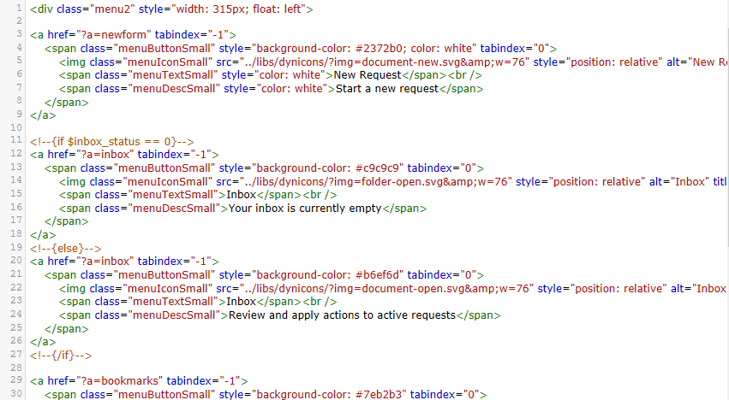
Here is how it all works!

Slide 11



P R O C E S S
HR
Develop the Workflow with Graphical UX
Create a Digital Form
Define routing to employees and groups
Other Features: Report Builder, Email Notifications, and more
Key VA Integrations: Active Directory, PIV Authentication
Similar Proprietary Product: Microsoft InfoPath (Sharepoint-based)

Slide 12
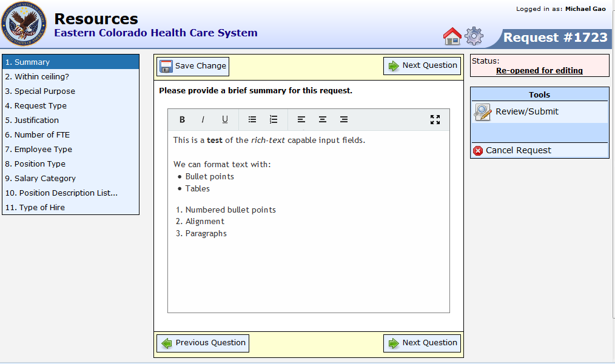
CLEAN DATA ENTRY
User interface takes complex forms, and presents it in smaller, more manageable sections
All data is stored in a relational database for simplified search / reporting

Slide 13
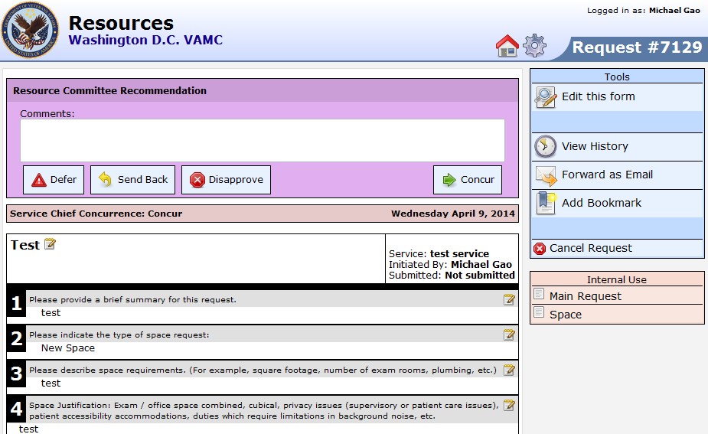
INTUITIVE DESIGN
Easy to use interface for decision-making
Supports Email notifications and other custom events
Training is typically not required for end-users

Slide 14
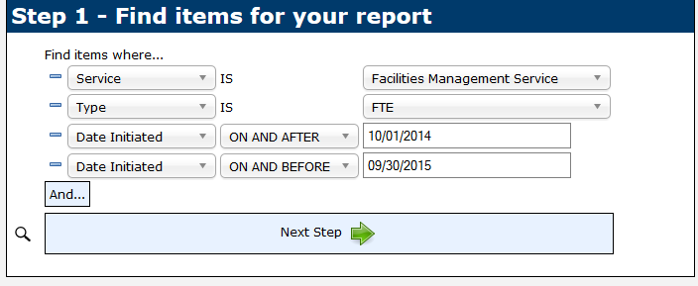
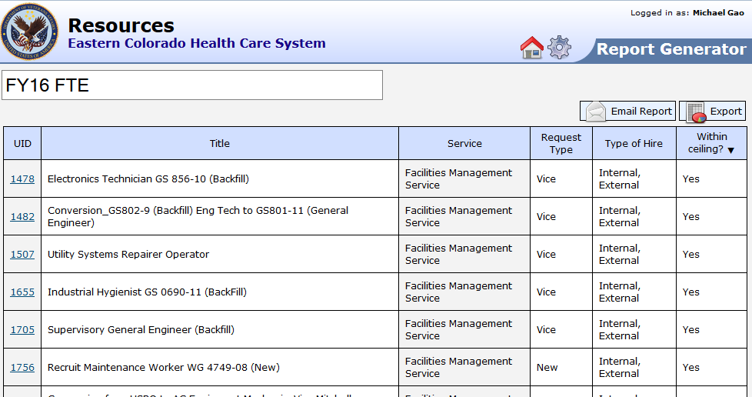
POWERFUL REPORT GENERATOR
No SQL database knowledge required to build reports
Exports to Excel
Always up to date using live data

Slide 15
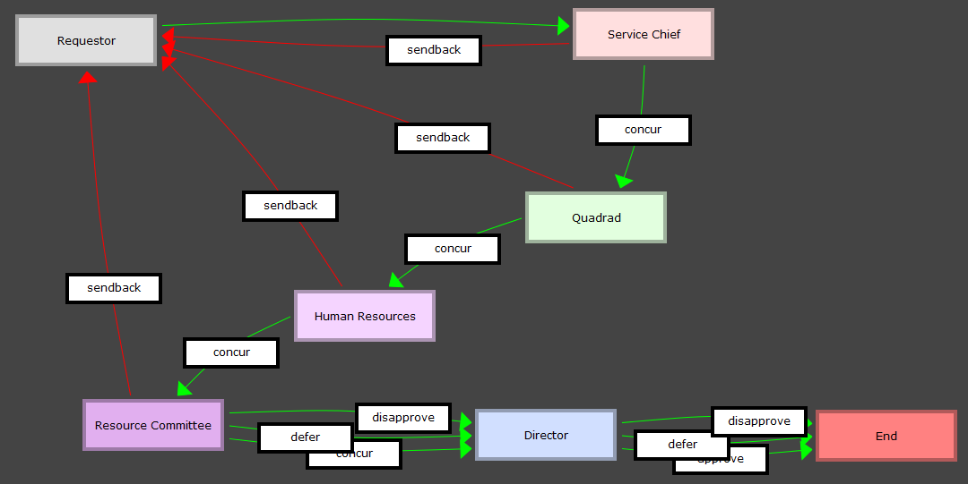
SIMPLE WORKFLOW CONFIGURATION
Database driven Flowchart enables rapid development and iteration
Immediately identify where an item is in its process, and where it needs to go.
Features role-based security to identify authorized users

Slide 16
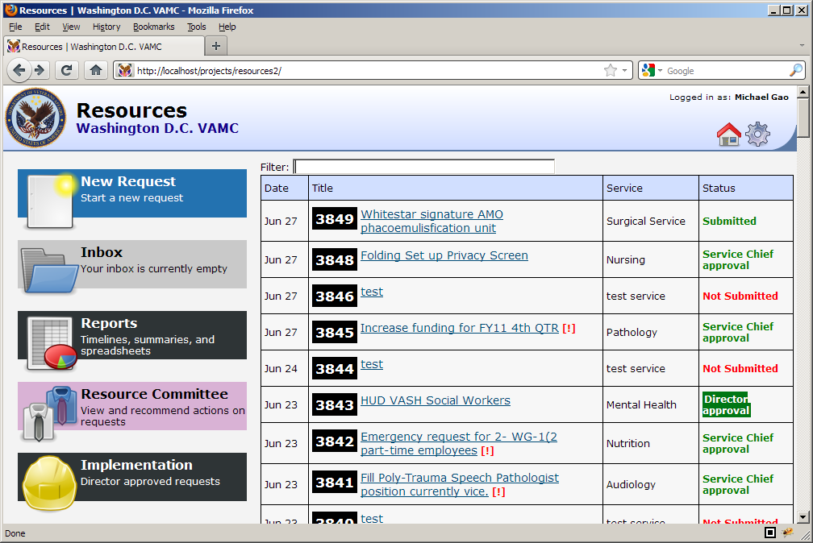
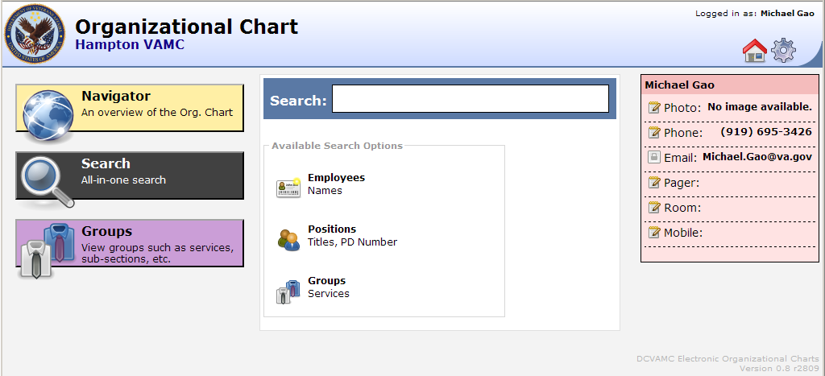
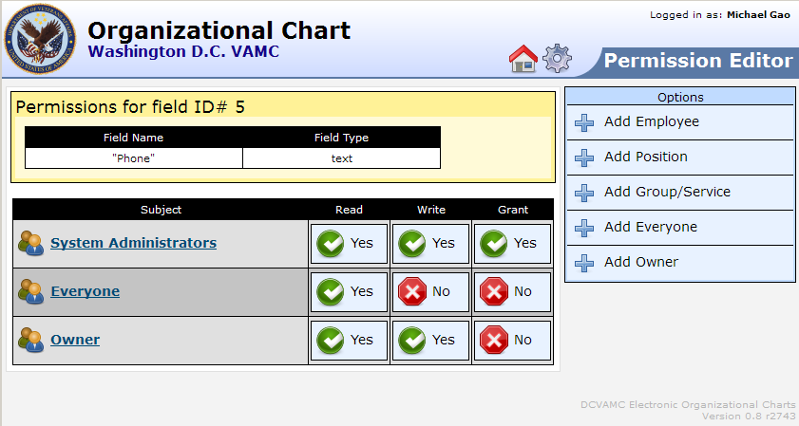
OTHER FEATURES
Searchable database
Instantly recall:
electronic forms and status
employee names
Positions
etc.
Phonetic matching helps with misspelled searches
Role-based security can lock down individual fields
Easy to use security options
16

Slide 17


TRAINING & EDUCATION
We support you through your entire journey
LEAF COACHES
LEAF COMMUNITY
VA Pulse
MONTHLY
ACADEMYS

Slide 18

BUILDING A COMMUNITY
Quarterly National Calls
Annual Conference
Workgroups for National Implementations
OIT Equipment Program
Clinical Practice Management
Consolidated Classification Unit
Compensation Center of Excellence
Forms Library to promote standardization and knowledge sharing

Slide 19

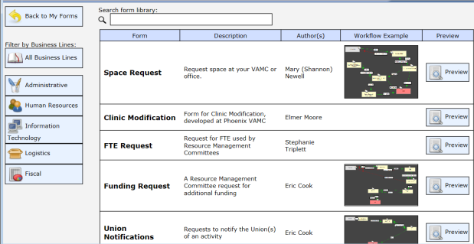
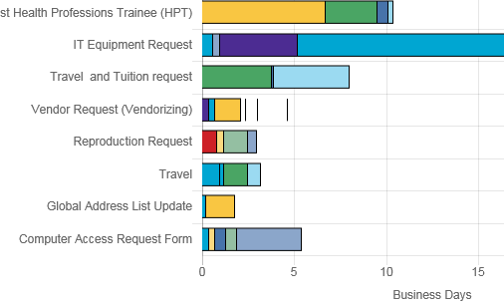
The LEAF Difference
COMMUNITY
Process to the people! Crowdsource VA organizational process improvements.
SHARING & STANDARDIZATION
Accelerate diffusion. Easily share winning forms /workflows.
MEASUREMENT
Measure processing times at the facility, VISN, and enterprise level.
“To care for him who shall have borne the battle, and for his widow, and his orphan…”
19

Slide 20
HOW TO GET INVOLVED
Request a Site
Submit request on LEAF Launchpad
Register for the next LEAF Academy
Join the Community
Join the VA Pulse LEAF Community
Get started with the LEAF User’s Guide
Join us for a Demonstration

Slide 21
How can LEAF help you?
Veterans Health Administration

