Slide 1
Employee Data Analysis using Excel
STUDENT NAME : V.Hemalatha
REGISTER NO. : 312204236
DEPARTMENT. : B.com accounting and finance
COLLEGE. :Annai Violet Arts And Science college

Slide 2
PROJECT TITLE
Employee Attrition Analysis using
Excel Dashboard

Slide 3


AGENDA
Problem Statement
Project Overview
End Users
Our Solution and Proposition
Dataset Description
Modelling Approach
Results and Discussion
Conclusion
3/21/2024 Annual Review

Slide 4

PROBLEM STATEMENT
This project aims to develop a Power BI Dashboard to comprehend employee attrition and explore the factors contributing to turnover, facilitating the development of effective retention strategies.

Slide 5

PROJECT OVERVIEW
.
The dataset, sourced from Analytics Employee Attrition & Performance, includes details such as employee demographics, job attributes, performance ratings, and attrition status, facilitating analysis and understanding of turnover factors.

Slide 6

WHO ARE THE END USERS?
HR Manager
Executives
Data Analysts
Team leaders
Recruiters

Slide 7

OUR SOLUTION AND ITS VALUE PROPOSITION
Developed an interactive dashboard in Power BI Desktop to visualize the analysis results. The dashboard includes various visualizations, filters, and slicers to facilitate the exploration and understanding of employee attrition patterns.

Slide 8
Dataset Description
Analyzed the dataset to gain insights into employee demographics, job attributes, performance ratings, and attrition status. This involved visualizing distributions, correlations, and trends using descriptive statistics and data visualization techniques.

Slide 9

THE "WOW" IN OUR SOLUTION
Proactive measures aligned with these insights can lead to a more engaged and committed workforce, ultimately contributing to long-term success.
3/21/2024 Annual Review
9

Slide 10
MODELLING
The HR Attrition Dynamic Dashboard is an interactive Excel-based tool designed to analyze and monitor employee attrition trends within an organization. This dashboard provides HR professionals and management with real-time insights into attrition patterns, demographics, and key metrics to support data-driven decision-making.
10

Slide 11
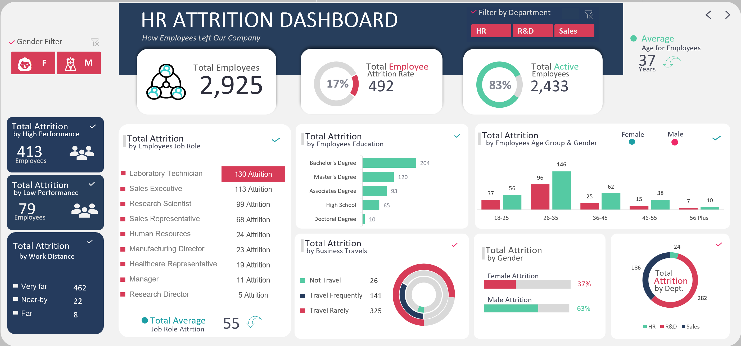
RESULTS
11

Slide 12
conclusion
This Employee Attrition Analysis Dashboard provides insights into demographic patterns, turnover trends, and employee welfare factors contributing to attrition within the organization.
Excel dashboard for employee attrition analysis can provide insights into employee turnover patterns, demographics, and key metrics.

