Slide 2
Version control

Slide 3
Why version control?
“I will just finish my work and then you can start with your changes.”
“Oh, co-authors A and B both worked on this file synchronously, and now I have to merge their changes. Also, they disagree.”
“Can you please send me the latest version?”
“thesis_final_final_v2_thisone_THISONE.docx”

Slide 4
Why version control? You can:
Go back to a working version (releases)
Work on the same file with multiple people and have git solve the merging
Also when you worked offline
When you find a bug, you can retrace when it was
Always find the latest version on the same spot
No more “thesis_final_final_v2_thisone_THISONE.docx”

Slide 5
Git is a version control system
Versioning manages changes to a piece of content.
XXX plaatje

Slide 6
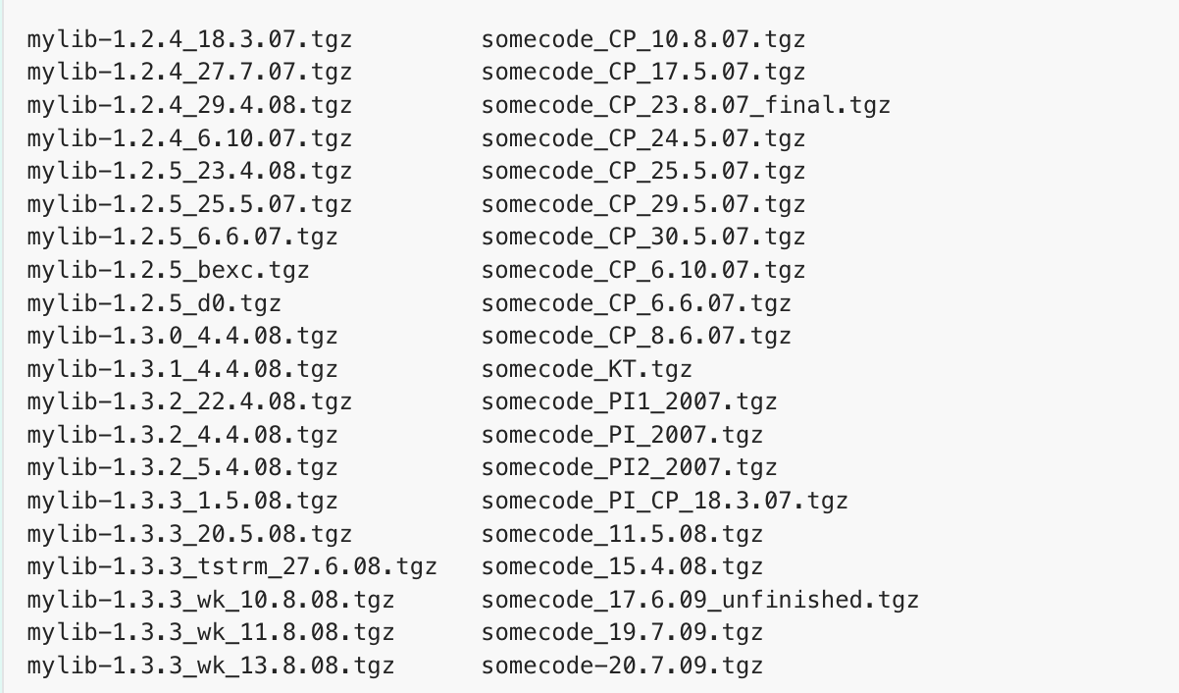
Git is a version control system
Low-fi version control
Notes:
Nadeel?
Giving a version to a collaborator and merging changes later with own changes sounds like lots of work.
What if you discover a bug and want to know since when the bug existed?
Not clear which versions of mylib and somecode are compatible

Slide 7
Git as VCS

Slide 8
Git vs github
Git is the command line software handles version control on your repository.
When you use GitHub, Git is always doing its thing behind the scenes.

Slide 9
Git vs github
GitHub is a cloud storage system for git repositories.
Offers additional tools for collaboration
Web interface
Works with web interface, or Github Desktop App , or Connects to Rstudio, or command line, or..

