Slide 1

COVID-19 GLOBAL IMPACT
ANTON KOROLEV

Slide 2
About myself:
My name is Anton and I’m currently studying data science at Galvanize DSI New York campus
I received my Bachelor's degree in Mechanical Engineering from the University of Massachusetts in 2019
At the moment I live in Brooklyn New York
Notes:
Insert a map of your country.

Slide 3

What is corona virus?
Coronaviruses are a family of hundreds of viruses that can cause fever, respiratory problems, and sometimes gastrointestinal symptoms too
Since emerging in China in December 2019, new coronavirus (COVID19) has caused a global health emergency
In the confirmed cases so far, most people get a fever with a dry cough; smaller numbers of patients might experience shortness of breath, a sore throat, or a headache[1]
Notes:
Insert a picture of one of the geographic features of your country.

Slide 4

Data collection
CHARTS, GRAPHS AND MAPS:
Three tables with worldwide information on number of deaths, confirmed and recovered cases were downloaded from data.humdata.org, each containing 250 rows and 77 columns. Rows represented the countries, and columns were latitude and longitude of each country with daily distribution of cases ranging from January 22nd 2020 to April 5th 2020[2]
STATISTICAL ANALYSIS:
A research was done in one of the Chinese hospitals where the symptoms for 138 patients infected with COVID-19 were recorded. The research data was obtained form jamanetwork.com as a table with 15 rows (symptoms) and 3 columns indicating how many patients were in Intensive Care Unit.
Notes:
Insert a picture illustrating a season in your country.

Slide 5
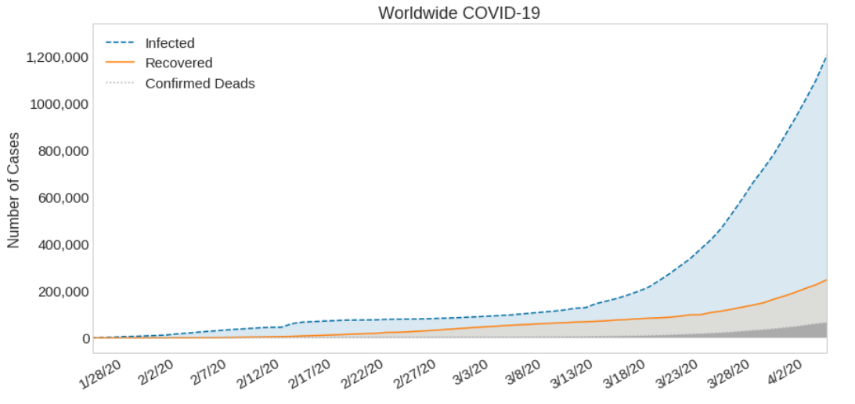
Visualizing worldwide covid19 cases
Notes:
Insert a map of your country.

Slide 6
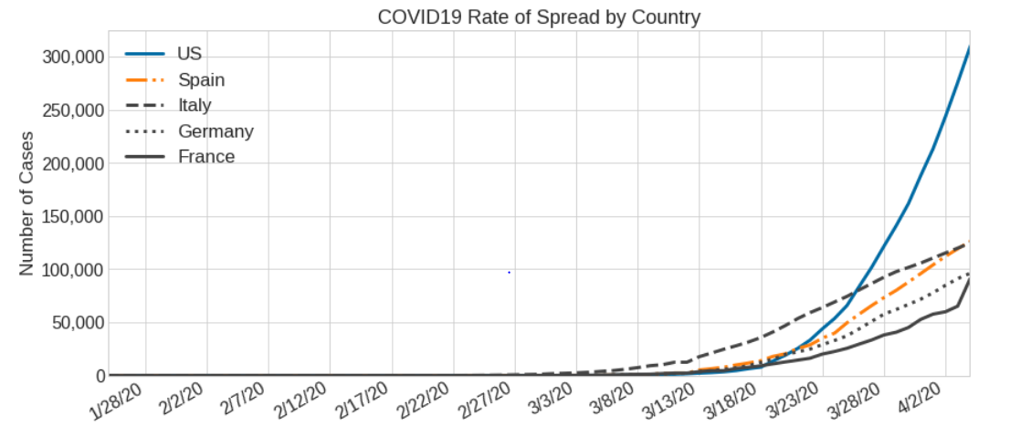
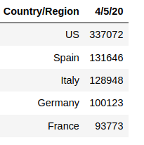
Top 5 countries with confirmed cases April 5th 2020
Notes:
Insert a picture illustrating a custom or tradition here.

Slide 7
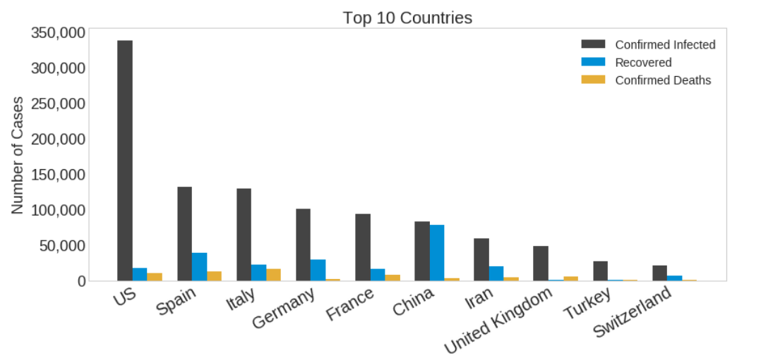
Top 10 countries with confirmed cases April 5th 2020
Notes:
Insert a map of your country.

Slide 8
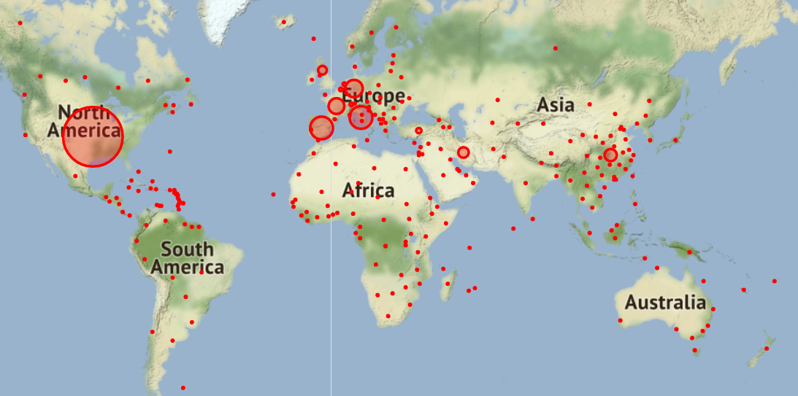
Distribution of confirmed cases on the world Map

Slide 9
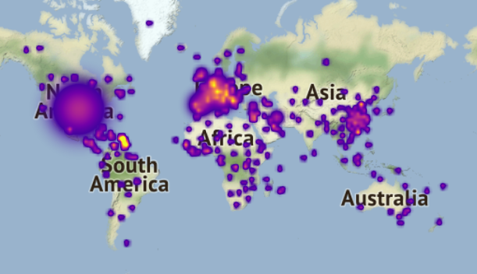
Heat map of deaths cases worldwide

Slide 10
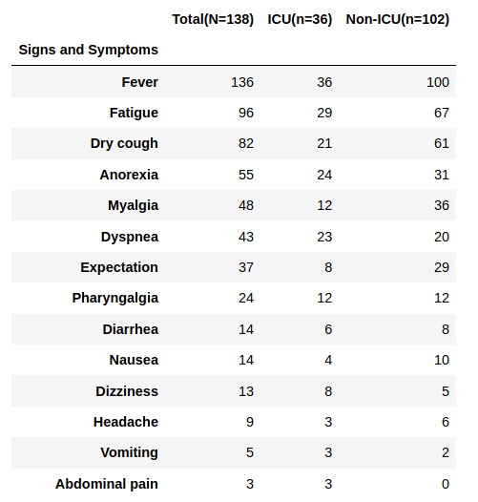
Statistical analysis
Clinical Characteristics of 138 Hospitalized Patients With 2019 Novel Coronavirus Infected Pneumonia in Wuhan, China[2]
Chi-Square test is used when researches need to estimate whether two random variables are independent
Notes:
Insert a picture of the head leader of your country.

Slide 11
Statistical analysis
H0: The Dizziness and ICU admission are independent.
H1: The Dizziness and ICU admission are NOT independent
Alpha = 0.05
p value = 0.006
0.006 < 0.05 hence reject H0
H0: The Dry Cough and ICU admission are independent.
H1: The Dry Cough and ICU admission are NOT independent
Alpha = 0.05
p value = 0.887
0.887 > 0.05 hence fail to reject H0

Slide 12
Conclusions:
1. The number of people getting infected with COVID19 in United States is the highest in the world
2. China is the best at fighting the virus among the top 10 countries with the most number of confirmed infected cases
3. If two patients infected with COVID-19 show up at the hospital with the limited number of beds in Intensive Care Unit. The one who feels dizzy should be admitted to ICU first.

Slide 13
Further analysis:
The number of upcoming infected cases could be predicted using linear regression model in the future analisys

Slide 14
References:
1. https://data.humdata.org/dataset/novel-coronavirus-2019-ncov-cases
2. https://jamanetwork.com/journals/jama/fullarticle/2761044
3. https://www.wired.com/story/what-is-a-coronavirus/

Slide 15
Questions ?
?
?
?
?
?
?
?

