Slide 1

Middle Fusion and Binary Mask Help UNet 2D in Brats Image Segmentation
Big Data in Health Care
Valentina Barbera
Vittorio Haardt
Luca Porcelli
Luca Sinanaj
Università degli studi di Milano-Bicocca

Slide 2

Outline
Data and Pre-Processing
Model and Results
Problem Solution and Results
Conclusion and Improvements
Big Data in Health Care
2 16

Slide 3
Outline
Data and Pre-Processing
Data Set
Pre-Processing
Online Data Augmentation
Model and Results
Problem Solution and Results
Conclusion and Improvements
Big Data in Health Care
3 16

Slide 4

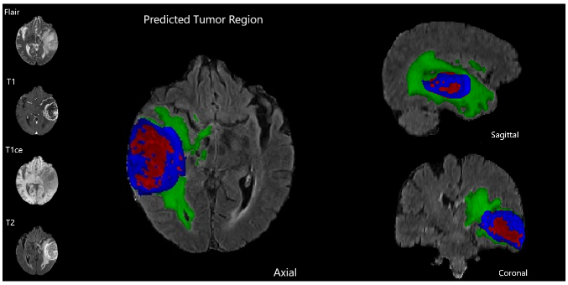
1.1 Data Set
Image type
4 channel images
3 dimensional images
166 brains
Objective
Dataset
Image segmentation in 3 classes using UNet 2D for comparing:
Early fusion
Middle fusion
Training Set: 82 brains and 1409 slices
Validation Set: 34 brains and 598 slices
Test Set: 50 brains and 836 slices
Big Data in Health Care
4 16

Slide 5
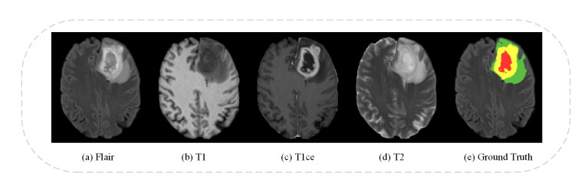
1.2 Pre-Processing
To reduce the computational weight, we used UNet 2D, separating the vertical, frontal and lateral images. The result obtained for the Vertical are generalizable for the other two.
We used only the slice with tumor (>0.5% of tumor in GT).
Idea: the model should also learn to recognize where the tumor is not present.
Sample Data
Only 40% of data was used for RAM problem
Big Data in Health Care
5 16

Slide 6
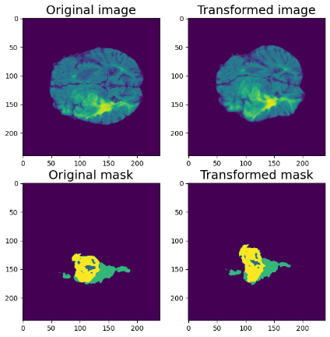

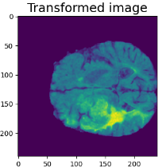

1.3 Data Transformation
Having more images was not possible due to RAM capacity problems.
Despite that we want more variability in the data, since we have only few different brains.
Data Transformation
Transformation are done to images only in training data
Randomized
60% no transformation
20% elastic transformation
20% grid distortion
Big Data in Health Care
6 16

Slide 7
Outline
Data and Pre-Processing
Model and Results
UNet
Results and Problems
Problem Solution and Results
Conclusion and Improvements
Big Data in Health Care
7 16

Slide 8
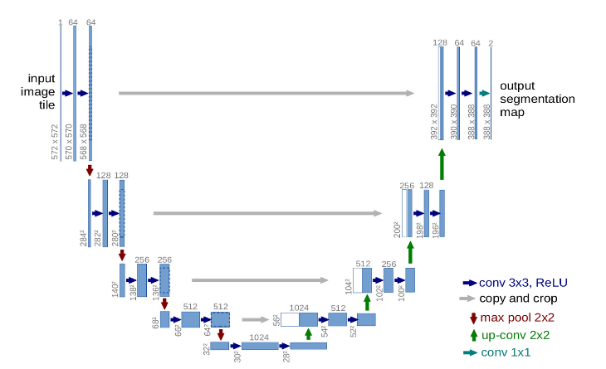
2.1 UNet
Base UNet has 4 input channel and 4 output channel, 3 tumors + 1 brain (not used).
Middle fusion has the first layer separated for every channel, then it concatened them on the second layer.
x4
Hyper-parameters
Epoch = 100
Batch size = 5
Learning rate = 1e-4
Optimizer = Adam
Decay = 0.1 (every 45/65)
Loss = cross entropy loss
Metrics: Accuracy, IoU, Dice
Big Data in Health Care
8 16

Slide 9
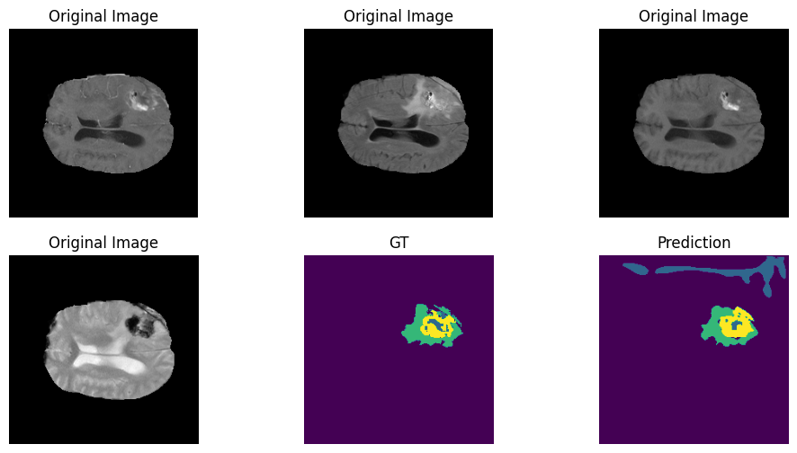
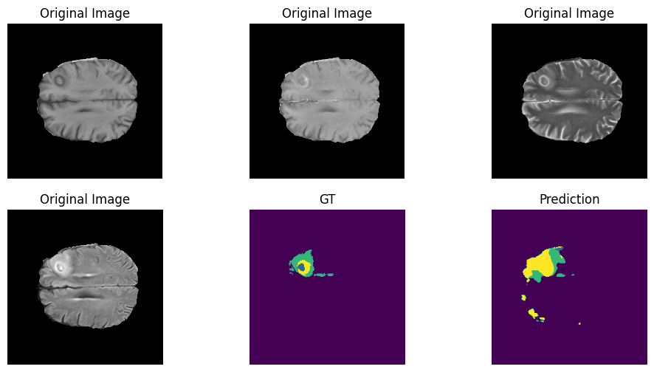
2.2 Results and Problems
Early fusion
 | Early Fusion | Middle Fusion
Accuracy | 0.69 | 0.61
IoU | 0.44 | 0.37
Dice (1) | 0.70 | 0.69
Dice (2) | 0.77 | 0.68
Dice (3) | 0.74 | 0.63
Middle Fusion
Big Data in Health Care
9 16

Slide 10
Outline
Data and Pre-Processing
Model and Results
Problem Solution and Results
Problem Solutions
Problems in Mask Application
Evaluation
Conclusion and Improvements
Big Data in Health Care
10 16

Slide 11

3.1 Problem Solutions
The problem is both the model did not focus on the brain area and that it use training epochs just to focus on that area.
Solution 1: crop around the brain (not feasible automatically)
Solution 2: implement a binary mask to guide the model
Application of Solution 2
Early fusion: mask concatenated to the input as an additional channel
Middle fusion: mask treated as an additional channel, with its branch
Middle Fusion Alternative Approach
A branch for only the mask give to much importance to it.
Middle fusion: mask concatenated to input of every branch (2 channel)
Big Data in Health Care
11 16

Slide 12
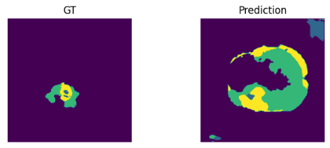

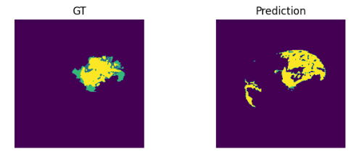
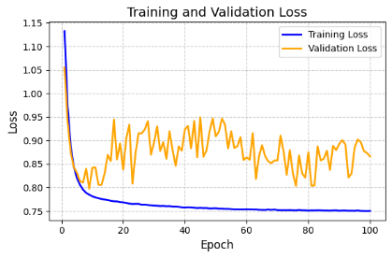
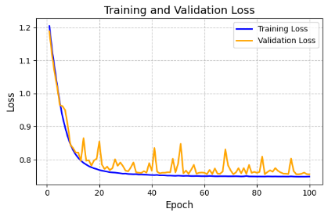
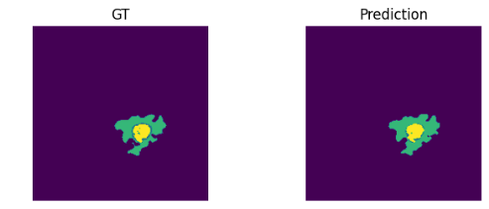

3.2 Problems in Mask Application
Early Fusion Mask
Both from validation and form prediction is visible how using bask in early fusion and in middle fusion base approach, drove to much attention to it.
Middle fusion alternative approach has the best performance.
Middle Fusion Mask 1
Middle Fusion Mask 2
Big Data in Health Care
12 16

Slide 13
3.3 Evaluation
 | Early Fusion | Middle Fusion | Early Fusion Mask | Middle Fusion Mask 1 | Middle Fusion Mask 2
Accuracy | 0.69 | 0.61 | 0.54 | 0.28 | 0.76
IoU | 0.44 | 0.37 | 0.27 | 0.16 | 0.49
Dice (1) | 0.70 | 0.69 | 0.42 | 0.17 | 0.78
Dice (2) | 0.77 | 0.68 | 0.67 | 0.31 | 0.83
Dice (3) | 0.74 | 0.63 | 0.47 | 0.54 | 0.75
Big Data in Health Care
13 16

Slide 14
Outline
Data and Pre-Processing
Model and Results
Problem Solution and Results
Conclusion and Improvements
Conclusion and Possible Improvements
Big Data in Health Care
14 16

Slide 15
4.1 Conclusion and Possible Improvements
Best preforming model was by far UNet Middle Fusion with mask using the second approach, it scored best in every metric.
The obtained results are assumed to be generalizable also for the other two direction (lateral, frontal).
Possible Improvements
Use all the images
Use real data augmentation
Test also late fusion
Use a Dice based loss function
This experiment could be done using UNet 3D.
Big Data in Health Care
15 16

Slide 16
Thanks for the attention! Questions?

