Slide 1

Marketing Analytics –TIDE POWDER
Group 10
Anh Le
Akhilandeshwari Bekkary
Jimit Mehta
Rashmi Savla
Varun Himmatramka

Slide 2
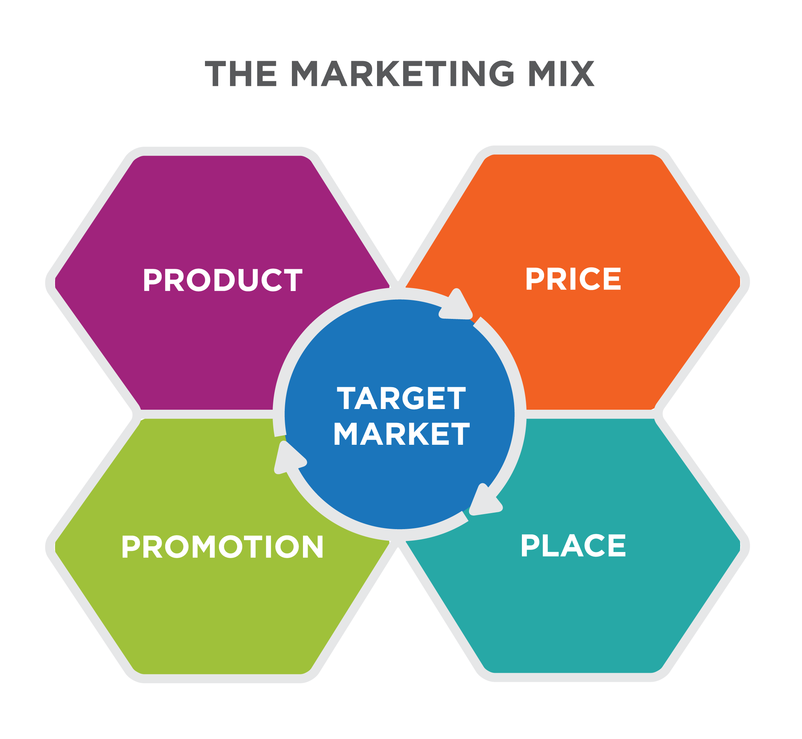

Slide 3


Recommendation 1
Objective 1: What are the market areas where we can increase the market share and how? Does features and display effects the sales of Tide Powder?
Method: Proc Panel (Random one)
Recommendation: We should have features and display for the products where we need to increase sales for based on the package types and flavour.

Slide 4
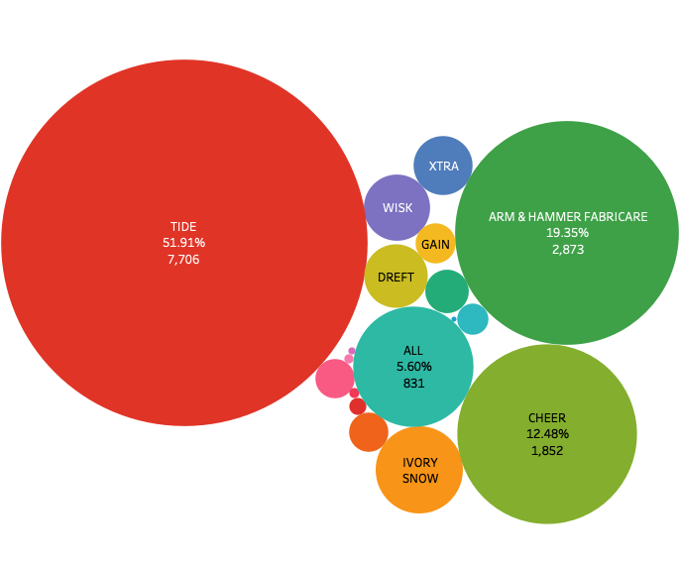
MARKET SHARE OF POWDER LAUNDRY-DETERGENT MARKET: GROCERY STORE
Total spending of customers for laundry products in grocery store is $216,877. For powder only, this number is $14,846 (6.85%).
The Top Five brands are Tide (our brand), Arm & Harmer, Cheer, All, and Ivory Snow.
Approximately, the top five brands above make 92% of US powder market, and our brand Tide already occupied 52% (by units sold).
As the biggest player in the market, we care more about competitors with relatively large shares and will focus more on this group.

Slide 5
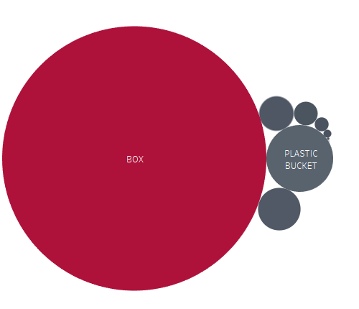
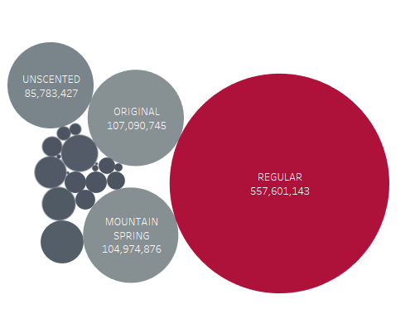
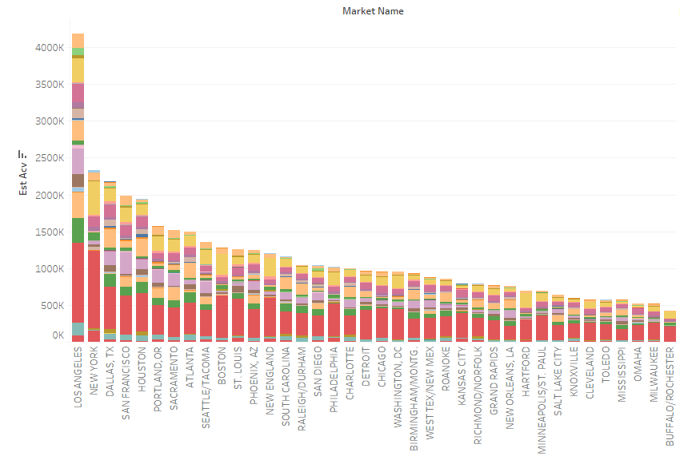
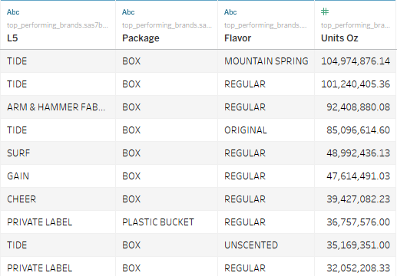
MARKET SHARE

Slide 6
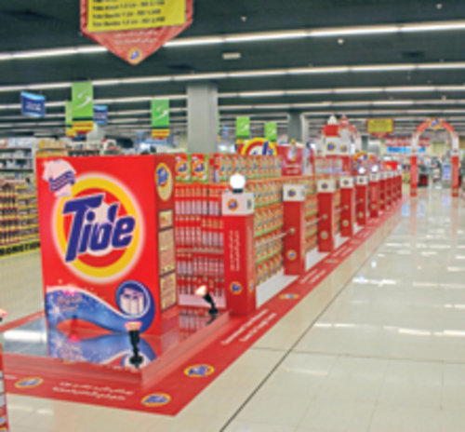
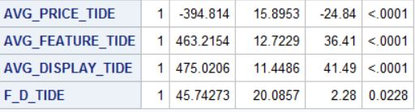
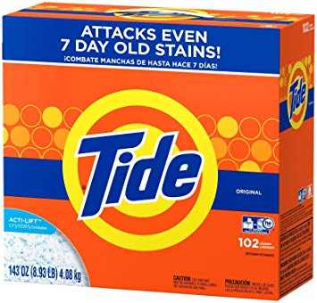
Effects of Features and Display on Sales

Slide 7


Recommendation 2
Questions: What are the demographic factors of top customers with Tide powder, Effect of Price
Method: Mixed Logit Model (PROC MDC), Price Elasticity
Recommendation: Monitor the activities with customers of these types to see any new trend.At the same time, focus direct marketing to other categories ( probably using Loyalty/Monetary model to get more insights on target action).

Slide 8
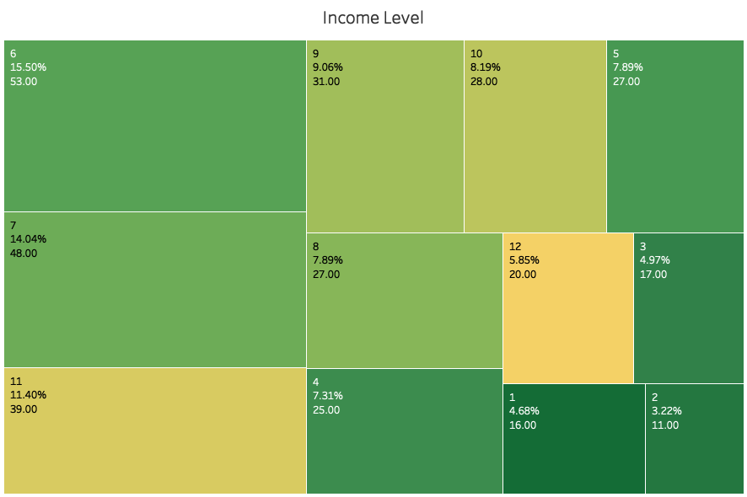
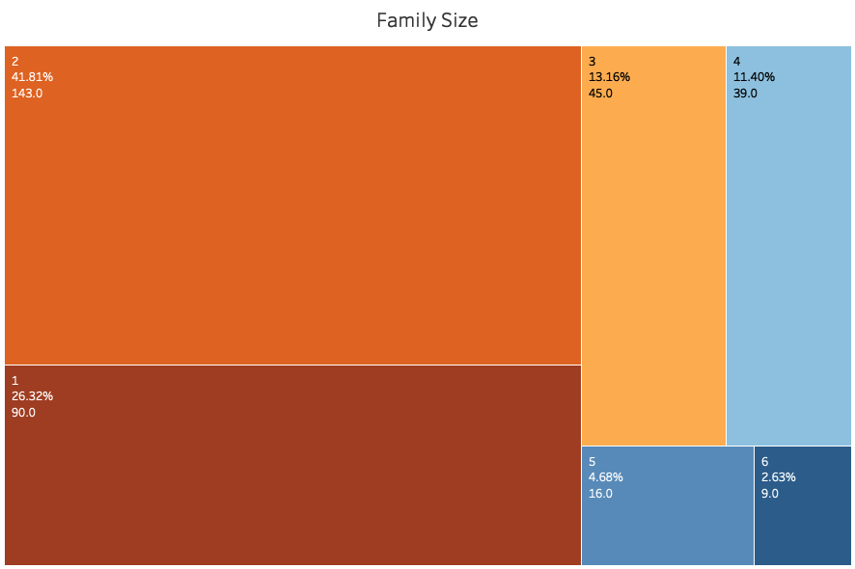
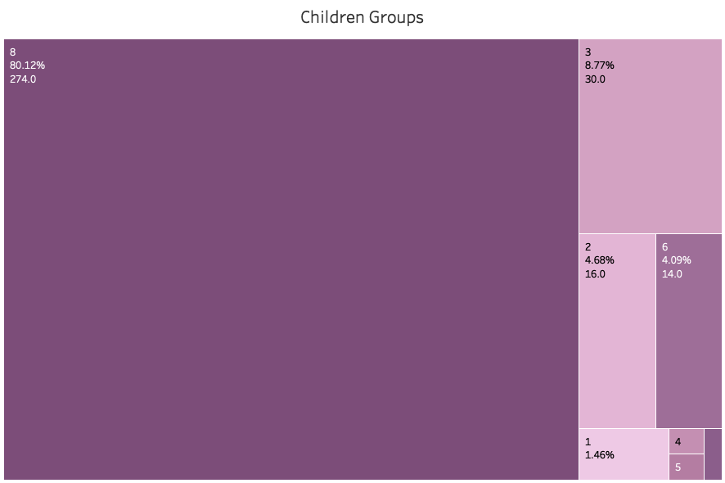
Intuition: Tide Powder’s Top Customers
The top households are identified to be a couple(2), have low income (6) ( $25000- $34999 per year), and have no children(8).
Respectively, kid groups 8, income level 6 and family size 2 have 80%, 16% and 42% of total units consumed.

Slide 9


Market Sensitivity to Price and Promotion
Lower chance of the chosen brand
Among the characteristics of the products, only Price and Promotion was backed with enough evidences to draw inferences.
The directions of the effect makes sense in macro economics. On demand curve, as price increases, the demand quantity decreases.
The own and cross elasticity will capture the magnitude of these impacts on choice probability.
Price goes up
Promotion is used (feature +display)

Slide 10


How Sensitive Are Customers To Price Adjustment From Tide And Other Brands ?
When Tide adjust its average price 1% higher, the probability that customers choose our brand lowers by 0.94%.
When other brands increase their avg price by 1 %, there is a higher chance by 2.69% that the customers will choose our brand.
Tide Action
0.94%
Competitor’ Action
2.69%

Slide 11

How Sensitive Are Customers To Promotion Adjustment From Tide Vs Other Brands ?
When our brand adds 1% more of average promotion to products, the likelihood of selection goes down by 3.94%.
When other brands add 1% more of average promotion to their products, our brand earns a higher of chance of being chosen by 0.21%.
Tide Action
0.21%
Competitor’ Action
3.94%

Slide 12

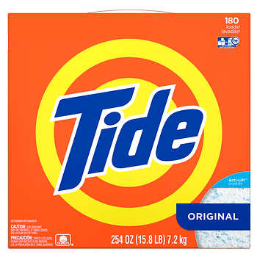
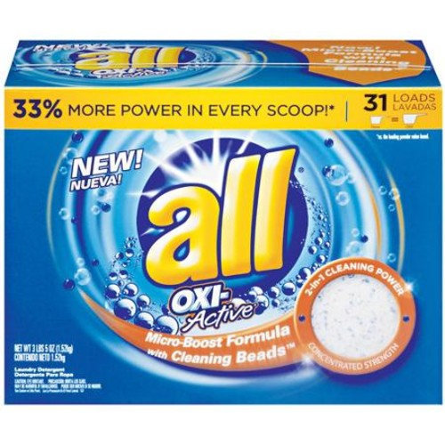

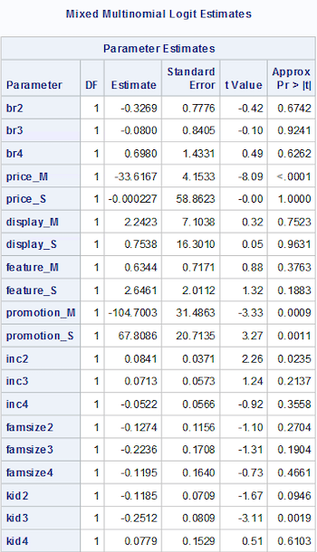
Evidences of Top Demographic Traits: Income
VS
Under demographic factors, a salary jump will pick up the likelihood of choosing Cheer over Tide, All, and Ivory Snow.
This has shown Tide not being preferred by high income family, which gives some evidence to the idea that low-income households are truly the Tide’s top customers.

Slide 13
Evidences of Demographic Traits: Kids
VS
A higher level of “children group code” decrease the chance of All to be chosen over Tide, Cheer, and Ivory Snow.
Level 8 under “children group code”, however, belong with Tide’s top families. Therefore, its higher chance of selection over All somehow confirmed that a majority of Tide’s top households has no kids.

Slide 14


Recommendation 3
Objective 3: Which customers do we need to target for Tide powder?
Method: Loyalty Monetary Model
Recommendations :
Target households with 2/3 Members in Family , who have no children or may be one child

Slide 15
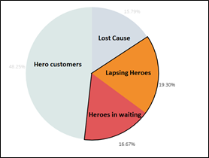

CUSTOMER LOYALTY FOR TIDE POWDER

Slide 16
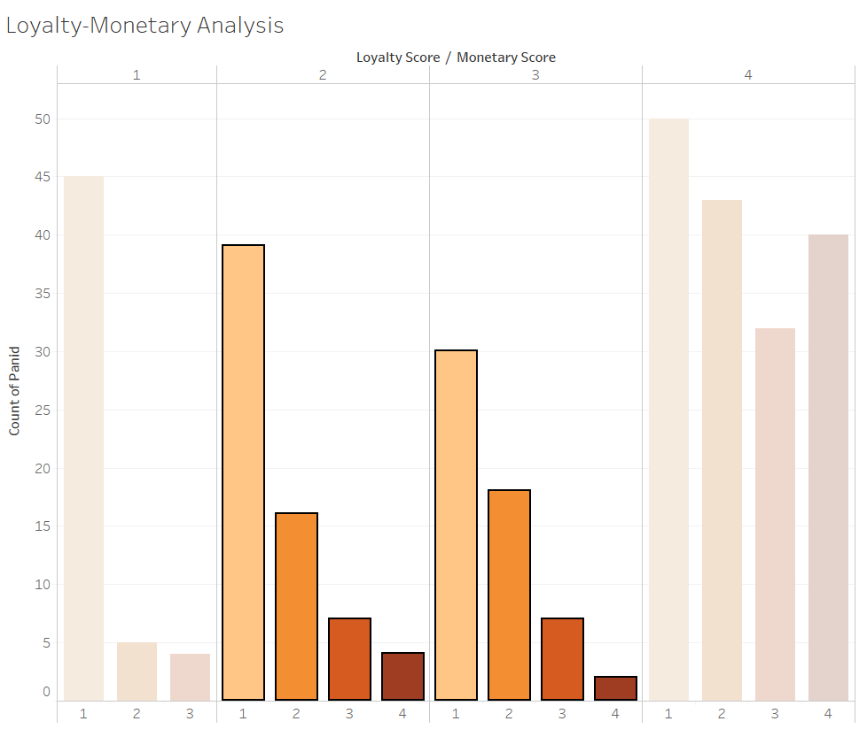
MONETORY VALUE

Slide 17
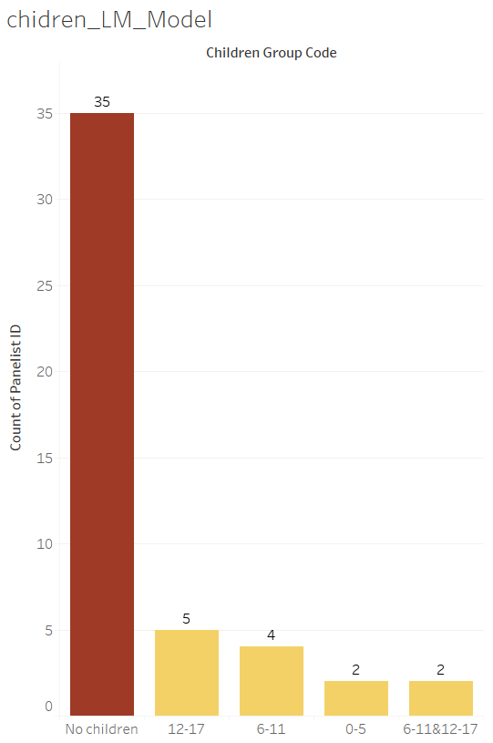
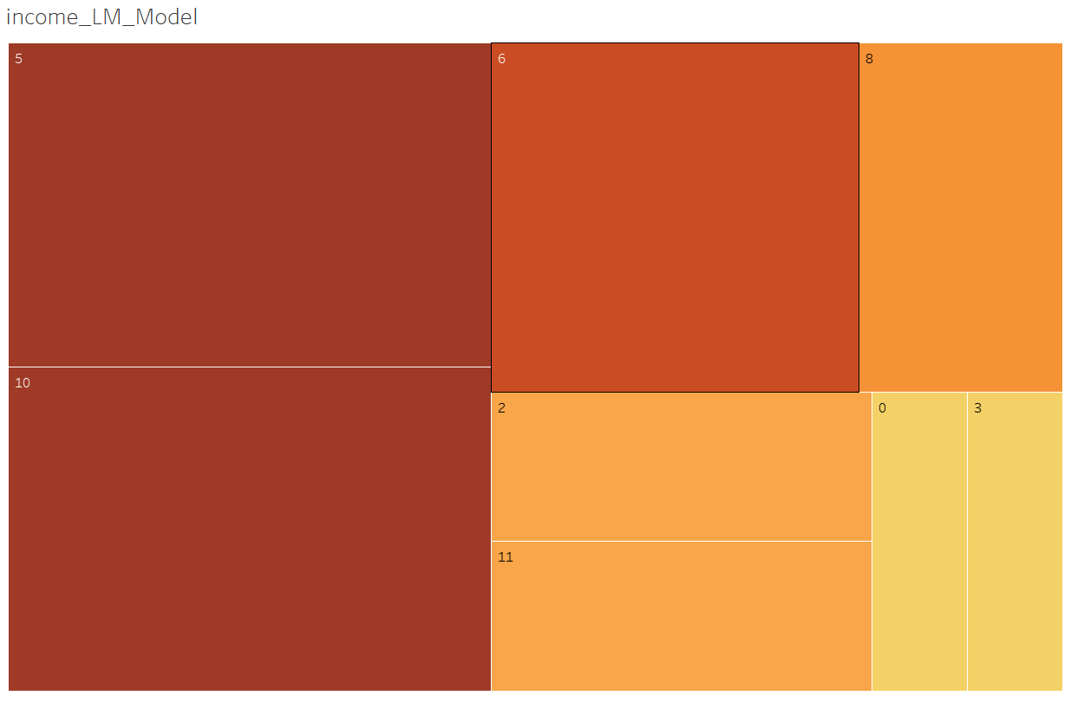
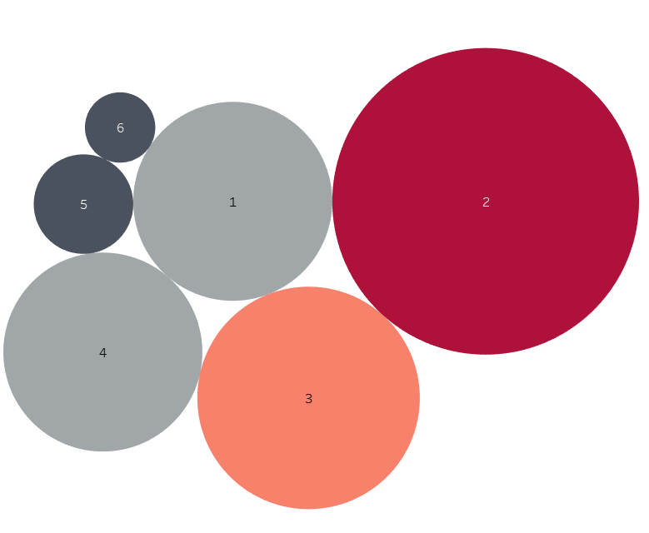
DEMOGRAPHIC ANALYSIS
INCOME
CHILDREN
FAMILY SIZE

Slide 18


