Slide 1
Robot HAT Hardware
Components
Raspberry Pi 5
↕
How the Robot HAT expands Raspberry Pi 5 for robotics and PiDog V2
Robot HAT
→ motors • servos • sensors • audio • power
Viktoriya Kurmisheva, Elham Timory
ITAI 2374 • Prof. Sitaram Ayyagari

Slide 2
What the Robot HAT Does
The Robot HAT gives the Raspberry Pi more control over real hardware used in robotics.
Raspberry Pi 5
processing
Robot HAT
connections + control
Robot Hardware
movement + sensing
→
→
Connects motors, servos, sensors, audio, communication devices, and battery power.
Supports robotic movement through motor control and PWM servo control.
Helps PiDog V2 connect software decisions with physical actions.
Reference: SunFounder, “Robot HAT.”
Robot HAT Hardware Components | 2

Slide 3
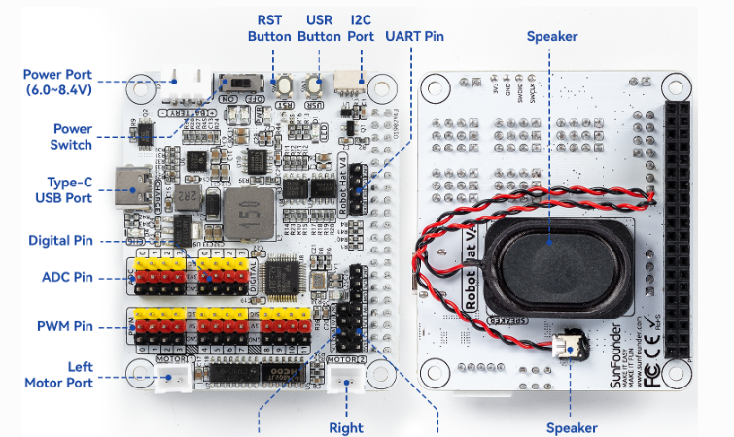
Main Robot HAT Ports and Connectors
The official board diagram highlights the ports students need to understand:
Power port and Type-C USB port
Digital pins and ADC pins
PWM pins for servo control
Left and right motor ports
I²C, UART, and SPI expansion interfaces
Speaker, buttons, and status features
Reference: SunFounder, “Robot HAT.”
Robot HAT Hardware Components | 3

Slide 4
Key Components and Uses
Motor driver
Controls DC motors with direction and PWM signals.
PWM servo ports
Handle PiDog leg, head, and tail servo movement.
ADC + digital pins
Read analog sensor values and support ultrasonic sensing.
I²C / UART / SPI
Communication interfaces for sensors and modules.
Power + audio + LEDs
Battery integration, I2S audio, speaker, power indicators, and user LED.
References: SunFounder, “Robot HAT”; SunFounder, “PiDog.”
Robot HAT Hardware Components | 4

Slide 5
PiDog V2 Example: From Sensor to Movement
This example shows how PiDog’s sensors, Raspberry Pi, Robot HAT, and servos work together.
Camera Module
Color / Face Detection
Raspberry Pi 5
Processes Distance + Vision
PiDog Sensors
Ultrasonic • Touch • IMU
Robot HAT
Connects Sensors + Controls Servos
PWM Servos
Leg / Head / Tail Movement
PiDog Response
Movement Changes / Obstacle Avoided
Example: ultrasonic sensor detects an object → Raspberry Pi processes the distance → Raspberry Pi sends a command through the Robot HAT → servos change PiDog’s movement.
Reference: SunFounder, “PiDog.”
Robot HAT Hardware Components | 5

Slide 6
Practical Considerations
Power
Wiring
Compatibility
Motors and servos can draw a large amount of current, so the robot needs a stable battery and secure power connections.
Sensors, motors, and communication devices need the correct ports because incorrect wiring can prevent the robot from working.
PiDog V2 updates the Robot HAT and servo configuration to support Raspberry Pi 5.
Conclusion
The Robot HAT expands Raspberry Pi 5 by adding the hardware control needed for sensing, movement, audio, power, and robotics projects.
References: SunFounder, “Robot HAT”; SunFounder, “PiDog.”
Robot HAT Hardware Components | 6

Slide 7
References
draw.io. “Flowchart Maker & Online Diagram Software.” App.Diagrams.Net, 2025, https://app.diagrams.net/.
“Hardware Introduction — SunFounder Robot HAT Documentation.” Sunfounder.Com, 2026, https://docs.sunfounder.com/projects/robot-hat/en/latest/hardware_introduction.html.
“SunFounder Raspberry Pi Robot - PiDog — SunFounder PiDog Kit 1.0 Documentation.” Sunfounder.Com, 2026, https://docs.sunfounder.com/projects/pidog/en/latest/
Robot HAT Hardware Components | 7

