Slide 1
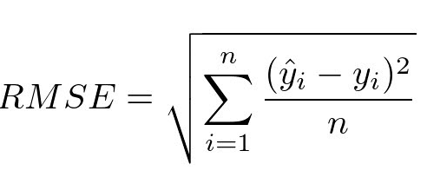
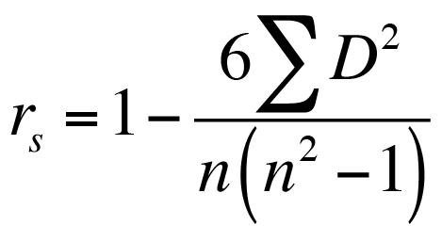
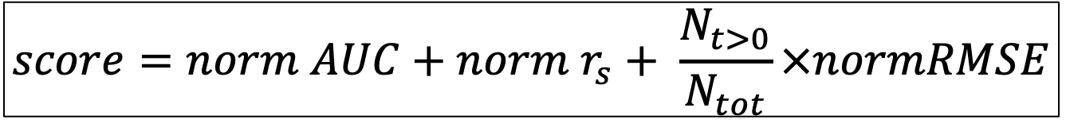
Metrics used for the evaluation of the benchmarking results
For tumor fractions > 0
For all tumor fractions (including 0)
For tools classification performance (presence/absence of tumor)
AUC-ROC score (TPR vs FPR)
$$score=norm AUC+norm r_{s}+ \frac{N_{t>0}}{N_{tot}}×normRMSE$$
Notes:
https://biodatamining.biomedcentral.com/articles/10.1186/s13040-023-00322-4
Rank fusion algorithm

Slide 2
Potential Figure 2 (after summary Figure 1)
Score
Performance
Per metric
Per DMR tool
Per fraction
0
.2
.4
.6
.8
1

Slide 3
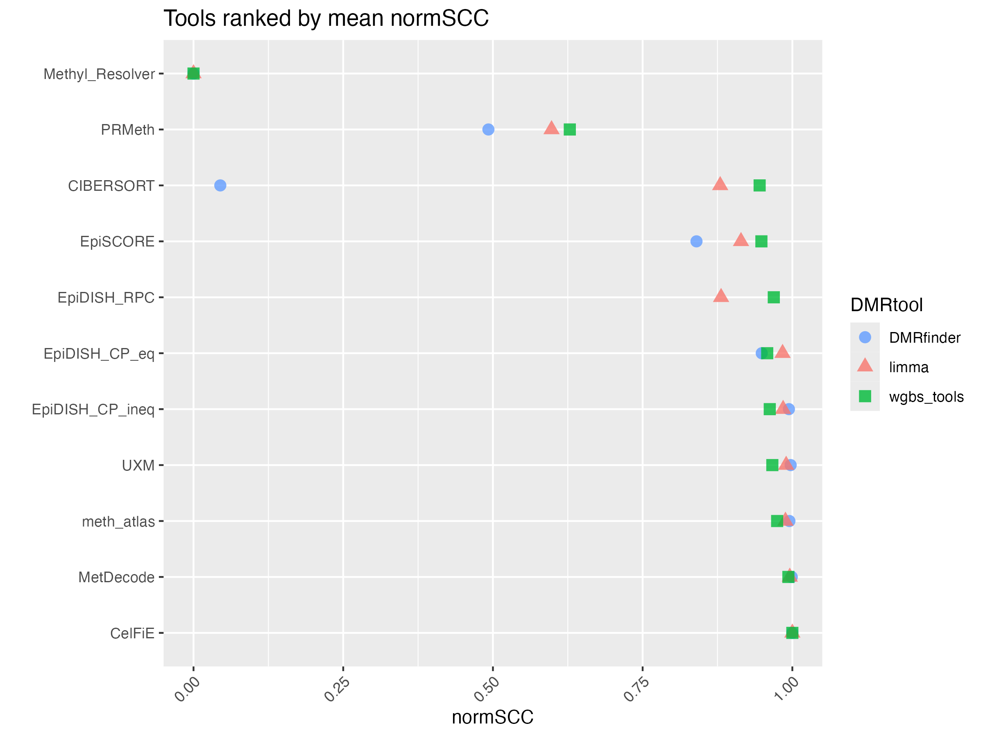
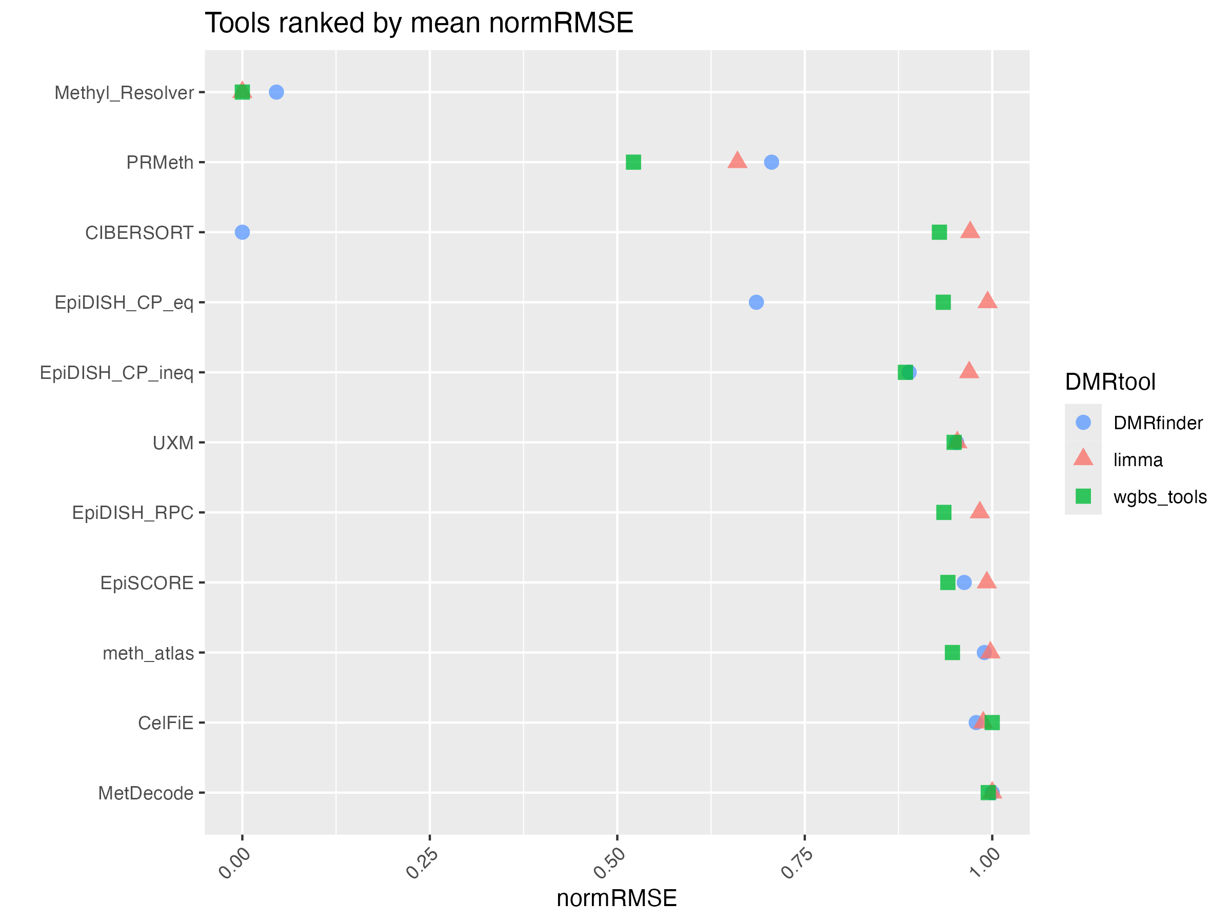
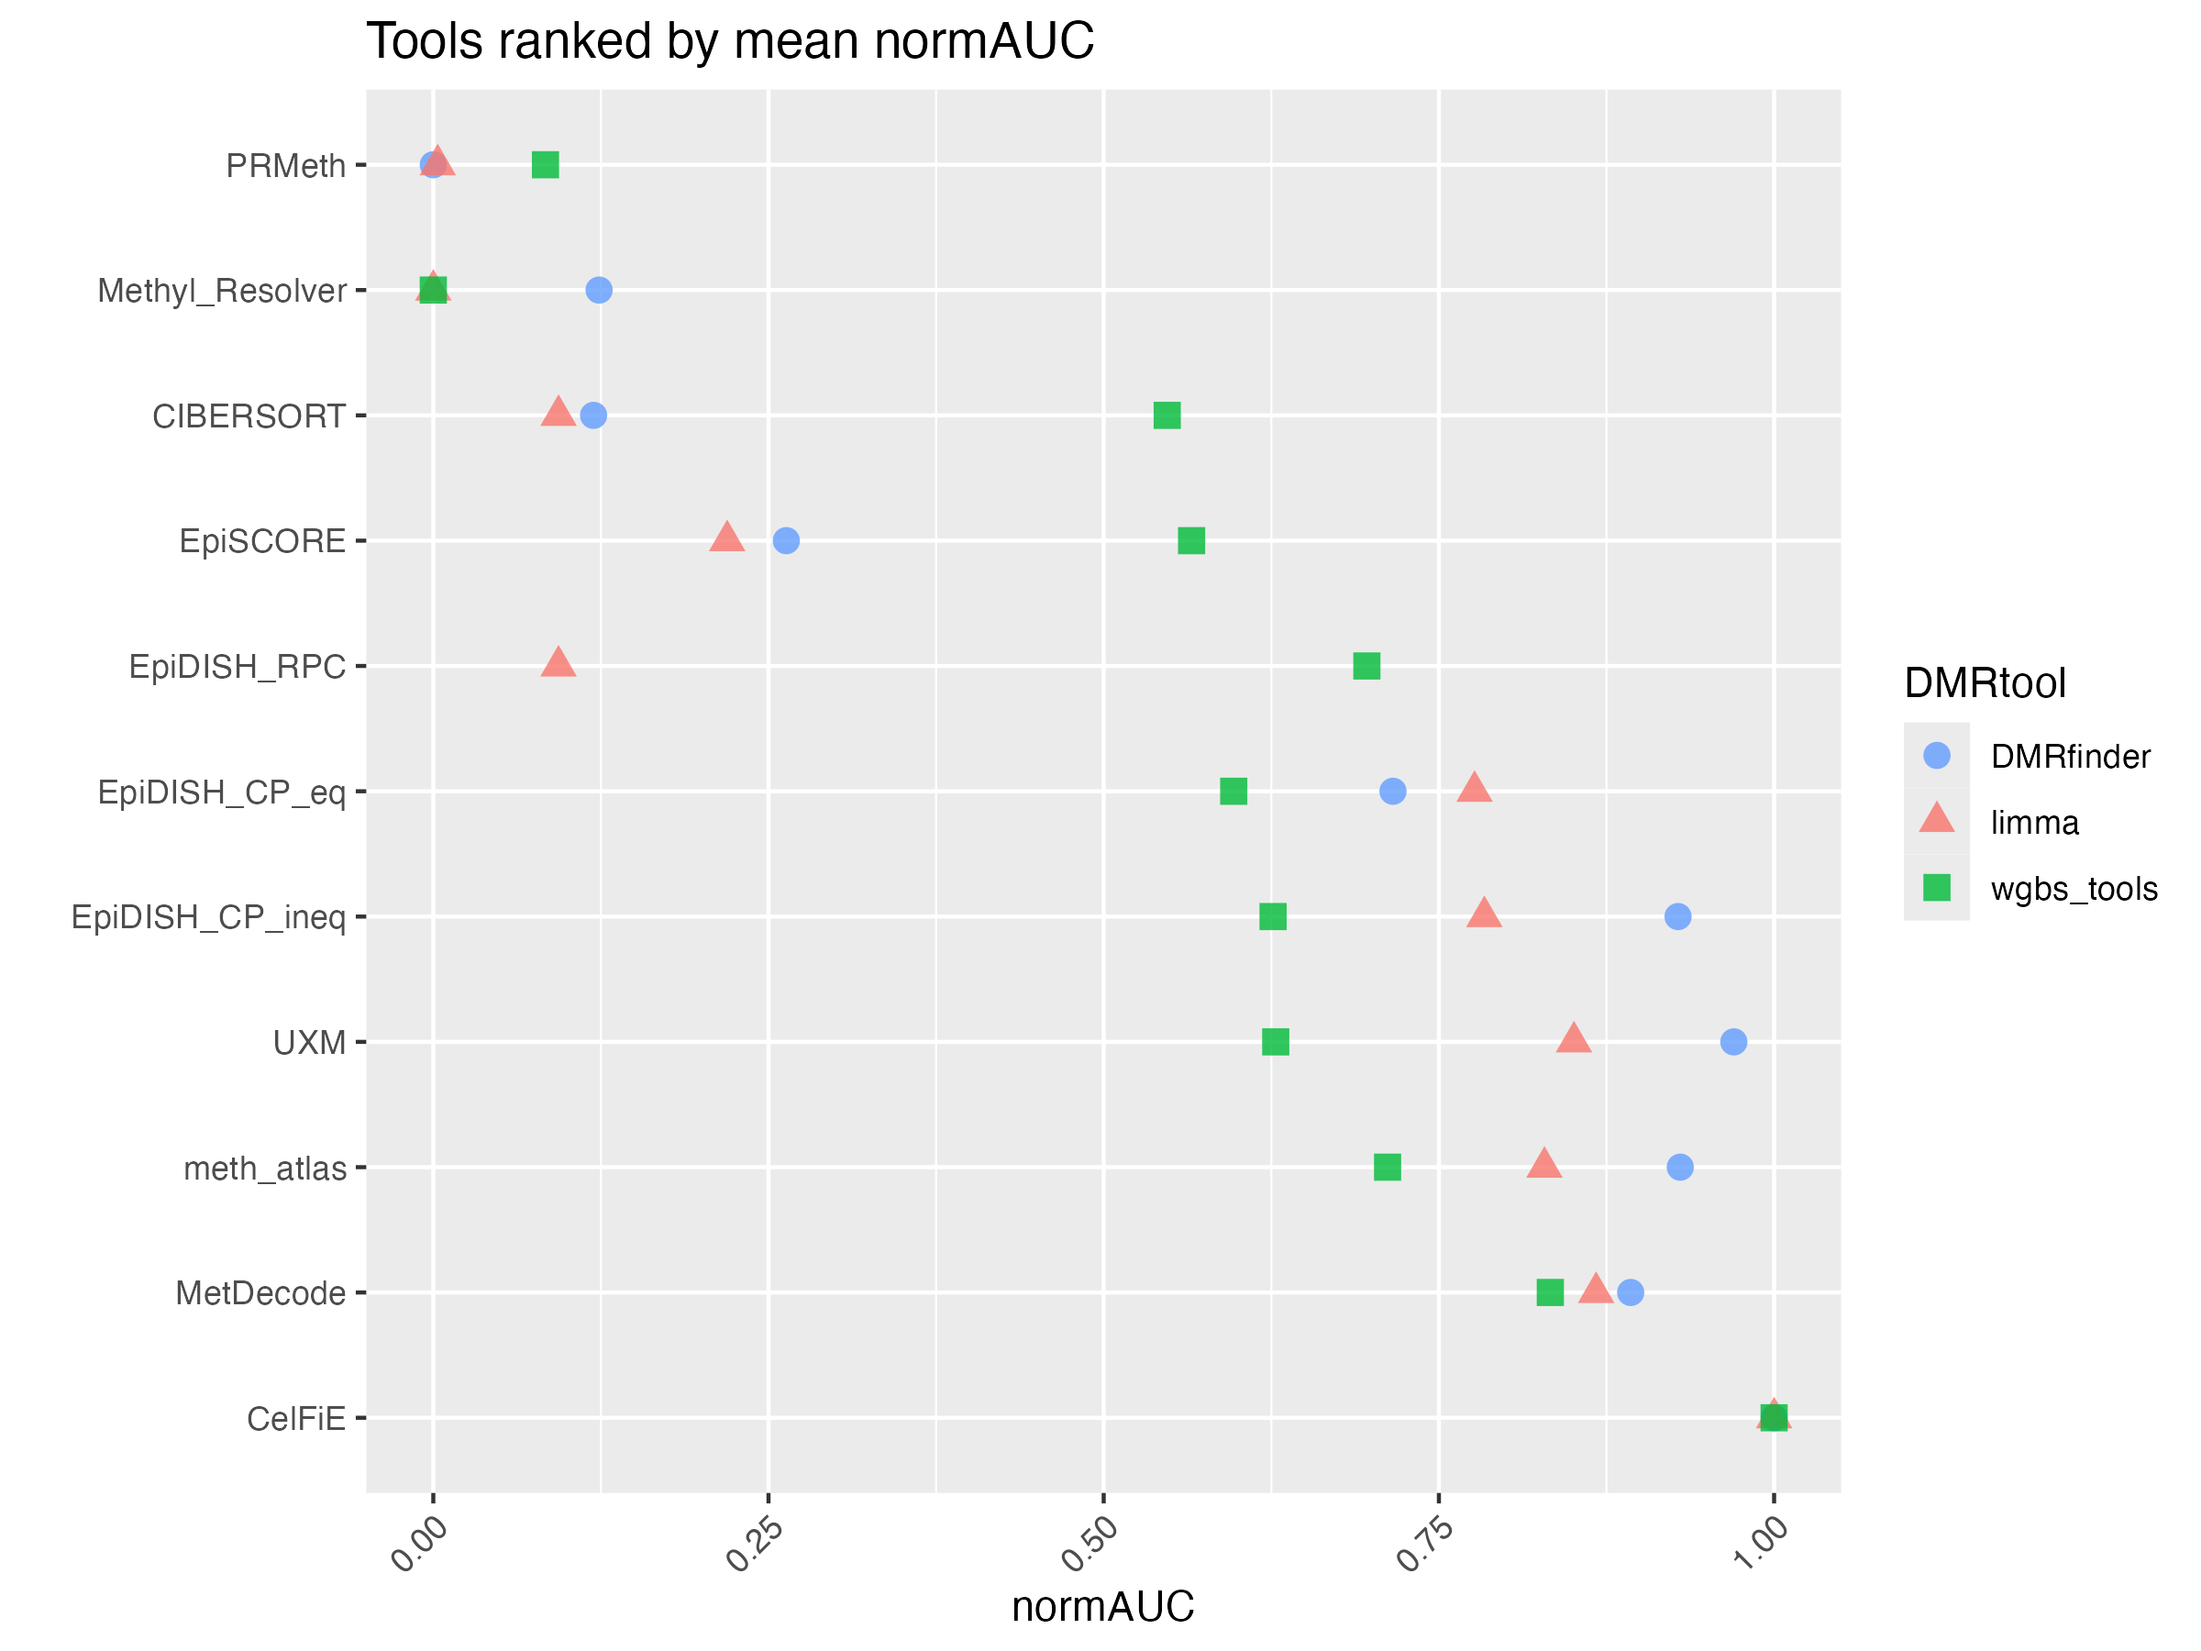
Potential Figure 3
SCC
RMSE
Mean AUC

Slide 4
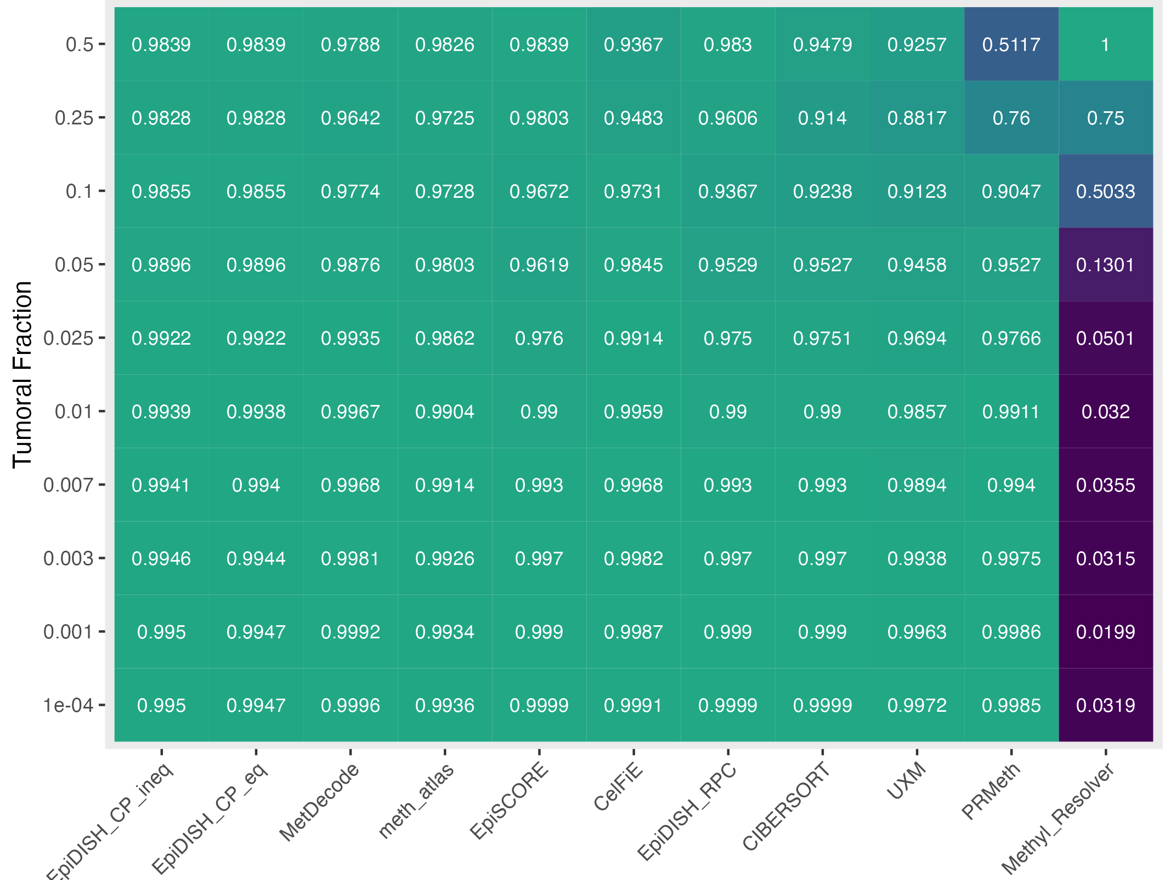
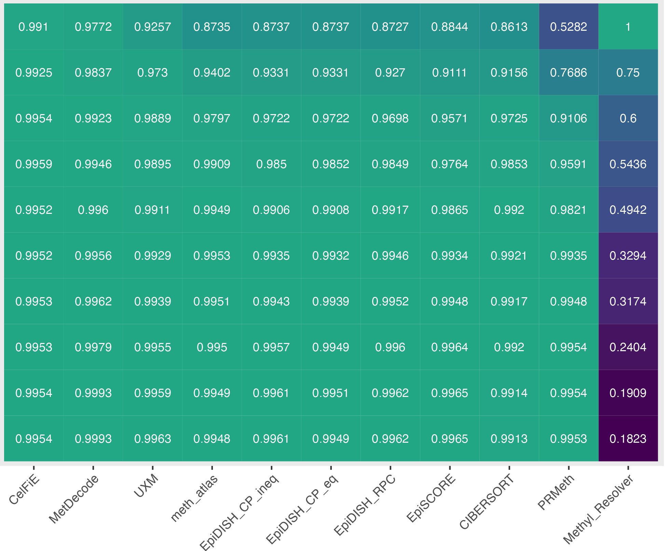
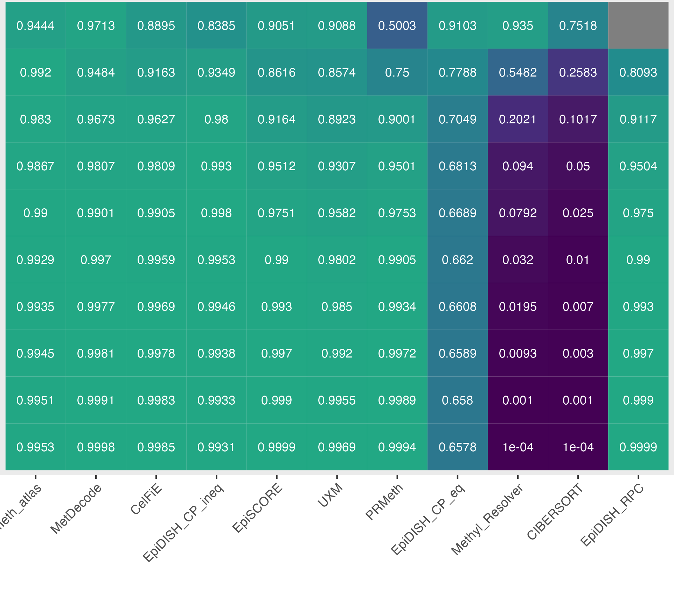
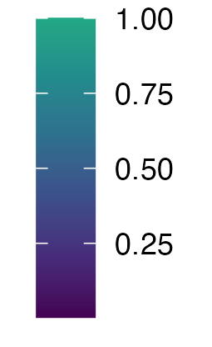
Potential Figure 4
limma
wgbs_tools
DMRfinder
1-RMSE

Slide 5
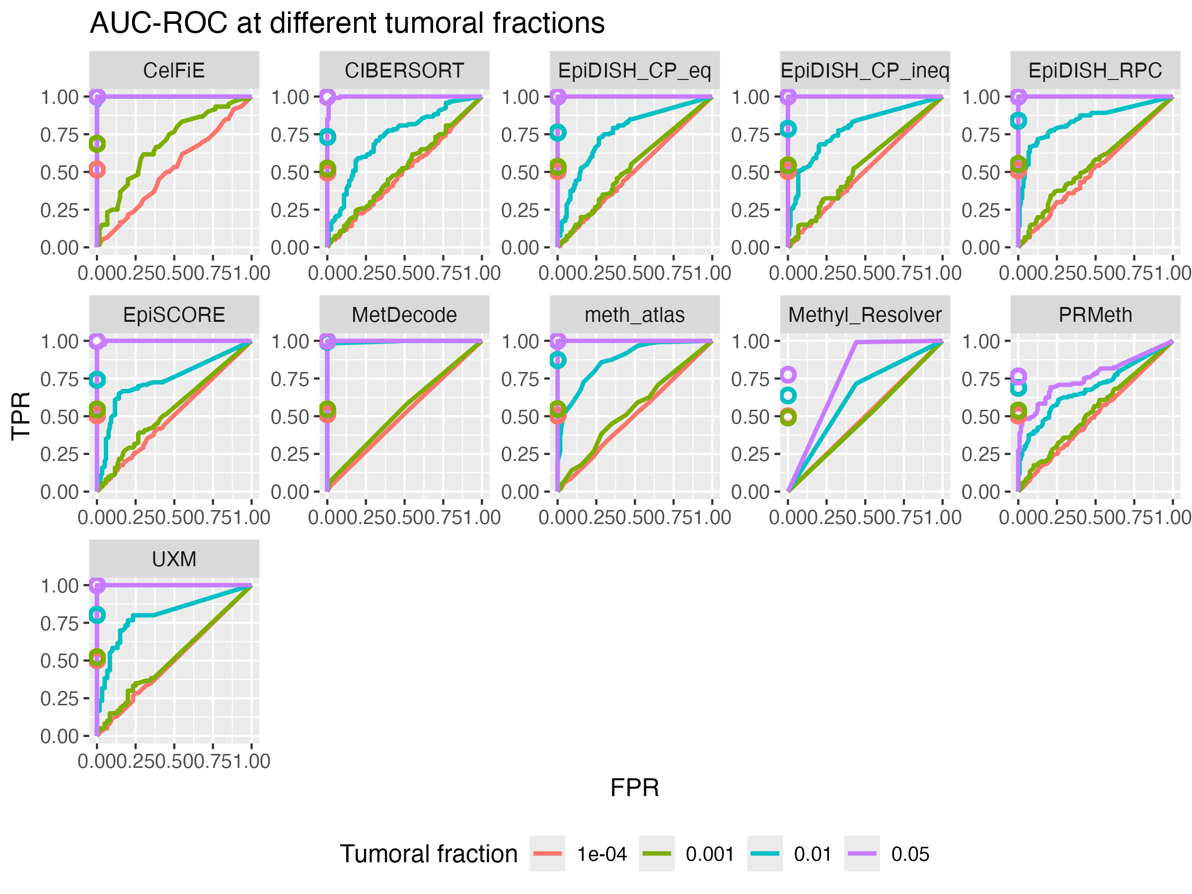
Potential Figure 5 (performance in classification, wgbstools)
AUC

Slide 6
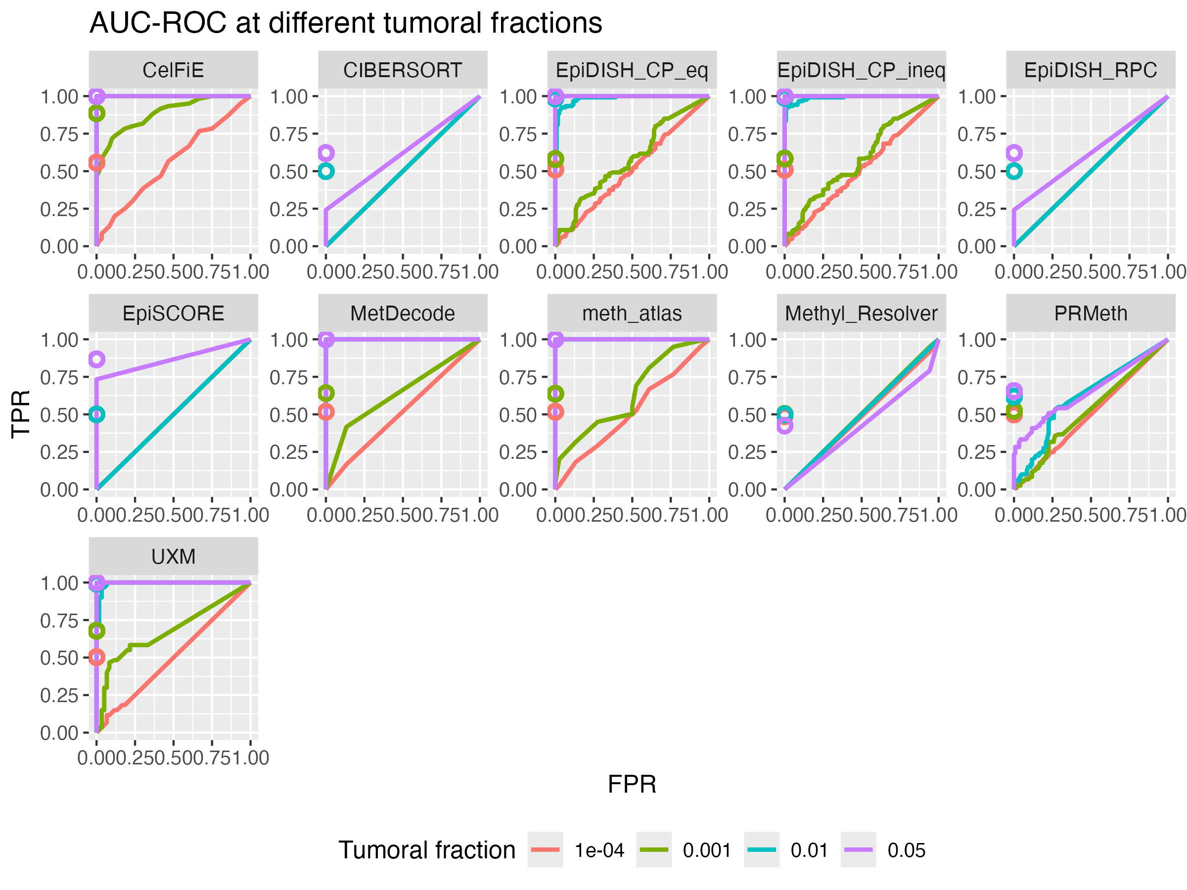
Potential Figure 5 (performance in classification, limma)
AUC

Slide 7
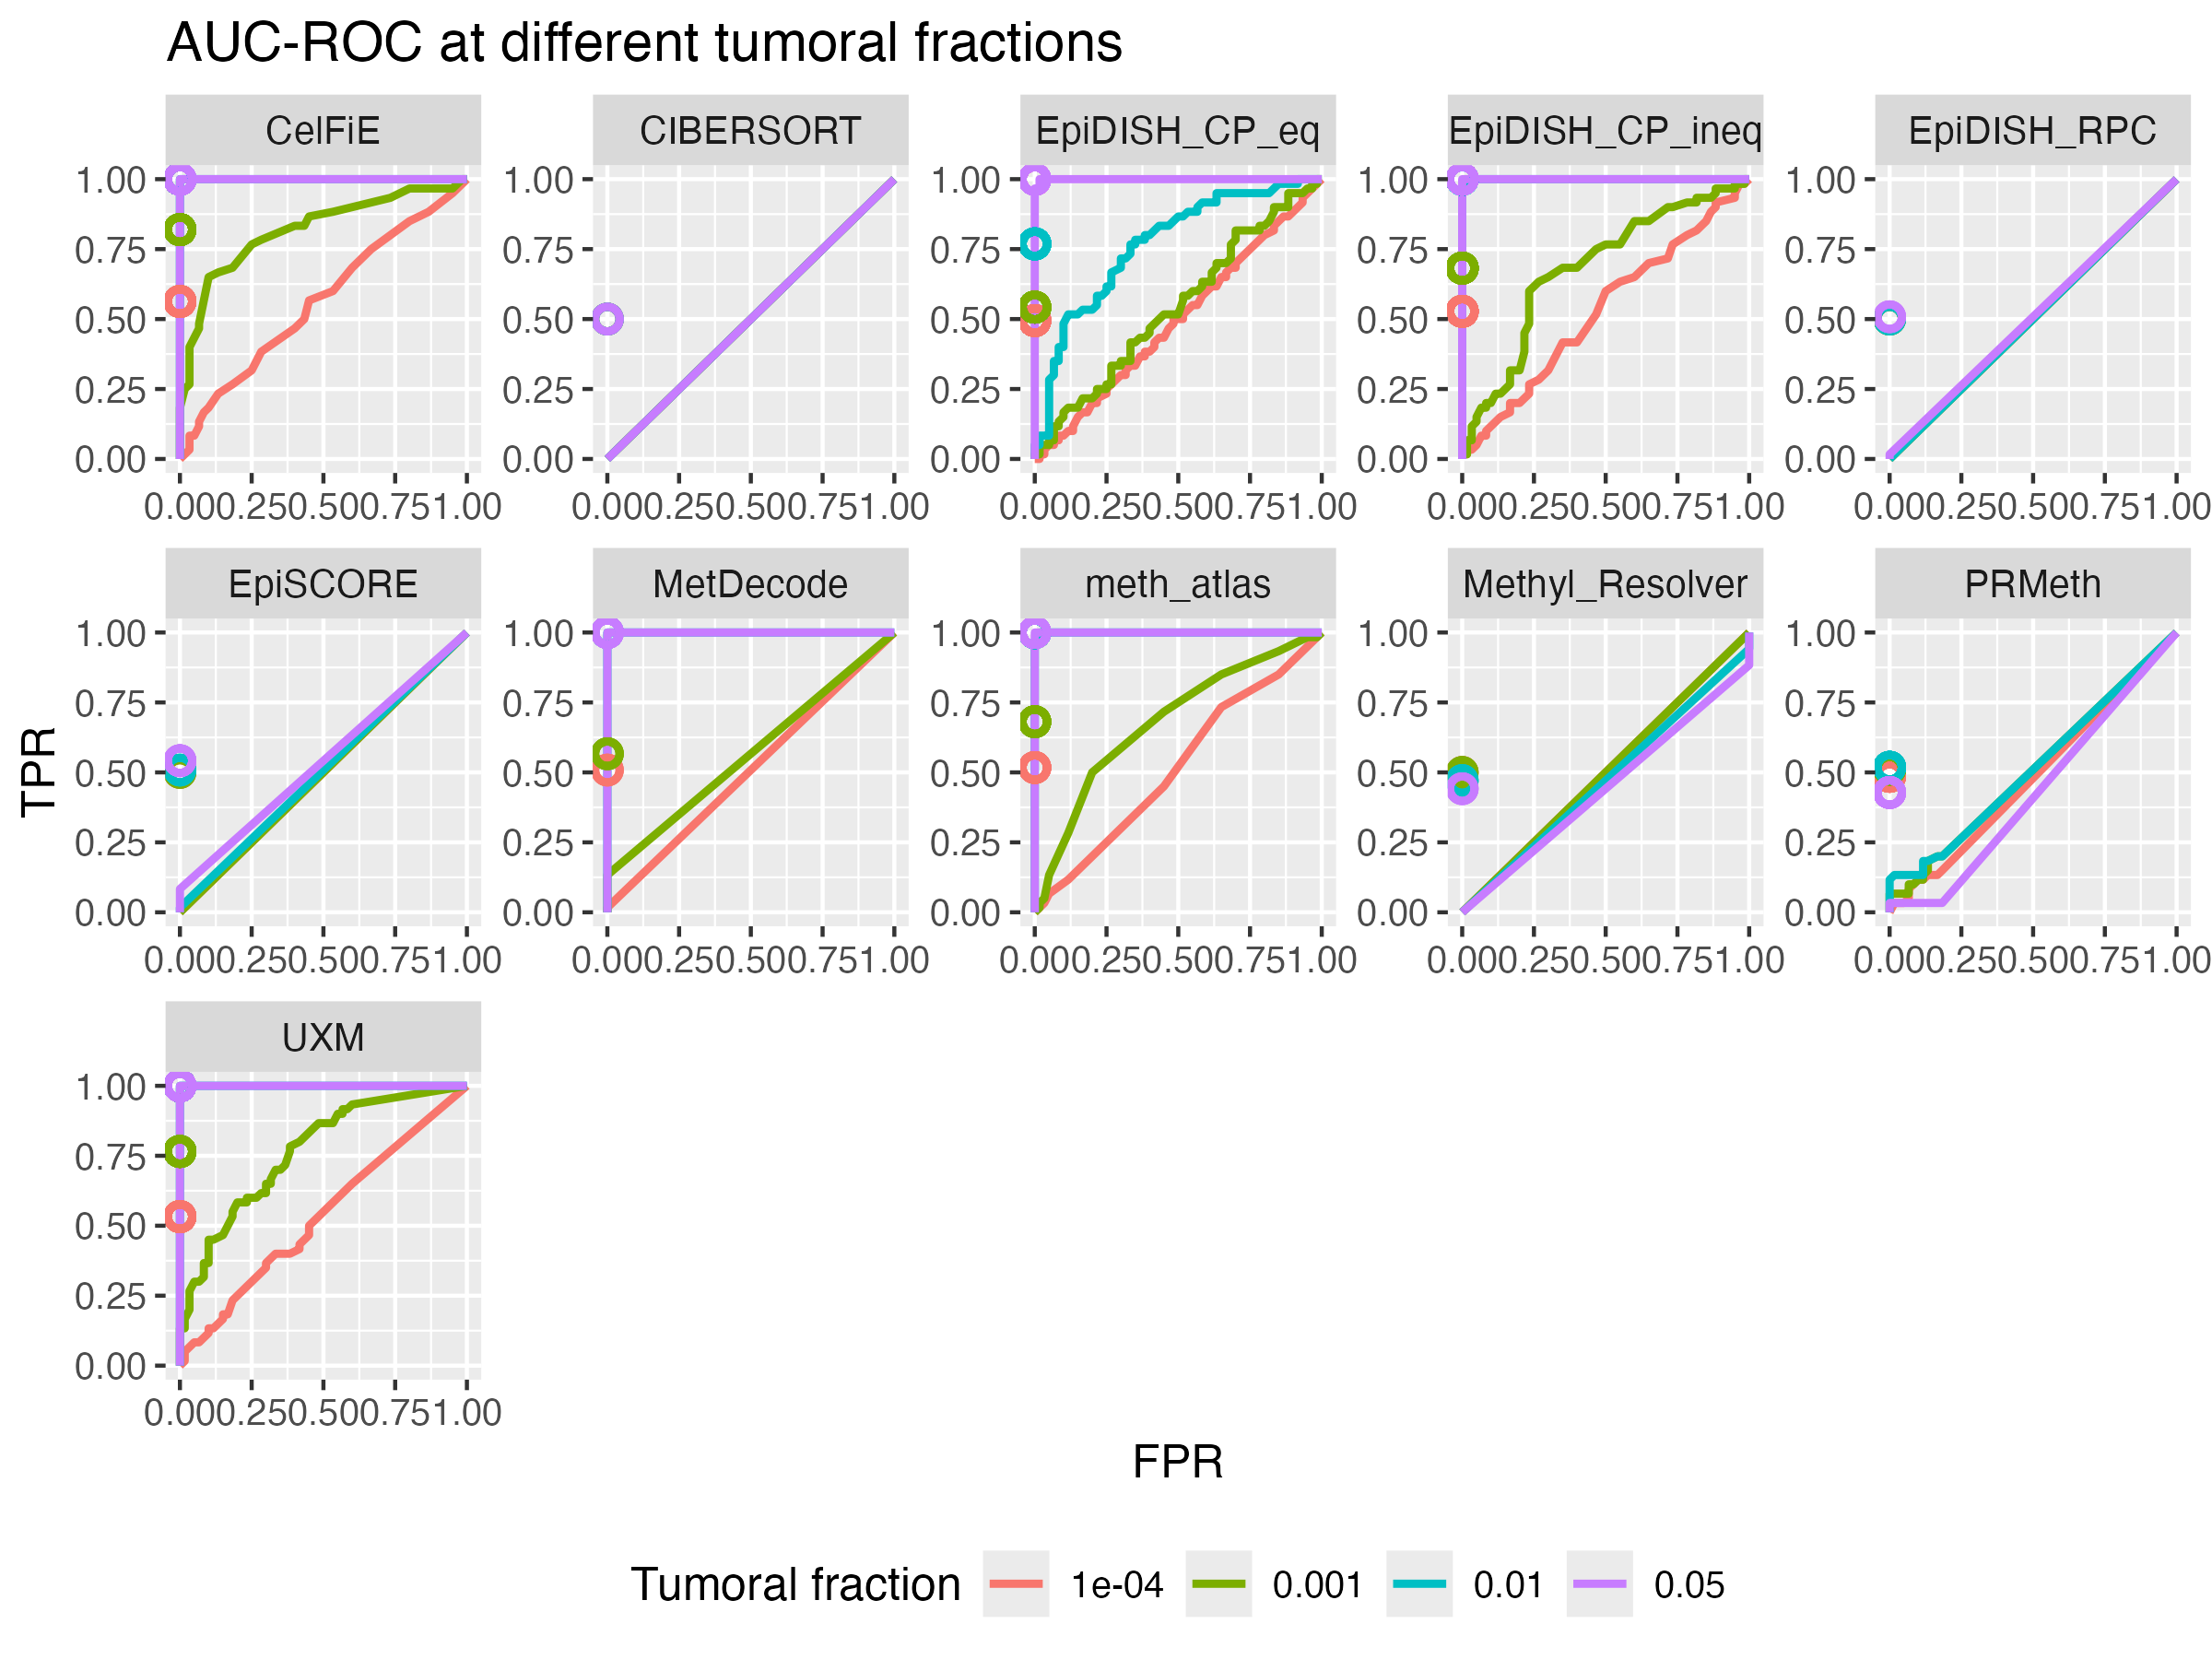
Potential Figure 5 (performance in classification, DMRfinder)
AUC

Slide 8
Potential Figure 6 (performances across the different datasets)

Slide 9
Potential Figure 7 (robustness at lower sequencing depth)

Slide 10
Potential Figure 8: performance on our case study (in-vitro mixtures)

Slide 11
Potential Figure 8 (scalability of the tools: time, RAM, CPUs)

Slide 12
Questions
How do we want to perform in-silico mixtures of public datasets?
Do we take fixed tumor fractions with replicates?
Do we take fixed tumor fractions with replicates sampled from a normal distribution? (e.g. we fix 1%, then we sample replicates from a normal distribution with mean 1% and sd +/- 0.01)
Do we sample tumor fractions from a uniform distribution without replicates? (in this case we would better simulate the actual samples but without replicates can be complicated to assess robustness etc)

