Slide 1

Name
Education
Ph.D. Candidate in Applied & Computational Mathematics and Statistics department, University of Notre Dame (U.S.)
Vicky R. Zhu
Intern Group
Pharmaceuticals Division
Dept.: BDSD/DSS, Berkeley
Advisor: Shyam Panjwani, Hao Wei, and Kostas Spetsieris
Email:
Vicky.zhu@bayer.com
Vicky Zhu (vickcul.github.io)
Notes:
3rd year.

Slide 2



Evaluation of Dynamic Partial Least Square Method
/// August 25th ///
Vicky Zhu
Advisors:
Shyam Panjwani
Hao Wei
Kostas Spetsieris

Slide 3




Outlines
Objectives
Background and Literature
Projection Method: Partial Least Squared (PLS) and Dynamical PLS methods
Papers: different dynamical PLS scheme
Evaluate novel dynamical PLS Algorithm
3 Case Studies on synthetic data
Method Comparisons
Conclusion and Future Research
DiPLS algorithm can recover PLS and has better results
Batch Statistical Control Process (BEM and BLM)
Applied to real data

Slide 4
Objective

Slide 5
Overview
Objective: understand projection methods (PLS, dynamical PLS) and evaluate them with synthetic data
Projection Methods for Megavariate data analysis:
Higher-dimension (>3D) lower-dimension (a line, a plane, sphere)
PLS: regression prediction problem
Main idea: original variable is a linear combination of new (latent) variables s.t. the covariance between latent variables is maximized.
Problems & Challenges:
PLS only consider static relationship between inputs and outputs, left large covariance unmodeled.
Commonly see dynamical relationship in reality
If adding time components:
Understand the traditional PLS approach with some add-on to handle the dynamical parts: neural network framework, transformation filter, etc.
Understand batch statistical process control approach such as batch evolution modeling (BEM) and batch level modeling (BLM)
Specifically, implement the dynamical-inner PLS algorithm with consistent inner and outer relation in Jupyter Notebook
Notes:
Take out the BEM part, and wait until the future work part to introduce

Slide 6
Basic Concept For this Project

Slide 7
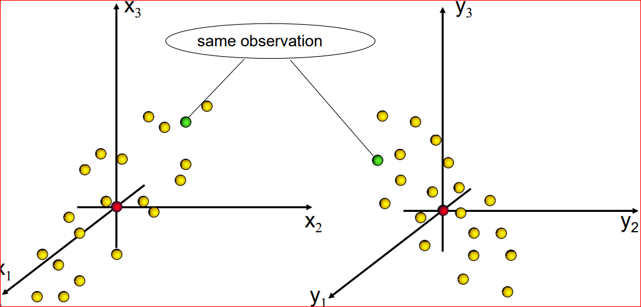
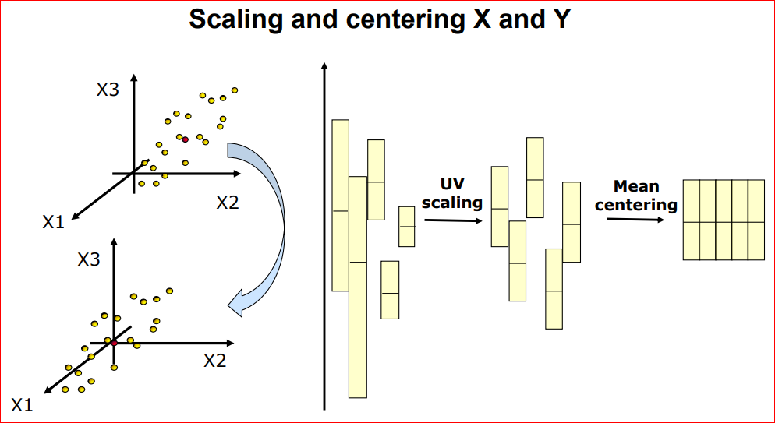
Partial Least Squared (PLS):
Each observation is represented by 2 points, one in the X space and one in the Y space
Scale data: mean zero and unit variance scheme

Slide 8
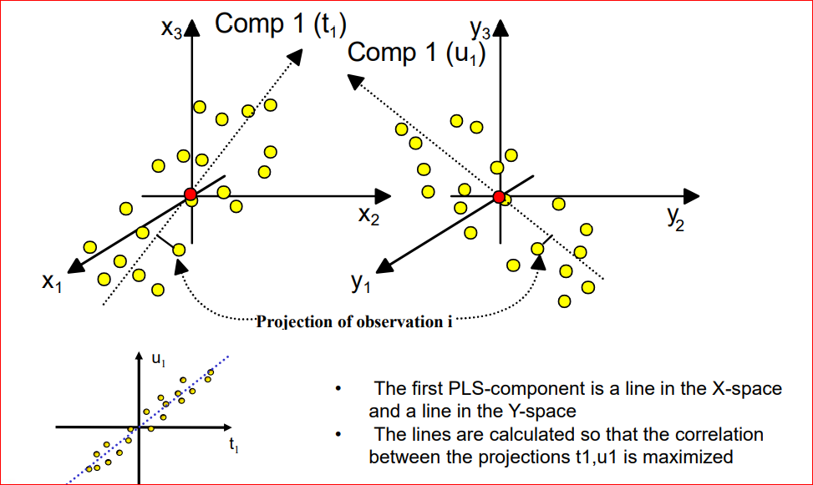
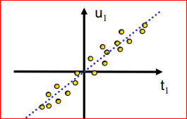
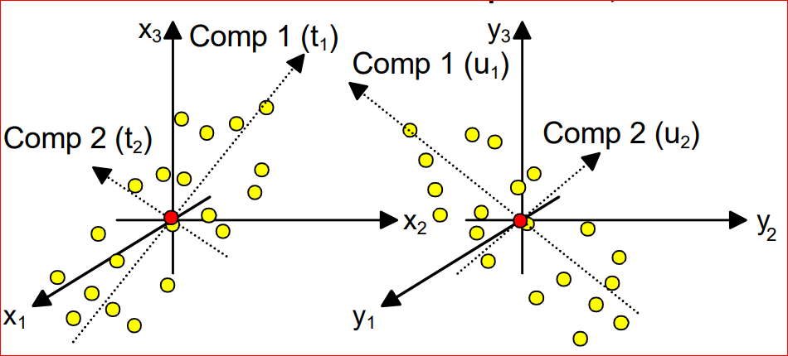
Partial Least Squared (PLS):
Component constructions
• The first PLS-component is a line in the X-space and a line in the Y-space
Lines that maximize Corr(ti,ui)
• The second PLS component is represented
by lines in the X- and Y-spaces such that
X-lines are orthogonal (not true for Y-lines).

Slide 9
Partial Least Squared (PLS):
Outer and inner modeling:
Outer modeling: get latent variable t and u by decomposition
from the scaled data input, X and Y.
t = Xw
u = Yq w and q is the weighted vectors (eigenvectors).
T = [t1 t2 … ] and U = [u1 u2 …]
Inner modeling: get relationship between u and t.
u = bt + r
Linear static relationship between latent variables,
b is the coefficients and r is the residuals.
Notes:
Consistent using ”relationship” and “model”

Slide 10
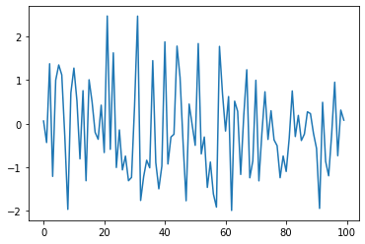
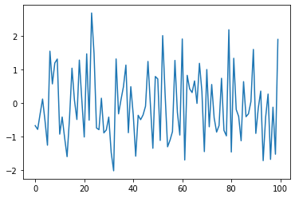
My work focus on dynamical PLS approach:
PLS + Dynamical Method
1. It is a direct extension of already well established PLS, so intuitive to understand.
2. Dynamical PLS can completely recover PLS, easier to modify.
3. Dynamical PLS algorithm has a broader impact in compared to other approach.
(i.e. some batch statistical process does not focus on prediction, the goal is to determine good/bad batches)
4. This supervised machine learning algorithm has relatively easier interpretation base on the data input type.
Which one is generated from dynamical process?
y
y
trial #
trial #
Notes:
interpretation? In a simple way, loading, score plots as in compare

Slide 11
Literature on Dynamical PLS

Slide 12
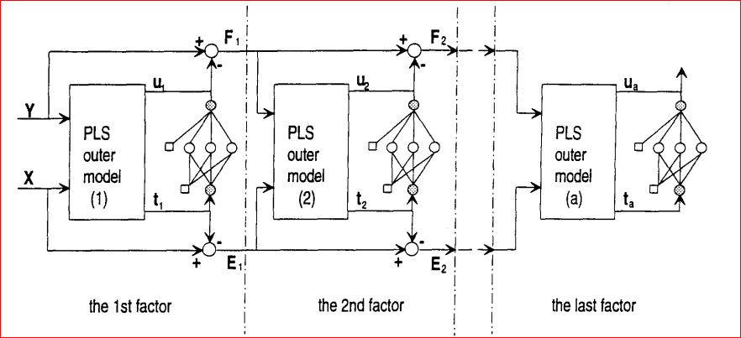
Nonlinear finite impulse response (NFIR) modeling via neural net PLS
Qin and McAvoy paper, 1995
Task: handle nonlinear process with input collinearity data
Method: integration of Neural networks with PLS to tackle
Outer Modeling: same as PLS projection to calculate the latent variables.
Inner Modeling: using neural networks.
Advantage: straightforward method such that inner model can capture nonlinear relationship.
Disadvantage:
Does not give explicit representation of the dynamic relationship, so it is difficult to interpret.
Computation expensive when more components are extracted.

Slide 13
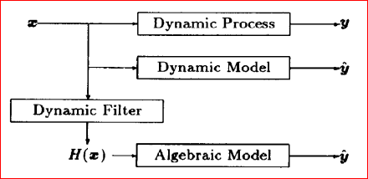
Dynamic PLS for process control
Kaspar and Ray, 1993
Task: dynamic model for control system design as opposed to linear algebraic structure between latent variables.
Method: find a dynamic transformation of the x time series input, then apply an algebraic relationship with y.
Outer Modeling: same as PLS projection.
Inner Modeling: applied transformation filter.
(i.e., “average” of the dynamics)
Advantage: compact representation since no lagged variables appear in the outer relations after filtering.
Disadvantage:
need prior knowledge to design the filter, so the dynamic components in the inputs can be removed.
Inconsistent between the outer model and inner morel. (Inner model has dynamics, but not the outer model)

Slide 14
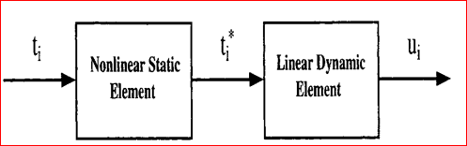

Modeling & Control of MVA processes Dynamic PLS approach
Lakshminaryaana, etc (1997)
Task: nonlinear data as modeling of multi-input, multi-output process
Method: employ single-input, single-output Hammerstein structure.
Advantage:
Direct modification of the PLS inner relationship.
Break into many univariate Hammerstein models to obtain an overall model.
Disadvantage:
all the input information is used in model building, so does not reduce the dimensionality of the redundancy .
Hammerstein structure cannot model every type of nonlinearity.
i.e. A polynomial with some order to t
ARX model is between t* and u

Slide 15
Overview
Literature Review of 3 papers on dynamical PLS, leads to the current Algorithm on DiPLS
Neural Net PLS in various modeling (Qin & McAvoy)
Straightforward, but difficult to interpret and computationally expensive.
Transformation dynamical PLS
(Kaspar & Ray)
No lag variable involved in outer modeling, but raised an inconsistent issue
Hemmerstein Model of dynamical PLS
(Lakshminarayanan, etc.)
Direct modification through inner modeling but does not reduce the original dimensions.
Dynamical-Inner PLS
(Dong & Qin)

Slide 16


Dynamic-inner PLS
Dong & Qing, 2015
Task: develop a dynamical PLS algorithm for an explicit description between inner and outer model.
Method:
Outer Modeling:
DiPLS: at time k,
Inner Modeling:
DiPLS: at time k,
PLS: no need to specify time
u = Yq
t = Xw
PLS:
u = bt+r
Notes:
For single output, y_k is a scalar, q is also a scalar
t_k is also a scalar, x_k is 1 by features and w is features by 1, k is the time, not the latent variable. This is an element of the vector t

Slide 17
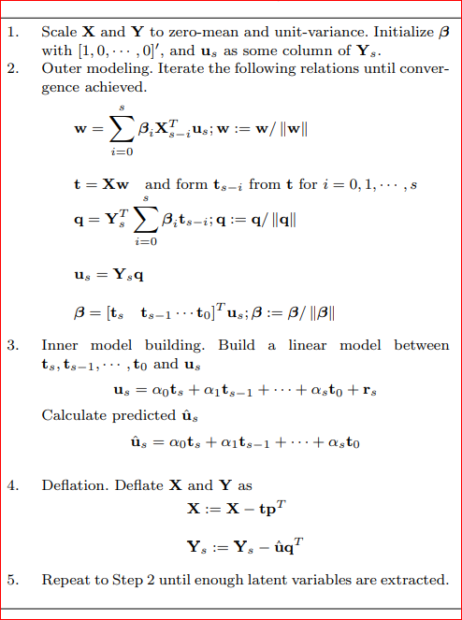

Dynamic-inner PLS
Dong & Qing, 2015
Task: develop a dynamical PLS algorithm for an explicit description between inner and outer model.
Method:
Outer Modeling:
DiPLS: at time k,
Inner Modeling:
DiPLS: at time k,
consistent between outer and inner dynamics!!!!
(easier to interpret)
Notes:
For single output, y_k is a scalar, q is also a scalar
t_k is also a scalar, x_k is 1 by features and w is features by 1, k is the time, not the latent variable. This is an element of the vector t

Slide 18
Implement DiPLS method in 3 case studies

Slide 19



Case studies in synthetic data:
3 sets of 1000 (xi, yi) data are simulated: 500 training + 400 validation + 100 testing
X has 5 features and Y has 1 property
X ~ Static
Y ~ Static
X ~ Dynamic
Y ~ Static
X ~ Static
Y ~ Dynamic
(DiPLS = PLS)
Notes:
Explain the thoughts process, why we need the synthetic data: to enhance the understanding of the algorithm, we need to verify with some data.
(what you want to achieve reminding, why you do that, and how you can do that) synthetic data gives better control….. Now we are ready to show you some results.

Slide 20
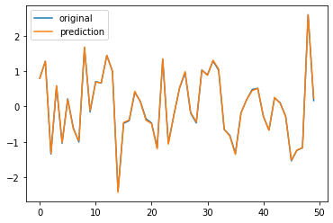
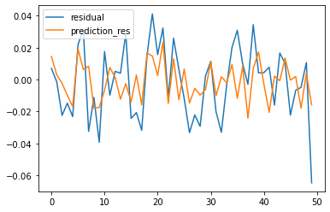
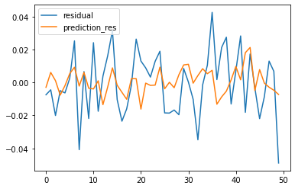
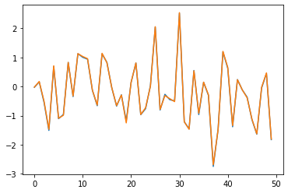


Results: case study 1 -- static process for X and Y
Training
since x depends on t, so generate t(k)~N(0,4) independently
1st component for the original data
2nd component for the residuals
3rd component for leftover white noise
y
y_res
y_res
trial #
trial #
trial #
Testing
y
y
y
MSE for Y: 0.00061
MSE for Y: 0.00053
MSE for Y: 0.00047
Notes:
X and Y labels.

Slide 21

Case1: static process comparison with sklearn package
Algorithm: pls = PLSRegression(n_components=3)
DiPLS = PLSRegression(n_components=3, lag = 0)
R2 = 0.99941
MSE = 0.00053
R2 = 0.99948
MSE = 0.00046
y
y
trial #
trial #
If lag = 1: DiPLS
Outer-mod coefficient | Feature 1 | Feature 2 | Feature 3
beta0 | 0.99948 | 0.96563 | 0.99889
beta1 | -0.00319 | 0.25990 | -0.04704
Inner- mod coefficient | Feature 1 | Feature 2 | Feature 3
alpha0 | 0.4927 | 0.0063 | 0.1418
alpha1 | 0.4362 | 0.0002 | -0.0046
Coefficient0 >> coefficient1 for each iteration, which implies the input data with lag 1 has little impact in the outer and inner model building.

Slide 22
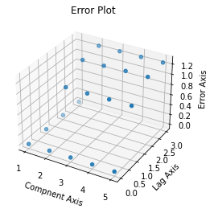
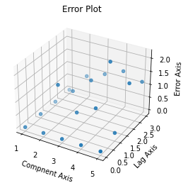
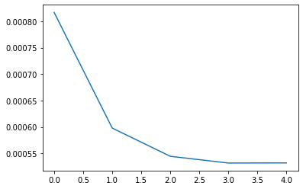
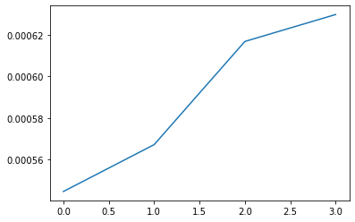
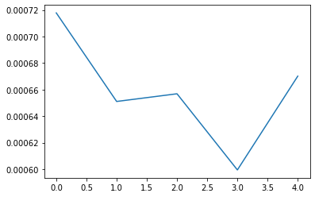
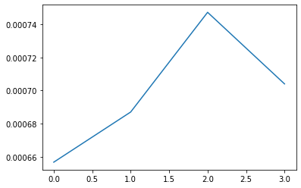
Parameter Tunning for DiPLS:
How many components and lags are needed?
Method 1: Directly calculate validation set
Method 2: 5-fold Cross Validation
MSE
lag = 0
# of Component = 3
MSE
lag = 0
# of Component = 3

Slide 23
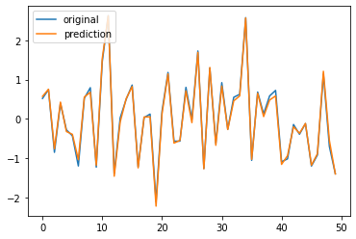
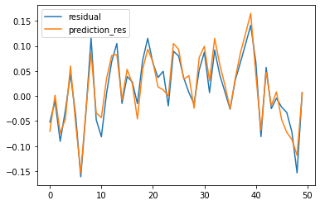
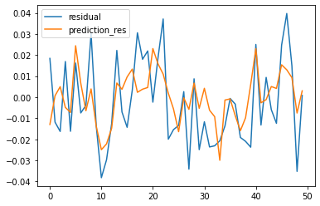
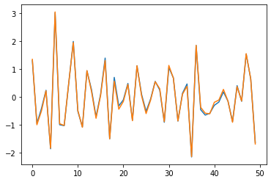


Case study 2: Dynamic process for X, but static process for Y
t(k)= A1*t(k-1)+A2*t(k-2) Cov(X1,X2) != 0, but Cov(X,Y) = 0 this means s = 0
Training
1st component for the original data
2nd component for the residuals
3rd component for leftover white noise
y
y_res
y_res
trial #
trial #
trial #
Testing
y
y
y
MES for Y: 0.0043
MES for Y: 0.00032
MES for Y: 0.00023

Slide 24

Case2: comparison with sklearn package
Still a “Static process”: time lag = 0, so no lagging terms => equivalent to PLS modeling
pls = PLSRegression(n_components=3)
DiPLS = DiPLSRegression(n_components=3, time lag = 0)
R2 = 0.999772
MSE = 0.000243
R2 = 0.999776
MSE = 0.000241
y
y
trial #
trial #
If time lag = 1:
Outer-mod coefficient | Feature 1 | Feature 2 | Feature 3
beta0 | 0.97219 | 0.94773 | 0.91380
beta1 | -0.23415 | 0.31938 | 0.40615
Inner- mod coefficient | Feature 1 | Feature 2 | Feature 3
alpha0 | 0.54828 | 0.0039 | 0.0131
alpha1 | -0.00347 | 0.0009 | 0.0020
Coefficient0 >> coefficient1 for each iteration, which implies the input data with lag 1 has little impact in the outer and inner model building.
Notes:
Add a bullet on why it’s still lag = 0

Slide 25
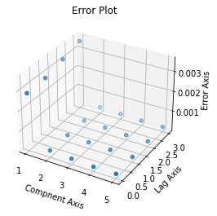
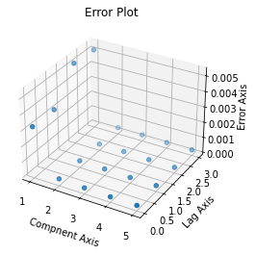
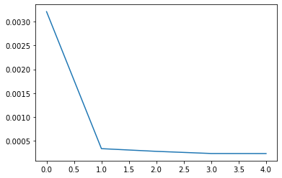
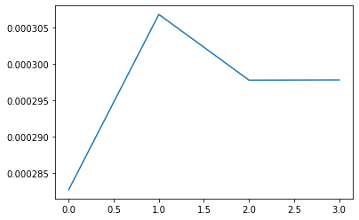
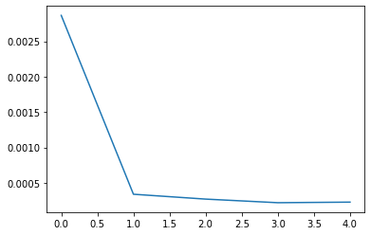
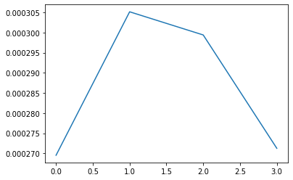
Parameter Tunning for DiPLS: Case 2
How many components and lags are needed?
Method 1: Directly calculate validation set MSE
Method 2: 5-fold Cross Validation MSE
lag = 0
# of Component = 3
Lag = 0
# of Component = 3

Slide 26
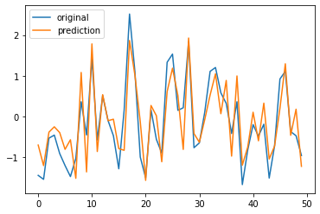
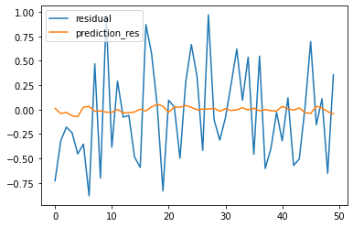
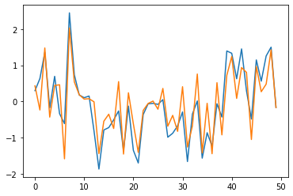
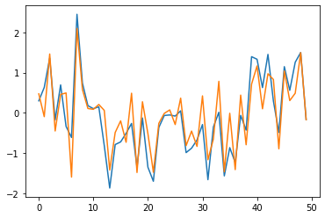
Case study 3: Dynamic process for Y, but static process for X
Training
4rd component for leftover white noise
1st component for the original data
y
y_res
…
trial #
trial #
Testing
y
y
…
MES for Y: 0.21
MES for Y: 0.20

Slide 27
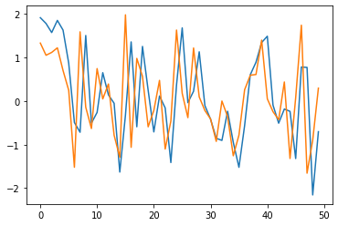
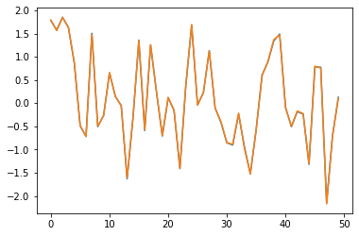
Case3: comparison with sklearn package
“dynamical process”: s != 0
pls = PLSRegression(n_components=4)
DiPLS = PLSRegression(n_components=4, lag = 1)
R2 = 0.9998
MSE = 0.0001
y
y
trial #
trial #
If lag = 1: DiPLS
Outer coeff | Feature 1 | Feature 2 | Feature 3 | Feature 4
beta0 | 0.4681 | 0.0143 | -0.0825 | -0.8276
beta1 | 0.8836 | -0.9998 | -0.9965 | -0.5613
Inner- coeff | Feature 1 | Feature 2 | Feature 3 | Feature 4
alpha0 | 0.2272 | 0.0011 | -0.0340 | -0.3457
alpha1 | 0.4399 | -0.0913 | -0.4185 | -0.2343
Some significant of coefficient1 appear!

Slide 28
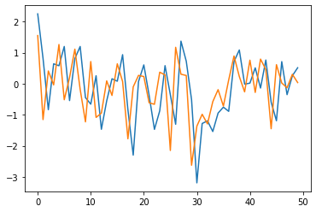
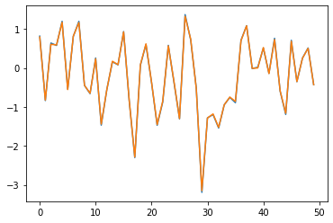
case 4: Both X and Y are dynamical process
In additional to the paper, we add this scenario and want to see if the lag parameter is like in case 3, s = 1
pls = PLSRegression(n_components=4)
DiPLS = PLSRegression(n_components=4, lag = 1)
R2 = 0.9998
MSE = 0.0001
y
y
trial #
trial #
If lag = 1: DiPLS
Outer coeff | Feature 1 | Feature 2 | Feature 3 | Feature 4
beta0 | 0.3654 | 0.7393 | 0.4862 | -0.6493
beta1 | 0.9308 | -0.6733 | 0.8738 | -0.7604
Inner- coeff | Feature 1 | Feature 2 | Feature 3 | Feature 4
alpha0 | 0.2797 | 0.0434 | 0.0285 | -0.2198
alpha1 | 0.5363 | -0.0418 | 0.0967 | -0.2651
Some significant of coefficient1 appear!

Slide 29
Conclusion
Why this project?
1. Non-linear and non-static input data are commonly seen in pharmaceutical industry.
2. Nature extension of PLS if we find a way to handling time components.
3. Several algorithms has developed in chemical industry, knowledge transfer to pharm realm.
.
Current Work
1. Evaluate DiPLS algorithms in three case studies.
2. For static process, DiPLS can be completely recover PLS.
3. For dynamical process, DiPLS has outperform PLS.
4. Parameter tunning methods; directly validation and 5fold CV.
Future work
1.BEM and BLM approach.
2. Within PLS scheme: algorithms contains NNPLS structure and transformations.
3. apply to some real data and see if it’s consistent with our synthetic data results.
Notes:
Shorten texts; highlight

Slide 30
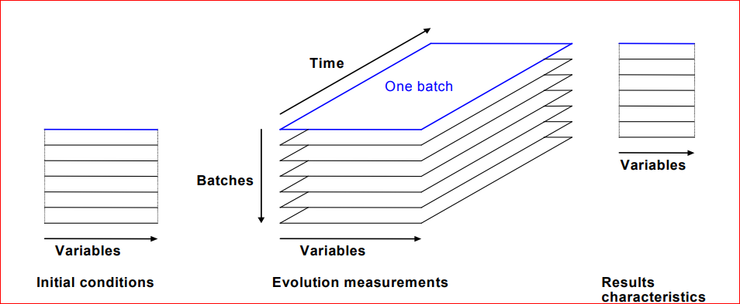
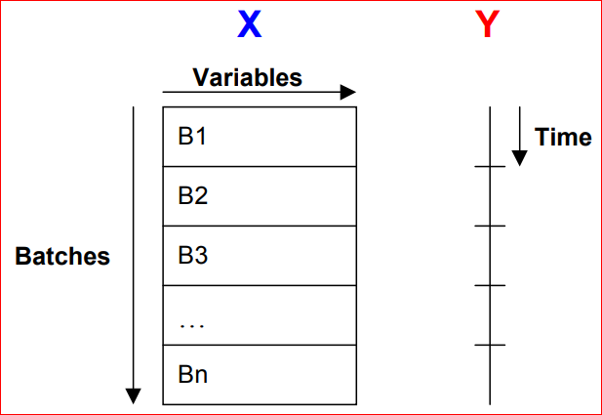
Batch Evolution Modeling (BEM):
Unfolding 3-way table and use dimension reduction to monitor the process/evolution.
Unfolding using PLS
Advantage: easy to handle missing data since batches have different lengths.
3-way table to 2-way matrix, such that each row corresponded to one time point in one particular batch.

Slide 31
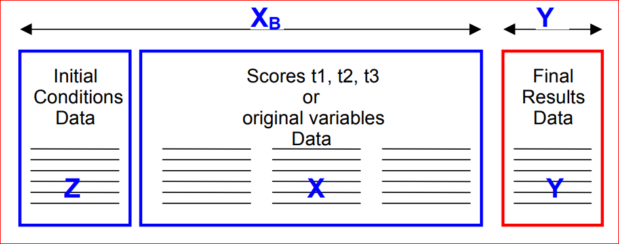
Batch Level Modeling (BLM):
All available data are used
Provided that Y-data, the X_B matrix may also be related to the results using PLS.
Initial conditions data are often pooled with process evolution data to form a new X-matrix, X_B. This can be summarized using PCA.
Each row corresponded to one whole batch.

Slide 32
Thank you !
Mentor: Shyam Panjwani
Mentor: Hao Wei
Mentor: Kostas Spetsieris

