Slide 1

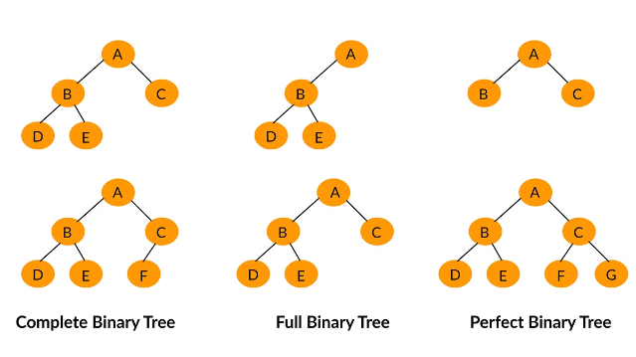

Count of Smaller Numbers After Self
The problem involves determining the count of smaller elements to the right of each element in an integer array. This provides a comprehensive solution, explains the approach in detail, and analyzes the complexity of the implemented algorithm. The chosen method efficiently tackles the problem using a modified merge sort technique, ensuring optimal performance.
by Vivek kolla

Slide 2

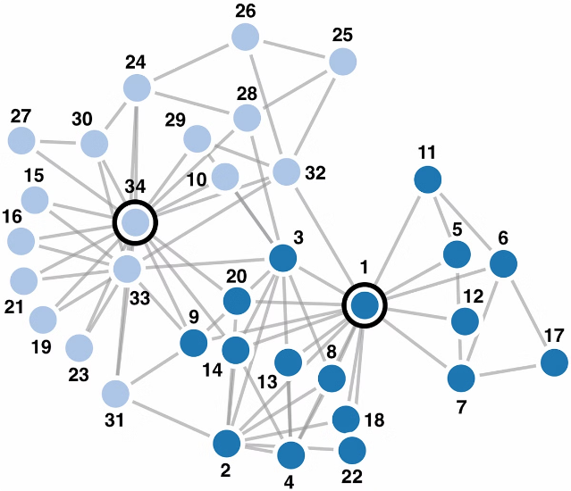
Introduction
1
Understanding the Problem
The goal is to determine the count of smaller numbers after each element in a given array.
2
Approach
We will explore different algorithms and their time complexities to solve this problem efficiently.
3
Applications
This problem has applications in data analysis, stock trading, and other areas where finding the relative position of elements is important.

Slide 3
Problem Statement
Given an integer array nums , we need to return an integer array counts where counts[i] is the number of smaller elements to the right of nums [i].
Example
Input: [5, 2, 6, 1] Output: [2, 1, 1, 0]
Input
Explanation:
For 5, there are 2 smaller elements to its right (2 and 1).
For 2, there is 1 smaller element to its right (1).
For 6, there is 1 smaller element to its right (1).
For 1, there are no smaller elements to its right.
An array of integers.
Output
Divide: Recursively divide the array into two halves until each half contains a single element.
Conquer: During the merge process, count the elements in the right half that are smaller than the elements in the left half.
Merge: Combine the two halves while maintaining the count of smaller elements.
An array containing the count of smaller numbers after each element in the input array.
Count and Merge:
Maintain an array counts to keep track of the count of smaller elements for each index.
During the merge step, compare elements from both halves and update the counts array accordingly.

Slide 4
CODING
while (i < leftSize) {
counts[leftIndices[i]] += rightCounter;
indices[k++] = leftIndices[i++];}
while (j < rightSize) {
indices[k++] = rightIndices[j++];}
free(leftIndices);
free(rightIndices);}
void mergeSort(int* nums, int* indices, int* counts, int left, int right) {
if (left < right) {
int mid = left + (right - left) / 2;
mergeSort(nums, indices, counts, left, mid);
mergeSort(nums, indices, counts, mid + 1, right);
merge(nums, indices, counts, left, mid, right); } }
mergeSort(nums, indices, counts, 0, numsSize - 1);
free(indices);
return counts; }
int main() {
int nums[] = {5, 2, 6, 1};
int numsSize = sizeof(nums) / sizeof(nums[0]);
int returnSize;
int* result = countSmaller(nums, numsSize, &returnSize);
printf("Output: [");
for (int i = 0; i < returnSize; ++i) {
printf("%d", result[i]);
if (i < returnSize - 1)
printf(", ");}
printf("]\n");
free(result);
return 0; }
#include <stdio.h>
#include <stdlib.h>
void merge(int* nums, int* indices, int* counts, int left, int mid, int right) {
int leftSize = mid - left + 1;
int rightSize = right - mid;
int* leftIndices = (int*)malloc(leftSize * sizeof(int));
int* rightIndices = (int*)malloc(rightSize * sizeof(int));
for (int i = 0; i < leftSize; ++i)
leftIndices[i] = indices[left + i];
for (int i = 0; i < rightSize; ++i)
rightIndices[i] = indices[mid + 1 + i];
int i = 0, j = 0, k = left, rightCounter = 0;
while (i < leftSize && j < rightSize) {
if (nums[leftIndices[i]] <= nums[rightIndices[j]]) {
counts[leftIndices[i]] += rightCounter;
indices[k++] = leftIndices[i++];
} else {
rightCounter++;
indices[k++] = rightIndices[j++]; } }
while (i < leftSize) {
counts[leftIndices[i]] += rightCounter;
indices[k++] = leftIndices[i++]; }

Slide 5
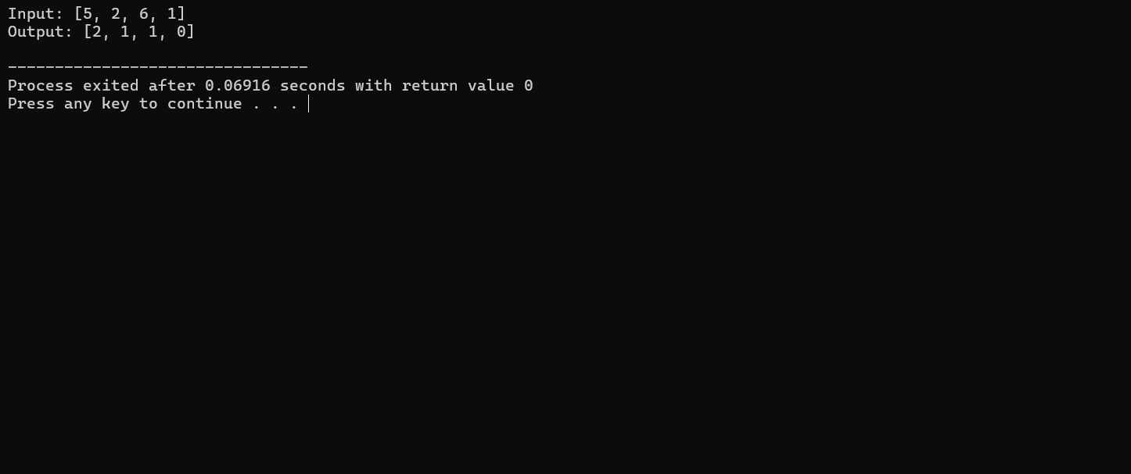
OUTPUT
The merge function merges two halves and counts the smaller elements on the right.
The mergeSort function recursively divides the array and sorts while counting smaller elements
The countSmaller function initializes the necessary arrays and calls mergeSort.
The main function demonstrates the use of countSmaller and prints the input and output arrays.

Slide 6

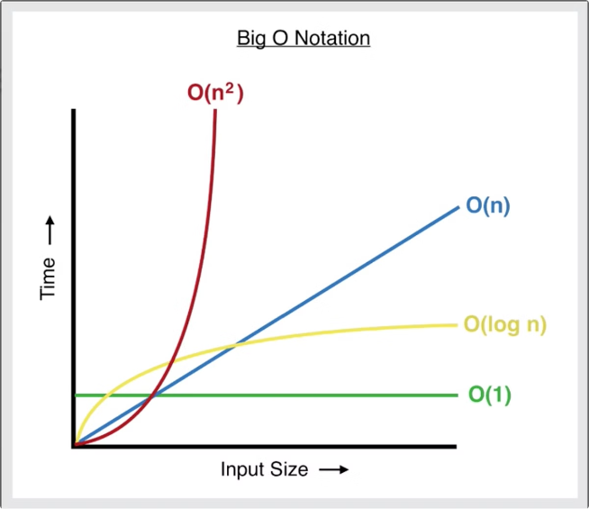
Complexity Analysis
1
Brute Force
A simple approach is to compare each element with all the elements that come after it. This has a time complexity of O(n^2).
2
Segment Tree
We can use a Segment Tree data structure to keep track of the smaller elements. This has a time complexity of O(n log n).
3
Binary Indexed Tree
Another efficient approach is to use a Binary Indexed Tree (Fenwick Tree) to count the smaller elements. This also has a time complexity of O(n log n).

Slide 7

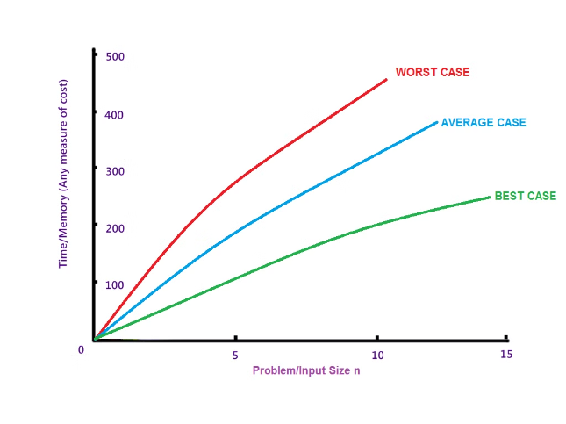
Best Case
Optimal Solution
The optimal solution for this problem has a time complexity of O(n log n), which can be achieved using a Segment Tree or Binary Indexed Tree.
Explanation
These data structures allow for efficient range queries and updates, which are crucial for solving this problem.
Space Complexity
The space complexity of these solutions is also O(n), as we need to store the intermediate data structures.

Slide 8
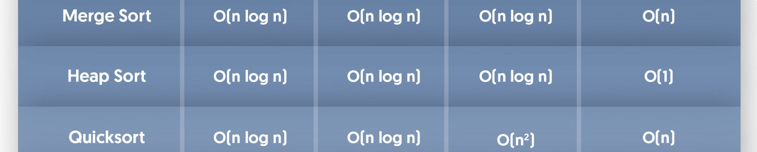



Worst Case
Input Array
Time Complexity
Space Complexity
The worst-case input for this problem is an array in descending order, as this will require the most comparisons.
In the worst case, the brute force approach has a time complexity of O(n^2), which is significantly slower than the optimal O(n log n) solution.
The space complexity remains the same, O(n), even in the worst case, as we still need to store the intermediate data structures.

Slide 9

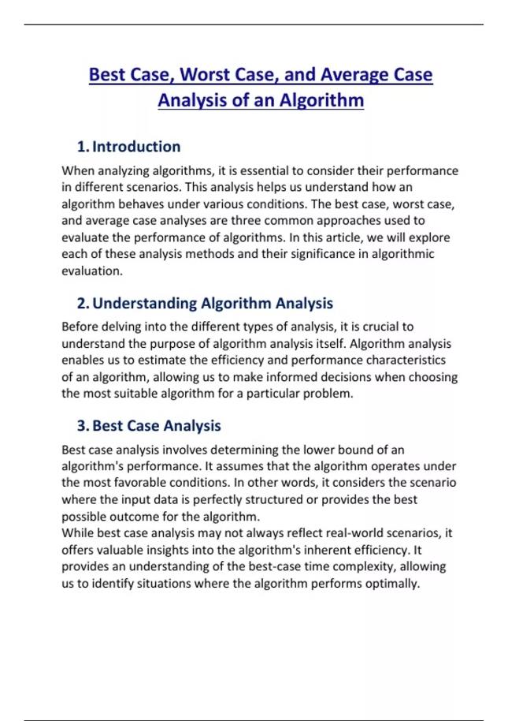



Average Case
Input Distribution
For the average case, we assume that the input array elements are randomly distributed, without any particular order.
Time Complexity
In the average case, the optimal solutions with O(n log n) time complexity are expected to perform well.
Comparison
The brute force approach, with its O(n^2) time complexity, will be significantly slower in the average case compared to the optimal solutions.

Slide 10

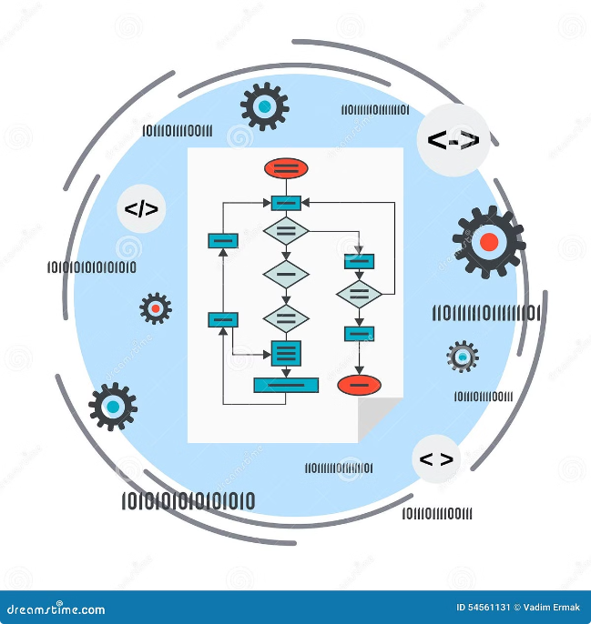
Conclusion
1
Efficient Solutions
The optimal solutions for the "Count of Smaller Numbers After Self" problem have a time complexity of O(n log n), achieved using data structures like Segment Trees or Binary Indexed Trees.
2
Tradeoffs
While the optimal solutions are more efficient, they may require more complex implementation and additional memory usage compared to the brute force approach.
3
Real-World Considerations
The choice of algorithm should consider factors such as input size, memory constraints, and the specific requirements of the problem domain.

