Slide 1





Using Latent Class Analysis to Develop Typologies of Online Sellers of Potentially Illicit Animal Leather Products Presented by: Ulhas Gondhali
ESC 2025
Greece
Petrossian, G.A., Gondhali, U., Kim, Y., Lang, J. A., Riskevich, G., Barbosa, J., Chakraborti, S., Sharma, K., & Freire, J.
Funded by:

Slide 2

Outline
Introduction
Research Gaps
Current Study Objectives
Methods
Results
Discussion & Conclusions

Slide 3
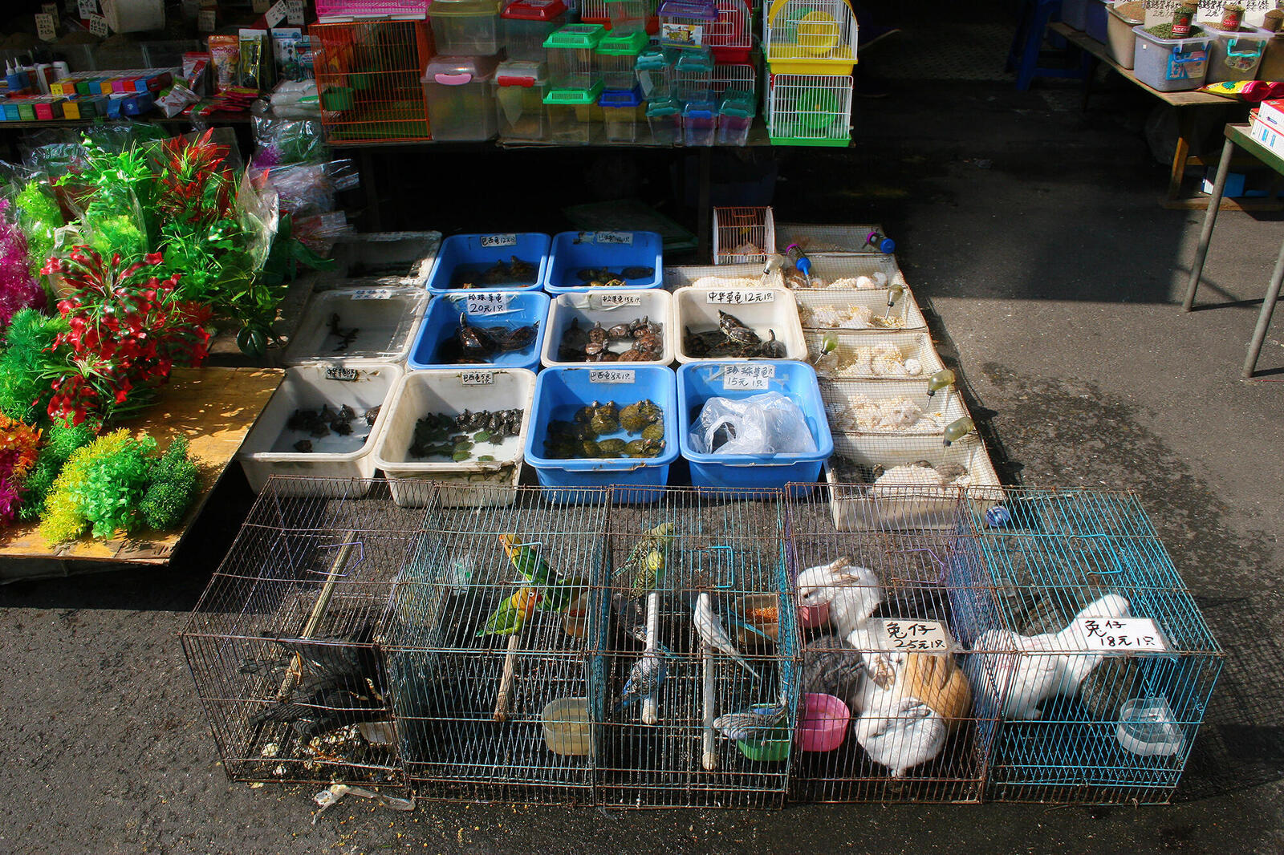
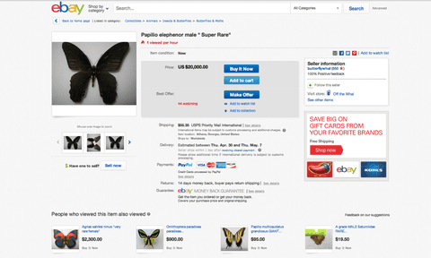
Introduction
Transition of physical marketplaces to virtual space
COVID-19 → closure of physical wildlife markets.
Surge in online wildlife trade (2020–2024).
Increased anonymity and cross-border reach
Research Gaps
Physical market seller typologies well-studied.
Online typologies scarce, especially for wildlife products.
Objective - Develop empirically grounded online seller typologies

Slide 4
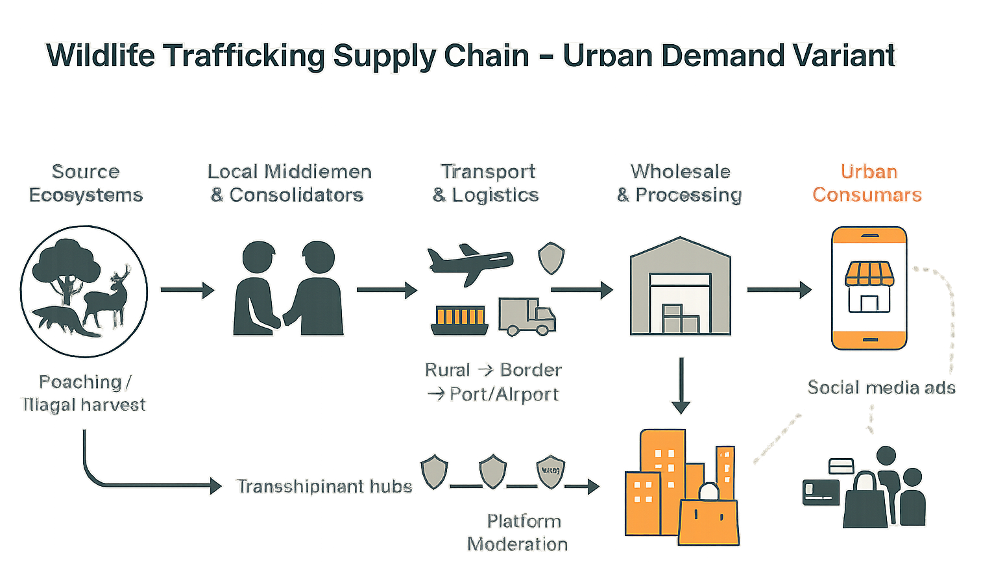
Why This Matters
Conservation: Identify high-risk sellers
Regulation: Enable risk-based monitoring
Platforms: Inform policy changes to block illicit trade.

Slide 5
Methods
Data Overview
Platform: eBay
Period: Feb, 2024–Mar 2024
Total Ads: 14,226 reptile leather ads → 227 high-volume sellers
(23% of ads, 0.3% sellers).
Variables for LCA
Three dimensions:
Level of organization – e.g., storefront presence, followers.
Professionalism & complexity – e.g., luxury goods, branding, duration.
Specialization in wildlife products – e.g., exclusivity, species count.
Started with 15 variables → reduced to 12 after correlation checks.
Why Latent Class Analysis
Person-centered, model-based approach.
Identifies unobserved subgroups based on categorical variables.
Suitable for small sample + many variables (random-effects LCA).
Used extensively in criminology for offender typologies.

Slide 6
Continued..
Data Collection Pipeline
Targeted crawling (ACHE + keyword seeding).
Info extraction: price, seller ID, species, product type, images.
Triage: Learn to Sample (LTS) using LLM-labelled training data
Data Cleaning Challenges
Seller/storefront mismatches.
Ambiguous species/product categorization.
Frequent seller turnover.
Manual verification + inter-rater reliability.

Slide 7
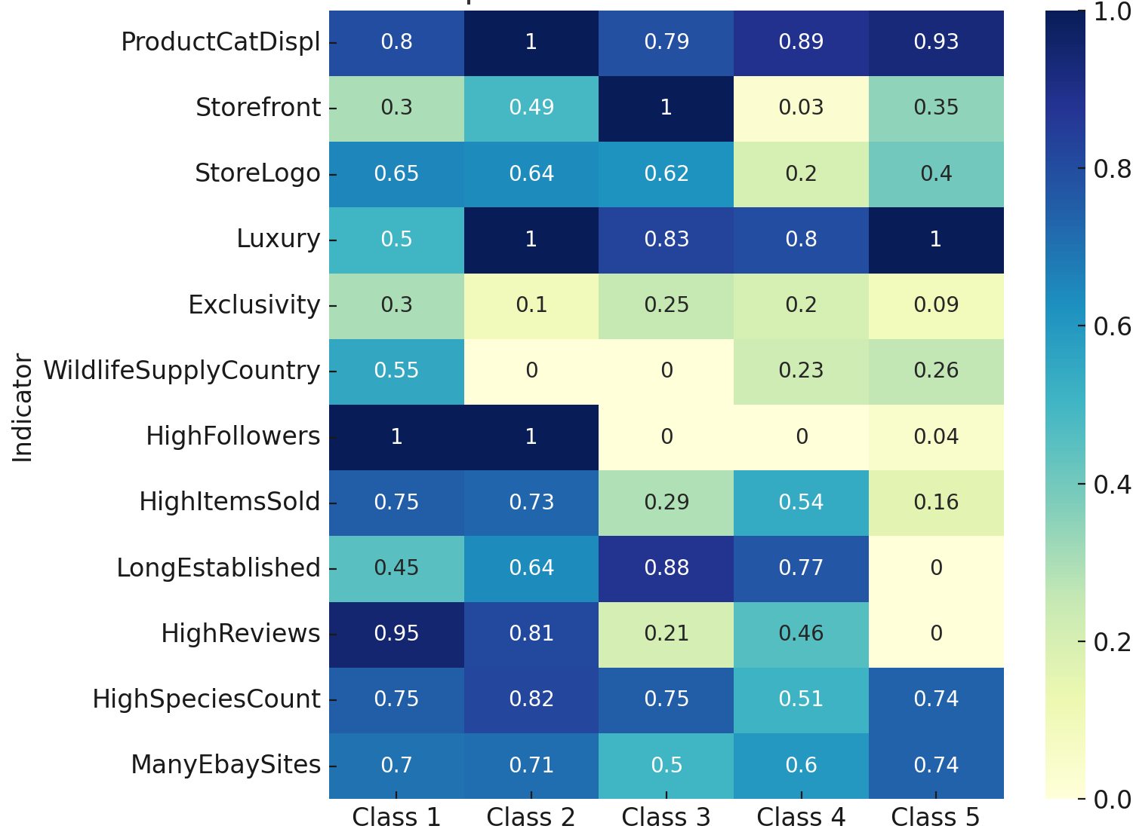
The Five Emerging Seller Typologies
Heatmap of Conditional Item Probabilities by Class for Five Classes
Moderate Visibility (8.8%) – modest branding, average presence.
Luxury, High-Visibility (40.1%) – strong visibility, low exclusivity.
Fully Professional Storefront (10.6%) – full storefront, high luxury.
Low-Profile (15.4%) – minimal presence outside eBay.
Luxury Without Exclusivity (25.1%) – multi-species, low branding.
Note: Class 1-Moderate Visibility Sellers; Class 2- Luxury, High-Visibility Sellers; Class 3-Fully Professional Storefront Sellers; Class 4- Low Profile Sellers; Class 5- Luxury, Without Exclusivity Sellers.

Slide 8
Continued..
Number of Individuals Within Each Class
Class | Number of Individuals | Percent of Individuals
Class 1 - Moderate Visibility Sellers | 20 | 8.81%
Class 2 -Luxury, High-Visibility Sellers | 91 | 40.09%
Class 3 - Fully Professional Storefront Sellers | 24 | 10.57%
Class 4 -Low Profile Sellers | 35 | 15.42%
Class 5 - Luxury, Without Exclusivity Sellers | 57 | 25.11%

Slide 9
Key Differentiators
χ²Square Test Results for Comparing Five Classes
Most influential:
High Followers
High Reviews
Long Established
Luxury status
Storefront presence
Least influential:
Many eBay sites
Exclusivity
Indicator Variable | χ2 Statistic | df | Cramer's V
High Followers | 219.28** | 4 | 0.983
High Reviews | 117.32** | 4 | 0.719
Long Established | 87.86** | 4 | 0.622
Luxury | 61.03** | 4 | 0.519
Storefront | 59.41** | 4 | 0.512
High Items Sold | 54.5** | 4 | 0.49
Wildlife Supply Country | 52.88** | 4 | 0.483
Store Logo | 24.79** | 4 | 0.33
Product Category Displayed | 18.86** | 4 | 0.288
High Species Count | 12.65* | 4 | 0.236
Exclusivity | 9.91* | 4 | 0.209
Many Ebay Sites | 5.96 | 4 | 0.162

Slide 10
Discussion
Summary of Findings
First LCA-based online wildlife seller typology.
5 empirically distinct classes.
Actionable for both biodiversity protection & platform governance.
Policy Implications
Conservation
Target sellers with low exclusivity & high species diversity.
Raise buyer/seller awareness on CITES species.
Regulation & Enforcement
Require permit/license proof for listings.
Use typologies in ML-driven risk monitoring.
Share flagged seller databases across platforms.

Slide 11
Conclusions
Illegal wildlife trade has shifted rapidly online, requiring new tools to understand and disrupt it.
Latent Class Analysis revealed five distinct seller types with clear behavioral patterns.
Key differentiators: social reach, reviews, branding, and market longevity.
Typologies can support risk-based monitoring, platform accountability, and targeted conservation action.
Building cross-platform and international strategies are essential to reduce laundering and protect biodiversity.

Slide 12
Thank you
Questions?
Ulhas Gondhali
ugondhali@jjay.cuny.edu

